Slide 1
Stem Cell Transplantation
Michael A. Pulsipher, MD
Children’s Hospital Los Angeles
USC Keck School of Medicine

Slide 2
Hematopoietic Stem Cell Transplant Outline
A. Principles and products
  1. Collection, processing, and storage
  2. Stem-cell source and dose
  3. Donor selection
  4. Contraindications
B. Conditioning therapy
  1. Autologous HSCT
  2. Allogeneic HSCT
C. Complications
  1. Graft failure
  2. Graft-versus-host disease (GVHD)
  3. Infections – Sung-Yun Pai to cover in Immune Deficiency Session
  4. Non-infectious complications
D. Disease-specific indications and outcomes—Covered in disease sessions
  1. Other Non-malignant disorders
  2. Cell Therapy

Slide 3
Collection, Processing, and Storage
Goal is to transfer hematopoietic stem cells (HSC) along with appropriate doses of key immune cells from donor to recipient
Cells types that matter and are often measured
  CD34+ cells
  T-cells (CD3, αβCD3 vs. γδCD3)
  B-cells (CD19)
  NK Cells (CD16, CD56)
Cell numbers that are used to choose doses
  CD 34 cells/kg recipient weight
    Auto doses 2-5x10⁶ CD34+/kg, allo (4-8x10⁶ CD34+/kg), cord (>1.5-2x10⁵ CD34+/kg)
  Total Nucleated Cells (TNC) or mononuclear cells (MNC)/kg recipient weight
    After Harvest 2-6x10⁸ MNC/kg, cords >4x10⁷ TNC/kg increases chance of success

Slide 4
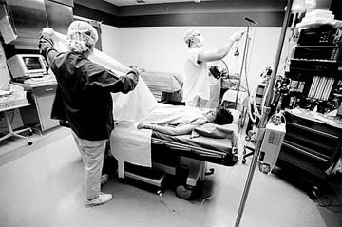
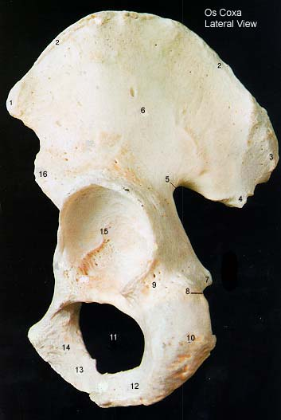
Bone Marrow—the Traditional Source

Slide 5
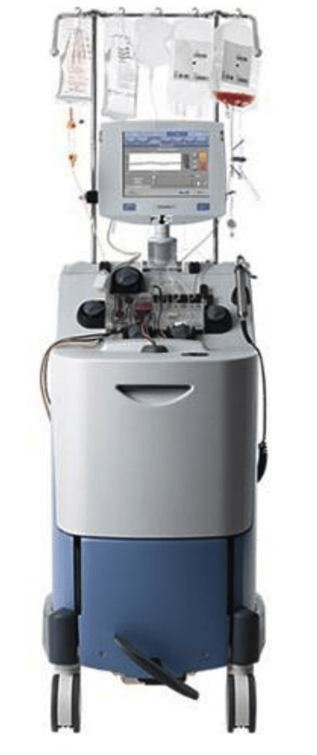
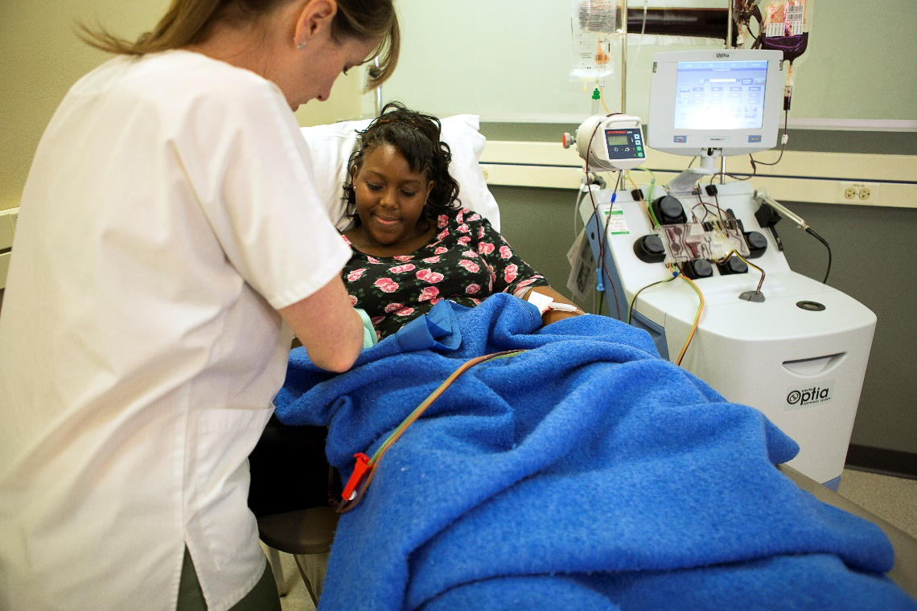
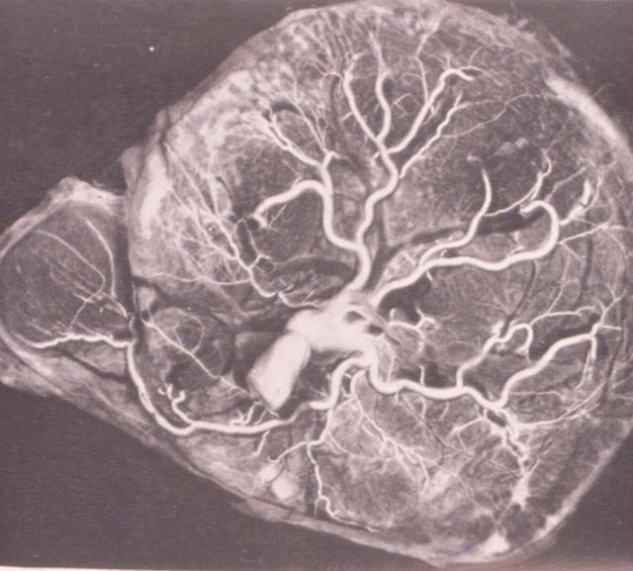
Other Sources—Peripheral Blood Mononuclear (Stem) Cells and Umbilical Cord Blood
Images courtesy of Terumo Blood and Cell Technologies

Slide 6
Collection of Peripheral Blood Stem Cells (PBSC)
Mobilization: BM CD34+ stem cells multiply and circulate in blood
  Priming Chemotherapy + G-CSF most commonly used
  G-CSF alone also works
  Timing of recovery calculated, patients followed with daily CD34+ measurements
  When CD34+ levels >20cells/𝜇L achieved, collection success increases
  If CD34+ levels do not rise with increasing WBC, plerixafor may be used
  Plerixafor: CXCR4 blocker, mobilizes CD34+ cells with a peak at 5-11 hours
Collection happens via leukapheresis
  Temporary collection catheter or CVL designed for apheresis needed
This process can be used for autologous or allogeneic donors

Slide 7
WBC and CD34+ Recovery after Chemo/G-CSF

Slide 8
What types of processing are needed?
Goal—deliver the correct dose of key cells and minimize reactions
  ABO incompatibility
    RBC depletion of bone marrow necessary for major mismatches
      A&B blood cannot be transfused into non-compatible types
      Removing RBC may cause loss of WBC—extra marrow needed to preserve cell dose
      Plasma depletion can be done for minor mismatches
    PBSC generally have low RBC content
      Small amounts of incompatible RBCs can be tolerated
  Cryopreservation
    Autologous collections and cord blood all cryopreserved with DMSO
      Premedication and counseling needed regarding infusion reactions
        Hypo/hypertension, bitter taste, odor
    Allogeneic infusions sometimes need cryopreservation
      Infusion should occur within 72 hours, better within 48
      With donor recipient scheduling issues, cryopreservation an option, generally efficacious
      During COVID, Cryo used often: OK for cancer, aplastic anemia-- more rejection, worse survival

Slide 9
Processing Continued
In Vitro T-cell Depletion
  CD34+ selection
    Removal of all cells except CD34+ cells
    Slow immune recovery
  CD3+ depletion, CD3+/CD19+ depletion, αβCD3+/CD19+ depletion
    Decreased TRM, possibly better recovery
  Newer methods—CD45 RA depletion
In Vivo T-cell depletion
  Serotherapy: hATG, rATG, Alemtuzumab
  Post-Transplant cyclophosphamide

Slide 10
Processing for Cell Therapy
Apheresis for collection of T-cells
  Best done early, prior to excessive chemotherapy, to maintain T-cell quality
  Some labs do further processing (CD4, CD8 selection)
  Cells sent for viral transduction, expansion
  Cryopreserved and returned for infusion
Peripheral blood collection of T-cells/NK cells
  Sent fresh or cryopreserved
  Expanded, potentially manipulated, returned for infusion

Slide 11
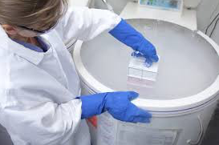
Storage of Stem Cells
For transport
  Fresh cells transported cool
  Frozen cells in regulated shippers (continuous temperature monitoring)
In the stem cell lab
  Dedicated liquid nitrogen tanks
  Liquid vs. Vapor phase
    Liquid phase after HIV/viral screening
  Continuous alarmed monitoring
  Cells viable 30+ years
Image courtesy of Waisman Biomanufacturing, University of Wisconsin-Madison

Slide 12
Stem Cell Sources—Different Ways to Grow a New Bone Marrow
Reported Sources
  Fetal Liver Cells
  Single or small numbers of “stem cells”
    iPSCs
Sources in use
  Umbilical Cord Blood (UCB)
  Bone Marrow (BM)
  Cytokine Mobilized Peripheral Blood Mononuclear Cells (PBMC)

Slide 13
Hematopoietic Cell Sources—Content of the Product Dictates Uses
Autologous Transplant (High Dose or Mega-Dose Therapy)
  Bone Marrow (risk with harvest)
  Cytokine Mobilized Peripheral Blood Mononuclear Cells (PBMC, quick engraftment)
  Manipulation of either source to alter immune response
  Winner—PBMC!
Allogeneic Transplant
  Umbilical Cord Blood (few T-cells, increased risk of rejection and slow engraftment, can use safely with more HLA mismatches, less chronic GVHD)
  Bone Marrow (Intermediate T-cells numbers, intermediate rejection and GVHD)
  PBMC (More T-cells, rapid engraftment, less early transplant morbidity, probably more chronic GVHD)
  Winner—?

Slide 14
Differences Between Stem Cell Sources—T-cell Content Key

Slide 15
Doses of Stem Cells Vary by Source
Bone marrow & PBSC with matched related and unrelated donors
  Target >4-8x10⁶ CD34 cells/kg recipient wt
    Can go higher, debate about upper limit re GVHD concerns
Cord Blood
  Target >4x10⁷ TNC/kg single unit
    For highly mismatched >5x10⁷/kg recipient wt
    Two units as needed for at least 3x10⁷/kg recipient wt
    No advantage to 2 units if single unit dose adequate, more GVHD with 2 units
T-cell depleted/haploidentical
  Target >5-20x10⁶ CD34+ cells/kg recipient wt
  Target <1x10⁵ CD3+ or αβCD3+ cells/kg recipient wt
Post-transplant cyclophosphamide
  Target >4x10⁸ MNC/kg recipient weight

Slide 16
Case Presentation: HLA and Donor Choice
An 18-month-old child with ALL in second remission is referred for transplantation. Which would be the best donor for this child?
A. The child’s own cryopreserved cord blood (cell dose 5X10⁷ TNC/kg)
B. A 55-year-old female unrelated donor, 7/8 match (willing to donate marrow or peripheral blood stem cells)
C. A cord blood unit matched at 4/6 antigens: cell dose 5.4x10⁷ TNC/kg
D. A 40-year-old male unrelated donor matched at 8/8 loci (only willing to donate peripheral blood stem cells)
E. A cord blood unit matched at 8/8 antigens (HLA A, B, DRB1) with a cell dose of 4.0x10⁷ TNC/kg

Slide 17
Case Presentation: HLA and Donor Choice
An 18-month-old child with ALL in second remission is referred for transplantation. Which would be the best donor for this child?
A. The child’s own cryopreserved cord blood (cell dose 5X10⁷ TNC/kg)
B. A 55-year-old female unrelated donor, 7/8 match (willing to donate marrow or peripheral blood stem cells)
C. A cord blood unit matched at 4/6 antigens: cell dose 5.4x10⁷ TNC/kg
D. A 40-year-old male unrelated donor matched at 8/8 loci (only willing to donate peripheral blood stem cells)
E. A cord blood unit matched at 8/8 antigens (HLA A, B, DRB1) with a cell dose of 4.0x10⁷ TNC/kg

Slide 18
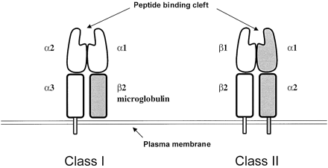
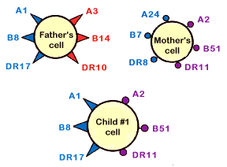
Human Leukocyte Antigen Groups (HLA, Chromosome 6)
© 2012 Terese Winslow LLC, U.S. Govt. has certain rights

Slide 19
HLA Loci and Known Alleles (DNA Level)
Class I (A, B, C)
Found on almost all cells (except some neurons)
HLA-A 6192
HLA-B 7431
HLA-C 6067
Class II (DR, DQ, DP)
Found on antigen-presenting cells, B cells
DRB1 2737
DQB1 1857
DPB1 1584

Slide 20
Minor HLA Antigens—If it were only as simple as HLA
Minor H Antigens Encoded by Autosomal Genes
HA-1 – HA-7
A2-1 – A2-4
B7-1 – B7-6
A3, A11, A29, B44, B65, Cw7
Minor H Antigens Encoded by the Y chromosome
HLA-A2-HY
HLA-A1-HY
HLA-B7-HY
B8-1

Slide 21
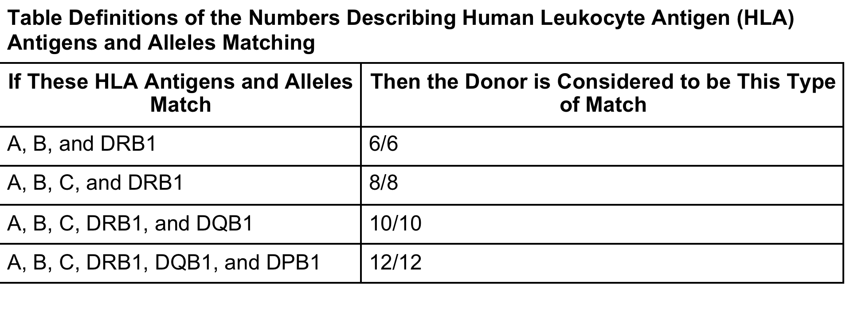
Terms and Levels of Matching
Antigen level: protein by serology antibody test
Allele level: DNA-based testing
Antigen Recognition Domain (ARD): DNA sequences that replicate vital parts of the protein.

Slide 22
NMDP Guidelines for URD Searches Dehn Blood 2019
ARDS: Antigen Recognition Domain—key part of the HLA protein
Reproduced with permission from Dehn J, Spellman S, Hurley CK, et al. Selection of unrelated donors and cord blood units for hematopoietic cell transplantation: guidelines from the NMDP/CIBMTR. Blood. 2019 Sep 19;134(12):924-934. ©2019 by the American Society of Hematology.

Slide 23
NMDP Guidelines for Cord Choice Dehn Blood 2019
Reproduced with permission from Dehn J, Spellman S, Hurley CK, et al. Selection of unrelated donors and cord blood units for hematopoietic cell transplantation: guidelines from the NMDP/CIBMTR. Blood. 2019 Sep 19;134(12):924-934. ©2019 by the American Society of Hematology.

Slide 24
Key Considerations Donor/HLA
HLA match most important
Single allele/antigen mismatch is the limit for URD BM/PBSC (7/8)
Cord Blood allows 4/6 matches
  6-7/8 better, high cell dose (>5x10⁷ TNC/kg) helps with mismatches
BM is preferred in pediatrics over PBSC
  Data especially strong for nonmalignant disorders
  PBSC results in faster engraftment, more GVHD.
  Used for high risk procedures: reduced intensity regimens, second HCT, etc.
  PBSC also used for cell manipulation (T-cell depletion)

Slide 25
Screening a Pediatric Donor
Need Assent, beware parental bias
Challenge if recipient unknown or difficult relationship
Avoid risks to donor health
  Careful review of underlying health conditions
  Donors with disorders should be assessed by specialists to define risk (e.g. DM should see their endocrinologist)
  If risk is considered minimal, donation can proceed
Screened for transmissible diseases
  HIV, HBV, HCV, syphilis, WNV, Chagas, etc.

Slide 26
Other Considerations for Donor Choice
Assent/Consent—if an 18+yo sib is equivalent to younger sib, choose the adult
Blood type matching helps/not necessary
CMV negative donors for negative recipients
  Positive for positive also may be better
Gender match or male to female good: avoid multiparous females
Donor/recipient size mismatch can be a problem
  Max from donor 20mL/kg, goal >4x10⁶ CD34+ cells/kg
Ideal cord dose >4x10⁷ TNC/kg (min >2.5x10⁷ TNC/kg)
  >3x10^7 TNC/kg total dose if 2 cords used
  Outcomes better with 1 cord vs. 2 if dose OK (less GVHD)

Slide 27
So who is the preferred donor?
First Choice: Matched sibling, still first choice
Next: Fully matched unrelated donors (URD, 8/8 or 10/10)
  BM preferred source
Siblings vs. 10/10 URD, survival similar, more GVHD with URD
  Single antigen mismatched sib (cross over, 7/8 match) similar to 10/10 URD
  *Emerging data suggest haplo may be equivalent to URD (studies ongoing)
Remaining Donors—outcomes similar, institutional preference
  Mismatched cord
  Mismatched URD
  Haploidentical parent or sibling (younger donor = better)

Slide 28
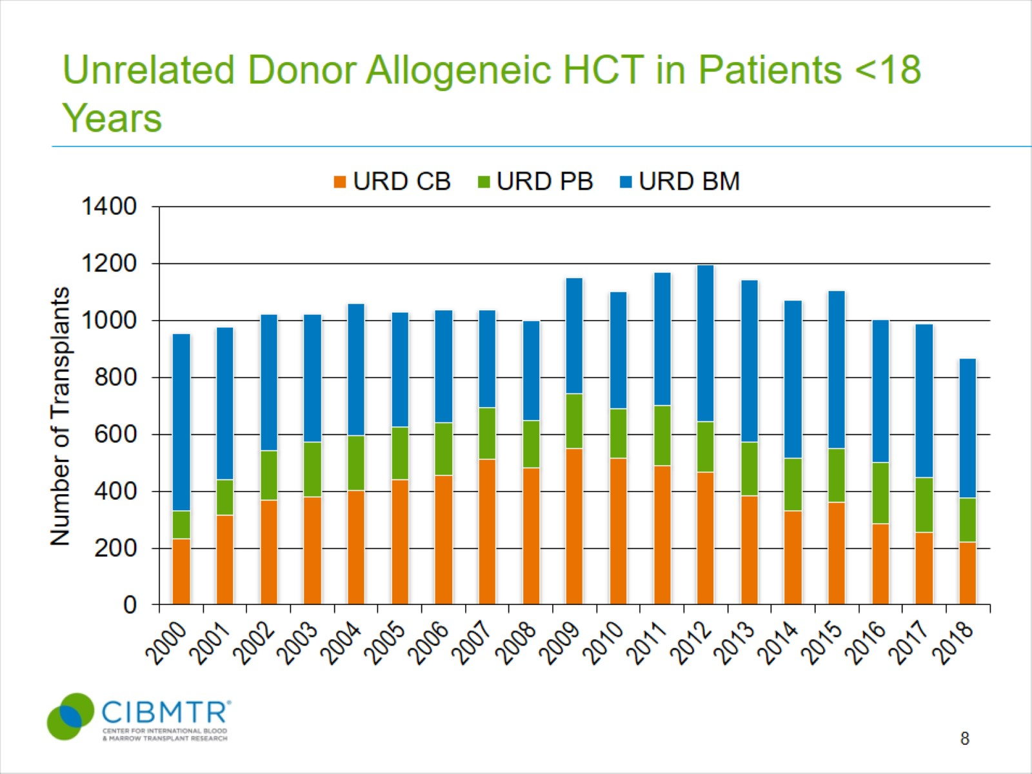
Unrelated Donor Allogeneic HCT in Patients <18 Years
From D'Souza, A, Fretham C, Lee SJ, et al. Current Use of and Trends in Hematopoietic Cell Transplantation in the United States. Biol Blood Marrow Transplant. 2020 May 11:S1083-8791(20)30225-1, doi: 10.1016/j.bbmt.2020.04.013, PMID 32438042. The views expressed in this article are that of the authors and does not reflect the position of the Center for International Blood and Marrow Transplant Research.
Notes:
Slide 8: This slide demonstrates the overall utilization of unrelated donors in pediatric allogeneic transplants. Bone marrow remains the most common graft source for unrelated donors accounting for 57% in 2018. The use of umbilical cord blood peaked in 2009 at 48% of unrelated donor transplants but has since shown a downward trend and is at 25% of pediatric unrelated donor transplant activity in 2018. Peripheral blood accounted for 18% of pediatric unrelated donor graft type in 2018. Please note slide includes non-US transplants.

Slide 29
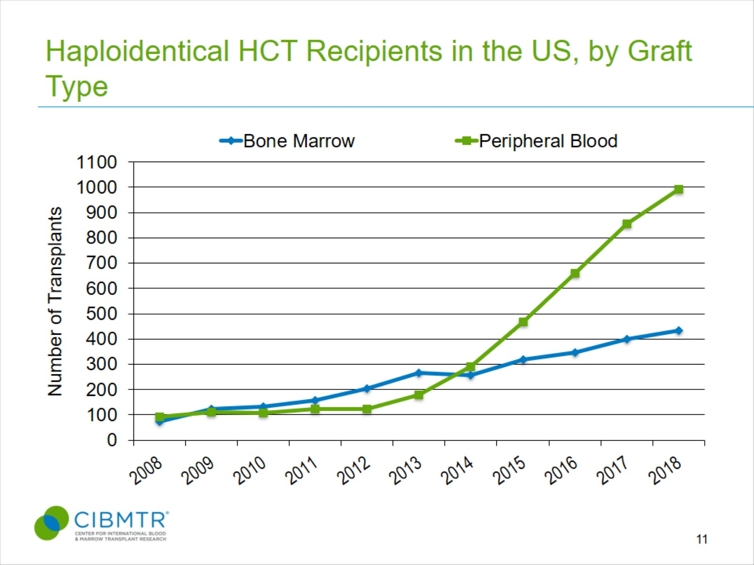
Haploidentical HCT Recipients in the US, by Graft Type
From D'Souza, A, Fretham C, Lee SJ, et al. Current Use of and Trends in Hematopoietic Cell Transplantation in the United States. Biol Blood Marrow Transplant. 2020 May 11:S1083-8791(20)30225-1, doi: 10.1016/j.bbmt.2020.04.013, PMID 32438042. The views expressed in this article are that of the authors and does not reflect the position of the Center for International Blood and Marrow Transplant Research.
Notes:
Slide 11: The graft source was peripheral blood in 70% of haploidentical transplants in 2018.

Slide 30
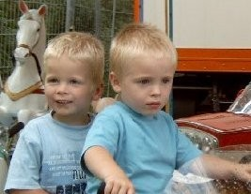
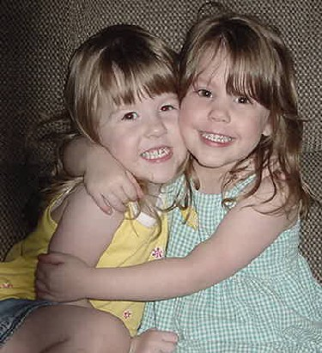
Which is syngeneic, which is allogeneic, who is the better donor?

Slide 31
Contraindications to HSCT: Major Increases in Risk occur with Pre-transplant Conditions
Active infection/inflammation
Non-recovery of counts pre-HCT (prolonged neutropenia)
Non-remission
MRD positivity—HSCT still done with success, increase relapse risk
Comorbidities: Measured by the HCT Comborbidity Index (HCT-CI)
  Underlying organ damage
    Pulmonary (FEV1, DLCOc <50%), Hepatic (LFTs >5x ULN, T bil >2), Cardiac (EF <50%), Renal (GFR < 70)—all risks
  Performance Status (low KS/LPS)
    <90 falls off, <60 major decline
  Psychiatric Disorder requiring significant therapy
Some of these issues can be addressed with reduced intensity regimen approaches

Slide 32
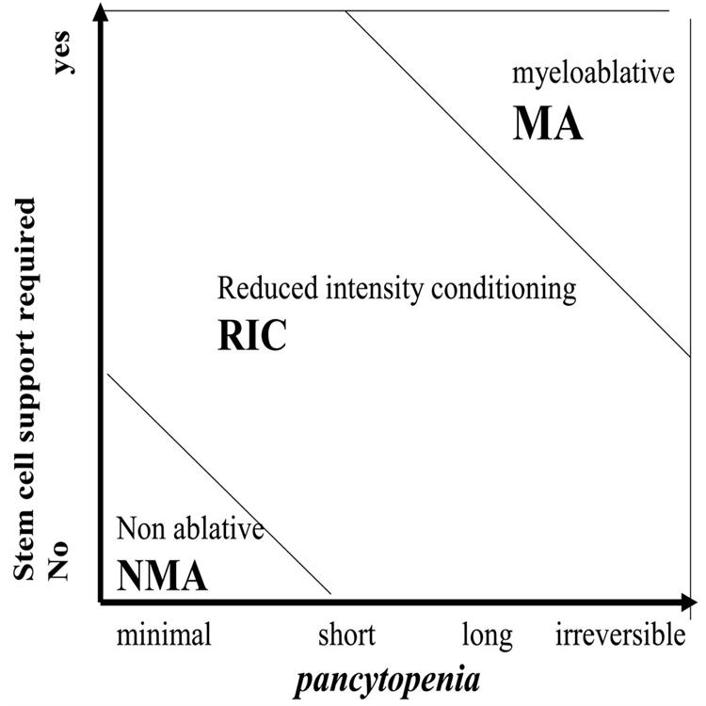
Implications of Reduced Intensity
Reprinted from Biology of Blood and Marrow Transplantation, Volume 15 (Issue 12), Bacigalupo, et al, Defining the Intensity of Conditioning Regimens: Working Definitions, Pages 1628-1633. ©2009 by Elsevier. Used with permission.

Slide 33
Current Practice: Allogeneic Preparative Regimens
Myeloablative approaches superior to RIC for AML/MDS
  BMT CTN randomized trial—marked increase in relapse with RIC
  Busulfan-based regimens: Bu/Cy, Bu/Fludarabine, Treosulfan/flu
TBI-based approaches better for ALL
  Prospective randomized iBFM trial: relapse ↓21%, OS ↑16% with TBI
    TBI ≥1200-13500cGy in 6-8 fractions + Cy or VP-16, ± thiotepa/fludarabine
Non-malignant disorder prep regimens vary
  RIC for HLH—flu/melphalan ± thiotepa, bu/cy, treo/flu
  Some disorders hard to engraft (SCD/thal)
  Serotherapy (rATG, Campath) always used to reduce GVHD
Some disorders require reduced, minimal, or no prep
  FA—sensitive to TBI, 300cGy vs. 1200, lower dose chemo, cy 40 vs. 120 or 200.
  SCID—Sib donors, no prep needed, URD, less prep may be possible.

Slide 34
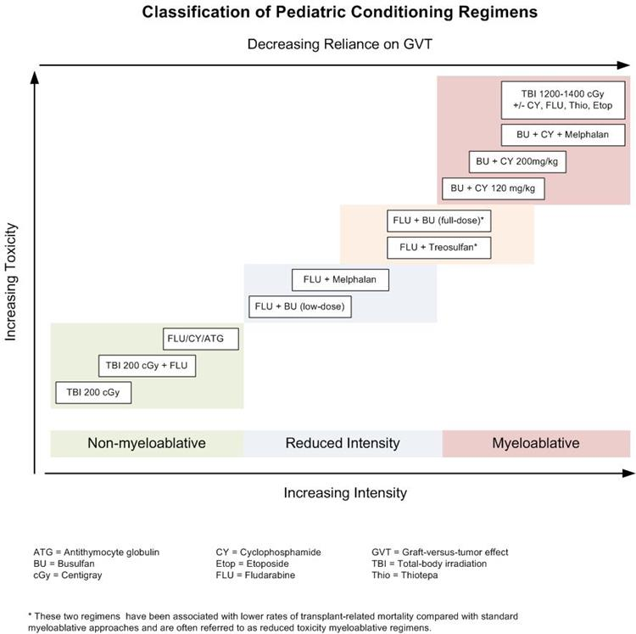
Allogeneic Conditioning Regimens
Reproduced with permission from Van Burik, Freifeld. Clinical Oncology, 3rd Edition. Philadelphia: Churchill Livingstone; 2004:942. ©2004 by Elsevier.

Slide 35
Current Practice: Autologous Preparative Regimens
All autologous regimens are high dose, myeloablative procedures
Disease specific (especially if targeted at CNS)
Neuroblastoma
  Carbo/Etop/Mel (CEM), Thio/Cy, Bu/Mel, I-131 MIBG
    Tandem procedures
CNS Tumors
  Carbo/thio x 3 tandem, Carbo/thio/etop x 1
Lymphoma
  BEAM (BCNU/Etop/Ara-C/Mel)

Slide 36
Complications: Infections
Occur early and late
Please see the following chart and Sung-Yun Pai’s lecture

Slide 37
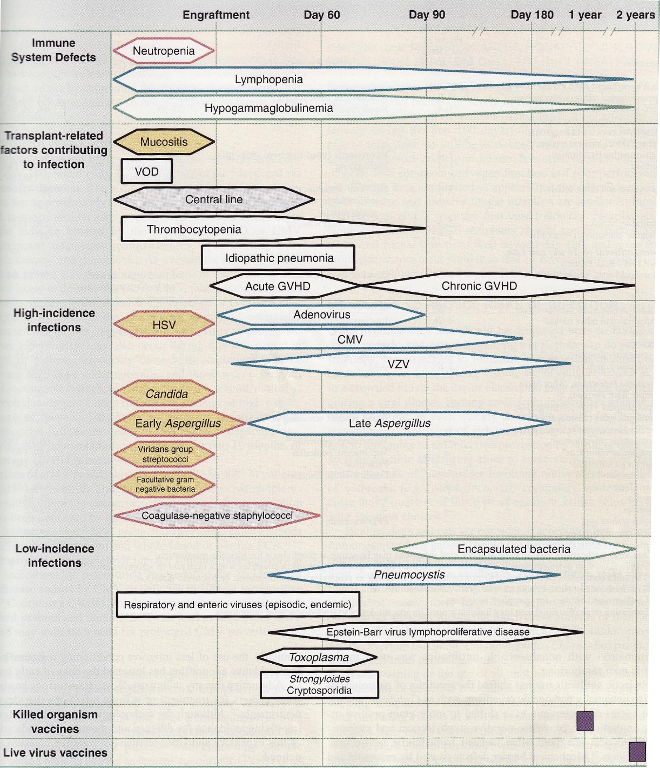
Phases of Predictable Opportunistic Infections
Adapted from Van Burik, Freifeld. Clinical Oncology, 3rd Edition. Philadelphia: Churchill Livingstone; 2004:942. ©2004 by Elsevier.

Slide 38
Key Infection Considerations
Transplant approach affects immune recovery
  Cord blood, T-cell depletion, ATG use=prolonged immune suppresion
  Marked increase in viral reactivation/infection
    CMV, Adeno, EBV—surveillance essential
Occurrence of aGHVD or cGVHD adds to risk
  Use of and dose of steroids critical risk factor
  Doses <1mg/kg and qod dosing can decrease risk
Infection increases the risk of all complications we will review

Slide 39
Case Presentation: Partial Chimerism and Graft Rejection
A 9m old with HLH transplanted with a RIC regimen (alemtuzumab/flu/mel) has falling whole blood donor chimerism at day +55 (90% to 70%). You should:
  A. Wean immune suppression rapidly and follow chimerism
  B. Give fludarabine followed by DLI
  C. Give a CD34+ stem cell boost
D. Arrange for a second HSCT from a different donor using rATG/flu/cy/low dose TBI
E. Increase Immune suppression to stabilize the graft

Slide 40
Case Presentation: Partial Chimerism and Graft Rejection
A 9m old with HLH transplanted with a RIC regimen (alemtuzumab/flu/mel) has falling whole blood donor chimerism at day +55 (90% to 70%). You should:
  A. Wean immune suppression rapidly and follow chimerism
  B. Give fludarabine followed by DLI
  C. Give a CD34+ stem cell boost
D. Arrange for a second HSCT from a different donor using rATG/flu/cy/low dose TBI
E. Increase Immune suppression to stabilize the graft

Slide 41
Managing Partial Chimerism
Chimerism is a measure of donor vs. recipient DNA
  Can be done with FISH (if sex mismatched) or short tandem repeats (STRs)
Can be whole blood or specific to lineages (T-cell [CD3] important)
↑ recipient T-cell chimerism in malignancies associated with relapse
Rapid loss of T-cell/whole blood donor chimerism associated with rejection
Therapeutic Approach:
  Aplastic anemia, ongoing anti-marrow response: increase immune suppression
  For most other disorders, wean/stop immune suppression
  If no GVHD after taper, consider donor lymphocyte infusion(s)
  Some disease states can be cured with low level donor chimerism (5-30%)

Slide 42
Risk Factors for Graft Rejection
NMA or RIC regimens
  Less suppression of recipient immunity: use PBSC/agents like fludarabine
HLA Mismatched donors
  More chance of immune recognition by recipient: avoid Donor-specific Abs
Cord blood/Haploidentical donors
  T-depleted products decreases engraftment: use intense, immunoablative regimens
Non-malignant disorders
  No pre-HSCT chemo means higher engraftment barrier: disease specific approaches
Hyper-inflammatory/hyperproliferative states
  Inflammation interferes with engraftment: calm down inflammation/proliferation
Infection/Viral reactivation
  Leads to inflammation: control infection first, prevent viral reactivation if possible

Slide 43
Case Presentation
3 year old day +16 after a cord blood transplant
  Engraftment day +14
Presents with fever to 39.5
  Skin rash on trunk with some extension to extremities
  Palmar and plantar erythema
  Pruritis
  No stools, normal LFTs
No fluid retention or hypoxia noted

Slide 44
Acute Graft-vs-Host Disease
Usually diagnosed before day +100
Typically occurs near time of engraftment
Almost always involves skin
Also can involve intestine, liver, or lung
Substantial cause of morbidity and mortality

Slide 45
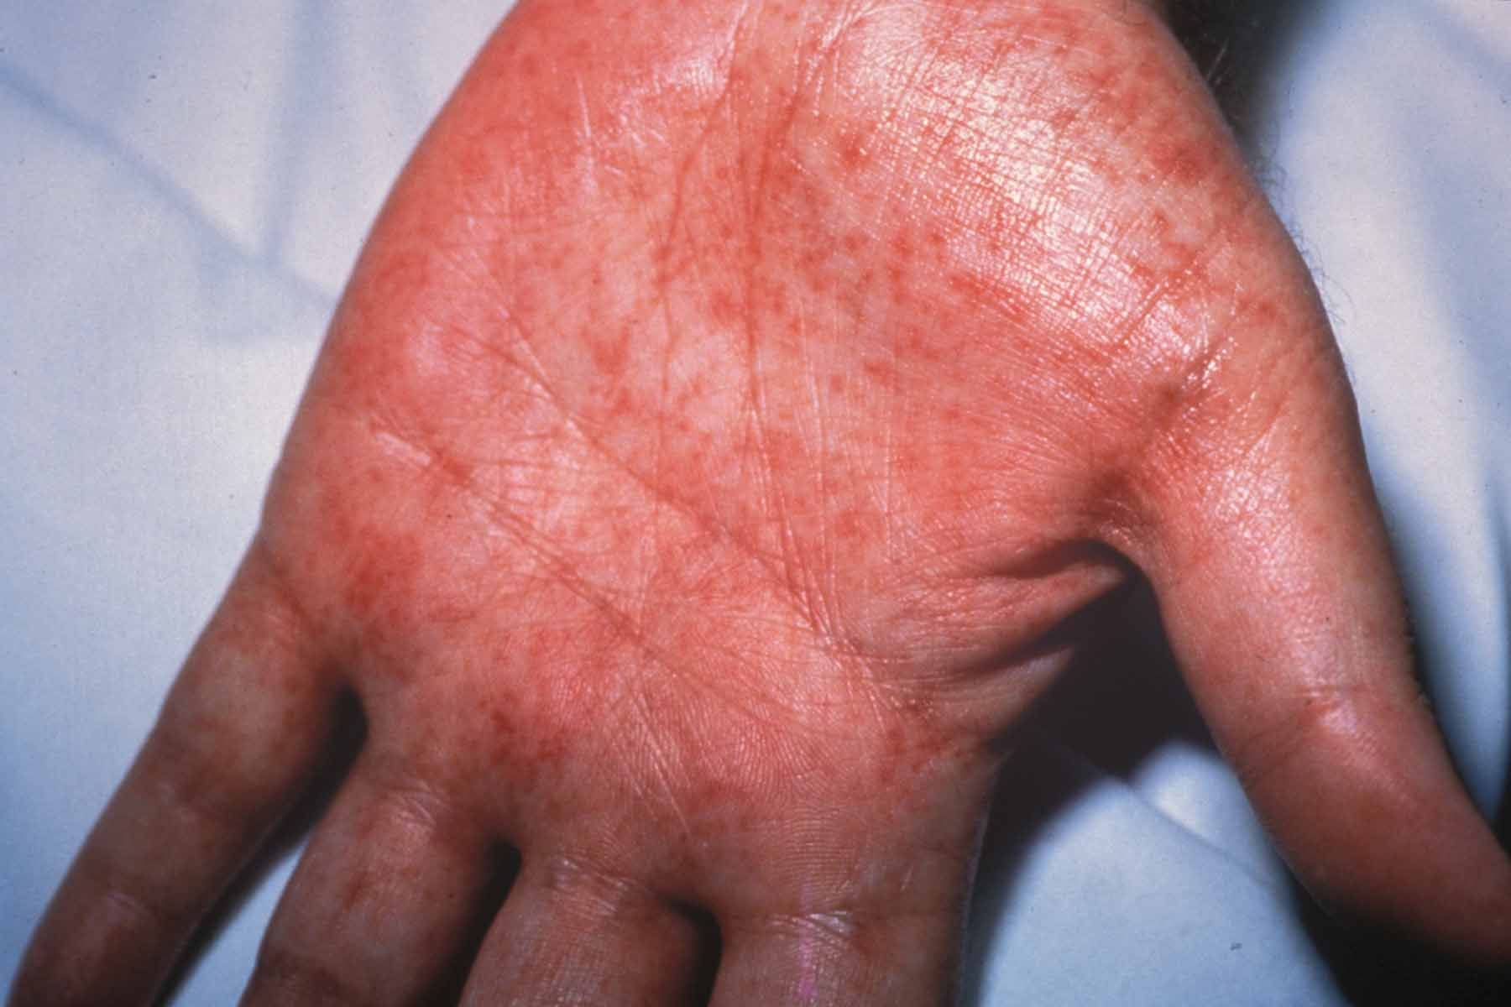
Palmar Erythema

Slide 46
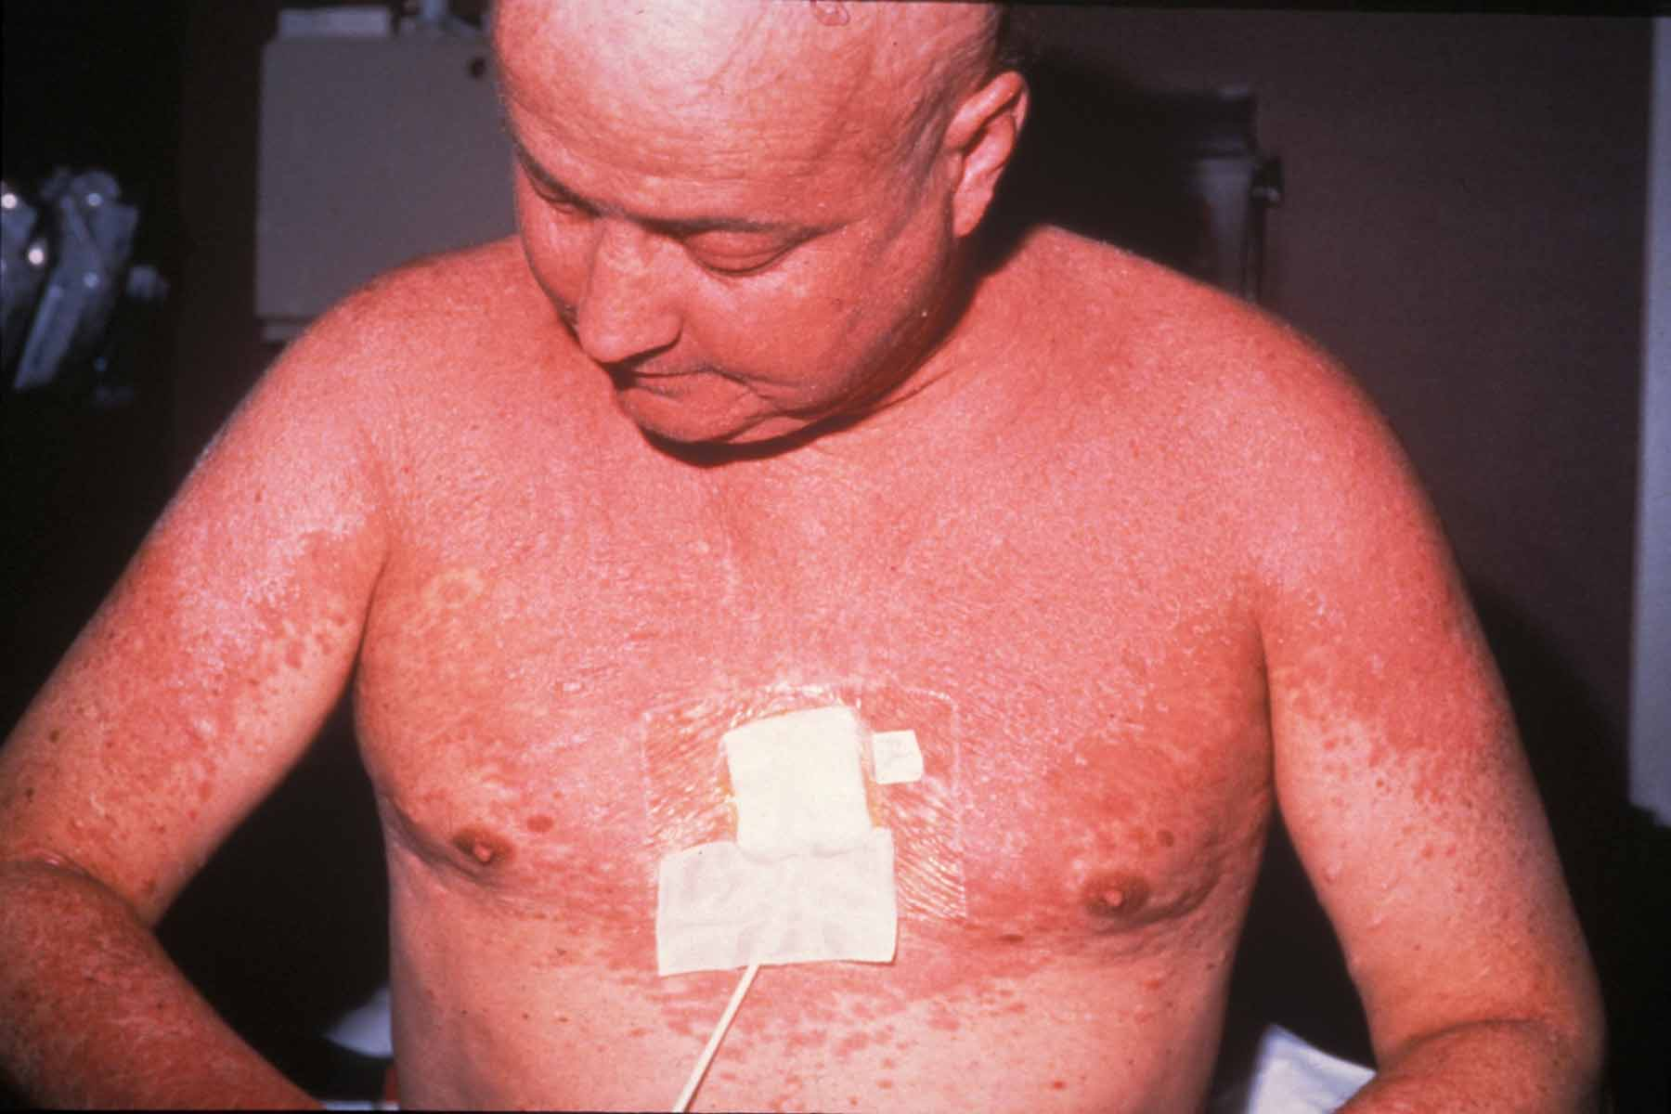
Puritic Maculopapular Rash

Slide 47
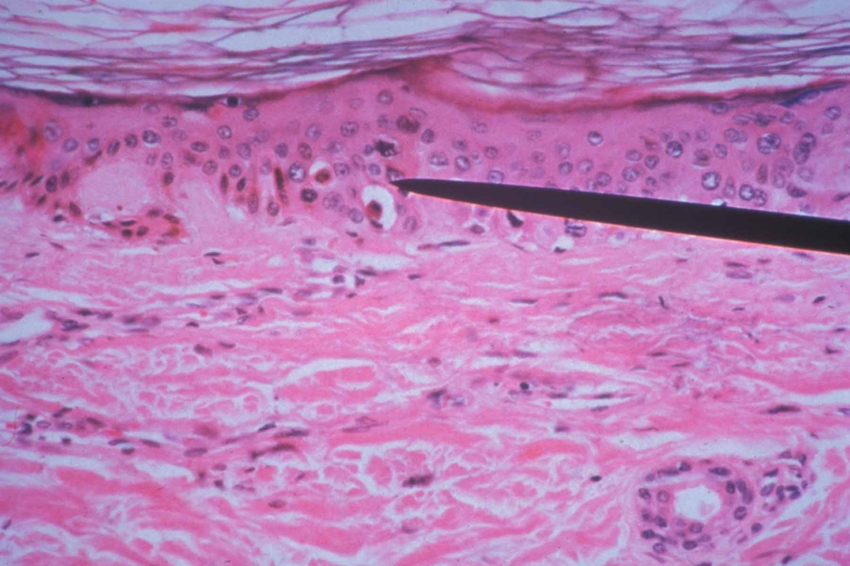
Basal Keratinocyte Apoptosis

Slide 48
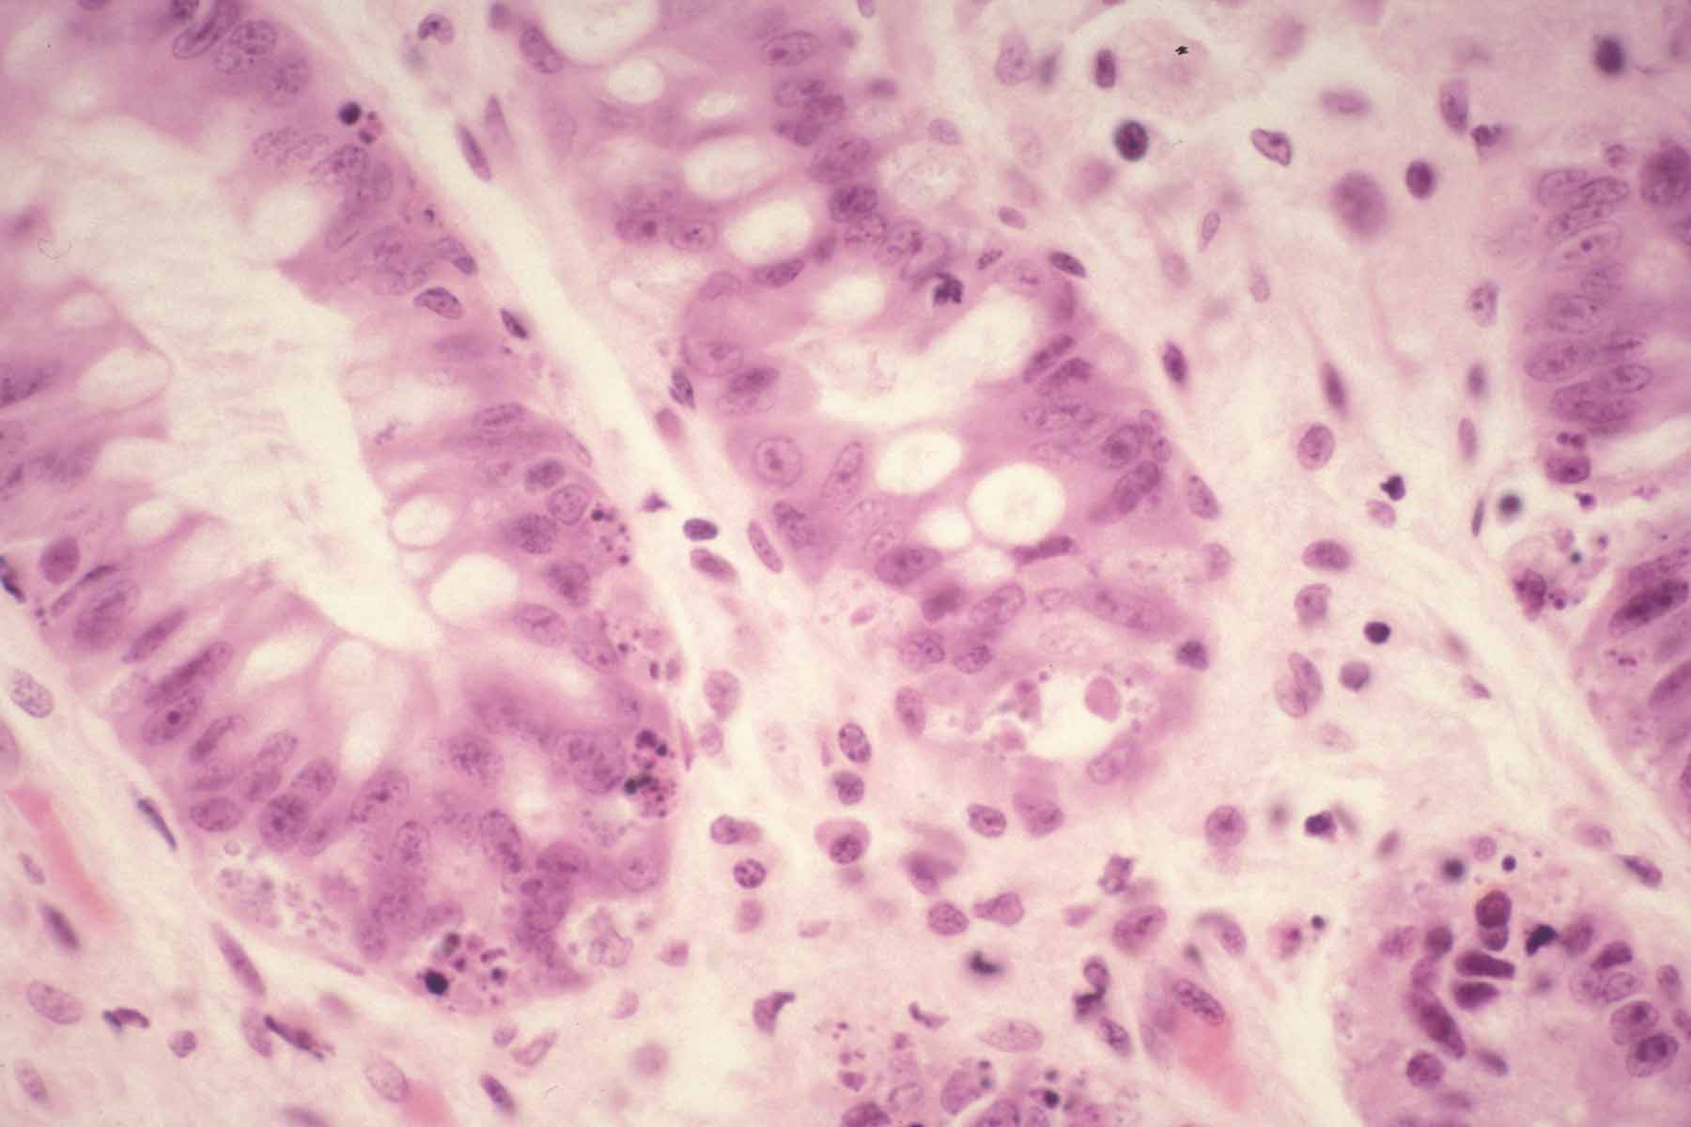
Basal Intestinal Crypt Apoptosis

Slide 49
Acute GVHD Staging
Stage | Skin | Liver | Gut
1 | Rash on <25% | Bili 2-3 mg/dl | Diarrhea 280-555ml/m²/d
2 | Rash on 25-50% | Bili 3.1-6 mg/dl | Diarrhea 556-883ml/m²/d
3 | Rash on >50% | Bili 6.1-15 mg/dl | Diarrhea >883ml/m²/d
4 | Generalized erythroderma with bullae | Bili >15 mg/dl | Severe abdominal pain

Slide 50
Acute GVHD Grading
Grade | Skin | Liver | Gut
1 | Stage I-II | none | none
2 | Stage III | Stage I | Stage I
3 | -------- | Stage II-III | Stage II-III
4 | Stage IV | Stage IV | Stage IV

Slide 51
Acute GVHD Prophylaxis
Most use calcineurin inhibitors (CI, tacro/CSP) +
  MTX given days 1,3, 6 +/- 11 for sib/URD BM/PBSC
  Some programs us Mycophenylate mofetil (MMF) instead of MTX
  Mycophenylate mofetil (MMF) plus CI used for cords
  Other agents that can be used: sirolimus, ATG, prednisone, post-transplant cyclophosphamide
T-cell Depletion
  In vivo: rATG, hATG, campath (alemtuzumab)
  Ex vivo: CD34+ selection, 𝛼𝛽-CD3/CD19 depletion
  Increased risk of infection, rejection, relapse
  Different types of depletion have different risks

Slide 52
Primary Acute GVHD Therapy
Mild disease—limited skin rash alone
  Optimize tacrolimus or CSP levels, topical steroids
If progressive or multisystem
  Prednisilone 1-2mg/kg/d
Steroid Refractory aGVHD (no response 3-7d)
  No clearly superior second regimen
    Ruxolitinib approved in kids >12 for SR-aGVHD
  ECP, etanercept, infliximab, pentostatin
  Poor prognosis due to infectious complications

Slide 53
Case Presentation
An 8-year-old child with AML 6 months post-transplant comes to clinic complaining of a maculo-papular rash on arms and legs, dry, irritated eyes, and a persistent cough. His mother has noticed that he gets winded much more quickly than he used to. Which investigation is most likely to yield a diagnosis?
A. Blood PCR for CMV
B. Bronchiolar lavage to rule out pneumocystis infection
C. Pulmonary function tests and high resolution CT
D. Galactomannan test for fungus
E. Upper GI endoscopy

Slide 54
Case Presentation
An 8-year-old child with AML 6 months post-transplant comes to clinic complaining of a maculo-papular rash on arms and legs, dry, irritated eyes, and a persistent cough. His mother has noticed that he gets winded much more quickly than he used to. Which investigation is most likely to yield a diagnosis?
A. Blood PCR for CMV
B. Bronchiolar lavage to rule out pneumocystis infection
C. Pulmonary function tests and high resolution CT
D. Galactomannan test for fungus
E. Upper GI endoscopy

Slide 55
Chronic GVHD
Diagnosed after day 100 (2m sometimes)
  Immunodeficiency
  Skin- lichen planus⇨ poikiloderma
  Vitaligo, hyperpigmentation
  Scleroderma
  Limited joint mobility
  Sicca syndrome
  Mouth ulceration/food sensitivity
  Hepatic- vanishing bile ducts
  Pulmonary- bronchiolitis obliterans
  GI- esophageal strictures, fat malabsorption

Slide 56
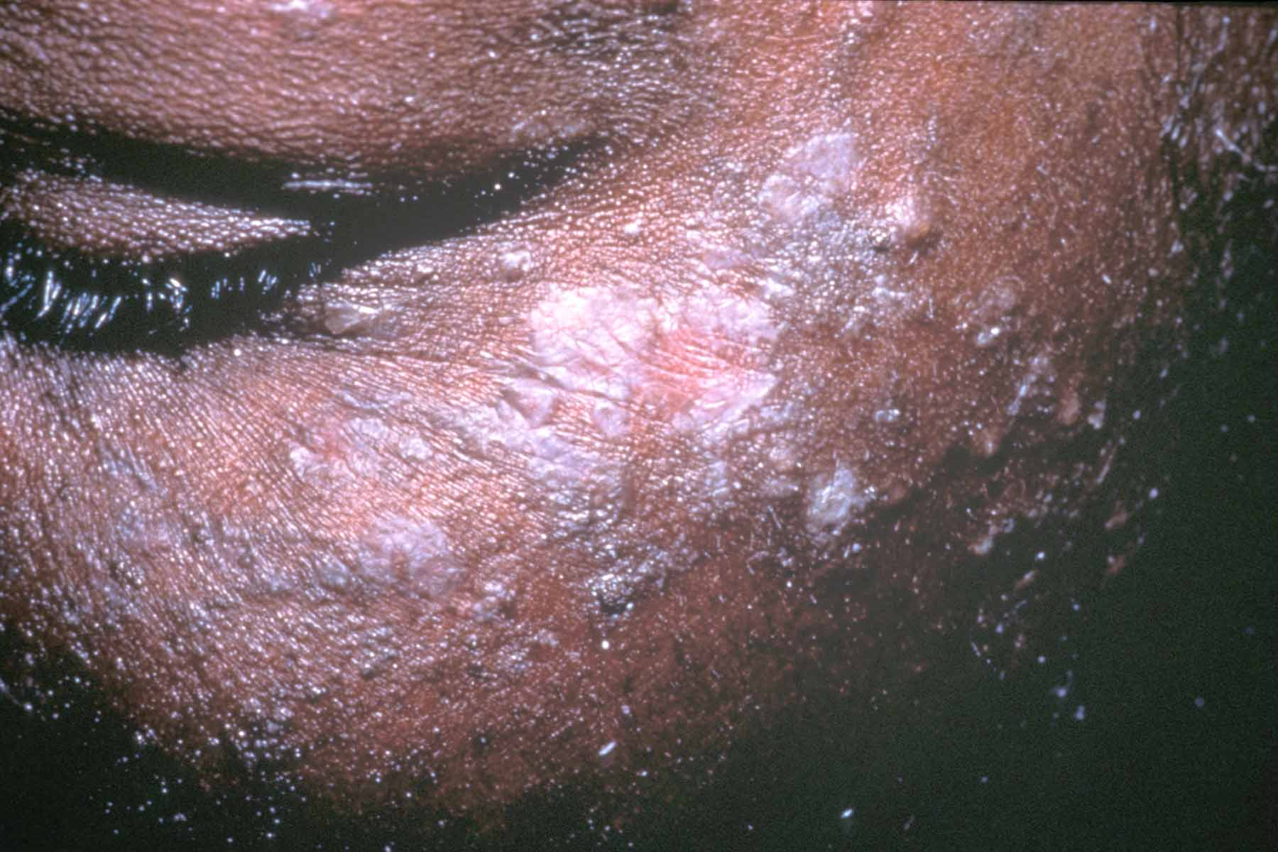

Slide 57
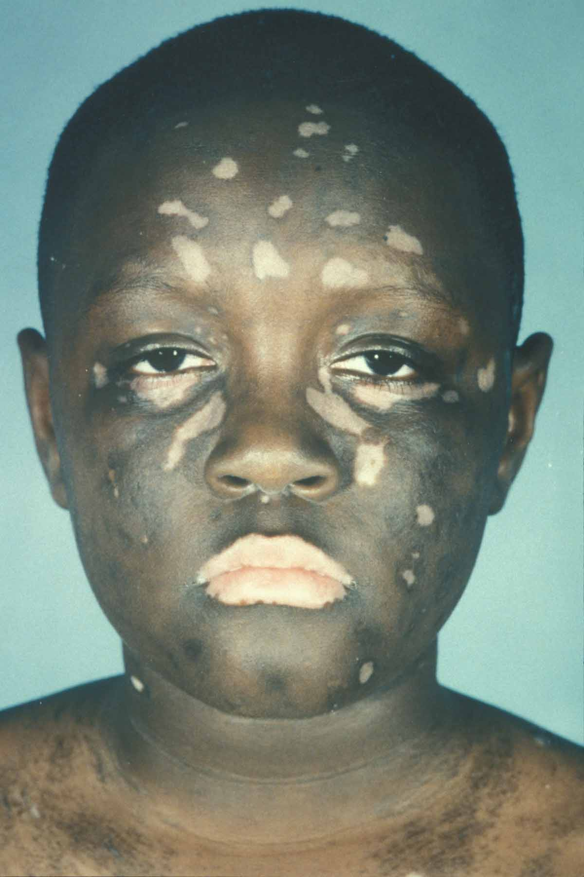

Slide 58
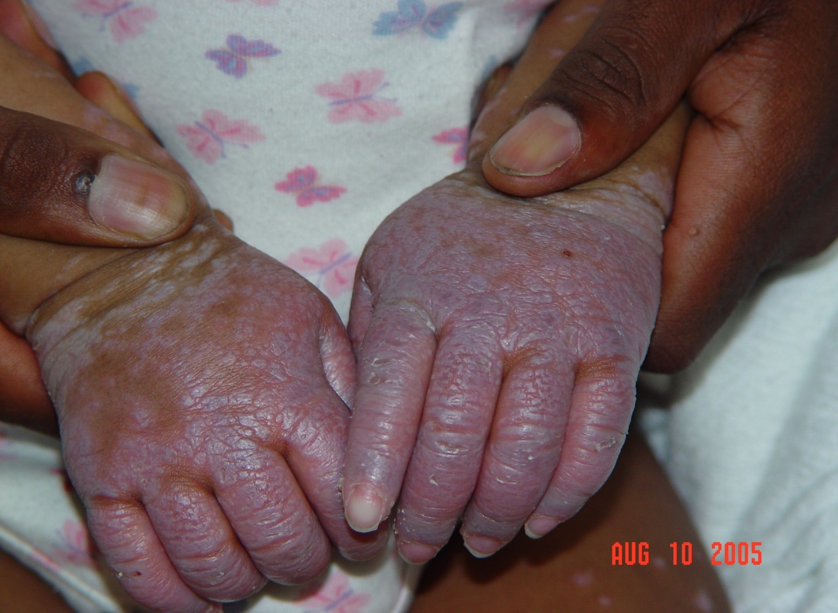

Slide 59
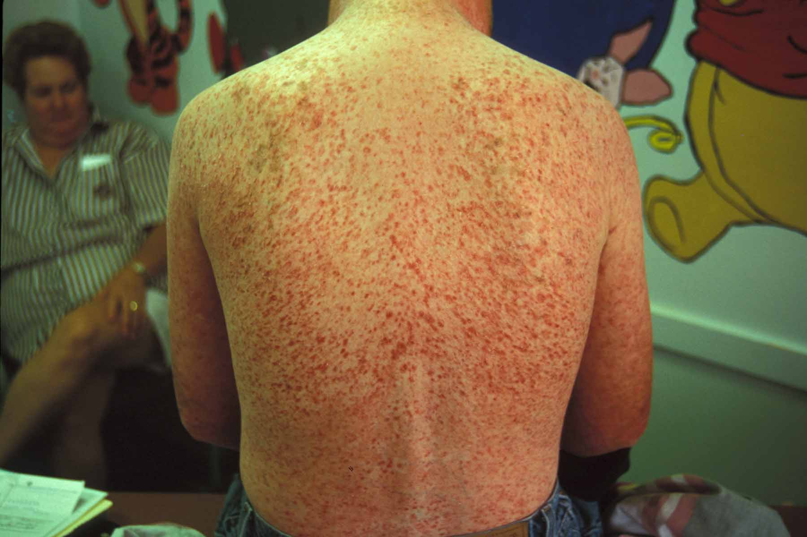

Slide 60
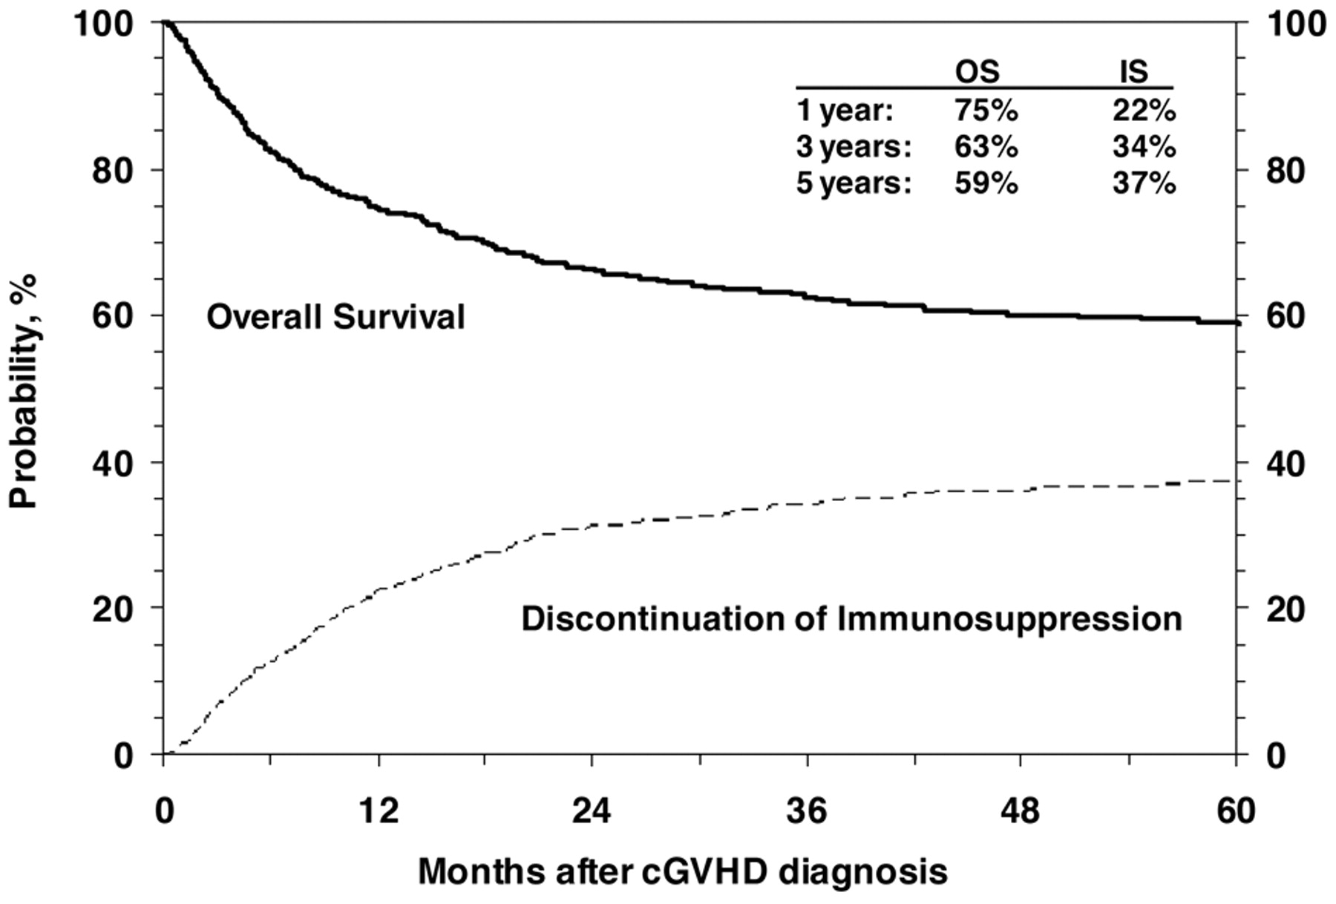

Cumulative incidence of discontinuation of immune suppression after the diagnosis of cGVHD shown with OS.
Republished with permission of the American Society of Hematology, from Blood, Risk factors associated with increased nonrelapse mortality and with poor overall survival in children with chronic graft-versus-host disease, Jacobsohn, et al, 118, 16, 2011; permission conveyed through Copyright Clearance Center, Inc.
©2011 by American Society of Hematology
Notes:
Cumulative incidence of discontinuation of immune suppression after the diagnosis of cGVHD shown with OS.

Slide 61
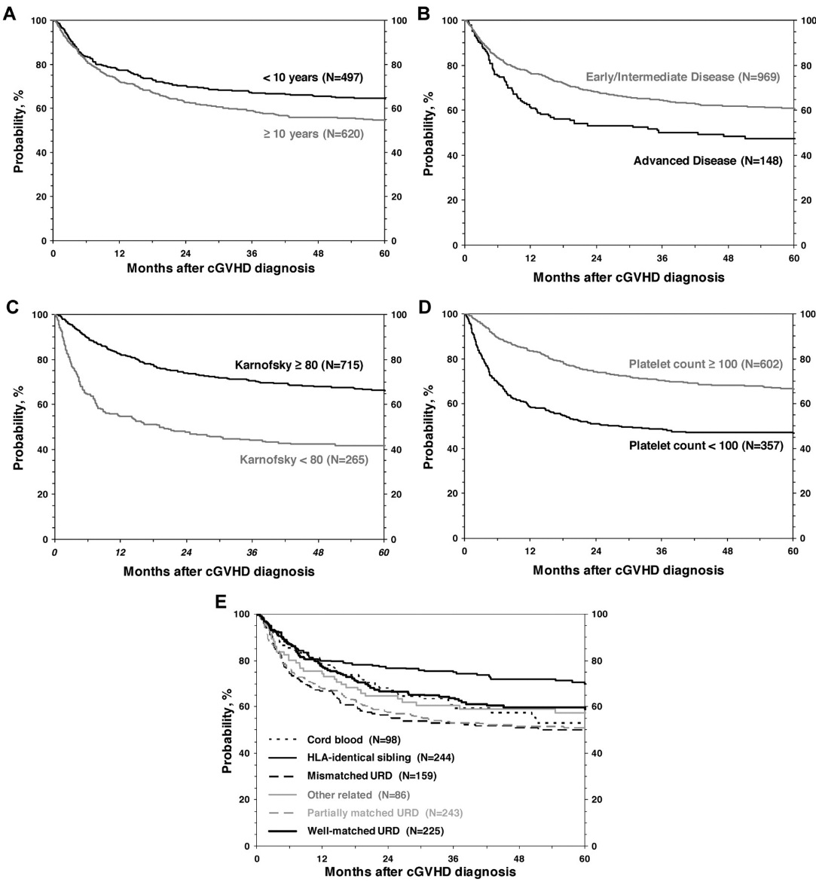
OS by risk factors included in multivariate analysis.
Republished with permission of the American Society of Hematology, from Blood, Risk factors associated with increased nonrelapse mortality and with poor overall survival in children with chronic graft-versus-host disease, Jacobsohn, et al, 118, 16, 2011; permission conveyed through Copyright Clearance Center, Inc.
©2011 by American Society of Hematology
Notes:
OS by risk factors included in multivariate analysis.

Slide 62
Standard Therapy for Chronic GVHD
Prednisone 1 mg/kg/day
Taper to 1 mg/kg/every other day over 6 weeks
Most children with > mild disease require tacrolimus/sirolimus/ cyclosporine plus other meds
Prolonged course possible
  Median duration of treatment is 2 years for responding patients

Slide 63
Salvage treatment for chronic GVHD
MMF
FK506
Thalidomide
Plaquenil
Pentostatin
Methotrexate
Rituximab
PUVA
Extracorporeal photopheresis
Newer approaches
  Low dose-IL-2
  Mesenchymal Stem Cells (filing with the FDA)
  Ruxolitinib (Jack2 inhibitor)
  Ibrutinib (FDA approved for cGVHD in kids)

Slide 64
Case Presentation
A 10 year old by undergoes stem cell transplantation for CML. The graft is T-Cell depleted as part of an NIH sponsored IRB approved research protocol. Day 145 post transplant the patient develops severe cervical lymphadenopathy and splenomegaly. The most likely diagnosis is:
A. Relapsed CML in accelerated phase.
B. Secondary Hodgkin disease.
C. PTLD.
D. Toxoplasmosis.
E. Transfusion acquired HIV.

Slide 65
Case Presentation
A 10 year old by undergoes stem cell transplantation for CML. The graft is T-Cell depleted as part of an NIH sponsored IRB approved research protocol. Day 145 post transplant the patient develops severe cervical lymphadenopathy and splenomegaly. The most likely diagnosis is:
A. Relapsed CML in accelerated phase
B. Secondary Hodgkin disease
C. PTLD
D. Toxoplasmosis
E. Transfusion acquired HIV

Slide 66
Post-Transplant Lymphoproliferative Disorder
Lymphoid proliferation resembling lymphoma
  EBV-associated: Usually DLBCL, can be Hodgkin-like or Plasmacytic
  Occurs within a few months of BMT
  Also occurs after solid organ transplantation
Highly associated with T-cell Depletion
  Product depletion techniques that preserve B-cells
    CD34+ selection
    CD3+ selection without CD19+ depletion
    Cord blood with ATG
  In vivo depletion (ATG, less with campath)
  Therapy that is highly T-cell suppressive
    ATG for resistant GVHD
Treatment
  Immune suppression withdrawal, rituximab, cyclophosphamide, EBV-targeted cytotoxic T-lymphocytes (CTLs, also called virus-specific T-cells [VSTs])

Slide 67
Case Presentation
3yo with stage IV neuroblastoma
Treated with 131I-MIBG and rescue
Hospitalized for autologous BMT with bu/mel
Day +15, preparing for discharge
  Develops abdominal discomfort and swelling
    RUQ pain
  Bilirubin increases from 1.5 to 4, direct 3.2
  Mild need for oxygen
  Weight gain of 12% over baseline

Slide 68
Venoocclusive Disease (VOD, also sinusoidal obstruction syndrome, SOS)
Typically in first 14 days of transplant
  May present late: through day +30
About 25% patients affected, severe in 5-8%
Caused by endothelial damage in the hepatic venules → platelet deposition → hepatic congestion → cholestasis
Associated with Cy, Busulfan, and TBI
  Sirolimus use is a risk when used with tacrolimus or cyclosporine

Slide 69
VOD Signs and Symptoms
  Weight gain
  RUQ pain (capsular distention)
  Hyperbilirubinemia
  Plt refractory
  Ascites (capillary leak)
  Renal Insufficiency
  Pulmonary Edema

Slide 70
VOD Management
Fluid management
  Diuresis, keeping patients fluid negative—this decreases intra-abdominal presssure
Challenges
  Maintain intravascular volume
  Manage renal failure (CVVH especially useful)
  Defibrotide (Antithrombotic agent)
    Indicated for VOD plus organ dysfunction
    Increases risk of bleeding--special attention must be paid to VOD coagulopathy

Slide 71
Case Presentation
16yo 50 days s/p haploidentical HSCT for ALL
GVHD prophylaxis with tacrolimus/sirolimus
Platelet drop from 50 to 15K/uL
Worsening creatinine
Increasing LDH
Smear shows schistocytes

Slide 72
Transplant-Associated Thrombotic Microangiopathy (TA-TMA)
Pathophysiology: Endothelial damage from HSCT causes thrombosis and fibrin deposition in the microcirculation
  Microangiopathic hemolytic anemia and platelet consumption
Kidney most commonly affected.
  Pulmonary, GI, Neuro-involvement possible
Presentation: anemia, thrombocytopenia, schistocytes,↑LDH,↓ haptoglobin
Causes/Associations: Calcineurin inhibitors (especially + sirolimus), TBI, high-dose busulfan, and infections
Treatent:
  Eculizumab (terminal complement inhibitor) can improve renal function
  D/C or lowering calcineurin inhibitors may help (especially if siro combo)

Slide 73
Case Presentation
6 year old day +64 out from TBI-based allogeneic transplant
  Presents to the ER with confusion
  Short tonic-clinic seizure witnessed in the ED
  Loss of vision noted
  What are key clinical facts you need to know?

Slide 74
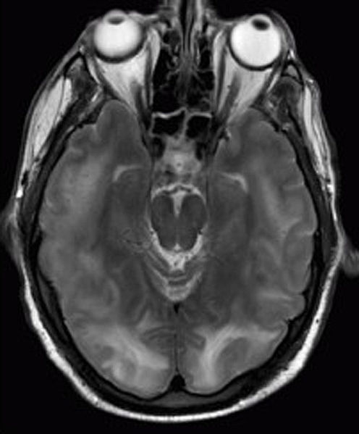
Postengraftment (Days 30-100)
Reproduced with permission from Chawla R, Smith D, Marik PE. Near fatal posterior reversible encephalopathy syndrome complicating chronic liver failure and treated by induced hypothermia and dialysis: a case report. J Med Case Rep. 2009;3:6623. Published 2009 Mar 26. doi:10.1186/1752-1947-3-6623. ©2009 by BioMed Central Ltd.

Slide 75
Posterior Reversible Encephalopathy Syndrome (PRES)
Symptoms associate with malignant hypertension
    Linked to calcineurin-inhibitors (tacrolimus and cyclosporine).
Postengraftment (Days 30-100)
Presentation: Headache, confusion, seizures, visual loss
Diagnosis: MRI imaging of the brain
    Characteristic pattern of enhancement, commonly in the posterior circulation, which may be seen, but poorly on CT
Treatment: Control HTN, stop calcineurin inhibitors

Slide 76
Late Effects after HCT
Worst Late Effect Associated with cGVHD
  Skin, eye and join issues, hair thinning, hypoxia
Two years after BMT, most common problem?
  Relapse
Non-relapse events
  Second malignancies: 2-6%,  in FA patients, assoc. c XRT
  Growth failure: Rare, associated with TBI + CNS XRT
  Other Endocrine issues: Hypothyroidism, Gonadal failure
Pre-HCT Rx and GVHD contribute significantly to late effects
  Cardiac related to XRT and anthracylines
  GVHD effect on lungs, QoL
Emerging Evidence of TBI effect on children < 3 at HCT

Slide 77
Hematopoietic Cell Transplantation: Indications
Cancer Treatment
  You will hear specific indications from disease experts
  I will discuss CAR T-cell therapy
Replacement or “Resetting”of a Dysfunctional Hematopoietic/Immune System
  Disease specific experts: Immune deficiency/WBC disorders
  SCD/Thalassemia
  Marrow Failure
Gene Therapy
  Allo-BMT useful if the gene can be delivered by hematopoietic cells
  I will touch upon mucopolysaccharidoses and leukodystrophies
  Current gene therapy approaches use gene modified PBSC
    Autologous BMT using Busulfan

Slide 78
Key Decisions: Chemotherapy vs. Transplant—Auto vs. Allo
Autologous: TRM <1% at most centers.
  CR1 if better outcome/ difficult salvage
  Fertility/ immune suppression/ late effects
Allogeneic: TRM 5-20%
  GVHD morbidity/QOL chief concerns
  Would want a 15% advantage over chemotherapy/autologous options

Slide 79
Indications for Hematopoietic Stem Cell Transplants for Age ≤20 years, in the US, 2018
Number of Transplants
Used with permission from CIBMTR. The views expressed in this presentation are that of the authors and does not reflect the position of the Center for International Blood and Marrow Transplant Research.
Notes:
Recent data from CIBMTR
From 2011 chart notes: In the pediatric population, allogeneic transplants are performed more often than autologous transplants. In 2011, allogeneic transplants performed in patients younger than 20 were for acute leukemias (43%) and non-malignant indications (35%). Among other non-malignant indication, primary immunedeficiencies and hemoglobinopathies are the most common indications. Autologous transplants were mostly performed for treatment of lymphoma and solid tumors in this patient population.
“The views expressed in this presentation are that of the authors and does not reflect the position of the Center for International Blood and Marrow
Transplant Research.”

Slide 80
HCT as Gene Therapy
Inborn Errors of Metabolism
  Most common and best data
    Hurler Syndrome MPS-IH
    X-Adrenoleukodystrophy (X-ALD)
  Other diseases
    Juvenile Metachromatic Leukodystrophy
    Infantile Hunters
    Epidermolysis Bulosa

Slide 81
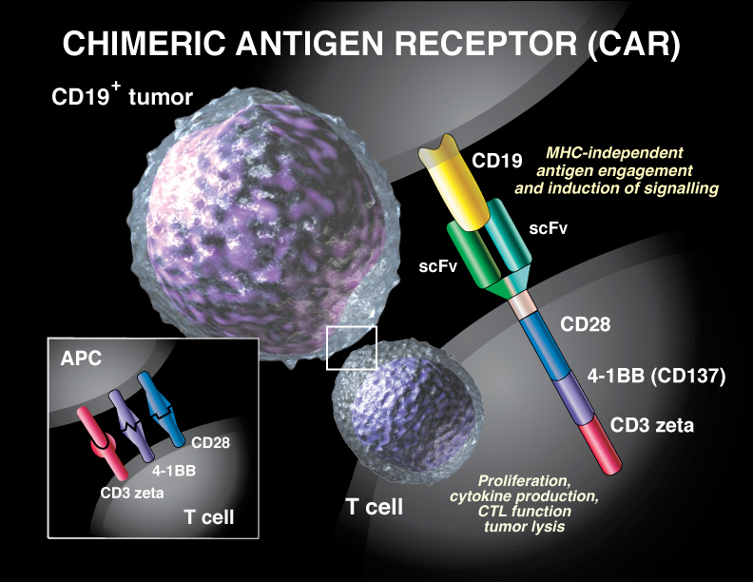
CART19: Chimeric Antigen Receptor T cells against CD19
© Sue Seif. Used with permission.
Notes:
Genetically modify T-cells to express an antigen recognition domain of a specific antibody, in this case CD-19. Traditionally did not lead to in vivo expansion. The newest generation of CAR T-cells were enhanced by adding a co-stimulatory domain. In our model the co-stimulatory domain is 4-1BB (CD137) CARs are not all the same.
The co-stimulatory domains were murine but now humanized to try to further minimize rejection.

Slide 82
CAR T-cells
Current FDA indication for CD19-targeted tisagenlecleucel:
  For the treatment of patients up to age 25 with B-ALL that is refractory or in second or later relapse
  Autologous cells used
  Many patients post-HSCT
    “Autologous cells” collected are donor T-cells
  80-90+% CR at day 28
  30-35% will either lose CARs and have a CD19+ relapse or have CD19- relapses, most in the first 6 months
Ongoing COG trial for ALL pts with MRD+ disease post consolidation
NHL indication for patients 18+
  Pediatric NHL trial completing
Active trials in AML, Solid tumors, ALL
  ALL trials looking at different costimulatory molecules, multiple targets

Slide 83
Consistency of DOR Across Studies
100
ELIANA
Single-center
80
60
Probability of event free, %
40
20
0
0
3
6
9
12
15
18
21
24
27
30
33
36
39
42
Patients at risk
— ELIANA
— Single-center
Time (months)
52
45
15
7
1
0
52
36
24
14
11
10
10
8
5
2
1
1
1
1
0
Reproduced with permission from Pulsipher MA. Are CAR T cells better than antibody or HCT therapy in B-ALL? Am Soc Hematol Educ Program. 2018;2018(1):16-24. doi:10.1182/asheducation-2018.1.16. ©2018 by the American Society of Hematology.

Slide 84
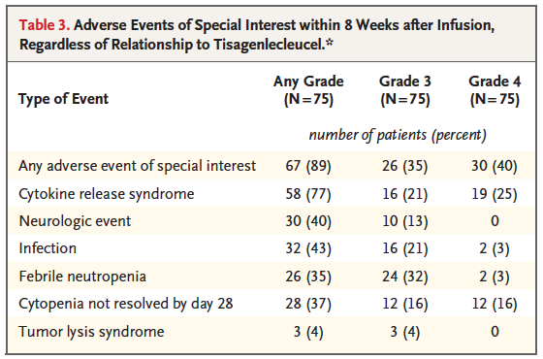
Adverse Events Maude NEJM 2018 378(5):439-448
From The New England Journal of Medicine, Maude, et al, Tisagenlecleucel in Children and Young Adults B-Cell Lymphoblastic Leukemia, 378, 439-448. ©2018 Massachusetts Medical Society. Reprinted with permission from Massachusetts Medical Society.

Slide 85
Best of Luck on your Test!
Future of HSCT
  Targeting cellular therapies
    CART
    CAR-NK
    Expanded NK Cells
    BiTE
    BiNK
  Combined therapies with immunomodulators
Hopefully progress with CART in AML and solid tumors soon

