Slide 1
Neuroblastoma and Related Tumors
Emily Greengard, M.D.
University of Minnesota

Slide 2
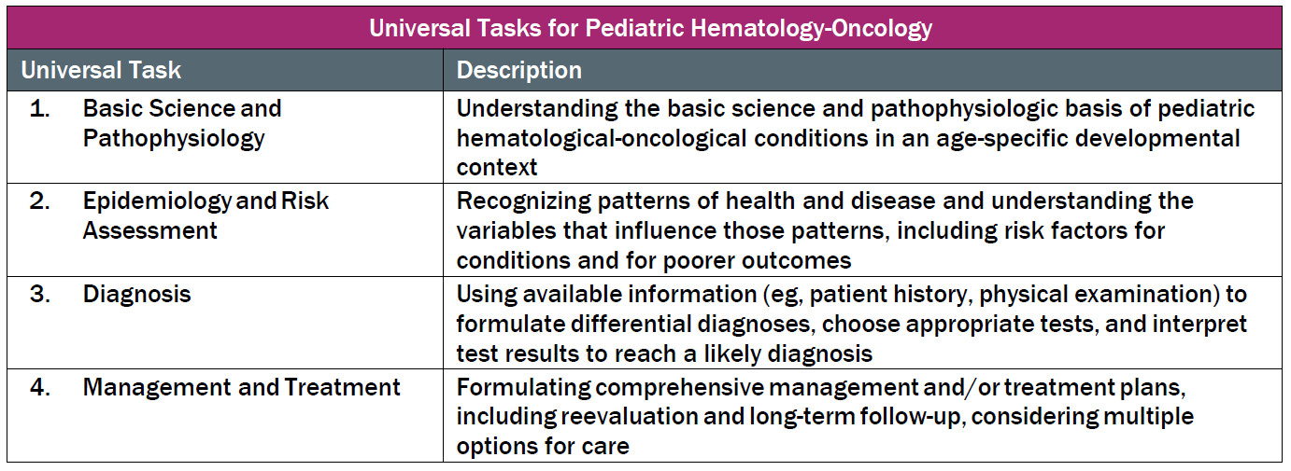
This talk will follow the topical structure suggested by the ABP:

Slide 3
Basic Science and Pathophysiology
Epidemiology and Risk Assessment
Diagnosis
Management and Treatment

Slide 4
Basic Science and Pathophysiology
Epidemiology and Risk Assessment
Diagnosis
Management and Treatment

Slide 5
Neuroblastic Tumors
Embryonal malignancy originating from neural crest tissue of the sympathetic nervous system
Encompasses a spectrum of tumors characterized by varying levels of neuronal differentiation:
  Ganglioneuroma
  Ganglioneuroblastoma (nodular vs. intermixed)
  Neuroblastoma
Heterogenous clinical course ranging from spontaneous regression to highly aggressive disease with fatal outcome

Slide 6
Pathologic features of neuroblastic tumors
Small, round, blue cell tumors
Homer-Wright rosette patterns: tumor cells around neuropil
Ganglioneuroma, ganglioneuroblastoma, neuroblastoma
  Varying degree of neuronal maturation
  Varying degree of mitosis and karyorrhexis
  Varying degree of Schwannian stroma intermixed with tumor cells

Slide 7
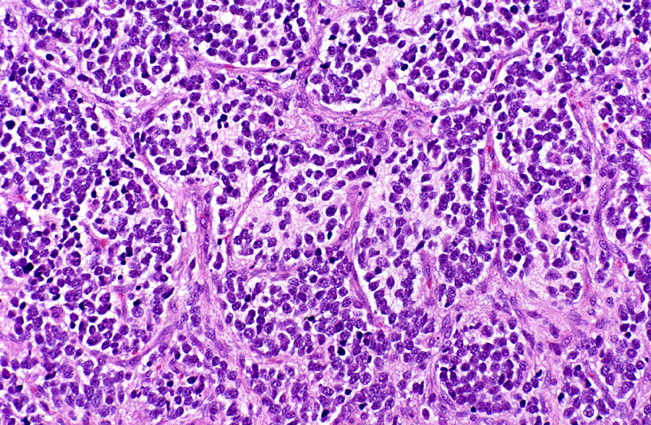
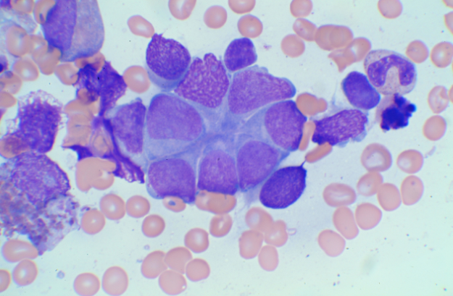
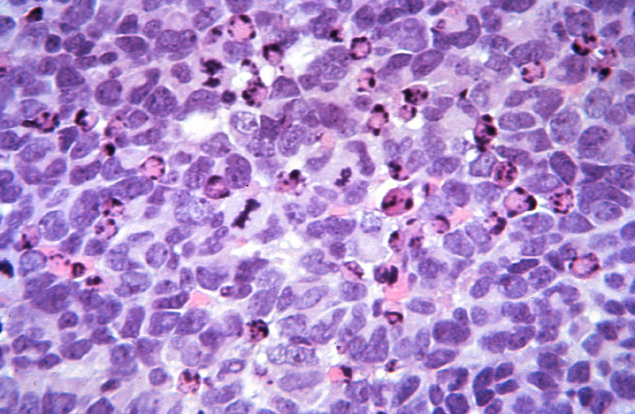
Pathology of Neuroblastoma
Differentiating histology, Low MKI
Poorly differentiated histology, Low MKI
Homer-Wright rosette patterns
Undifferentiated histology, High MKI
Images courtesy of Julie Park, MD

Slide 8
Molecular drivers of disease
Aberrant telomere maintenance leads to aggressive phenotype
  MYC driven tumors: NMYC amplification, NMYC overexpression and MYC overexpression
    20% of neuroblastic tumors
  Inactivating mutations in ATRX (alpha thalassemia/mental retardation syndrome X linked) chromatin remodeling gene
    Exclusive of MYCN amplification
    Activates alternative lengthening of telomeres (ALT) pathway
    Majority are > 5 years of age
  Activating rearrangements in TERT (telomerase reverse transcriptase)
    Exclusive of MYCN and ATRX mutations
    13% of neuroblastic tumors

Slide 9
Somatic genetic profiles
Two broad patterns of chromosomal changes
  whole chromosomal gains, lack of structural changes and hyperdipolid DNA content
    Associated with excellent outcome
  segmental chromosomal aberrations (SCAs) and/or diploid DNA content
    Associated with inferior outcome
      Hypothesized to result from altered telomere lengthening

Slide 10
Somatic: SCA and loss of genetic material
Chromosome 1p36
  detected in 23-30% of tumors
  associated with MYCNA
Chromosome 11q23
  detected in 30-40% of tumors
  associated with TERT rearrangement and ATRX mutation

Slide 11
Additional somatic mutations
Aberrations of ALK (ch2p23)
  Amplification detected in 4% of NB tumors
  Activating aberrations in 15% of NB
ch17q gain (specific gene not known)
  detected in >60% of tumors
AT-rich interactive domain 1A and B ( ARID1a/1b ) deletions and point mutations
  chromatin remodeling proteins
p53, PTPN11, and genes involved in Ras/MAPK signaling (<5% tumors)

Slide 12
Basic Science and Pathophysiology
Epidemiology and Risk Assessment
Diagnosis
Management and Treatment

Slide 13
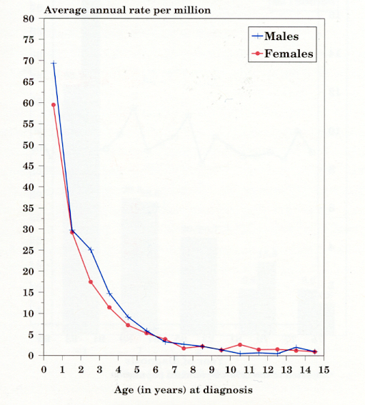
Epidemiology of neuroblastic tumors
Sympathetic nervous system age-specific incidence rates by sex, all races
SEER, 1976-84 and 1986-97
8-10% of all pediatric cancers
Incidence 10.5/million children/year (650 cases in NA annually)
Most common extracranial solid neoplasm in childhood
Most common solid tumor in children < 1 yr
Median Age 19 months
Male Predominance (1.2:1)
No geographic variation in incidence
African Americans and Native Americans more likely to have poor prognostic features and poorer outcomes
FROM: NCI SEER Pediatric Monograph, Cancer Incidence and Survival among Children
and Adolescence: United States SEER Program 1975-1995 p.67.

Slide 14
Genetic predisposition
Familial neuroblastoma (1-2% of NB diagnoses)
  Anaplastic lymphoma kinase (ALK) germline mutation
PHOX2B germline mutation
    Neurocristopathy syndrome:
      Central hypoventilation, Hirshsprung’s, Neuroblastoma
Neurofibromatosis
Beckwith-Wiedemann (WT2)
Li-Fraumeni (TP53)
Noonan’s (PTPN11)
Germline deletion at the 1p36 or 11q14-23 locus

Slide 15
Prognostic features of neuroblastic tumors
Age (North America: ≥ 18 months)
  Age < 1 year: 5 yr OS 90%.
  Age 1 to 4 years: 5 yr OS 68%.
  Age 5 to 9 years: 5 yr OS 52%.
  Age 10 to 14 years: 5 yr OS 66%
Stage of disease
Pathology
Presence of unfavorable genetic aberrations
  MYCN amplification
  Segmental chromosomal aberration/Diploid
  ALK aberration, ATRX mutation

Slide 16
International Neuroblastoma Staging System

Slide 17
International Neuroblastoma Risk Group Staging System (INRGSS)
Stage | Description
L1 | Localized tumor not involving vital structures (without image defined risk factors (IDRFs) and confined to one body compartment
L2 | Locoregional tumor with presence of one or more image defined risk factor
M | Distant metastatic disease (except MS)
MS | Metastatic disease in children less than 18 months with disease confined to skin, liver and/or bone marrow
IDRF:
Tumor encasing major vessels in neck/thorax/abdomen, encasing brachial plexus, extending across compartments, invading porta hepatis or renal pedicle, infiltrating organs, compressing spinal cord
Reproduced with permission. ©2009 American Society of Clinical Oncology. All rights reserved. Cohn, S et al: J Clin Oncol, Vol.27 (2), 2009: 289-297.

Slide 18
International Neuroblastoma Pathology Classification (INPC)
Tumor morphologic features prior to therapy
  Amount of Schwannian stroma
  Degree of tumor neuroblastic maturation
  Mitosis-karyorrhexis index (MKI) of the neuroblastic cells
Evaluated within the context of patient’s age
  < 18 mos; 18 mos – 5 yr and > 5 yr
Categories: Favorable vs Unfavorable
  Favorable: increasing age must correlate with increasing differentiation; low MKI
INPC is an independent prognostic variable for outcome
  Poor prognosis associated with less neuronal differentiation (poorly or undifferentiated) and high MKI

Slide 19
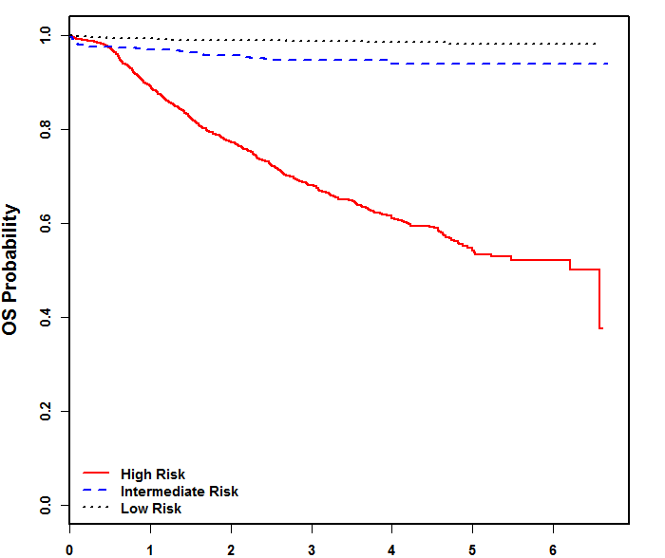
Risk stratification by prognostic factors
Low Risk
  INSS Stage 1, 2, 4s; INRGSS L1, MS
  Any age (4s/MS < 18 mos)
  No MYCN amplification
Intermediate
  INSS Stage 3, INRGSS L2
  INSS Stage 4, INRGSS M AND age < 18 months
  No MYCN amplification
  Age and histology important components of outcome
High Risk
  MYCN amplification
  INSS Stage 4, INRGSS M AND age ≥ 18 months; or 12-18 months with unfavorable histology or genomics
EFS by NBL Prognostic Group
Courtesty Children’s Oncology Group
10% of childhood cancer mortality

Slide 20
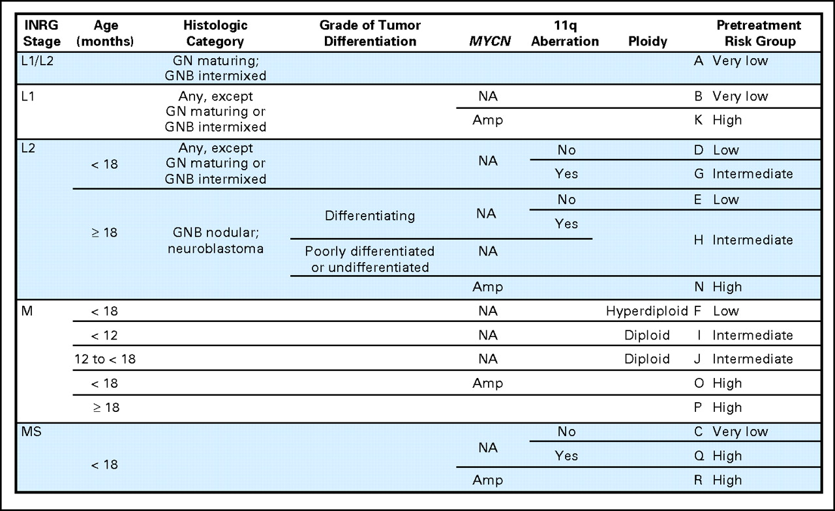
International Neuroblastoma Risk Group: Pretreatment Classification schema
Reprinted with permission. ©2009 American Society of Clinical Oncology. All rights reserved. Cohn, S et al: J Clin Oncol, Vol.27 (2), 2009: 289-297.

Slide 21
Basic Science and Pathophysiology
Epidemiology and Risk Assessment
Diagnosis
Management and Treatment

Slide 22
Clinical findings of neuroblastoma
Heterogenous disease with variable presentations
Symptoms associated with primary site of disease or nodal metastatic disease
  Neck Mass
  Abdominal Distension (35%)
  Horner syndrome (stellate ganglion)
  Genito-urinary symptoms
  Neurologic abnormalities
    Paralysis
  Hypertension
Symptoms associated with metastatic disease
  Constitutional symptoms
    Ill-appearing, fever
    malaise, irritability
    weight loss, anorexia
  Bone or Marrow metastases
    Pain: ill-defined (40%)
    Proptosis; “Raccoon Eyes”
  Respiratory distress
  Restrictive disease due to liver enlargement/mass
  Effusions (lymphatic or malignant)
  Skin nodules

Slide 23
Syndromes associated with neuroblastic tumors
Opsoclonus Myoclonus Ataxia Syndrome (OMAS)
  Occurs in approximately 4% NB diagnoses
  Myoclonic jerking and random eye movement, with or without cerebellar ataxia
  Associated with favorable NB features
  Long term neurologic and cognitive deficits, including psychomotor retardation
Kerner-Morrison Syndrome
  Tumor secretes Vasoactive Intestinal Peptide (VIP) causing intractable secretory diarrhea
  Tumor resection reduces secretion

Slide 24
Imaging modalities utilized for staging:
Evaluation of locoregional involvement and metastatic burden
Anatomic imaging: CT / MRI scan (spine)
  Primary and nodal metastatic sites
Radiolabeled metaiodobenzylguanidine (I-123 MIBG)
  Norepinephrine transporter present in 90% of neuroblastoma tumors resulting in update of MIBG
FDG PET
  Used when patient has MIBG non-avid disease
Tc99 bone scan
  Outdated; can be used at diagnosis but no longer used in evaluation of response

Slide 25
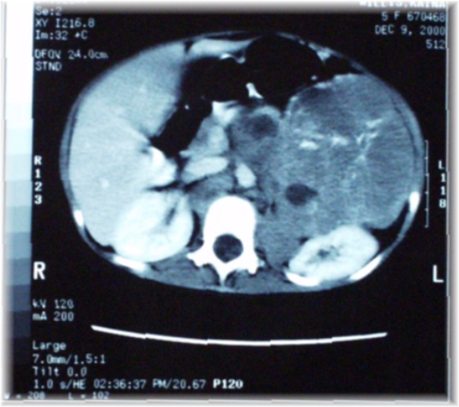
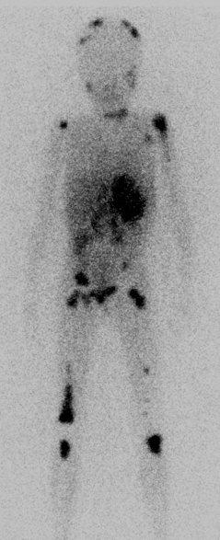
Diagnostic Imaging
CT adrenal primary
¹²³I-MIBG
FDG-PET
Images courtesy of Julie Park, MD

Slide 26
Laboratory/pathology studies:
Aid in diagnosis and risk stratification
Tumor Biopsy
  Histologic grading
  Molecular/Cytogenetic Analysis of disease
Bilateral Bone Marrow aspirate and biopsy
Serum or urine catecholamines metabolites (homovanillic acid (HVA) and vanillymandelic acid (VMA))
  Secreted by 90% of neuroblastoma tumors
  Diagnosis of neuroblastoma can be made if elevated VMA/HVA AND bone marrow pathology that is consistent with neuroblastoma
Nonspecific markers
  Neuron specific enolase (NSE), ferritin, LDH

Slide 27
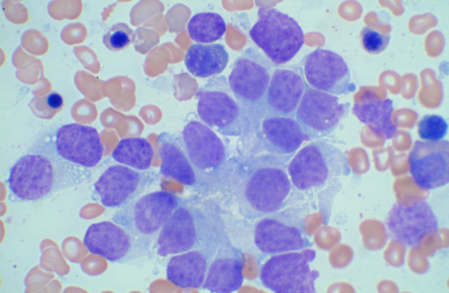
Neuroblastoma in bone marrow
Neuroblasts individually are small round cells
  Often (but not always) larger than small lymphocytes.
Cohesive clumps (5 or more cells) of various sizes and can take on polygonal shape
  HOMER-WRIGHT rosette formation
  “paving stone pattern”
Cell may also be found individually without forming clusters or nests (“leukemic pattern”)
Immunohistochemistry staining (S100, CD56, PGP9.5, NSE, synaptophysin)
Images courtesy of Julie Park, MD

Slide 28
Basic Science and Pathophysiology
Epidemiology and Risk Assessment
Diagnosis
Management and Treatment

Slide 29
LOW RISK neuroblastoma therapy
EFS/OS > 90%
Mainstay of therapy: SURGERY
  Resection without damage to normal organs
    Delayed surgery for symptomatic INSS 4s/INRGSS MS
    Complete resection not mandatory
OBSERVATION alone without biopsy
    Infants with small Stage 1/L1 adrenal tumors
    Ongoing trials to assess observation for additional non-adrenal small L1 tumors
Chemotherapy: acute life/organ threatening symptoms or recurrence
Radiation: acute life/organ threatening symptoms

Slide 30
INTERMEDIATE RISK Neuroblastoma therapy
EFS >85%/OS > 90%
SURGERY
  Upfront biopsy for genetic and histology data
  Delayed resection to achieve ≥50% reduction primary tumor size; Complete resection NOT mandatory
Response directed CHEMOTHERAPY (2 – 8 cycles)
  Vincristine, carboplatin, cyclophosphamide, doxorubicin
  Goals: ≥50% reduction of primary tumor, resolution of metastatic disease
  Longer duration if unfavorable histology, tumor SCA or tumor diploid (at least 4, up to 8 if combined with Stage 4/INRGSS M disease)
Radiation
  Reserved for acute life/organ threatening symptoms

Slide 31
HIGH RISK neuroblastoma therapy
Induction:
Multi-Agent Chemotherapy;
Stem Cell Collection;
Surgery
Consolidation:
Tandem High dose chemotherapy and autologous PBSC rescue; External Beam Radiotherapy
Post-Consolidation:
Biologic Response
Modifier (isotretinoin=RA);
anti-GD2 Immunotherapy

Slide 32
Role of biologic response modifiers in the treatment of minimal residual neuroblastoma
ANBL0032: anti-GD2 Immunotherapy
improves EFS and OS
CCG 3891: randomized trial of 13 cis Retinoic acid (RA, isotretinoin) post-consolidation therapy
Post-consolidation use of RA improved EFS compared to no therapy
RA+anti-GD2; 2 yr EFS: 66±5%
Event free survival
RA only; 2 yr EFS: 46 ±5%
Time (years) from enrollment
N Eng J Med, Yu, A, Gilman, A., Fevzi O, et al, Anti-GD2 Antibody with GM-CSF, Interleukin-2, and Isotretinoin for Neuroblastoma, Vol 363:1324-1334. Copyright ©2010 Massachusetts Medical Society. Reprinted with permission from Massachusetts Medical Society

Slide 33
Role of Myeloablative Chemotherapy/ASCT
First Defined In CCG3891
  Patients randomized to continuation chemotherapy vs. myeloablative chemotherapy and stem cell transplant (as well as a cisRA vs. no cisRA randomization)
    3-year EFS from time of randomization for chemo vs. ASCT:
      33% vs. 22% (p=0.034)
Revisited in ANBL0532
  Patients randomized to single vs. tandem transplant
    3-year EFS from start of immunotherapy for tandem vs. single:
      73% vs. 54% (p=0.004)
Matthay et al, NEJM 1999
Park et al, JAMA 2019

Slide 34
Role of surgery in the treatment of neuroblastoma
Low/Intermediate Risk Disease
  Goal: 50% reduction in primary tumor
    Achieved by chemotherapy alone OR surgery alone OR both
High risk disease
  Goal: Complete resection of primary tumor
    Preserve critical organs

Slide 35
Role of irradiation in the treatment of neuroblastoma
Low/Intermediate risk disease
  Limited to emergent management of life/organ threatening symptoms
High risk disease
  Primary tumor (2160cGy):
    volume = pre-surgical tumor + margin
    boost to residual gross tumor not found to increase local control success rates
  Metastatic soft tissue and bone:
    Sites that persist at end induction
  Timing:
    Following tandem ASCT

Slide 36
Neuroblastoma treatment strategies

Slide 37
International Neuroblastoma Response Criteria
Response | Criteria
Complete Response (CR) | No evidence of primary tumor or metastases, HVA/VMA normal
Very Good Partial Response (VGPR) | Greater than 90% reduction of primary tumor volume; no metastatases, no new bone lesions, all pre-existing lesions improved on bone scan; HVA/VMA normal
Partial Response (PR) | Fifty-90% reduction of primary tumor volume; ≥50% reduction in measurable metastases;> 50% decrease in number of bone sites; 0-1 bone marrow samples with tumor
Mixed Response (MR) | Greater than 50% reduction of any measurable lesion with, < 50% reduction in any other site; no new lesions; <25% increase in any existing lesion
No Response (NR) | No new lesions; <50% reduction but <25% increase in any existing lesion
Progressive Disease (PD) | Any new lesion or increase of a measurable lesion by >25%; previous negative marrow positive for tumor
Brodeur; J Clin Oncol 1993

Slide 38
Revised INRC based on 3 distinct components
 | PRIMARY TUMOR | METASTATIC: SOFT TISSUE/BONE | METASTATIC: BONE MARROW | OVERALL RESPONSE integrates all 3
CT/MRI (soft tissue sites) | Primary site measured using single measurement (RECIST longest dimension) | Soft tissue sites (non-continguous) measured using single LD or sum of LD (RECIST) | Morphology (Immunocytology and Biopsy)
MIBG (FDG-PET for MIBG non-avid tumors) | Separate evaluation for primary site uptake | Scored by lesions present in designated anatomic sectors
Park; J Clin Oncol 2017

Slide 39
INRC rev2
VMA/HVA levels are not incorporated into response assessment
Functional imaging (I123-MIBG or FDG-PET) incorporated to assess response in bone/bone marrow disease
Semi-quantification of bone marrow disease to assess response
Very Good Partial Response and Mixed Response no longer used
Minor Response captures response in metastatic sites but stable disease in primary tumor

Slide 40
INRC Overall Response (Revision 2)
Response | Criteria
Complete Response | All components meet criteria for CR
Partial Response | PR in at least one component and all other components are either CR, MD (Bone marrow), PR or Not involved; no component with SD or PD
Minor Response | PR or CR in at least one component but at least one other component with SD; no component with PD
Stable Disease | SD in one component with no better than SD or NI in any other component; no component with PD
Progressive Disease (PD) | Any component with PD

Slide 41
Primary Tumor Response
Response | Anatomical Imaging + MIBG (PET) Imaging
Complete Response | <10 mm residual soft tissue at primary site, AND complete resolution of MIBG or FDG-PET uptake (for MIBG non-avid tumors) (at primary site)
Partial Response | ≥30% decrease in longest dimension (LD) of primary site MIBG or FDG-PET uptake (at primary site) stable, improved or resolved
Progressive Disease | >20% increase in longest diameter, AND a minimum absolute increase of 5 mm in longest dimension
Stable Disease | Not CR, PR or PD

Slide 42
Metastatic Soft Tissue/Bone Response
Response | Anatomical Imaging + MIBG (PET) Imaging
Complete Response | Resolution of all sites of disease defined as: Soft tissue mass <10 mm AND Lymph nodes identified <15 mm, AND No MIBG uptake or FDG-PET uptake
Partial Response | ≥30% decrease in sum of diameters of non-primary lesions, AND: Non-target lesions stable or smaller in size AND No new lesions AND ≥50% reduction in MIBG absolute score or in number of FDG-PET avid lesions
Progressive Disease | New MIBG or FDG-PET avid soft tissue or bone lesion or biopsy proven; >20% increase in size AND a minimum absolute increase of 5 mm in sum of diameters of target soft tissue lesions; Relative MIBG score ≥1.2
Stable Disease | All others

Slide 43
Bone Marrow Response
Response | Cytology/Histology
Complete Response | Bone marrow with no tumor infiltration upon reassessment, independent of baseline tumor involvement
Progressive Disease | No tumor infiltration that becomes >5% upon reassessment; Tumor infiltration increases by >2 fold and has >20% tumor infiltration
Minimal Disease | ≤5 % tumor infiltration and remains >0-≤5%; No tumor infiltration that becomes ≤5%; >20% tumor infiltration that has >0-≤5%
Stable DIsease | >5% tumor infiltration that remains > 5% tumor infiltration upon reassessment but not CR, MD or PD

Slide 44
Complications and late effects of neuroblastoma treatment
Surgical:
  Organ removal or damage (renal)
  Neural damage
Radiation: organ dysfunction (renal, heart, hepatic, lungs, ovaries, pituitary, neurocognitive), altered musculoskeletal growth, infertility; secondary malignancy
Chemotherapy: Ototoxicity (platinum); Cardiac toxicity (anthracycline); Infertility (alkylator); Secondary malignancy (alkylator, etoposide)
Biologic therapy: Decreased bone density (isotretinoin)
Immunotherapy: late effects tbd

Slide 45
Pheochromocytoma and Paraganglioma (PPGLs)
Basic Science and Pathophysiology
Epidemiology and Risk Assessment
Diagnosis
Management and Treatment

Slide 46
PPGLs
Neuroendocrine tumors arising from chromaffin cells of either:
  sympathetic tissue in adrenal or extra-adrenal abdominal locations (sympathetic PPGLs)
    Aberrant secretion of norepinephrine and epinephrine
    80% adrenal medulla
    20% prevertebral and paravertebral sympathetic ganglia of the chest, abdomen, and pelvis
  parasympathetic tissue in thorax or head and neck (parasympathetic PPGLs)
    Rarely secrete catecholamines (4%)
    Arise in the neck or at the base of the skull region along the glossopharyngeal and vagal nerves
10% of pheochromocytomas and 25% of PGL are malignant

Slide 47
Molecular subtypes
Pseudohypoxia: mutations involving in overexpression of vascular endothelial growth factor (VEGF) and impaired DNA methylation leading to increased vascularization
Wnt-signaling pathway: activating mutations of Wnt-signaling pathway (Wnt receptor signaling and Hedgehog signaling)
  secondary to somatic mutations of CSDE1 (Cold shock domain containing E1) and MAML3(Mastermind like transcriptional coactivator 3) genes
Kinase-signaling pathway: abnormal activation of kinase signaling through PI3Kinase/AKT, RAS/RAF/ERK, and mTOR pathways

Slide 48
Biochemical phenotypes
Noradrenergic
  Elevated norepinephrine/normetanephrine levels; molecularly classified as molecular pseudohypoxia-related tumors
  Germline von Hippel-Lindau (VHL), succinate dehydrogenase (SDH) type A, B, C, or D, fumarate hydratase (FH), malate dehydrogenase type 2 (MDH2), and endothelial pas domain protein 1 (also known as hypoxia-inducible factor type 2A) (EPAS1/HIF2A) genes.
Adrenergic
  Secrete metanephrine; molecularly classified as kinase signaling-related tumors
  Located in adrenal
  Germline mutations in RET, NF1, or TMEM127
Dopaminergic
  Secrete dopamine with or without mild increase in norepinephrine (normetanephrine)
  Head and Neck PPGLs
  Metastatic disease, especially related to germline SDHB and SDHD mutations

Slide 49
Basic Science and Pathophysiology
Epidemiology and Risk Assessment
Diagnosis
Management and Treatment

Slide 50
Epidemiology and Risk Assessment
Rare tumor
  Annual incidence approximately 0.8 per 100,000 person-years
At least 40% associated w/ genetic predisposition (as much as 80% of pediatric patients)
  At least 20 known susceptibility genes
Genetic testing should be performed in pediatric patients
Independent risk factors for metastatic disease:
  Presence of SDHB germline mutation
  Extra-adrenal location
  Size of primary tumor > 5 cm (in SDHB-related PPGLs over 3.5 cm),
  Younger age of initial diagnosis
  Elevated 3-methoxytyramine (MT) levels
Copyright © 2019 by ASPHO

Slide 51
Basic Science and Pathophysiology
Epidemiology and Risk Assessment
Diagnosis
Management and Treatment
Copyright © 2019 by ASPHO

Slide 52
Imaging Modalities Utilized for Staging
Diagnosis based on documentation of catecholamine excess by biochemical testing and localization of the tumor by CT or MRI
Measurements of fractionated metanephrine (i.e. normetanephrine and metanephrine measured separately) in urine or plasma
¹⁸F-FDOPA or ⁶⁸Ga DOTATATE scanning is preferred functional modality for metastatic disease; or (18)F-FDG PET
  metastasize to lungs, liver, bones, and lymph nodes
(123)I-MIBG SPECT if considering MIBG therapy for metastatic disease

Slide 53
Clinical findings
Pain or nerve paralysis (head and neck)
Catecholamine release
  Classic symptom triad of headache, diaphoresis and tachycardia in the setting of hypertension.
  Hypertension is the most common sign and may be sustained or paroxysmal
  Headache occurs in up to 90% of patients
  Hypotension (excessive stimulation of beta adrenoreceptors by elevated levels of epinephrine), postural hypotension or alternating episodes of high and low blood pressure can also occur
  Anxiety, panic attacks
Copyright © 2019 by ASPHO

Slide 54
Basic Science and Pathophysiology
Epidemiology and Risk Assessment
Diagnosis
Management and Treatment
Copyright © 2019 by ASPHO

Slide 55
Treatment for localized disease
Surgical resection of the tumor
Pre-operative medical management
  antihypertensive medications, preferentially alpha- followed by beta-adrenoceptor blockade for 7-14 days to prevent perioperative cardiovascular complications
  maximize water and salt intake to maintain adequate intravascular volume
Copyright © 2019 by ASPHO

Slide 56
Treatment for metastatic disease
Metastatic or unresectable disease carries very poor prognosis
Chemotherapy (cyclophosphamide, vincristine, and dacarbazine)
Molecularly targeted therapy: sunitinib (tyrosine kinase inhibitor) and everolimus (mTOR inhibitor)
Copyright © 2019 by ASPHO

Slide 57
Role of Radioisotope therapy for Neuroblastoma and PPGLs
¹³¹I-MIBG therapy
  Used since 1980’s for treatment of relapsed and refractory NBL and PPGLs
  Several trials demonstrated safety/efficacy (mostly through NANT and COG)
  Phase 3 randomized trial evaluating upfront treatment with ¹³¹I-MIBG therapy for high-risk neuroblastoma currently enrolling
  Current focus for relapsed/refractory disease: combinations with novel agents
Lu 177 Dotatate
  Radiolabeled somatostatin analog
  FDA approved in 2018 for treatment of somatostatin receptor-positive gastroenteropancreatic neuroendocrine tumors (GEP-NETs)
    Approval based on randomized controlled trial of Lu 177 Dotatate vs. high dose long acting octreotide
      median PFS was not reached for lutetium Lu 177 dotatate and was 8.5 months in the high-dose long-acting octreotide arm

Slide 58
Thank You and Good Luck!
Questions?

