Slide 1
Wilms’ Tumor and Other Renal Tumors
Elizabeth Mullen, MD
Dana Farber Cancer Institute/Boston Childrens Hospital

Slide 2
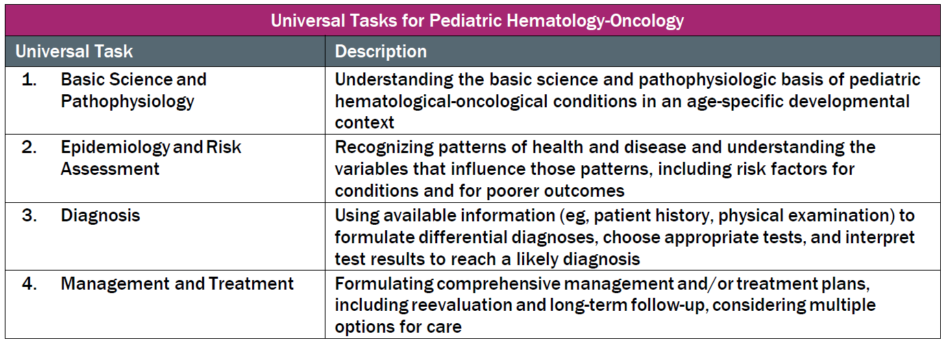
This talk will follow the topical structure suggested by the ABP:

Slide 3
Overview
Renal tumors represent 6-7% of all childhood cancers (stable incidence)
In North America, approximately 500-600 pediatric patients per year are diagnosed with renal tumors
Incidence of tumor type varies with age at diagnosis
  Vast majority are Wilms Tumor (80 – 90%)
  Other pediatric renal tumors include:
    Clear Cell Sarcoma of the Kidney (CCSK)
    Renal Cell Carcinoma (RCC)
    Malignant Rhabdoid Tumor of the Kidney (MRTK)
    Congenital Mesoblastic Nephroma (CMN)
    Cystic Nephroma (CN)

Slide 4

Histologic Distribution of First 4000 Patients enrolled on COG protocol AREN03B2

Slide 6
Wilms Tumor
Basic Science and Pathophysiology
Epidemiology and Risk Assessment
Diagnosis
Management and Treatment

Slide 7
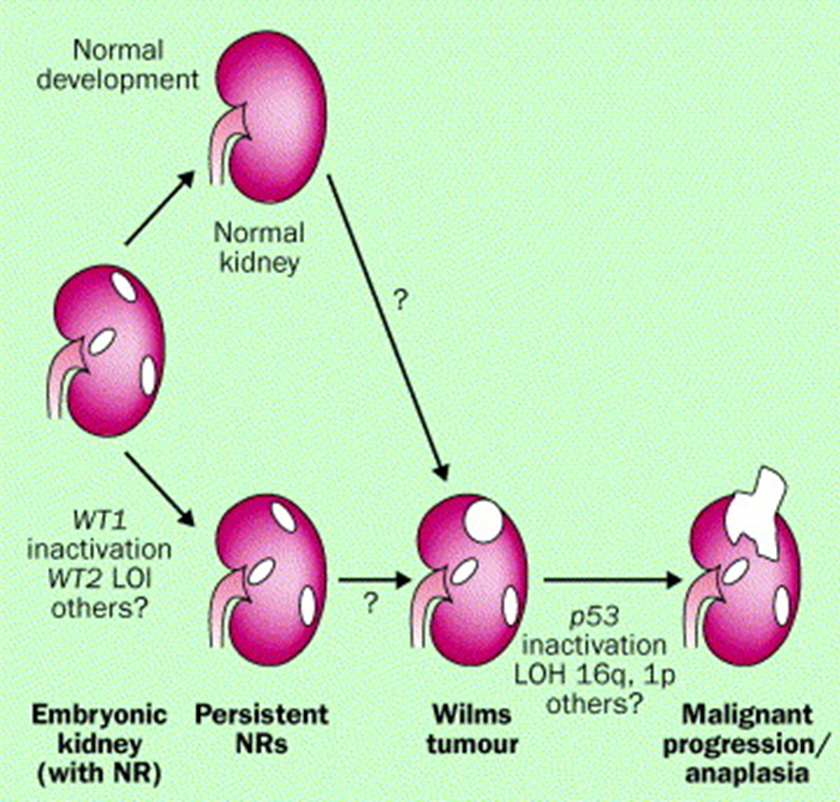

Tumorogenesis and Organogenesis
Model of nephrogenic rests, genetic alterations and tumorogenesis
The study of the histology and genetics of WT has led to increased understanding of the relationship of organogenesis and tumorogenesis
The histologic morphology of WT reflects the phases of normal nephrogenesis, microscopically resembling developing embryonic renal tissue
Important histologic entities include anaplasia, and nephrogenic rests
Reproduced with permission from Kalapurakal JA, Dome JS, Perlman EJ, et al. Management of Wilms' tumour: current practice and future goals. Lancet Oncol. 2004 Jan;5(1):37-46. © 2004 Elsevier Ltd. All rights reserved.

Slide 8
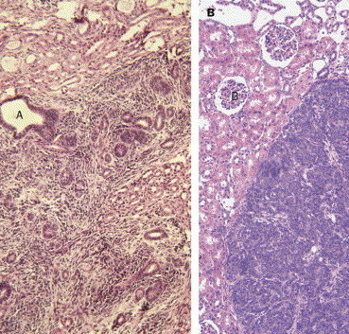
Nephrogenic Rests
Histologically defined as:
  The persistence of foci of embryonic renal tissue seen after the period of normal nephrogenesis
    “Residual islands of immature kidney tissue locked in a state of continual proliferation”*
  Seen in 30 – 40% of kidneys resected for WT
    Further described by position within the kidney – both in histology and radiology
      A Intra lobar
      B Peri lobar
*Reddy and Licht 1996
Images reproduced with permission from Kalapurakal JA, Dome JS, Perlman EJ, et al. Management of Wilms' tumour: current practice and future goals. Lancet Oncol. 2004 Jan;5(1):37-46. © 2004 Elsevier Ltd. All rights reserved.

Slide 9
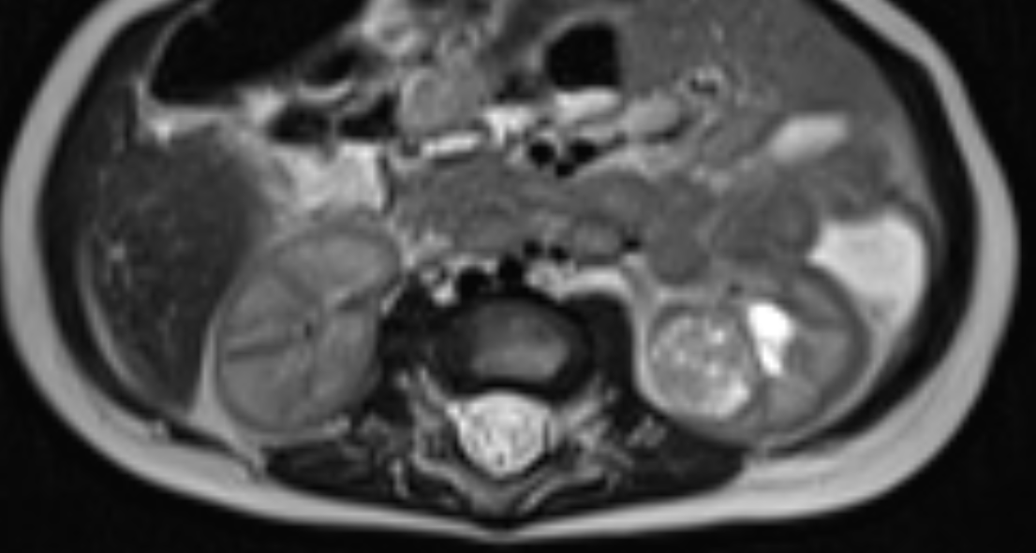
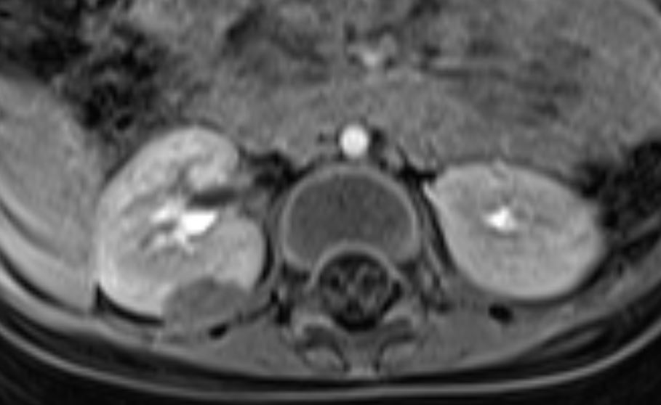
Nephrogenic Rests
  Intralobar rests
  Randomly distributed within cortex and medulla of kidney, irregular margins, stromal rich
  Increased rate of progression to WT, associated with WT1 mutations (DDS and WAGR)
  Perilobar rests
  Mostly subcapsular, sharply demarcated and contain largely tubules and blastemal elements
  Seen in sporadic tumors, associated with BWS, hemihypertrophy and genetic/epigenetic dysregulation at 11p15
From Lancet Oncology (5) 2004
Intralobar
Perilobar
Images from Imaging Characteristics of Nephrogenic Rests Versus Small Wilms Tumors: A Report From the Children's Oncology Group Study AREN03B2, by Sandberg JK, et al, AJR Am J Roentgenol, 2020 May;214(5):987-994. doi: 10.2214/AJR.19.22301. PMID: 32160052. © 2020 of The American Roentgen Ray Society.
Notes:
American Journal of Roentgenology. 2020;214: 987-994. 10.2214/AJR.19.22301
Read More: https://www.ajronline.org/doi/10.2214/AJR.19.22301
there are images from a paper on which I am an author – it appropriate I can ask senior author Geetika Khanna for permission, I believe these are from her files

Slide 10
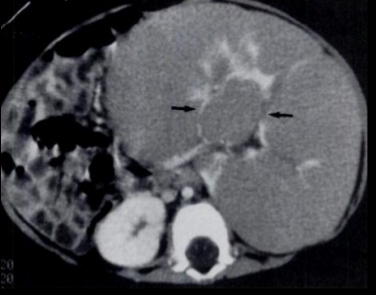
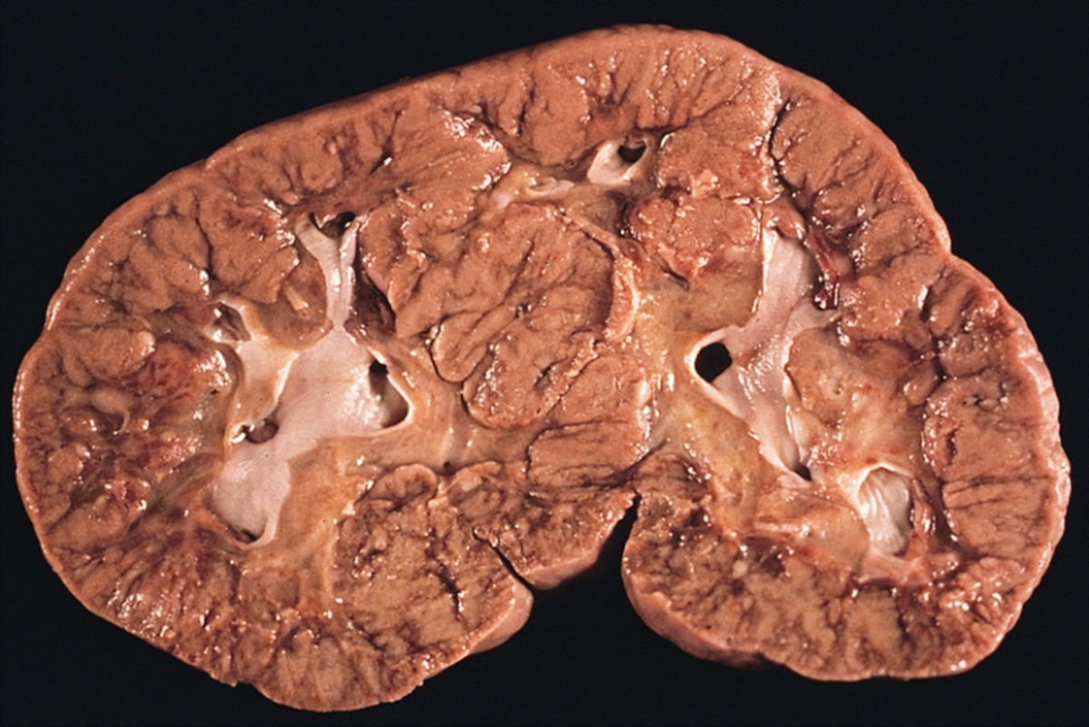
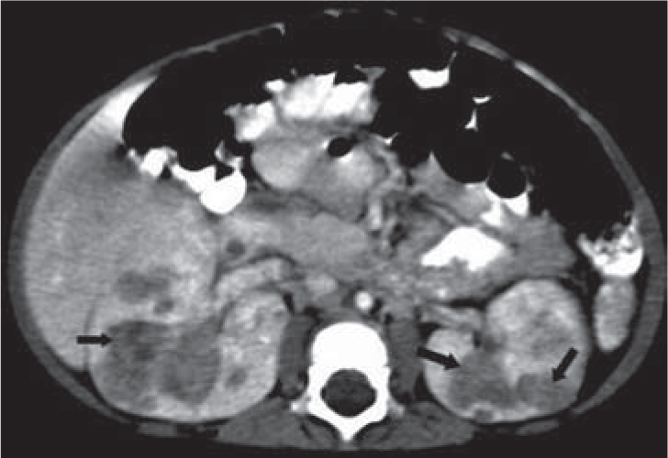
Nephroblastomatosis
  Multifocal or diffuse nephrogenic rests
  Can be perilobar or intralobar
  A. Diffuse hyperplastic perilobar nephroblastomatosis (DHPLN)
    Pre-neoplastic proliferative process associated with high risk of developing WT
    Usually bilateral, can be unilateral
    DHPLN has distinct radiologic and histologic appearance, with thick cortical rim of hyperplastic nephrogenic tissue
B. Diffuse Intralobar NR
https://commons.wikimedia.org/wiki/File:Nephroblastomatosis.jpg
From Moore S., Wieselthaler N. (2010) Nephroblastomatosis. In: Andronikou S., Alexander A., Kilborn T., Millar A.J.W., Daneman A. (eds) ABC of Pediatric Surgical Imaging. Springer, Berlin, Heidelberg. https://doi.org/10.1007/978-3-540-89385-1_50. (c) 2010 by Springer Nature. Reproduced with permission.
DHPLN
Notes:
Image upper left – net
https://www.bing.com/images/search?view=detailV2&ccid=xSpnsM7d&id=43C91D4125113C7AD66E48CC15119AB41B3EF706&thid=OIP.xSpnsM7dH1T7zu6_ab2ZYAHaFj&mediaurl=https%3a%2f%2fimage.slidesharecdn.com%2fnephroblastomatosis-150223053009-conversion-gate02%2f95%2fnephroblastomatosis-19-638.jpg%3fcb%3d1424669564&exph=479&expw=638&q=images+diffuse+hyperplastic+nephroblastomatosis&simid=608037545630630377&ck=DDEECAA6B202EDE33F8100EB4C86EC72&selectedIndex=14&qpvt=images+diffuse+hyperplastic+nephroblastomatosis&FORM=IRPRST&ajaxhist=0
Wikimedia nephroblastomatosis.jpg (lower left gross path image)
Upper left
If needed, I can supply image from personal patient files.

Slide 12
Wilms Tumor Genetics
Despite the early identification of WT1 as classic tumor suppressor gene, the genetic driver of many Wilms tumor are unknown. Heterogeneity in genetic etiology is reflective of pathologic and clinical heterogeneity.
The TARGET* initiative identified distinct biologic subsets of WT through comprehensive studies into genetic mutations, gene expression and methylation analysis
  Most WT have evidence of IGF2 overexpression without WNT activation or WT1 loss
  Many tumors have alterations in more than one pathway
  Recurrent alterations in several genes have been identified
    TRIM29, Let 7, Lin28, DROSHA, CACNA1E, SKCG-1,MYCN,TP53,PTCH1,DICER1
WT1, WT2 and WTX mutations occur most frequently
*Therapeutically Applicable Research to Generate Effective Treatments
Gadd et al. A COG and TARGET Initiative Exploring the Genetic Landscape of Wilms Tumor Nat Genet 2017 Oct; 49 (10):1487-1494
Notes:
A Children's Oncology Group and TARGET Initiative Exploring the Genetic Landscape of Wilms Tumor
Nat Genet Actions
Search in PubMed
Search in NLM Catalog
Add to Search
. 2017 Oct;49(10):1487-1494.
doi: 10.1038/ng.3940. Epub 2017 Aug 21.

Slide 13
Wilms Tumor Genetics
WT1
  Ch11p13
  Transcription factor that regulates expression of genes involved in cell growth, differentiation and apoptosis.
  Classic tumor suppressor gene, requires los of both alleles for tumor development (but alterations to one allele may contribute to abnormal cell growth)
  Found in 15% of WT
  Incidence of germline mutations ≈ 10%
    WAGR syndrome, Denys-Drash syndrome or Frasier syndrome
    Genitourinary anomalies, including hypospadias and cryptorchidism
  Associated with:
    Bilateral Wilms tumor
    Unilateral Wilms tumor with nephrogenic rests in the contralateral kidney
    Stromal and rhabdomyomatous differentiation.
WT1
15%

Slide 14
Wilms Tumor Genetics
  WT2
    Chromosome 11p15
    WT are initiated by mutations of IGF2 and H19 genes
    Alterations result in overexpression of IGF2
    Found in 30% of WT
    Incidence germline mutations ≈ 8%
    Beckwith-Wiedemann syndrome – occurs due to several aberrations within 11p15
    Can also have germline epigenetic or genetic changes at the 11p15.5 without any overgrowth manifestations
WT2
30%

Slide 15
Wilms Tumor Genetics
WTX (AMER1)
  Xq11.2
  Mutations or deletions in WTX have been reported in up to 30% of WT.
  WTX inhibits WNT pathway through interactions with beta-catenin
  Activating mutations of CTNNB1, central effector of WNT signaling pathway have been identified in 15% of WT.
  WTX also plays a role in normal kidney development
WTX
30%

Slide 16
Wilms Tumor Genetics
MicroRNA processing Genes
  Somatic mutations occur in 10-15% of WT
  DROSHA most common, result in reduced expression of Let-7 family of miRNAs
  Less common, DCGR8, DICER1, XPO5 and TARBP2, SIX1 and SIX2
TP53
  Found in anaplastic WT
  With comprehensive assessment of TP53 status (IHC, sequencing, deletion analysis almost all WT with anaplasia have evidence of TP53 alteration
  Thought to be a secondary event in genetic progression of WT
Other
25%

Slide 18
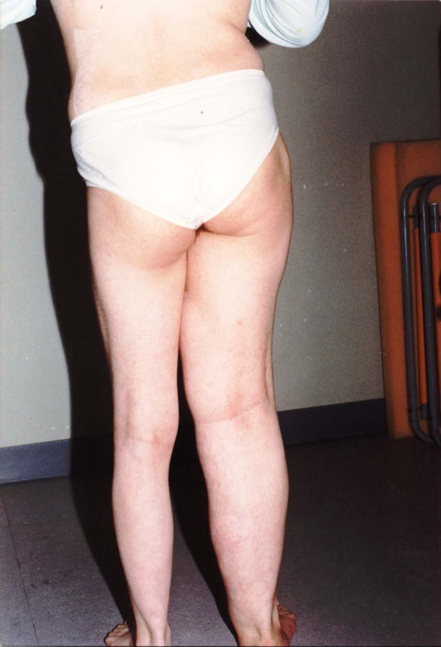
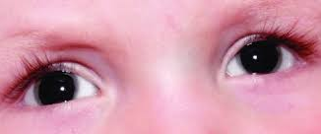
Genetic syndromes associated with Wilms Tumor
Left: From Pikilidou M, Yavropoulou M, Katsounaros M. Recurrent benign adrenal pheochromocytomas associated with hemihypertrophy. Endocrinol Diabetes Metab Case Rep. 2014;2014:140041. This image is licensed under a Creative Commons Attribution-NonCommercial-NoDerivs 3.0 Unported License.
Notes:
Aniridia image
https://www.google.com/imgres?imgurl=https%3A%2F%2Fwww.researchgate.net%2Fprofile%2FShilpa_Bisht%2Fpublication%2F318742859%2Ffigure%2Ffig2%2FAS%3A667765178380306%401536219033894%2FBilateral-Congenital-Aniridia-condition-caused-by-mutation-in-PAX6-gene.png&imgrefurl=https%3A%2F%2Fwww.researchgate.net%2Ffigure%2FBilateral-Congenital-Aniridia-condition-caused-by-mutation-in-PAX6-gene_fig2_318742859&tbnid=ds0GvD2xqg3mzM&vet=12ahUKEwijpf-p3cbsAhVBCN8KHc-cBQcQMygPegUIARDqAQ..i&docid=LMizhpVcPSg2OM&w=714&h=263&q=image%20aniridia&ved=2ahUKEwijpf-p3cbsAhVBCN8KHc-cBQcQMygPegUIARDqAQ
https://www.ncbi.nlm.nih.gov/pmc/articles/PMC4120361/figure/fig1/
Substitution for hemihypertrophy from suggested source, pubmed search

Slide 19
Phenotype | Genetic Alterations WT2 11p15 | Estimated Risk
Beckwith-Wiedemann Syndrome Overgrowth syndrome Associated with exomphalus, omphalocoele, macroglossia, macrosomia, neonatal hypoglycemia, visceromegaly, hemihyperplasia, high IGF2 expression and cancer predisposition | 11p15 uniparental disomy (pUPD11) | 8%
 | Hypermethylation of 11p15 imprinting center 1 (IC1) | 24%
 | Loss of Methylation of 11p15 imprinting center 2 (IC2) | 1%
 | CDKN1C mutation | 1-2%
 | No molecular findings | 4-5%

Slide 20
Phenotype | Genetic Alterations – WT-1 (11p13) | Estimated Risk
WAGR Syndrome Wilms Tumor, Aniridia, GU abnormalities, range of intellectual disability | WT1 deletion | 50%
Denys-Drash Syndrome Progressive renal disease, pseudohermaphrodism
 | WT1 missense mutations | >70%
Frasier Syndrome Focal segmental glomerulosclerosis, male gonadal dysgenesis | WT1 intron 9 splice site | Rare
Isolated WT | WT1 missense/nonsense mutations | 5%

Slide 21
Phenotype | Genetic Alterations | Estimated Risk
Simpson-Golabi-Behmel syndrome Overgrowth syndrome | X-linked inheritance GPC3 | 5-10%
Perlman Renal hamartomas, nephroblastomatosis, fetal gigantism | Autosomal inheritance DIS3L2 | >60%
PIK3C-A Related Overgrowth Syndromes Overgrowth syndrome | PIK3CA (mosaicism) | uncertain
Mosaic Variegated Aneuploidy Intrauterine growth retardation, microcephaly | BUB1B TRIP13 | >25%
Bohring-Opitz Syndrome Microcephaly, facial anomalies, intrauterine growth retardation | ASXL1 | 7%

Slide 22
Phenotype | Genetic Alterations | Estimated Risk
Fanconi anemia Multiple cancers | Biallelic BRCA2 mutation (FA D1) Biallelic PALB2 mutation (FA N) | >20% 40%
DICER1 Syndrome Cystic nephroma, PPB, WT | DICER1 | Infrequent
Li Fraumeni Syndrome Multiple cancers, anaplastic WT | TP53 | Infrequent
Familial WT | Various genes – TRIM28, FBXW7, REST, CTR9, NYNRIN KDM3B | Uncertain

Slide 24
Wilms Tumor
Basic Science and Pathophysiology
Epidemiology and Risk Assessment
Diagnosis
Management and Treatment

Slide 25
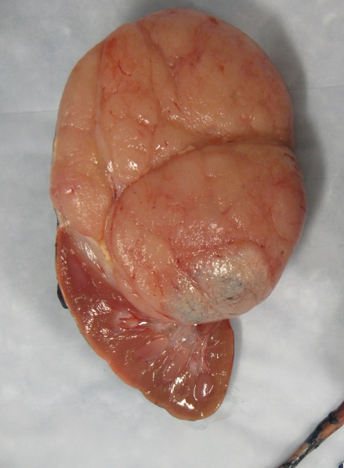
Epidemiology: Wilms Tumor
7.1 cases/1 million < 15 years; 500 cases in US annually
Represent the vast majority of pediatric renal tumors
Incidence varies by age.
Ethnic and international variations in incidence are reported
  Highest in Blacks, lowest in Asian children
Female predominance, especially for bilateral

Slide 26
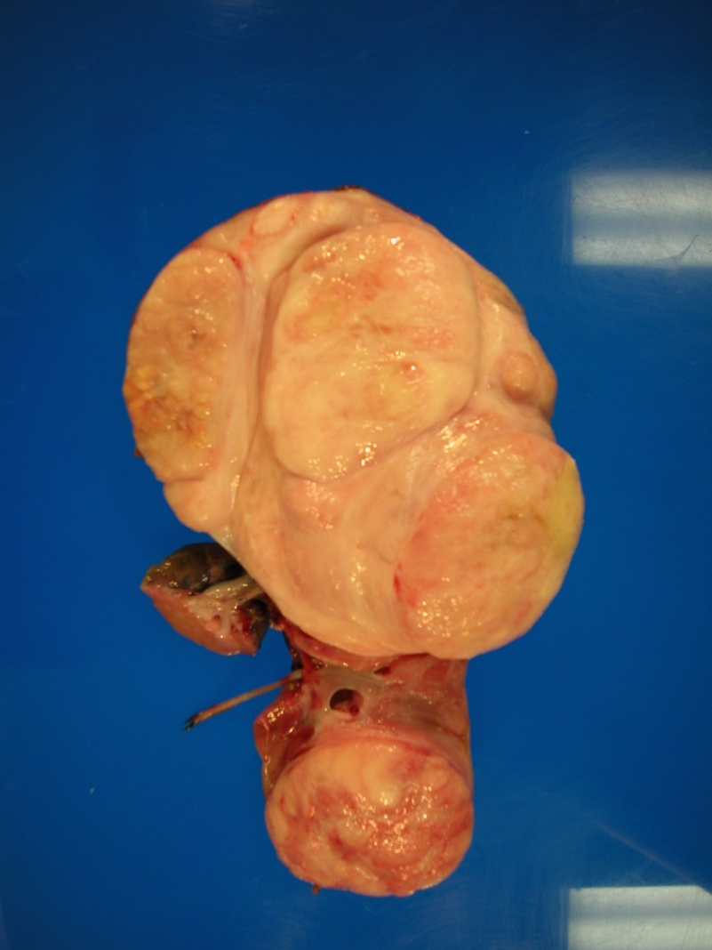
Epidemiology: Wilms Tumor
Median age diagnosis:
  43 months for girls, 37 months for boys
5-10% are bilateral, and present at a younger age:
  32 months for girls, 24 months for boys
10% present as multifocal loci in solitary kidney

Slide 27
Risk Assessment – Risk Stratification Factors
Histology
  Key initial risk stratification factor.
  95% of WT are FHWT, only 5% of WT are anaplastic
Stage
  Tumors are staged “locally” – abdominal - and overall
Other Factors
  Patient age
  Tumor weight
  Tumor genetics (LOH of 1p, LOH of 16q, Gain of 1q, 11p15 LOH)
  Underlying predisposition syndromes
  Resolution of pulmonary lesions

Slide 29
Wilms Tumor Histologic Appearance
B
A
95 % of WT are Favorable Histology
Classic histology of FHWT is triphasic:
  Epithelial component - resembling glomeruli (A)
  Blastemal component - resembling condensing nephrogenic mesenchyme (B)
  Stroma (C)
C
C
A
B

Slide 30
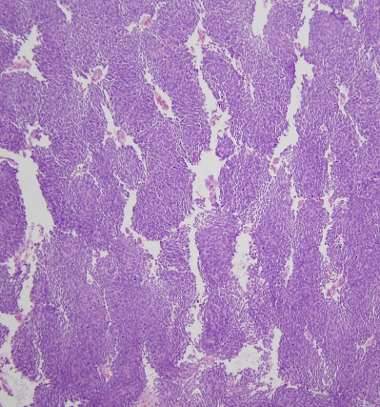
A
B
C
D
Tumors can consist of varying proportions of each cell types
  Subtypes can have therapeutic and prognostic significance
  Tumors can be monophasic or biphasic
    Epithelial predominant (A)
      Often smaller tumors in younger patients
    Blastemal predominant (E,F))
      Post-chemotherapy higher risk pathology
    Predominant stromal or rhabdomyomatous component. (D)
      These tumors often show little
      decrease in size with chemotherapy
    Heterologous (B,C)
      Elements of fat or cartilage
E
F

Slide 31
Nephrogenic rests versus Wilms tumor
NR
Normal kidney
Nephrogenic rests are distinguished
from Wilms Tumor in part by evolution
from normal kidney tissue for NR,
distinct capsule for WT
WT
WT
NR
NR

Slide 32
Anaplasia
Diagnostic Criteria of Anaplasia:
  Nuclei with diameters > 3 X diameter of adjacent tumor cells
  Hyperchromasia of enlarged cells, indicating increased chromatin content
  Presence of multipolar, polypoid or bizarre mitotic figures
  Can be Focal or Diffuse
  Associated with p53 mutations and expression

Slide 33
SIOP Post Chemotherapy
Histologic Risk Classification
Low Risk | Completely necrotic tumor Cystic partially differentiated nephroblastoma
Intermediate Risk | Epithelial, stromal, mixed or regressive type Focal Anaplasia
High Risk | Blastemal predominant ( > 66% of viable tumor) Diffuse Anaplasia

Slide 34
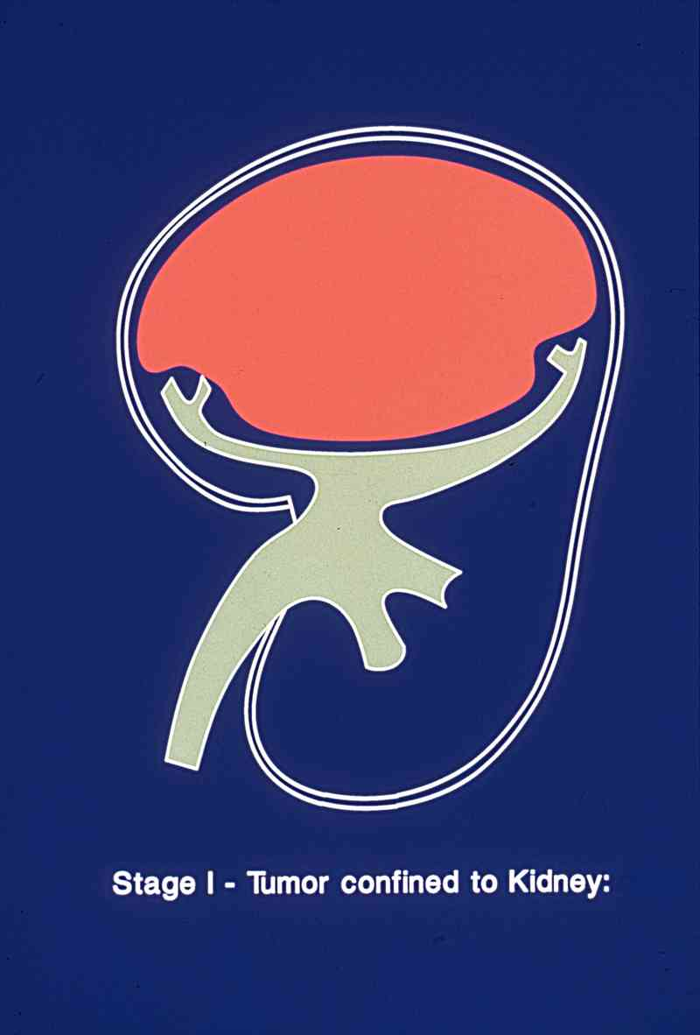
Stage I: Confined to the Kidney
Tumor is limited to the kidney and is completely resected.
The renal capsule is intact.
The tumor is not ruptured or biopsied before being removed.
No involvement of renal sinus vessels.
All lymph nodes sampled are negative.
Image courtesy of Susan Cohn

Slide 35
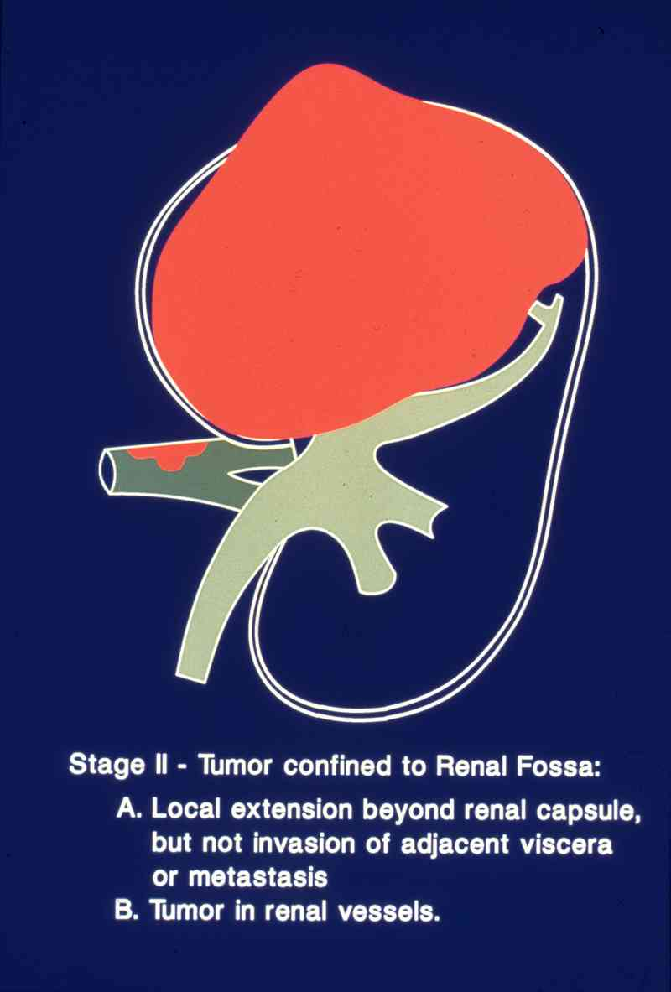
Stage II: Confined to the Renal Fossa
Completely resected tumor including enbloc resection of vascular extension.
There is regional extension of the tumor (i.e., penetration of the renal sinus capsule, or extensive invasion of the soft tissue of the renal sinus, extension into blood vessels outside of renal parenchyma).
All lymph nodes sampled are negative.
Image courtesy of Susan Cohn

Slide 36
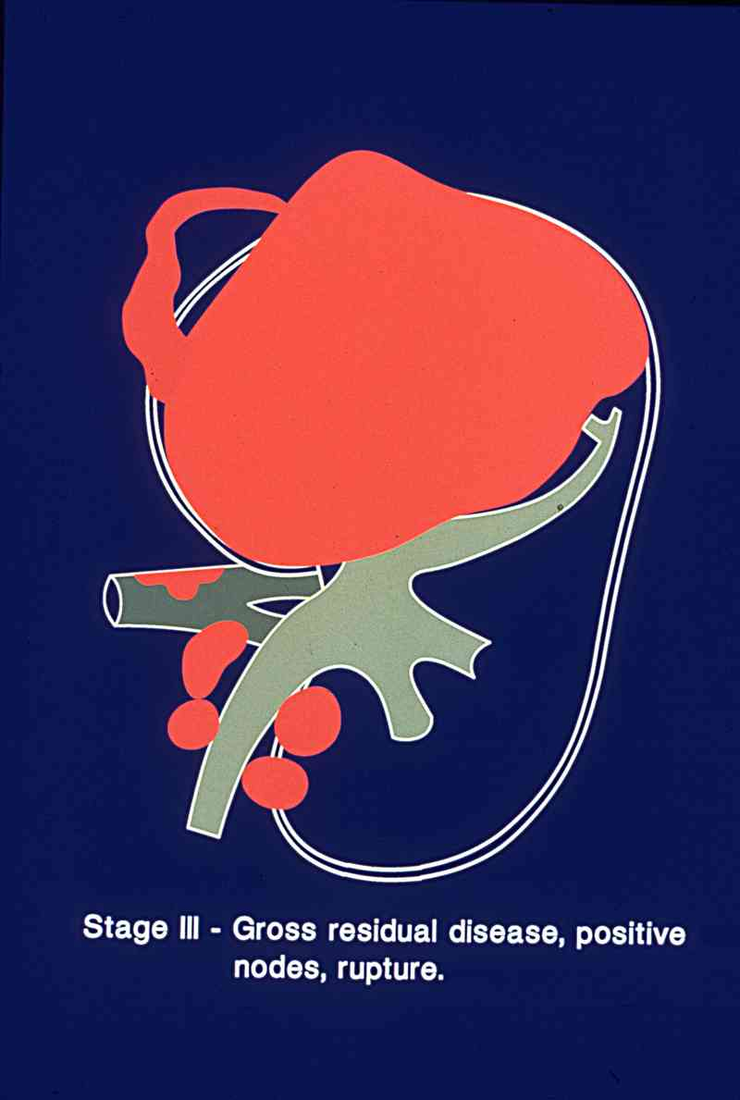
Stage III: Microscopic or Gross Residual Disease in Abdomen
Residual non-hematogenous spread after surgery, confined to the abdomen
Lymph nodes in the abdomen or pelvis are involved by tumor.
The tumor penetrated through the peritoneal surface or peritoneal implants.
The tumor is not completely resectable, spills/ruptures
Gross or microscopic tumor remains (positive margin)
Tumor is treated with pre-operative chemotherapy, with or without biopsy
The tumor is removed in more than one piece (e.g., a tumor thrombus in the renal vein is removed separately from the nephrectomy specimen).
Image courtesy of Susan Cohn

Slide 37
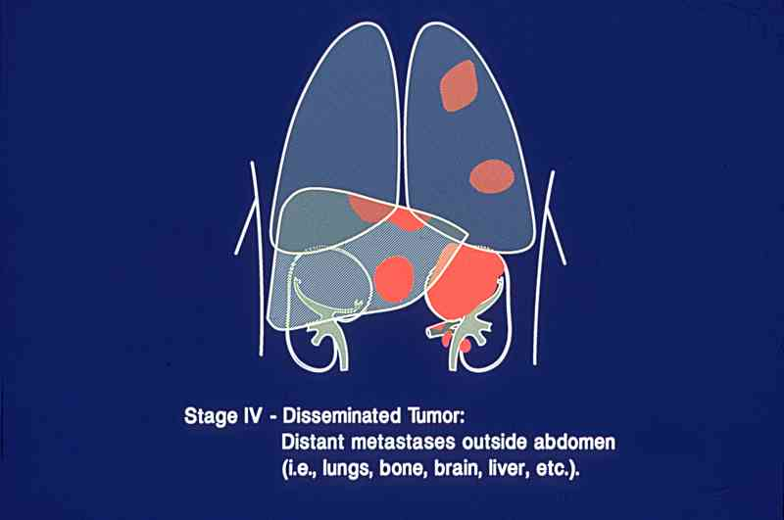
Stage IV: Disseminated Tumor
Hematogenous tumor spread
  Lungs, liver, bone, brain
Lymph node metastases outside the abdominopelvic region (mediastinal or cervical)
Image courtesy of Susan Cohn

Slide 38
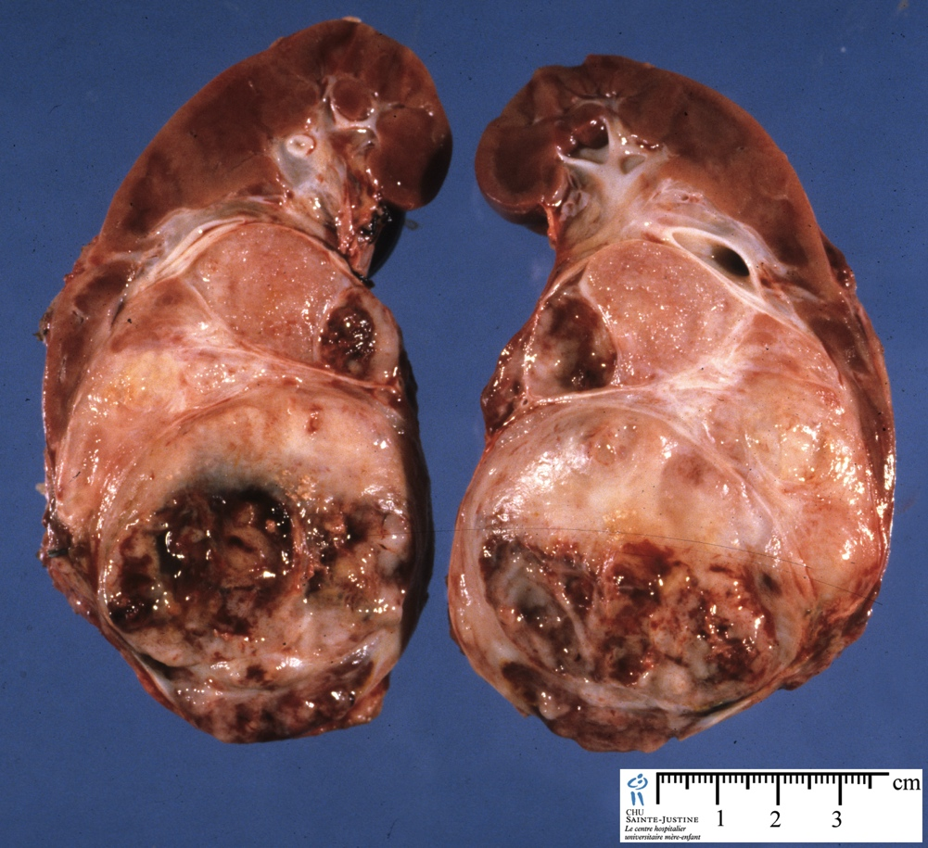
Stage V: Bilateral Tumor Involvement
Occurrence of tumors on both kidneys
  Synchronous
  Metachronous
5-10% of Wilms Tumor
Can be challenging or impossible to distinguish between small WT and NR
More common with nephroblastomatosis or associated congenital malformations
Patients with unilateral tumor and underlying predisposition characterized as “Bilaterally Predisposed”

Slide 39
SIOP Staging: Post-chemotherapy

Slide 40


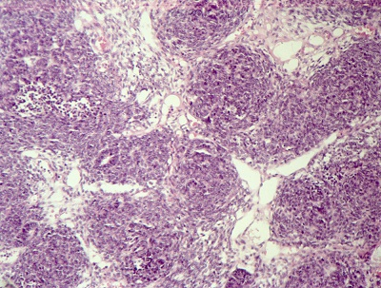
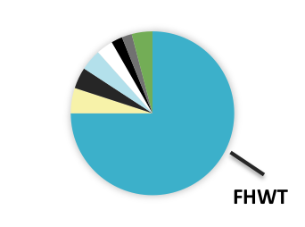
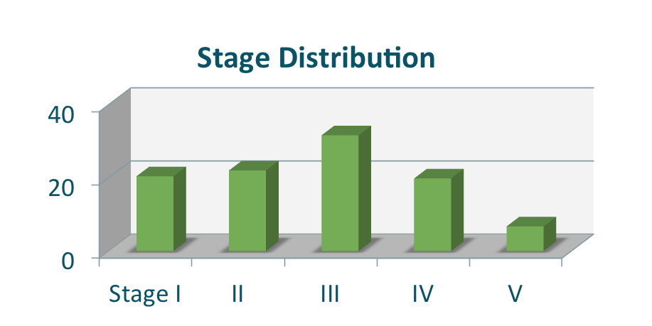
Favorable Histology Wilms Tumor (FHWT)
2742 patients (75%)
53.8%
46.2%
Mean Age at Presentation 3.9 years
(median 3.3, range 29.7)
%

Slide 41
Wilms Tumor
Basic Science and Pathophysiology
Epidemiology and Risk Assessment
Diagnosis
Management and Treatment

Slide 42
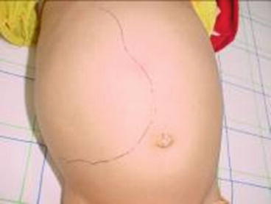
Clinical presentation of renal tumors
Usually presents as an asymptomatic upper abdominal mass noted by caregiver
Abdominal pain (40%)
Fever (20-30%)
Anemia (from bleeding into tumor) – can be severe and life threatening
Gross hematuria (from tumor extension into the renal pelvis) (25%)
Hypertension (from distortion of renal vasculature, renin excretion) (25%)
Can present with acquired von Willebrand’s disease ( < 10%)
Notes:
https://www.bing.com/images/search?view=detailV2&ccid=mlURs5ci&id=3D483DA78D0099A1105A9535A8AA10EC8E5FA168&thid=OIP.mlURs5cira5692fCGs9BzAAAAA&mediaurl=https%3a%2f%2fi2.wp.com%2fobgynkey.com%2fwp-content%2fuploads%2f2017%2f06%2fA320195_1_En_8_Fig1_HTML.jpg%3fw%3d960&exph=278&expw=368&q=image+physical+exam+asymptomatic+abdominal+mass+wilms+tumor&simid=608027250461969303&ck=0959367B45A1291EF11113A6328E293F&selectedIndex=0&FORM=IRPRST&ajaxhist=0
I can likely find another image, from patient files (de-identified) or can remove

Slide 43
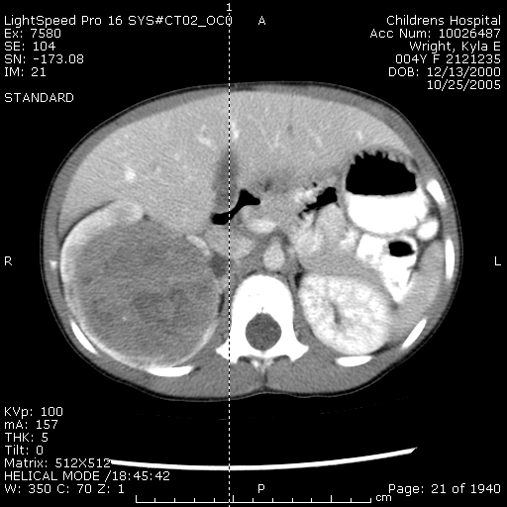
Diagnosis
In most instances, initial diagnostic study is ultrasound
Once renal mass identified, cross sectional imaging of abdomen, and in most cases, chest indicated*. MRI may be helpful in identification of bilateral lesions
Classic imaging finding of Wilms Tumor
“claw sign”
Chest CT is important in the detection
of small pulmonary lesions not seen on CXR
*unless renal tumor believed to be benign

Slide 44
Diagnosis – Assessment of Risk Stratification
Evolution over time
NWTS
1 & 2
NWTS
3 & 4
NWTS 5
COG
Stage
Stage
Histology
Stage
Histology
Age
Tumor Weight
Stage
Histology
Age
Tumor Weight
LOH 1p/16q
Lung Nodule Response
Bilateral/ predisposition
AREN03B2
AREN0532
AREN0533
AREN0534
AREN0321
Adapted with permission from Jeff Dome, MD, PHD

Slide 46
Wilms Tumor
Basic Science and Pathophysiology
Epidemiology and Risk Assessment
Diagnosis
Management and Treatment

Slide 47
Survival Rates for Wilms Tumor
Survival %
(approximate)
NWTS/COG/SIOP
Impact of Multimodality therapy: surgery, chemotherapy and radiation therapy
Slide adapted with permission of Jeff Dome MD, PhD

Slide 48
Treatment of Stage I – IV Favorable Histology WT
This review will focus largely on standards of therapy according to NWTS/COG therapeutics studies, which advocate an approach of upfront nephrectomy whenever feasible
Pros – immediate removal of bulk disease, establishment histologic diagnosis and appropriate therapy, full upfront tumor staging, use of tumor biology to guide therapy
  For patients where upfront nephrectomy is not possible (surgical assessment of risk, including factors of size of tumor > 14 cm associated with intra-op rupture, invasion into contiguous organs, tumor thrombus in the IVC above the level of the hepatic veins, obvious pre-op rupture on imaging, respiratory compromise from burden of pulmonary disease) - tissue diagnosis by biopsy is required.
  Fine needle aspirate is not recommended. Goals of biopsy are both accurate histologic diagnosis, and to obtain sufficient tissue for biologic studies used to guide therapy. Core and open biopsy have different pros and cons.
  .

Slide 49
Treatment of Stage I – IV Favorable Histology WT
SIOP strongly advocates pre-nephrectomy chemotherapy for children with renal tumors, most often without tissue diagnosis prior to starting therapy
  Based on premise that vast majority of pediatric renal tumors are WT.
  Advocate therapy for all localized tumors two drug chemotherapy (VA), with 3 drug therapy for metastatic disease (VAD)
  Advantage – SIOP advocate lower incidence of surgical complications, less rupture, possible role of down staging, ability to base therapy off response to chemotherapy with post-chemotherapy histology risk stratification system. Advocate no biopsy due to risk of tumor spread through biopsy.
  Upfront nephrectomy recommended for children > 1 year of age, children > 10 years.
Both approaches have achieved excellent outcomes in all stages of FHWT.
Overarching principles of continued therapeutic trials in WT are to maintain or improve survival while minimizing acute and late toxicities

Slide 50
Standards of Care –Therapy
Very Low Risk FHWT
  Criteria for enrollment on Very Low Risk Arm of COG AREN0532
    Stage I, FHWT
    Confirmed negative lymph node sampling
    Tumor weight < 550gms
    Patient age < 2 years
    Exclusions
      Known predisposition syndrome
      Multicentric Tumor
      Contralateral nephrogenic rests
http://meetinglibrary.asco.org/content/110480?media=vm

Slide 52
Very Low Risk - Outcomes
Strategy of observation only for this group was successful
  4 yr EFS 89.7%, OS 100%
Strong association with risk of relapse with LOH/LOI of 11p15
  20% with LOH of 11p15 had relapse
  25% of LOI of 11p15 had relapse
No association of relapse with
  LOH 1p (n=3), 16q (n=7), 1q gain (n=5), WT1 mutation (n= 12), histologic subtype or presence of nephrogenic rests
  Clinical Outcome and Biological Predictors of Relapse After Nephrectomy Only for Very Low-risk Wilms Tumor: A Report From Children's Oncology Group AREN0532. Fernandez CV, Perlman EJ,et al. Ann Surg. 2017 Apr;265(4):835-840.

Slide 53
Very Low Risk - Outcomes and Standard of Care
Very short time to relapse - Median 4.2– 43 mo)
Salvage therapy with DD4A and XRT were shmo (2.2 own to be effective, but do involve intensification of therapy over EE4A
  Future directions include refinement and expansion of observation only cohort
    Exclusion of patients with unfavorable biology
      LOH and LOI of 11p15, LOH of 1p, 16q, 1q gain
    Elimination of weight criteria, Expansion to age 4
  Conclusion: Based on results of COG AREN0532 study, for patients meeting criteria for Very Low Risk WT, Observation only after surgery is recommended
EE4A, Vincristine/actinomycin remains a reasonable alternative

Slide 55
Standards of Care –Therapy Low Risk FHWT
  Stage I and Stage II FHWT without LOH of 1p and 16q are classified as Low Risk
    This patient group was not studied on COG therapeutic trials
  NWTS data demonstrated a 4 yr EFS of 91.4 and OS of 98.4 for Stage I and II FHWT patients without combined LOH of 1p/16q
Standard of care is EE4A therapy, 19 weeks of vincristine/actinomycin therapy after upfront nephrectomy
Impact of alteration of therapy for finding 1q gain in this group subject of future study

Slide 57
Standards of Care – Stage III FHWT
Stage III patients treated as Standard Risk on COG protocol AREN0532
Patients were treated with DD4A chemotherapy:
  25 weeks of vincristine, actinomycin and doxorubicin, + flank/whole abdomen XRT
  Patients with finding of LOH of 1p and 16, or anaplasia at delayed nephrectomy were removed from protocol therapy.
Patients had an 4 yr EFS of 88% and OS 97% - therefore DD4A + XRT is standard of care therapy for these patients
  Fernandez et al, Outcome and Prognostic Factors in Stage III Favorable Histology Wilms Tumor: A report from the Children’s Oncology Group, JCO

Slide 58
Factors associated with relapse on AREN0532
STANDARD RISK patients Factor | N | 4 yr EFS | P value EFS | 4 yr OS
Lymph nodes negative | 237 | 95% | <0.01 | 98%
Lymph nodes positive | 152 | 83 |  | 95
LOH neither | 382 | 92% | <0.01 | 97
LOH 16q | 99 | 83 |  | 97
LOH 1p | 56 | 74 |  | 93

Slide 59
Factors associated with relapse on AREN0532
STANDARD RISL patients Factor | N | 4 yr EFS | 4 yr OS
Lymph nodes negative + LOH 1p or 16q positive | 69 | 86% | 97%
Lymph nodes negative + LOH 1p and 16 negative | 168 | 98* | 99
Lymph nodes positive + LOH 1p or 16q positive | 43 | 74%* | 91
Lymph nodes positive + LOH 1p and 16q negative | 109 | 87 | 97
EFS p < 0.01,
OS p = 0.26

Slide 60
Stage III WT FH - Future Directions
Further risk-based stratification strategies on future trials:
  Higher risk patients (biology, lymph nodes, post-chemo blastemal histology– intensification of chemotherapy
  (regimen M or new regimen MVI)
  Lower risk patients (negative lymph nodes, no negative biologic risk factors, necrotic or intermediated post-chemo histology) – reduction in chemotherapy
  (omit doxorubicin)

Slide 62
Stage IV Favorable Histology Wilms Tumor*
NWTS V Treatment
  VCR, Dactinomycin, Doxorubicin (Regimen DD-4A)
  XRT (1200cGy) to lungs + XRT (1080Gy) to flank / whole abdomen
 | Frequency | Treatment | 4 yr EFS | 4 yr OS
Stage I | 40% | Vcr/Actino | 92% | 98%
Stage II | 23% | Vcr/Actino | 83% | 92%
Stage III | 23% | Vcr/Actino/Dox + XRT | 85% | 94%
Stage IV | 10% | Vcr/Actino/Dox + XRT | 75% | 86%
Modified Stage IV FHWT slides used with permission of Dr. David Dix *

Slide 63
Late Effects of therapy for NWTS patients
Cardiac
Increased risk CHF: cumulative frequency 4.4% at 20 yrs
Pulmonary
Lung fibrosis: 12 – 14 Gy 70% predicted FVC
Second Malignancy
1-6% at 16 yrs (5278 NWTS patients)
  Leukemia
  Breast Cancer
  Other Solid Tumors

Slide 64
COG AREN0533 Approach to Patients with
FHWT and Lung Nodules
Overarching principle of AREN0533:
  To maintain excellent outcome while decreasing long term toxicity
Lung Nodule by CT scan
3-drug therapy (VCR, Actino, Doxo)
Complete response
at week 6
Incomplete response
at week 6
Add cyclo/etop (Regimen M)
Whole lung XRT
Continue 3-drug therapy
No XRT

Slide 65
Outcome of SIR patients on AREN0533
For 163 patients on AREN0533 with slow incomplete response (SIR) of pulmonary lesions after 6 weeks of DD4A therapy, subsequently treated with Regimen M (addition of cyclo/etoposide) and whole lung XRT, +/- abdominal XRT:
4-year EFS: 88.5%
4-year OS: 95.4% - < 0.001
Events expected: 30 - Events observed: 16
Compared to outcome of patient with FHWT and lung mets treated on NWTS with DD4A and lung XRT, which led to:
4 year EFS of 74.5% OS of 86%

Slide 66
Conclusions
Patients with stage IV FHWT with SIR of lung metastases showed superior EFS with the addition of cyclophosphamide/etoposide (Regimen M) compared to the historical standard (Regimen DD4A)
Evidence is sufficient to conclude that the results are statistically significantly better than the null hypothesis
Standard of care treatment for patients with SIR of pulmonary mets after 6 weeks of DD4A is Regimen M, with lung ( +/- abdominal XRT)
  This is balanced with increased risk of toxicity, as well as poor salvage after relapse

Slide 68
AREN0533 Approach to Patients with FHWT and Lung Nodules
Lung Nodule by CT scan
(CXR no longer required)
3-drug therapy (VCR, Actino, Doxo)
Complete response
at week 6
Incomplete response
at week 6
Continue 3-drug therapy
No XRT
Add cyclo/etop (Regimen M)
whole lung XRT

Slide 70
AREN0533 Results - Pulmonary CR patients
105 patients with complete response CR) of lung lesions after 6 weeks of DD4A:
Further treated with DD4A and NO Lung radiation (+/- abdominal RT)
4-year EFS: 79.5% P=0.052
4-year OS: 96.1%
Events expected: 18 - Events observed: 25
Recurrences were in lung only (17), lung and liver (1) and abdomen (1)
Compared to outcome of patient with FHWT and lung mets treated on NWTS with DD4A and lung XRT, which led to:
4 year EFS of 74.5% OS of 86%
AREN0533 patients with lung CR

Slide 71

Summary of RCR patients
  The study 4-year EFS (78%) is not statistically significantly different from 85%, based on the number of observed versus expected events (p=0.15)
Results compare favorably with overall NWTS-5 results for Stage IV FHWT%, all patients treated with pulmonary XRT (4 yr EFS of 75%)
With this approach, 40% of patients are spared lung XRT
  Significant impact on late effects
Treating physicians should balance the benefit of avoidance of lung RT against the possibility of a modest increase in relapse
* Important caveat - significance of 1q Gain for RCR patients

Slide 72
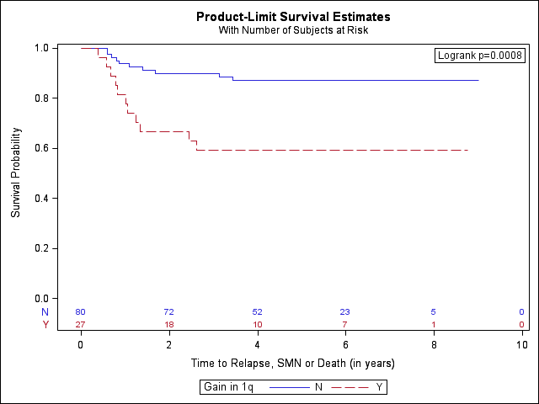
Impact of 1q Gain for RCR patients
Retrospective analysis of the cohort of RCR patients demonstrated significant impact of 1q status
  Patients with RCR and 1q gain (21/96=22%) had worse outcome than those with RCR without 1q gain
      EFS 57% vs 86%,
      OS 89% vs 97%
    Relapse in RCR with 1q gain was predominantly pulmonary (9/11) .
Impact of 1q gain on RCR patients
No 1q gain, 4-year EFS: 89%
1q gain, 4-year EFS: 57%

Slide 73
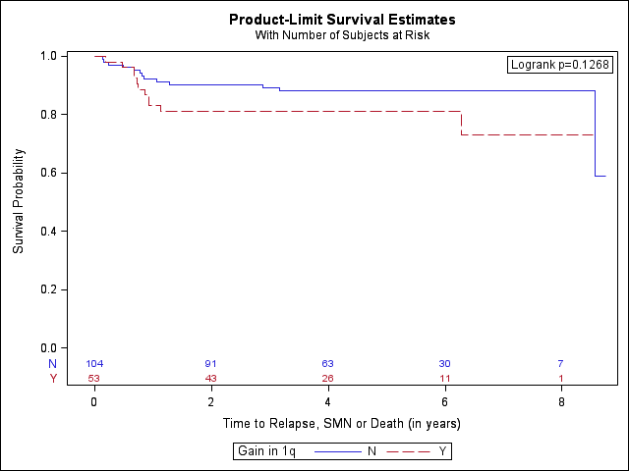
Impact of 1q Gain for RCR and SIR patients
Reduction of therapy (no lung XRT) therefore not recommended for patients with CR and 1q gain
Intensification of therapy will be studied for this group
For SIR patients, Regimen M + radiation protective against relapse in stage IV FHWT with EFS of 86% (1 q gain) and 92% (no 1q gain)
Impact of 1q gain on SIR patients
No 1q gain, 4-year EFS: 92%
1q gain, 4-year EFS: 86%

Slide 75
Treatment of Stage IV Favorable Histology Wilms tumor with Extrapulmonary Metastasis
Patients with extrapulmonary mets were treated with Regimen M after 6 weeks of DD4A therapy
  Regimen M, VAD (vincristine, actinomycin and doxorubicin) and CE (cyclo, etoposide)
  All patients with pulmonary mets received lung RT, regardless of lung nodule response
  All sites of metastatic disease received XRT
4 yr EFS of 81.7% and OS of 90.9% on AREN0533, compared to EFS of 78.9% OS of 86.8% on NWTS -
  No statistical improvement from DD4A therapy on NWTS
  Small number of patients (44) and relapses (8)
  Plan to continue study of this regimen (or new regimen MVI)
  Dix et al, Treatment of Stage IV Favorable Histology Wilms tumor with Extrapulmonary Metastasis: A report from the Childrens Oncology Group, Abstract, SIOP 2016

Slide 77
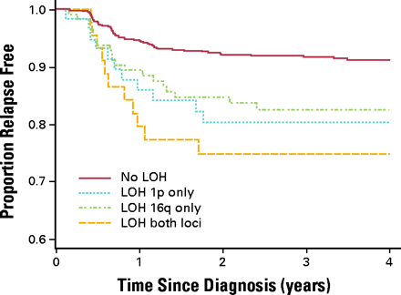
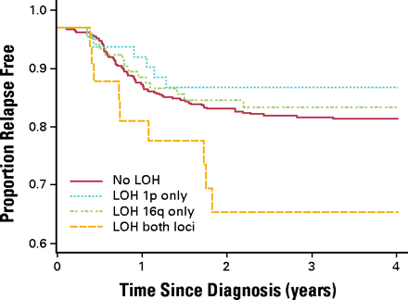
NImpact of LOH of 1p AND 16q for FHWT - NWTS
Stage I/II FHWT patients
Stage III/IV FHWT patients
4 yr EFS = 92%
4 yr EFS = 83%
4 yr EFS = 74.9%
4 yr EFS = 65.9%
Grundy et al, JCO, 2005

Slide 78
TreatAREN0532 and AREN0533 offered intensification for combined loss of LOH 1p/16q
 | Standard Therapy NWTS-5 | Augmented Therapy AREN0532/AREN0533
Stage I/II with LOH 1p and 16q | Regimen EE4A (VCR, Actino) | Regimen DD4A (VCR, Actino, Doxo)
Stage III/IV with LOH 1p and 16q | Regimen DD4A (VCR, Actino, Doxo) plus XRT | Regimen M (VCR, Actino, Doxo plus 4 cycles of Cyclo/Etop) plus XRT

Slide 79
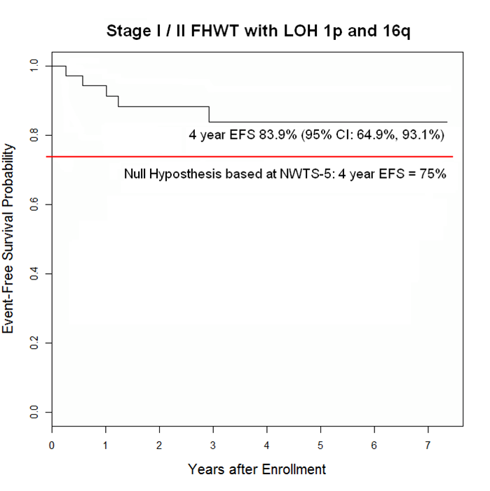
Outcome of patients with Stage I/II FHWT and LOH on AREN0533
Combined LOH 1p and 16q in 35 evaluable patients
6 observed events vs 9 expected
AREN05333: 4 yr EFS 87, OS 100%
Vs
NWTS-5: 4 yr EFS 69%, OS = 92%
p-value=0.6414
Dix et al, JCO, 2019

Slide 80
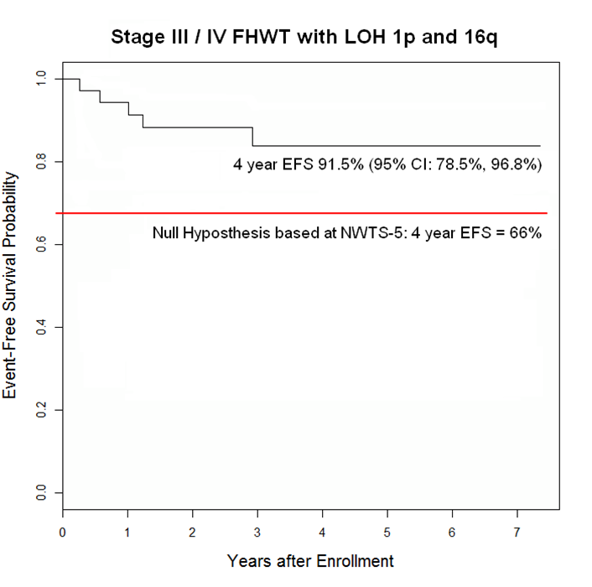
Outcome of patients with Stage III/IV FHWT and LOH 1p/16q on AREN0533
Combined LOH 1p and 16q in evaluable patients
4 observed events vs 18 expected
AREN0533: 4 yr EFS 90%, OS 96%
vs
NWTS-5: 4 yr EFS = 61%, OS = 86%
p-value=0.0188
Dix et al, JCO, 2019

Slide 81
Conclusions for LOH of 1p/16q from AREN0533
Augmentation of therapy with regimen improved EFS for stage III/IV FHWT patients with combined LOH 1p and 16q, and should be considered standard of care
Improvement in survival for stage I/II FHWT patients with LOH 1p and 16q is less clear, not statistically significant. Augmentation of therapy can be considered, but should be carefully weighed by the provider and family.

Slide 83
Anaplastic Wilms Tumor
Represents about 5% of WT
Presents at older age, higher stage (for DA)
Outcomes worse for all stages than FHWT, requires more intensive therapy
Cure rates for higher stage DAWT unacceptably low. Ongoing study

Slide 84
Anaplastic Wilms Tumor
Characterized by p53 mutations, often have positive p53 IHC
  Can be focal (15%) or diffuse (85%)
    Focal:
      Anaplasia is sharply localized in primary tumor, without marked nuclear or mitotic atypia in remainder of lesion
    Diffuse :
      1)Non- localized anaplasia
      2) Localized anaplasia with nuclear unrest elsewhere
      3) anaplasia outside tumor capsule or in metastasis
      4) Biopsy reveals anaplasia
P53 Staining

Slide 85
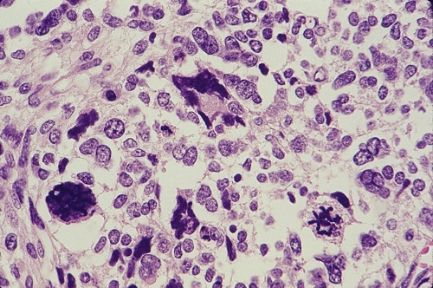
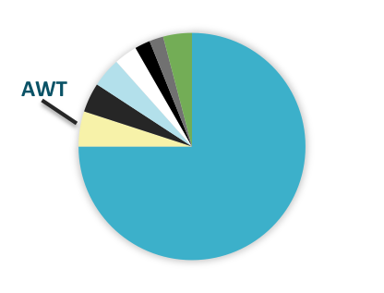
Anaplastic Wilms Tumor (AWT)
183 patients (5%)
90 (49%) 93 (51%)
26 (14%) Focal Anaplasia
157 (86%) Diffuse Anaplasia
Mean age at presentation 5.4 yrs (median 4.5, range 23.2yrs)
Stage Distribution
%

Slide 86
Diffuse Anaplastic WT
Stage-specific 4-year OS has trended up with therapy intensification
Stage | NWTS-3 + 4 Regimen DD-RT VDA/XRT | NWTS-3 and -4 Regimen J VDAC/XRT | NWTS-5 Regimen I VDCE/XRT | COG AREN0321 Regimen UH-1 or UH-2 (Original or Revised) UH- 1 - VDC/CCyE, XRT UH-2 – VDC/CCYE/VI, XRT N= 66
II | 47% | 70% | 78% | 86%
III | 21% | 56% | 65% | 89%
IV | 0% | 17% | 32% | 49%
V: vincristine, D: doxorubicin, A: actinomycin D, C: cyclophosphamide, E: etoposide, Cb: carboplatin; XRT: radiation
Slide adapted with permission of Jeff Dome MD

Slide 88
Renal Cell Carcinoma
Basic Science and Pathophysiology
Epidemiology and Risk Assessment
Diagnosis
Management and Treatment

Slide 89
Renal Cell Carcinoma (RCC) - Overview
RCC is most common renal tumor in adults, increasing recognition in children
Represents about 5% of pediatric renal tumors, incidence increases with age
  Extremely rare < age 10, most common renal tumor in children > 15 years of age
Subtypes are associated with genetic predisposition, other risk factors

Slide 90
Renal Cell Carcinoma (RCC) - Overview
Chemotherapy and radiotherapy largely ineffective
Surgery is the most effective therapy
  Surgical treatment should include lymph node dissection
  Recent study of pediatric RCC showed good cure rates even for locally metastatic RCC (Geller et al, Cancer 2020)
Systemic therapy varies according to subtype
  Immunotherapy and targeted therapy
    VEGF tyrosine kinase inhibitors, mTOR inhibition, anti-PDL1 antibodies

Slide 91
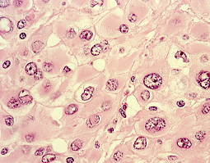
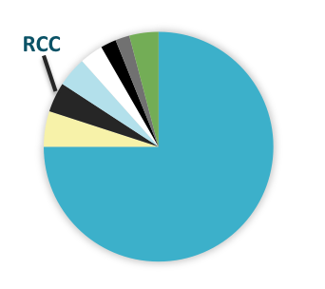
Renal Cell Carcinoma (RCC)*
154 patients (4.2%)
78 (50.7%) 76 (49.3%)
Mean age at presentation 12.2 years (median 13, range 27.5)
Presence of metastatic disease
N1 30%
M1 19%
Histologic subtype | Patient # | %
TFE3 or TFEB translocation associated | 67 | 44%
Papillary | 20 | 13%
Renal Medullary | 15 | 9.9%
RCC other | 52 | 34.2%
Geller /2013

Slide 92
Prevalence by Histology Age > 10 years

Slide 93
Renal Cell Carcinoma Predisposition Syndromes
von Hippel-Lindau (VHL) disease
  autosomal dominant condition with mutation/deletion of VHL, tumor suppressor gene on chromosome 3p26. Increases angiogenesis, particularly in retina and cerebellum
  60% of patients with VHL develop RCC.
    Mean onset 39 years, but screening recommended as early as age 10
  Treatment with nephron sparing surgery/cryotherapy/oblation
Tuberous sclerosis
  Rare subtype, most common have prominent papillary architecture (TSC-associated papillary RCC). TS also associated with angiomyolipomas (AMLs).
  Possible role of mtor inhibitors

Slide 94
Renal Cell Carcinoma Predisposition Syndromes
Familial RCC
  inherited chromosome 3 translocation
  Succinate dehydrogenases (SDHB, SDHC, and SDHD) mutations, also associated with pheochromocytoma
Hereditary leiomyomatosis and RCC
  autosomal dominant susceptibility for development of cutaneous leiomyomas, early onset multiple uterine leiomyomas and an aggressive form of type 2 papillary renal cell cancer

Slide 95
Renal Medullary Carcinoma (RMC)
Seen almost exclusively in individuals with sickle cell trait.
Originally described in 1995, extremely rare, but increasingly recognized
Usually presents in young adults, male predominance (66%)
  Presents most often with pain and hematuria
  Highly aggressive, most often presents with widespread metastatic disease, very poor prognosis
Characteristic histology, and also defined by loss of INI-1
Responses reported with chemotherapy in some patients
  Gemcitabine, paclitaxel, dox, methotrexate
  Investigation of targeted agents, EZH2 inhibition, PDL-1 inhibition

Slide 96
Translocation associated RCC (tRCC)
Rare tumor – accounts for only 1-5% of all cases of RCC. Most common in adolescents and young adults – accounts for almost 50 % of RCC in childhood
Slight female predominance, presents in all races
Recognized in 2004 as distinct entity – defined by Xp11.2 translocation (multiple fusion partners), characteristic morphology, strong nuclear expression of TFE3 or TFEb
TFE3

Slide 97
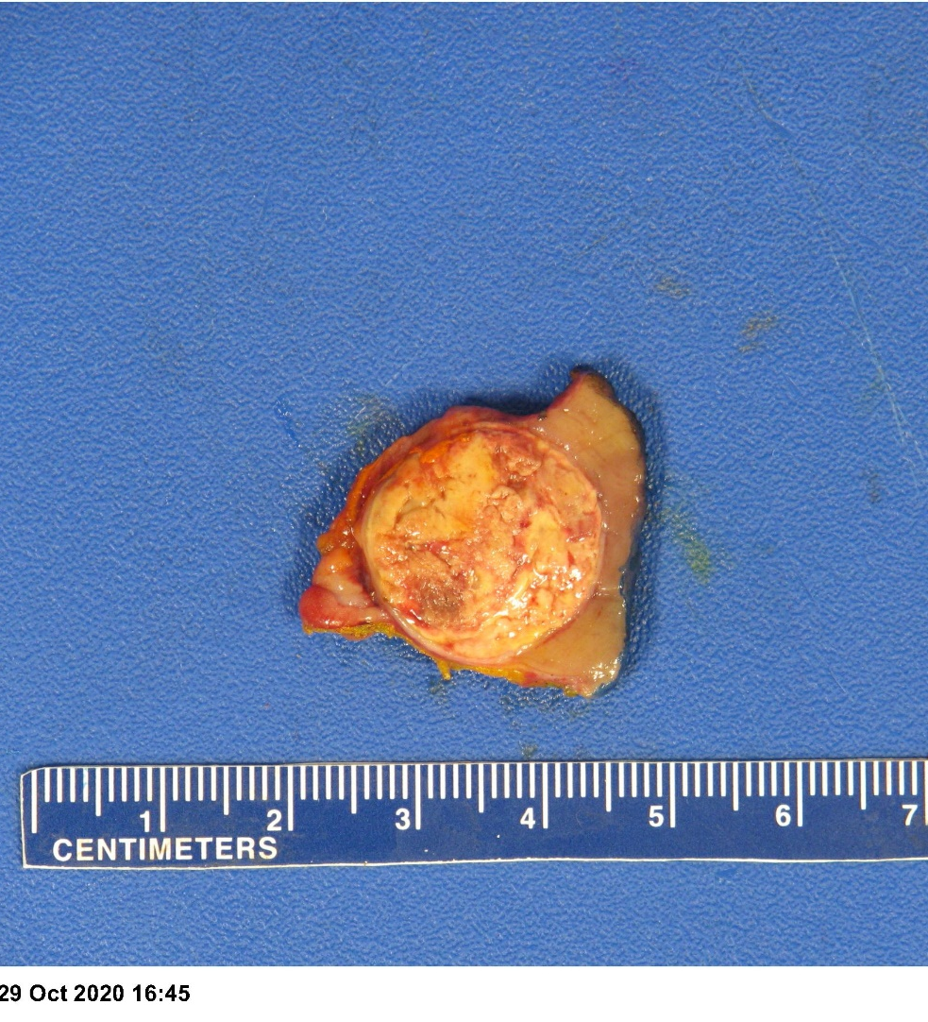
Translocation associated RCC (tRCC)
Surgery curative for localized, and locally metastatic disease.
Can be associated with previous childhood malignancy
Poor prognosis for distant or recurrent metastatic disease.
  Chemotherapy and radiation therapy not effective
  Targeted therapies being explored
    Ongoing study of VEGFR tyrosine kinase inhibitors (axitinib) and PD/PD-L1 targeted therapy (nivolumab) - COG Protocol AREN1721

Slide 98
Clear Cell Sarcoma of the Kidney
Basic Science and Pathophysiology
Epidemiology and Risk Assessment
Diagnosis
Management and Treatment

Slide 99
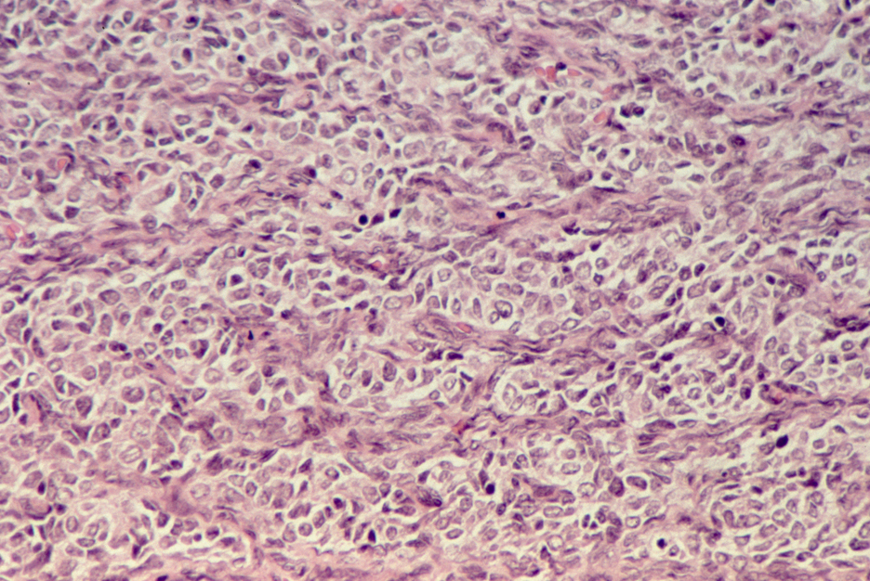
Clear Cell Sarcoma
Propensity to metastasize
(Bone metastizing renal tumor of infancy)
  Bone, brain, and soft tissue
  Historic high recurrence rate and poor outcome for stage IV disease
Male predominance
Mean age of presentation 3 years
Histology:
  Cords and nests of pale-stained tumor cells with abundant extracellular matrix separated by a network of fine capillary arcades.
  Histologically often confused with Wilms and other pediatric renal tumors
Distinctive molecular findings
  BCOR ITD’s in 80% of cases
  YWHAE-NITM2 fusions in up to 10%

Slide 100
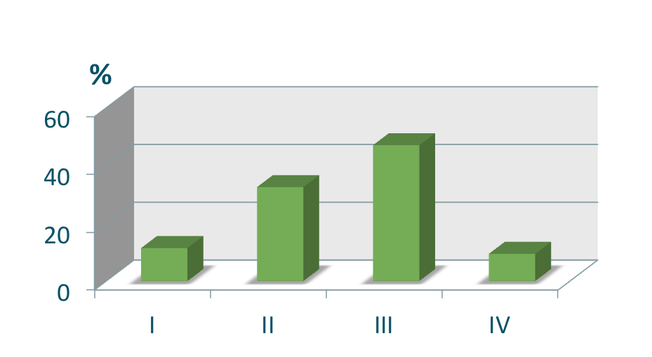
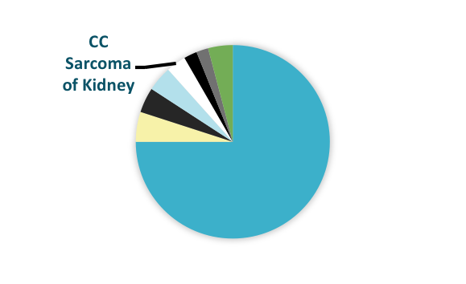
Clear Cell Sarcoma of the Kidney (CCSK)
124 patients (3.3%)
77 (62.1%) 47 (37.9%)
Mean age at presentation 2.9 years (median 2.2, range 16)
Stage Distribution

Slide 101
Clear Cell Sarcoma of the Kidney
Multiagent therapy, including:
  vincristine, anthracyclines, ifosphamide/cyclophosphamide, carboplatin and etoposide has yielded marked improvement over last decades
On the recent COG trial AREN0321:
  Stage II and III patients did well with RT and regimen I therapy
  (vincristine, doxorubicin, cyclophosphamide and etoposide)
  The use of RT was safely eliminated for Stage I patients receiving regimen I
  Stage IV patients were treated with UH-1 therapy
  vincristine, doxorubicin, cyclophosphamide and etoposide
Late relapses, including to bone and brain have been observed, resulting in suggestion of prolonged surveillance guidelines

Slide 102
Malignant Rhabdoid Tumor of the Kidney
Basic Science and Pathophysiology
Epidemiology and Risk Assessment
Diagnosis
Management and Treatment

Slide 103
Malignant Rhabdoid Tumor
Most commonly encountered in infants under 1 year, rare > 5 yo
Lack of INI1 expression
  Somatic or Germline
Often metastatic to lungs, abdomen, lymph nodes, liver, bone and brain at diagnosis
Can present simultaneously with intracranial lesions (AT/RT)
Clinically aggressive tumor, extremely poor prognosis
INI1 negative

Slide 104
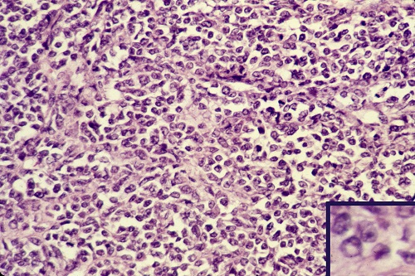
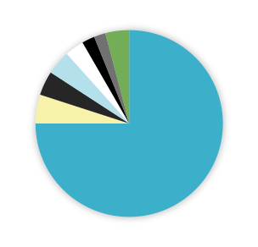
Malignant Rhaboid Tumor (MRT)
RT
136 patients (3.7%)
65 (48%) 71 (52% )
Mean Age at Presentation: 19.8 months,
(median 10.8 mos, range 177 mos )
  42.3% Extra-renal
  52.3% Renal primary
  5.4% Indeterminate primary
Analysis of tumor and germline INI1 status ongoing
Stage Distribution
%

Slide 105
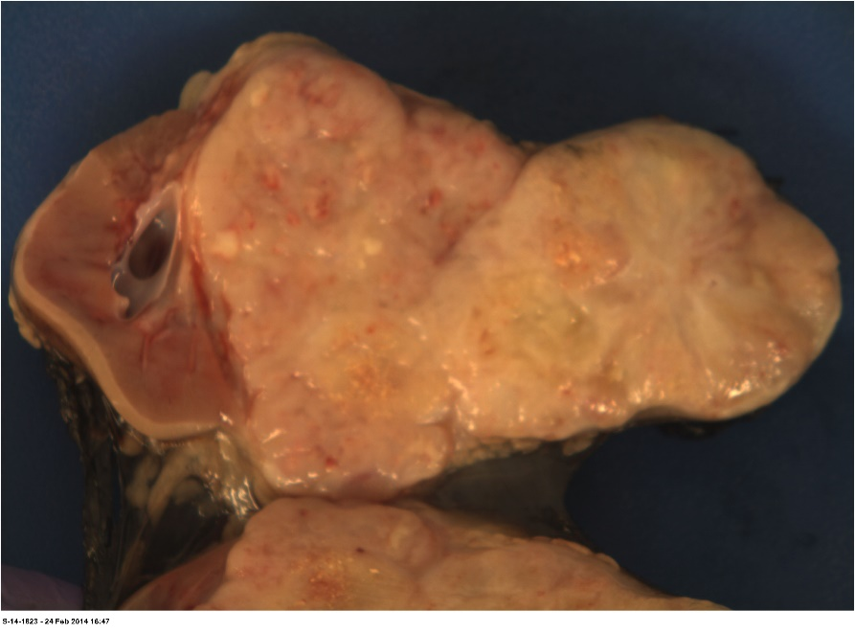
Malignant Rhabdoid Tumor
Treated on High Risk Renal Tumor Protocol AREN0321
Window with vincristine/irinotecan showed lack of efficacy
Patients were treated with Regimen UH-1 with VDC/CCyE
  Vincristine, doxorubicin, cyclophosphamide, carboplatinum and etoposide
  Significant toxicity – doses reduced and XRT delayed in regimen UH-2
  Outcomes poor, particularly in higher stages
Many novel agents under investigation
  EZH2 inhibitors (tazemetostat)
  Immunotherapy (PDL -1 inhibitors)

Slide 107
Congenital Mesoblastic Nephroma
Basic Science and Pathophysiology
Epidemiology and Risk Assessment
Diagnosis
Management and Treatment

Slide 108
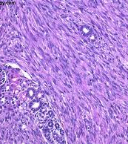
Congenital Mesoblastic Nephroma
Almost exclusively detected within the first year of life, most prevalent renal tumor in first 3 months of life, often detected prenatally
Clinical symptoms: hypertension and elevated concentrations of calcium and renin. Hypercalemia can continue after resection
Histology: classic and cellular and mixed subtypes
  Cellular type associated with t12:15 (ETV6-NTRK3) - also found in infantile fibrosarcoma
  EGFR internal tandem duplicates (ITD) and BRAF rearrangements can also be found
Image courtesy of Julie Park, MD

Slide 109
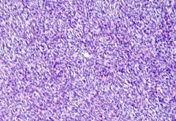
Congenital Mesoblastic Nephroma (CMN)
CMN
82 patients (2.2%)
43.9% (36) 56% (46)
Mean Age at Presentation: 2.4 months (median 1 mo., range 24 mo)
60% Cellular 27.4% Classic 11.6% Mixed
%

Slide 110
Prevalence by Histology in First year of life

Slide 111
Congenital Mesoblastic Nephroma
Outcomes excellent with surgery only, OS 95%
Chemotherapy for stage III controversial -
  Combinations of vincristine/dactinomycin, doxorubicin, cyclosphosphamide, ifosfamide and etoposide have been used
Investigation of TRK inhibitor Larotrectinib for metastatic cellular CMN with 12:15 translocation ongoing
No role for radiotherapy

Slide 113
Cystic Nephroma
Basic Science and Pathophysiology
Epidemiology and Risk Assessment
Diagnosis
Management and Treatment

Slide 114
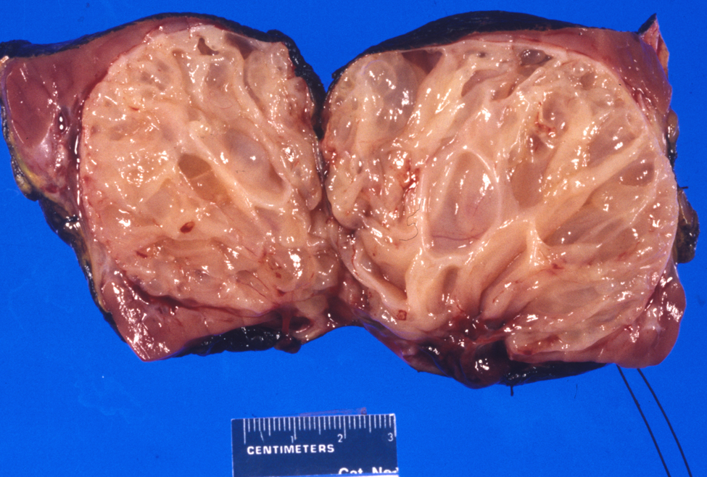
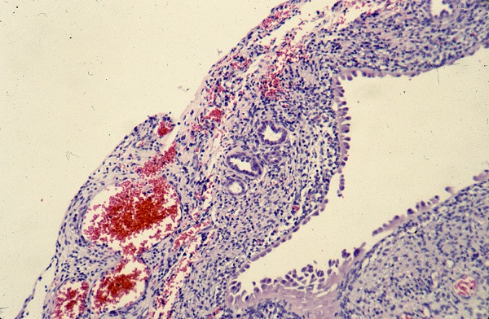
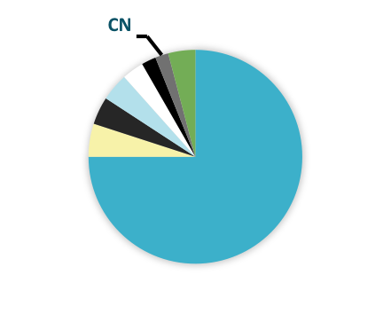
Cystic Nephroma (CN)
73 patients (2%)
54% (39) 47% (34)
Mean Age at Presentation 2.3 years (median 1.3, range 14.4)
High correlation with DICER mutations

Slide 115
Cystic Nephroma (CN)
High correlation with germline DICER mutations – genetic counseling and testing recommended
Patients identified with DICER germline mutations should have routine planned surveillance – may have previous history of Pleuropulmonary Blastoma (PBP)
Recognized entities of Dicer associated WT and renal sarcoma – may be malignant evolution of CN
Tumors can be bilateral, and can be synchronous or metachronous
Treatment of CN is surgical resection
No known role of chemotherapy or radiation

Slide 117

Special Thanks to:
Jeff Dome, MD, PhD
Julie Park, MD
Harry Kozakewich, MD
Antonio Perez-Atayde, MD
And patients and families
For sharing slides and images
David Dix, MD

Slide 118
Good Luck!!!!!!!

