Slide 1
Transfusion Medicine
Rachel S. Bercovitz, MD MS
Associate Professor of Pediatrics, Northwestern University Feinberg School of Medicine
Medical Director, Hemophilia Treatment Center at Ann & Robert H. Lurie Children’s Hospital of Chicago

Slide 2
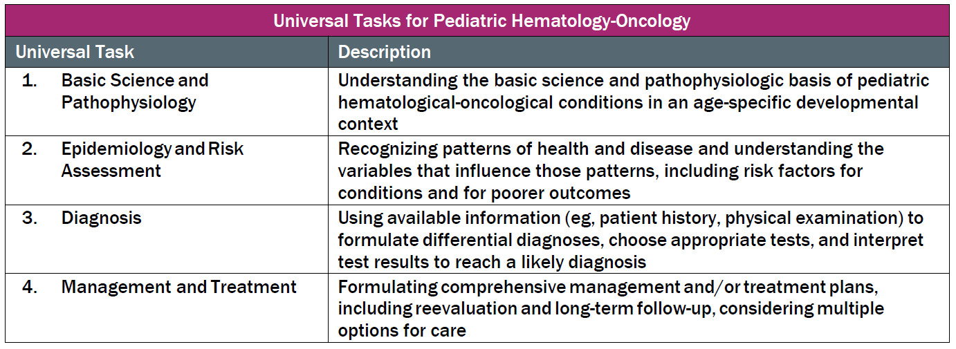
This talk will try to follow the topical structure suggested by the ABP when appropriate:

Slide 3
Outline
Transfusion medicine questions make up 5% of Boards
Objective is to give you knowledge and confidence to ace this 5%
Topics
  What we do to blood components
  Why we do what we do
  What blood transfusions can do to our patients

Slide 4
Component Collection & Storage
What we do to blood components

Slide 5
Blood Components
Cellular products
  Red blood cells (RBCs, packed red blood cells, pRBCs)
  Platelets
  Granulocytes
Non-cellular products
  Frozen plasma (FP, fresh frozen plasma, FFP, PF-24)
  Cryoprecipitate (cryo)
Collection
  Whole blood – component separation via centrifugation and processing
  Apheresis – single component collection

Slide 6
Collection – Whole Blood
Cryo
Plasma
Plasma
WHOLE BLOOD
Platelets
Platelets
Platelets
RBCs
Platelets
Platelets
Platelets
Platelets
Cryoprecipitate is made by thawing FP in 1-6°C. The precipitate is suspended in 10 mL of plasma. The leftover plasma (cryo-poor) is not routinely transfused.
RBCs

Slide 7
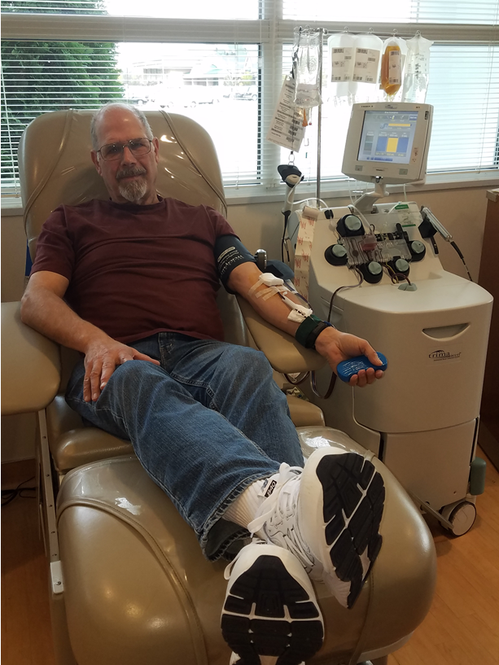
Collection – Apheresis
Double RBC units (~ 500 mL)
Double plasma units (~ 500 mL)
Platelet units
  Number of units produced depends on platelet count of the unit
  Each unit has to have > 3 x 10¹¹ platelets
Image courtesy of Rowena Punzalan, MD

Slide 8
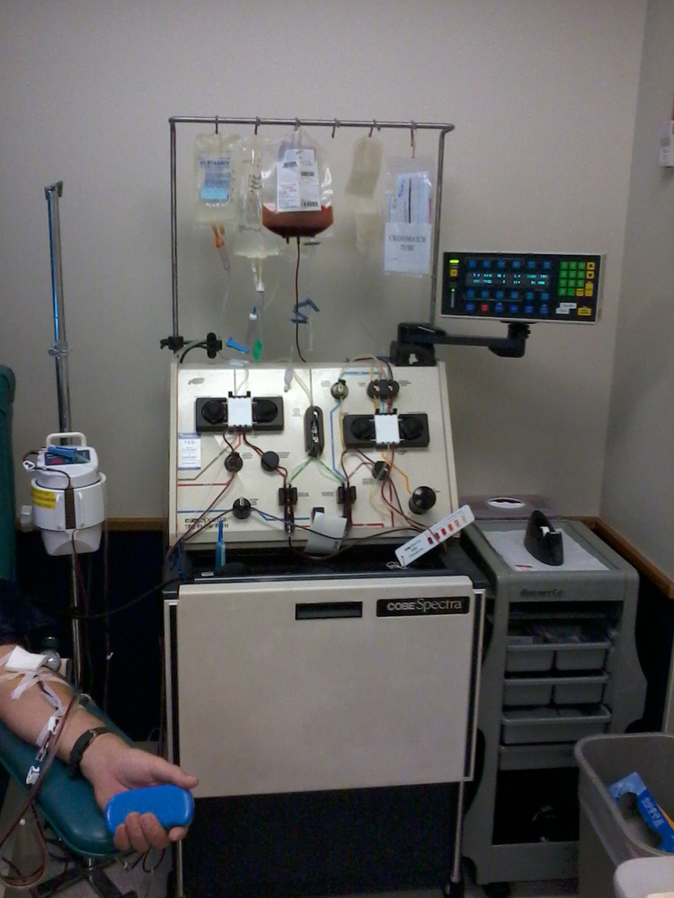
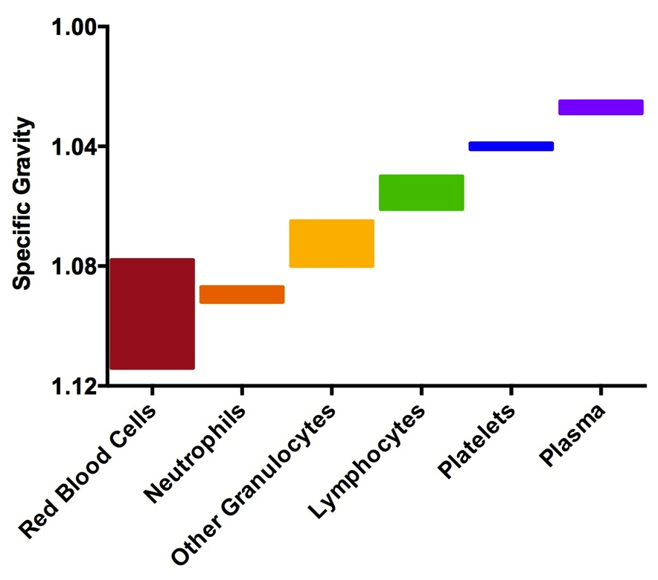
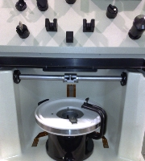
Apheresis Collection Blood Components

Slide 9
Component Processing & Storage
Component | Storage Temp | Shelf Life | Other fun facts
Red Blood Cells | 2 – 6°C < -65°C (in glycerol) | 21– 42 days 10 years | Typically leukodepleted pre-storage Not warmed prior to transfusion Hct of RBC unit is ~55% Once thawed and deglycerolized, ok for 24 hours and cannot be refrozen
Platelets | 20 – 24°C | 5 days | Require constant gentle agitation
Plasma | < -18°C 2 – 6°C | 1 year 5 days (thawed) 28 days (never frozen) | Plasma frozen ≤ 8 hours after collection is fresh frozen plasma (FFP) Plasma frozen ≤ 24 hours after collection is frozen plasma (FP) or PF-24
Cryoprecipitate | < -18°C | 1 year | Pooled into 5- or 10-packs
Granulocytes | 20– 24°C | 24 hours | Should be given ASAP

Slide 10
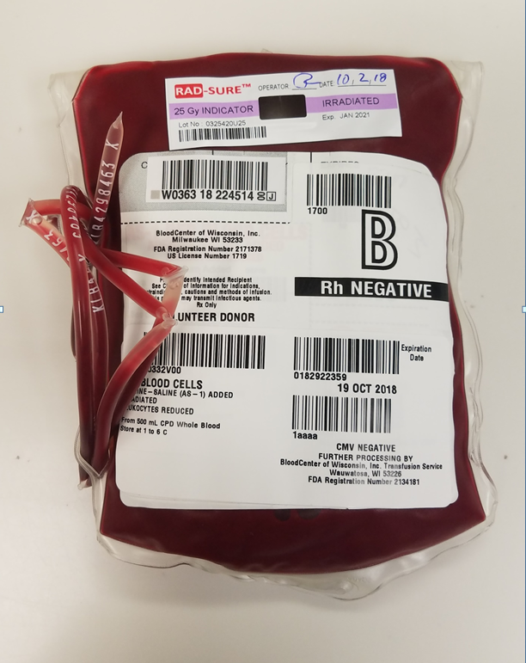
Red Blood Cell Storage Solutions
Image courtesy of Rowena Punzalan, MD

Slide 11
Component Processing & Storage: Clinical Pearls
RBCs are stored in the refrigerator
  Yersinia enterocolitica, Listeria monocytogenes, Serratia liquefaciens, and CoNS are all bacteria that can thrive in 1-6°C
  Patients with cold agglutinin disease should be given RBCs through a warmer to prevent further hemolysis
Platelets are stored at room temperature for 5 days
  Platelets have highest incident of bacterial contamination (1 in 1000-2000 units are contaminated). About 10% of these units cause infection.
  Gram positive bacteria cause ~70% of infections, but gram negative bacteria cause ~80% of deaths
  Platelets can be most difficult blood component to stock during disasters
Becher ME, Hay SN. 2005. Clin Microbiol Rev. 18(1):195-204

Slide 12
Type & Crossmatch
What we do with blood components

Slide 13
Terminology
Type: Determine ABO and Rh (D) type of blood recipient
Screen: Evaluate for alloantibodies against common and clinically significant RBC antigens
Crossmatch (cross, Xmatch): Electronically or manually confirm compatibility between donor and recipient

Slide 14
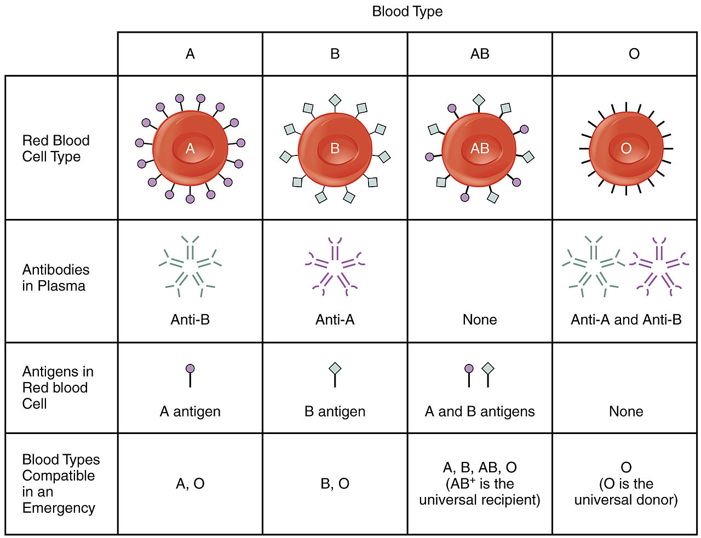
Type & Crossmatch –
ABO Type
A
B
AB
O
Front Type
Back Type
A, B, AB, O
© 1999-2020, OpenStax, Rice University. Except where otherwise noted, content created on this site is licensed under a Creative Commons Attribution 4.0 International Public License; partners@openstaxcollege.org.
A, O
B, O
O

Slide 15
Type & Crossmatch – ABO
Isohemagglutinins (anti-A and anti-B) are IgM antibodies formed by non-A and non-B individuals, respectively, due to environmental exposures
Type O individuals have anti-A and anti-B (IgM) and anti-AB (IgG)
  IgM antibodies responsible for acute hemolytic transfusion reaction
  Anti-AB IgG is what causes hemolytic disease of the fetus/newborn (HDFN)
Match ABO type
Anti-RBC antibodies should always be avoided
  Donor anti-recipient is a minor mismatch (Avoid when possible)
  Recipient anti-donor is a major mismatch (Avoid at all costs)

Slide 16
Type & Crossmatch – Front & Back Types Different
What this looks like (examples)
  Patient has A RBCs but no anti-B antibodies
  Patient has AB RBCs and also has anti-B antibodies
Causes
  Immunosuppressed
  Young infants
  Patients undergoing ABO-mismatch HSCT
  Chimerism
When in doubt, give O RBCs

Slide 17
Type & Crossmatch – Alloantibody evaluation
Screen
  Patient plasma is mixed with panel RBCs that have known antigen profiles
  Tests for common and clinically significant alloantibodies
If positive, a larger panel is done to identify antibody (10-15 cells/panel)
Can take ≥ 30 minutes depending on complexity
 | RH |  |  |  |  |  | Kell |  | Kidd |  | Duffy |  | P | Lewis |  | LU |  | MNS |  |  |  | Test Tube
 | D | C | E | c | e | f | K | k | Jkª | Jk^{b} | Fyª | Fy^{b} | P₁ | Leª | Le^{b} | Luª | Lu^{b} | M | N | S | s | I | 3 | C | A
1 | + | + | 0 | + | + | 0 | + | + | + | + | 0 | + | + | + | 0 | 0 | + | + | + | + | 0
2 | + | 0 | + | + | 0 | 0 | 0 | + | + | 0 | + | 0 | 0 | 0 | + | 0 | + | 0 | + | + | +
3 | 0 | 0 | 0 | + | + | + | 0 | + | 0 | + | + | + | + | 0 | + | 0 | + | + | 0 | 0 | +

Slide 18
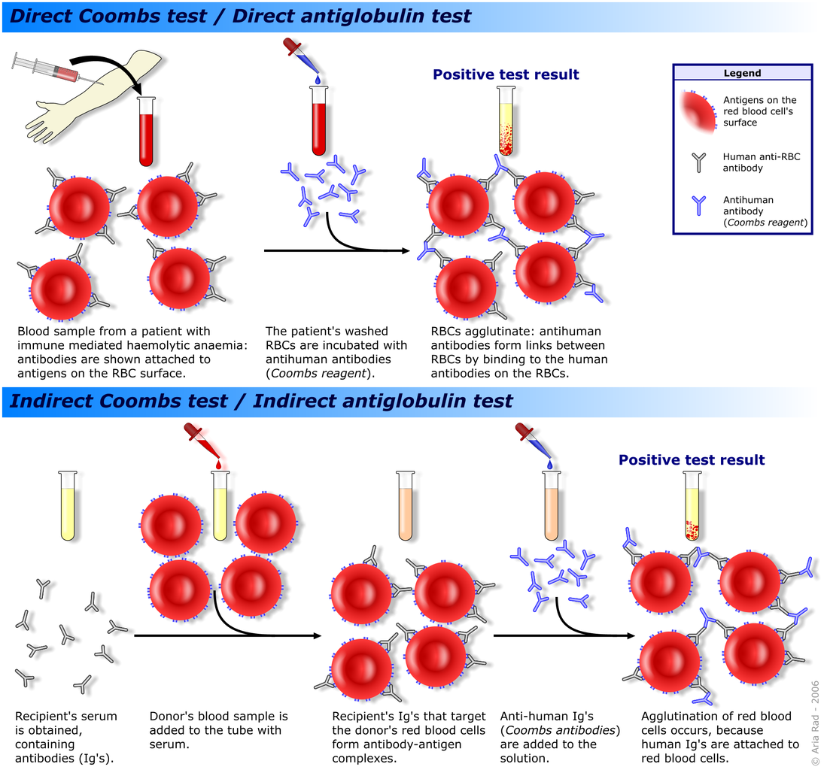
Immune hemolytic anemia
Screen for RBC-bound antibodies
Screen for antibodies in plasma
Alloantibody testing
© 2006 Aria Rad. This file is licensed under a Creative Commons Attribution-ShareAlike 3.0 Unported (CC BY-SA 3.0); https://upload.wikimedia.org/wikipedia/commons/1/1c/Coombs_test_schematic.png.

Slide 19
Type & Crossmatch – RBC Crossmatch
Patient plasma mixed with RBCs from the unit to be transfused
Anti-human IgG can be added to make the test more sensitive
If antibody screen is negative, usually electronic crossmatch is done
Screen and crossmatch are good for 72 hours
Emergency, uncrossmatched blood
  O- blood issued
  1:14,000 chance of a delayed hemolytic transfusion reaction from pre-formed alloantibodies (likely much lower in pediatric patients)
  Chance of alloantibodies in a transfusion-naïve, nulliparous patient is very low

Slide 20
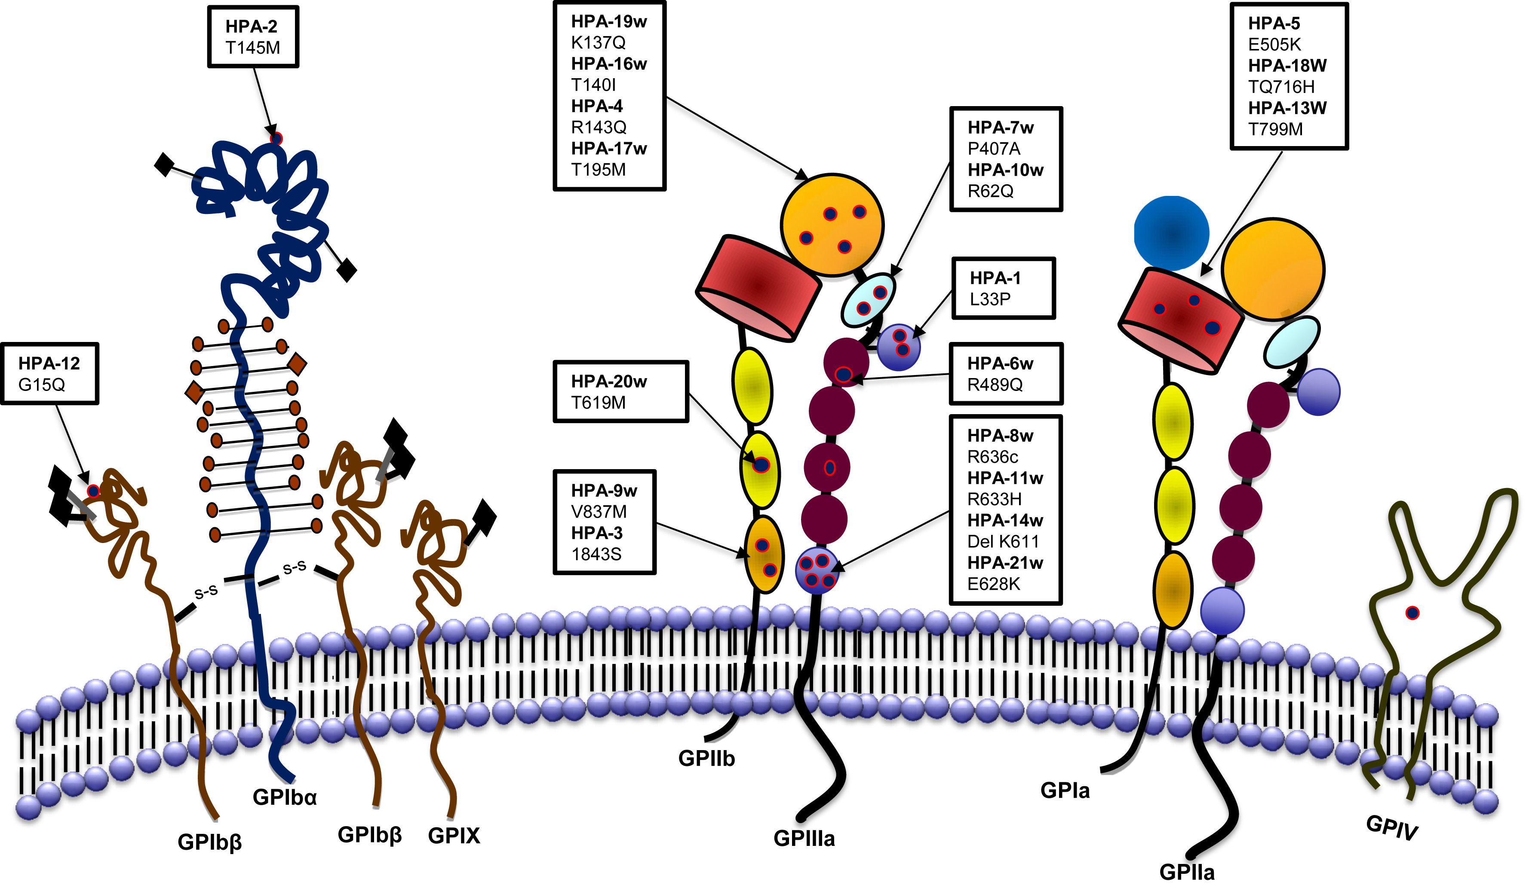
Type & Crossmatch – Platelet Crossmatch
Anti-human platelet antigen (HPA) antibodies (see below)
Anti-human leukocyte antigen (HLA) antibodies
From “Fetal and neonatal alloimmune thrombocytopenia” (Fig 1), by D Zdravic, I Yougbare, B Vadasz, et al., Semin Fetal Neonatal Med, 2016 Feb;21(1):19-27. © 2016 by Elsevier. Reproduced with permission.

Slide 21
Type & Crossmatch - Platelets
Rarely is a physical crossmatch performed
Platelets need to be ABO and Rh compatible
Patient Type | Compatible Platelets
A | A, AB
B | B, AB
O | O, B, A, AB
AB | AB

Slide 22
Type & Crossmatch - Platelets
AB is the universal plasma/platelet donor
(4% of population)
Rarely is a physical crossmatch performed
Platelets need to be ABO and Rh compatible
Patient Type | Compatible Platelets
A | A, AB
B | B, AB
O | O, B, A, AB
AB | AB

Slide 23
Rh System
The D antigen is an Rh antigen, but not all Rh antigens are D
People are either D positive or negative
Rh type is tested as part of the Type & Screen/Crossmatch process
  People do not have naturally occurring anti-D antibodies
  Anti-D is most common alloantibody
  Approximately 20-30% of D- people exposed to D-antigen will form antibody
Anti-D antibodies can cause serious pregnancy complications with hemolytic disease of the fetus and newborn (HDFN)
If D status unknown, give D negative blood
RBCs, granulocytes, and platelets should be D-matched

Slide 24
Transfusion Indications
Why we do what we do

Slide 25
Transfusion Indications
Erythrocytes
Platelets
Granulocytes
Plasma and cryoprecipitate
Therapeutic apheresis
Directed donors

Slide 26
Common Indications
Component | Indication
RBCs | Anemia Acute blood loss
Platelets | Thrombocytopenia Platelet function defect
Granulocytes | Severe, resistant infection in patient with severe neutropenia
Plasma | Multiple coagulation factor deficiency
Cryoprecipitate | Hypofibrinogenemia Dysfibrinogenemia

Slide 27
Dose & Response
Component | Dose | Expected Response
RBCs | 10 mL/kg or 1 unit (~250 mL) whichever is smaller | Hemoglobin: 1 g/dL Hematocrit: 3%
Platelets | Apheresis unit: 10 mL/kg or 1 unit (250-300 mL) whichever is smaller | 30-60 minute post-transfusion increase of ~50,000 platelets/µL
Plasma | 15 mL/kg | 15% coagulation factor levels
Cryo | 1-2 units/10 kg (round up) | Fibrinogen: 60-100 mg/dL

Slide 28
Red Blood Cell Indications
Need to increase O₂ carrying capacity by increasing RBC mass in severe or symptomatic anemia
Studies of adults who refuse transfusion demonstrate^{1,2}
  Morbidity and mortality increase at Hb < 8 g/dL
  For every 1 g/dL drop in Hb, risk of mortality increases 2.5-fold¹
  Sharp increase in mortality when Hb < 5 g/dL²
Typical transfusion dose is 1 unit (~250 mL) or 10 mL/kg, whichever is smaller
  Expected rise in Hb is 1 g/dL with this dose
  Usual administration is over 2-4 hours
¹Carson et al. Mortality and morbidity in patients with very low postoperative Hb levels who decline blood transfusion. Transfusion 2002;42:812-8.
²Shander et al. An update on mortality and morbidity in patients with very low postoperative hemoglobin levels who decline blood transfusion. Transfusion 2014;54

Slide 29
Erythrocytes – General Transfusion Thresholds
Hb (g/dL) | What to Do
< 7 | Transfuse*
7 – 10 | Transfuse based on clinical situation.**
> 10 | Transfusion rarely indicated
*Exceptions include iron deficiency anemia due to the fact that oral iron therapy can increase Hb rapidly

Slide 30
**RBCs – Additional Threshold Considerations
Rate of anemia development
Ability to compensate
Comorbidities that can effect oxygenation of RBCs or delivery of oxygenation
Expected recovery time
  Bone marrow failure
  Iron deficiency anemia
  Hemolytic anemia
Evidence of end-organ damage or dysfunction

Slide 31
TRIPICU Study
637 pediatric patients in the ICU randomized
  320 in restrictive group (Hb <7)
  317 in liberal group (Hb <9.5)
Excluded: active bleeding, heme/onc
Reduced transfused patients by > 50%
No difference in multi-organ dysfunction (MODS, primary outcome) or other outcomes
Outcome | Hb 7, n=320 (%) | Hb 9.5, n=317 (%) | P value
Received transfusion | 146 (46) | 310 (98) | <0.001
Units/transfused patient | 1.9 ± 3.4 | 1.7 ± 2.1 | 0.24
New/progressive MODS | 38 (12) | 29 (12) | NI
Suspension of Protocol | 39 (12) | 20 (6) | 0.01
Pre-first transfusion Hb | 6.7 ± 0.5 | 8.1 ± 0.1 | <0.001
Post-first transfusion Hb | 9.4 ± 1.2 | 11.2 ± 1.1 | <0.001
Death | 25 (7%) | 26 (7%)
NI: Not inferior
Lacroix J, Hebert PC, Hutchinson JS, et al. Transfusion Strategies for Patients in PICUs. N Engl J Med. 2007; 356:1609-1619

Slide 32
Platelet Indications
Platelet count (platelets/µL) | Trigger for transfusion
10,000 | Uncomplicated, hypoproliferative thrombocytopenia
20,000 – 25,000 | Inflammation (sepsis, mucositis) Coagulation defects (DIC, anticoagulation medication) Recent bleeding Procedure (CVL placement,
40,000 | Lumbar puncture
50,000 | Moderate hemorrhage (GI bleeding) Surgery Sick neonate
75,000-100,000 | Major hemorrhage or postoperative bleeding CNS or eye surgery, surgery in prone position
Any platelet count | Platelet function defect and significant bleeding or surgery
Based on UK National Health Service Pediatric 2017 and ASCO 2018 Guidelines

Slide 33
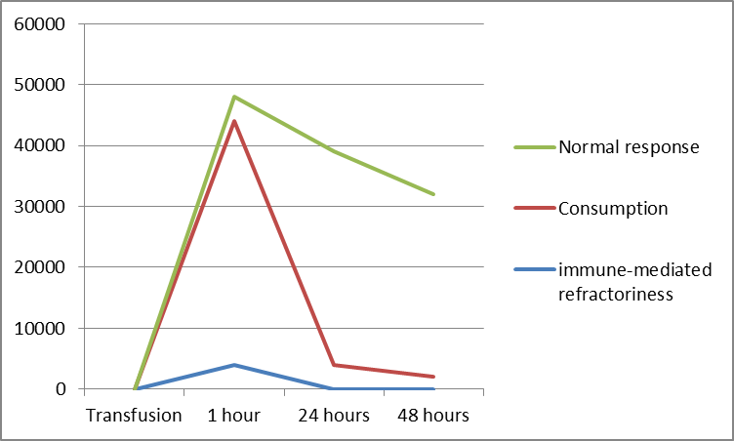
Response to Platelet Transfusion
Platelet count increase/ul
Corrected count increment = [(Post-plt count – Pre plt count) x BSA (m²) x 10¹¹]/# of platelets transfused*
*Use 3x10¹¹ if unsure
Image courtesy of Rowena Punzalan, MD

Slide 34
Platelet Refractoriness
Consider if patients fail to achieve expected platelet count rise after 2 transfusions
Antigens on platelets
  HLA class I
  AB antigens on platelets
  Platelet glycoproteins
  Drug-induced
Typically due to alloantibodies, but patients with autoimmune thrombocytopenia will be refractory to transfused platelets
Anti-HLA class 1 antibodies is most common cause

Slide 35
Approach to platelet refractoriness
Get 30-60 minute post-transfusion platelet count (immune vs. non-immune clearance)
HLA-matching
  Recipient HLA type and HLA antibody screen
  Must be irradiated
Platelet crossmatch (recipient plasma + donor platelets)
ABO matching (to avoid recipient anti-donor platelet-bound antibodies)
Increase platelet dose
Decrease manipulation (washing, plasma reduction)
Image courtesy of Rowena Punzalan, MD

Slide 36
Plasma Indications
Support during disseminated intravascular coagulopathy (DIC) or massive transfusion
Factor replacement when factor concentrates are unavailable (Factors V & XI)
Replacement in plasma exchange when indicated
Warfarin reversal
  If urgent or no other options available
  3- and 4-factor prothrombin complex concentrates not approved in pediatric patients (≤ 16 years old)
Second- or third-line treatment of ACE inhibitor-induced angioedema

Slide 37
Cryoprecipitate Indications
Support during disseminated intravascular coagulopathy (DIC) or massive transfusion
Hypofibrinogenemia, dysfibrinogenemia, hypodysfibrinogenemia
Factor replacement when factor concentrates are unavailable
  Factor VIII
  Factor XIII
  von Willebrand factor
Bonus Boards Hint: Pay attention to Roman numerals. It is easy to confuse VIII and XIII.

Slide 38
Granulocyte Indications
There are no data that demonstrate benefit of granulocyte transfusion compared to standard antimicrobial therapy
No definitive guidelines
  Absolute neutrophil count < 500/µL
  Clinical evidence of bacterial or fungal infection
  Poor response to antimicrobial therapy (typically 3-5 days)
  Consideration of co-morbidities and anticipated neutrophil recovery
Question of efficacy of granulocyte transfusion unlikely to be settled after most recent randomized controlled trial (2008-2014) enrolled < 50% of needed subjects

Slide 39
Transfusion Indications – Directed Donor
Directed donors – family members (less commonly friends) donate blood to a specific patient rather than to the general blood supply
DIRECTED DONATION IS NOT RECOMMENDED
  Less safe – family and friends may lie re: qualifications to avoid embarrassment of not donating or because they feel they are exceptional
  Creates inventory issues and potential scenario where directed-donor unit is transfused to another patient
  Directed-donor units are not given to other patients if patient does not need it
  Risk of transfusion-associated graft-vs-host disease (TA-GVHD)
Exception: Patient has a rare RBC or platelet phenotype and family member is only one able to provide compatible blood

Slide 40
Therapeutic Apheresis
What we do to blood components and what they do to our patients

Slide 41
Apheresis – Out With the Old, In with the New
Objective #1 is to remove the problem
  Sickled cells
  Plasma containing antibodies
Objective #2 is to replace with something helpful
  Normal RBCs
  Healthy plasma
Importance of Objective 1 vs. 2 is dependent on indication
  In TTP provision of healthy ADAMTS13 is more the goal than removal of antibodies
  In RBC exchange goal is removal of sickle cells and replacement with healthy cells
  For Guillain Barré, removal of antibodies is the goal and replacement with albumin is merely to replace volume and maintain oncotic pressure

Slide 42
Therapeutic Apheresis (TA) Modalities
Therapeutic plasma exchange (TPE, plasmapheresis, plasma exchange, PLEX)
Red cell exchange
Leukocytapheresis
Thrombocytapheresis
Extracorporeal photopheresis
Selective adsorption (lipids)
Rheopheresis (selective protein removal)
Hematopoietic stem cell collection

Slide 43
Centrifugation Apheresis

Slide 44
Common Therapeutic Apheresis Indications
Plasmapheresis | Thrombotic thrombocytopenic purpura (TTP) Antibody-mediated solid organ transplant rejection Autoimmune neurologic disorders (myasthenia gravis, Guillain Barré, transverse myelitis, neuromyelitis optica) Autoimmune diseases (ANCA vasculitis) Catastrophic antiphospholipid antibody syndrome (CAPS) Pretransplant sensitization (ABO incompatible)
Erythrocytaphoresis | Acute chest syndrome with respiratory insufficiency Acute stroke in sickle cell disease patients Primary and secondary stroke prevention in patients with sickle cell disease if simple transfusion is contraindicated
Extracorporeal Photopheresis | Cutaneous T cell leukemia/lymphoma Cellular solid organ transplant rejection Graft-versus-host disease (steroid-refractory)
Padmanabhan A, et al. Guidelines on the Use of Therapeutic Apheresis in Clinical Practice - Evidence-Based Approach from the Writing Committee of the American Society for Apheresis: The Eighth Special Issue. J Clin Apher. 2019 Jun;34(3):171-354

Slide 45
Considerations for Therapeutic Apheresis
Refer to the ASFA Apheresis Guidelines
  Indication
  Replacement fluid (plasma versus albumin for TPE)
  Frequency and duration
Vascular access: how many procedures
  Peripheral access preferred
  Central venous catheter able to accommodate negative pressure of withdrawal
Miscellaneous items: Patient age/size re: blood prime or sedation for procedure, medications that can be removed through apheresis
Padmanabhan A, et al. Guidelines on the Use of Therapeutic Apheresis in Clinical Practice - Evidence-Based Approach from the Writing Committee of the American Society for Apheresis: The Eighth Special Issue. J Clin Apher. 2019 Jun;34(3):171-354

Slide 46
Risks of Therapeutic Apheresis
Direct risks of procedure
  Hypotension due to fluid shifts and extracorporeal fluid volume
  If citrate is used, hypocalcemia ± hypomagnesemia
  Fatigue
  Reduced coagulation factors (esp. fibrinogen) if using albumin as replacement fluid. Risk is correlated with frequency of procedure.
Indirect risks
  Transfusion reaction – if plasma used for TPE or from RBC exchange
  Risks of central venous catheter – infection, thrombus

Slide 47
Other Apheresis Procedures
Collection of hematopoietic stem cells for allogeneic or autologous transplant
Collection of cells for cellular therapy
  CAR T-Cell Therapy
  Anti-cancer vaccines
  Genetic modification of stem cells to treat hemoglobinopathy
  NK cells

Slide 48
Uncommon Apheresis Procedures
Leukocytapheresis
  Used for symptomatic hyperleukocytosis in leukemia
    Acute myeloid leukemia (AML): WBC > 100 x 10⁹/L
    Acute lymphoblastic leukemia (ALL): WBC > 400 x 10⁹/L
  Can reduce early mortality (≤ 3 weeks after diagnosis), but no affect on long-term event-free or overall survival
  Procedure can reduce WBCs by 30-60%
  Chemotherapy should be given ASAP to prevent reaccumulation
Thrombocytapheresis
  Very rare in pediatrics
  Symptomatic thrombocytosis (bleeding or clotting) with platelet count > 1000-1500/dL

Slide 49
Component Modification
What we do to blood components

Slide 50
Blood Component Modifications
Leukoreduction
Irradiation
Volume/plasma reduction

Slide 51
Component Modifications – Leukoreduction
Universally done by most (but not all) blood centers in the U.S.
  Typically performed on RBCs after separation from plasma
  Preferred method is pre-storage (≤24 hours after collection)
  Previous methods include in-line filter during transfusion
Reduces WBC to < 5x10⁶
Done via filtration
Done via centrifugation – either post-collection or during apheresis collection
You cannot leukoreduce granulocytes

Slide 52
Component Modifications - Leukoreduction
Reduces risk of alloimmunization
Reduces incidence of febrile non-hemolytic transfusion reaction (FNHTR)
Is considered cytomegalovirus (CMV) safe and reduces transmission
Can reduce risk of TA-GVHD
Universal leukoreduction has eliminated need for indications
Patients for whom the above things would be bad should receive leukoreduced blood

Slide 53
Component Modifications – Irradiation
Blood products are exposed to radiation
  Devices using x-rays
  Devices using gamma rays from cesium-137 or cobalt-60
Irradiation prevents proliferation of donor T lymphocytes to prevent TA-GVHD
Done to cellular products (RBCs, platelets, granulocytes)
Do not irradiate hematopoietic stem cells
  The goal is to have these cells engraft
  Irradiation would defeat the purpose of a stem cell transplant

Slide 54
Component Modification – Irradiation
Does not change out-date of platelets or granulocytes
Shortens RBC shelf life to 28 days
  From day of collection
  From day of irradiation
  Whichever is shorter
Best to irradiate RBCs at issue
  Reduces free potassium in the unit
  Otherwise, if >24-48 hours, wash or volume reduce the product

Slide 55
Irradiation Indications
Fetal and neonatal recipients of intrauterine transfusions
Selected immunocompromised recipients
Recipients of cellular components known to be from a blood relative
Recipients who have undergone marrow or peripheral blood progenitor cell transplantation
Recipients of cellular components whose donor is selected for HLA compatibility

Slide 56
Selected Immunocompromised Recipients
Pre-term neonates
Young children who may not yet have presented with an immunodeficiency (typically < 1 year, up to < 6 years)
Congenital immune deficiencies
Aplastic anemia
Hematologic malignancy
Patients receiving chemotherapy (including autologous stem cell transplant)
Allogeneic stem cell transplant recipients and donors
Receipt of purine analogue chemotherapy

Slide 57
Component Modifications – Volume Reduction
Centrifugation to remove the supernatant
  Patients with a history of anaphylaxis during transfusion
  Patients with a history of escalating allergic reactions despite prophylaxis
  Minor ABO mismatch when it matters (donor has anti-recipient antibodies)
  Irradiated RBCs that are ≥24 hours old
Patients with volume issues (can reduce transfusion by 50 – 150 mL/unit transfused)
Cannot be done to plasma or cryo (because they are 100% “supernatant”)
Alternative is washing – centrifugation and replacement of supernatant with saline

Slide 58
Transfusion Reactions
What blood transfusions can do to our patients

Slide 59
Taxonomy of Transfusion Reactions
Acute (hours)
Delayed (days-weeks)
Infectious
Bacteria/Sepsis
Hepatitis B,C
HIV
Simple fever (FNHTR)
Hemolysis (AHTR)
Cardiac overload (TACO)
Acute lung injury (TRALI)
Allergic/anaphylaxis
Graft vs host disease (GVHD)
Iron overload
Hemolysis (DHTR)
Post transfusion purpura (PTP)
Non-infectious

Slide 60
Taxonomy of Acute Transfusion Reactions
FEVER
FNHTR
Hemolysis
Sepsis
DYSPNEA
TRALI
TACO
Anaphylaxis
PRURITIS
Allergy/anaphylaxis

Slide 61
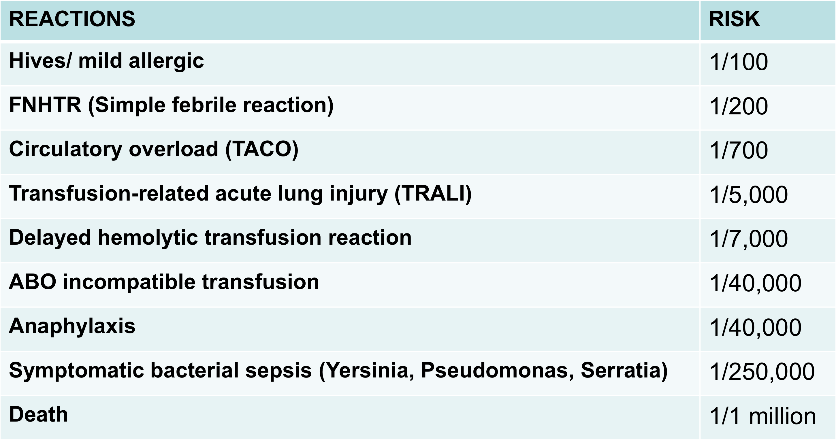
What Are the Odds?
Risk per unit transfused

Slide 62
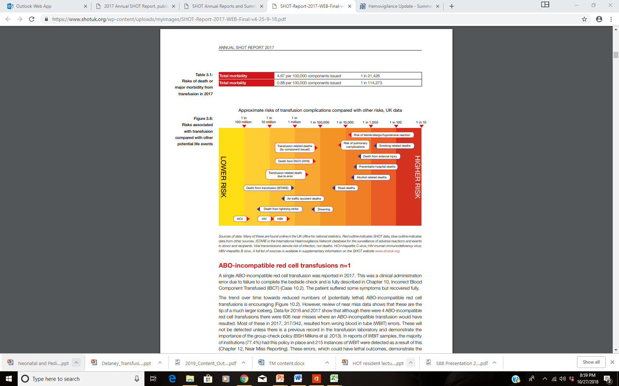
Relative risks of transfusion (UK data 2017)
 | per 100,000 units | Incidence
Total morbidity | 4.67 | 1 in 21,426
Total mortality | 0.88 | 1 in 114,273
PHB Bolton-Maggs (Ed) D Poles et al. on behalf of the Serious Hazards of Transfusion (SHOT) Steering Group. The 2017
Annual SHOT Report (2018). https://www.shotuk.org/wp-content/uploads/myimages/SHOT-Report-2017-WEB-Final-v4-25-9-18.pdf . © Serious Hazards of Transfusion (SHOT). Reproduced with permission.

Slide 63
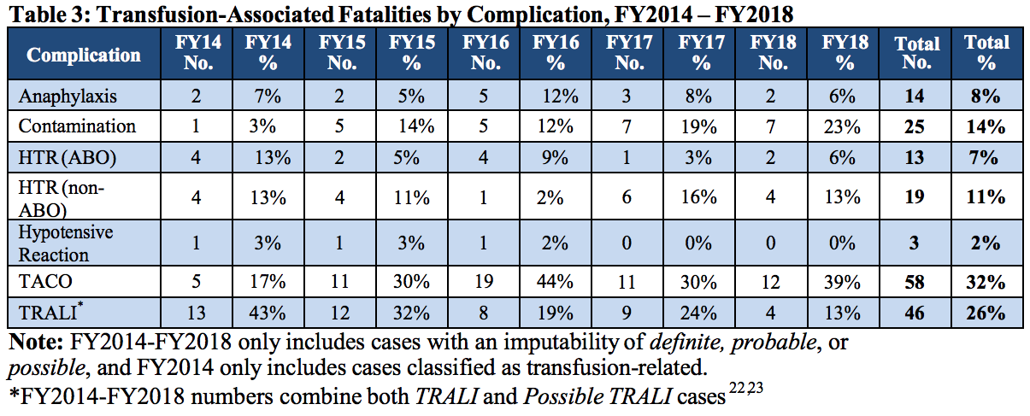
From Fatalities Reported to FDA Following Blood Collection and Transfusion Annual Summary for FY2018, p. 5,
https://www.fda.gov/media/136907/download

Slide 64
Donor screening for infectious disease in US
HIV Ab, RNA
Hepatitis C Ab, RNA
Hepatitis B surface Ag, core Ab, RNA
HTLV I/II
Syphilis
West Nile virus RNA
Zika
T. cruzi
Babesia: not all states
CMV
Not screened:
  Creutzfeldt-Jakob disease
  Variant Creutzfeldt-Jakob disease
  Malaria
  Hepatitis E
  Unknown pathogens
  Non-blood borne pathogens

Slide 65
Risk of transfusion-transmitted infection in US
Infection | Per unit transfused
Hepatitis B | 1:250,000-1.5 million
Hepatitis C | 1:1.5 million
HIV | 1:2.9 – 4.7 million
HTLV I & II | 1:2,000,000
Syphilis | None since 1966
West Nile Virus | ~ 1 case per year

Slide 66
General Thoughts on Transfusion Reactions
First step is to STOP THE TRANSFUSION!!!
It’s better to overcall a transfusion reaction than under call a transfusion reaction
Additional symptoms matter
  Fever + hypotension is worse than fever alone
  Respiratory distress + hypertension = TACO
  Respiratory distress + hypotension = TRALI
Not everything that occurs during a transfusion is a transfusion reaction
Some weird things that occur during a transfusion may be a reaction

Slide 67
Allergic Reactions
Type | Non-infectious, acute
Risk | Mild: 1:100 (Platelets most common, up to 6%), Severe: 1:40,000
Timing | Mild - seconds to 2-3 hours after start Severe - seconds to 45 min after start
Clinical presentation | Mild - pruritus, hives, erythema, angioedema Severe - airway obstruction (stridor/wheeze/dyspnea), hypotension/shock, tachycardia, GI symptoms
Pathophysiology/etiology | Mild/severe: type 1 hypersensitivity (mast cell) Severe: IgA deficiency* Citrate allergy: Patients allergic to citrus fruits
Diagnosis | Based on symptoms
Treatment | 1) Mild: Stop Tx, antihistamine (you can restart) 2) Severe: Stop Tx, Epinephrine, ABC support
Prevention | Volume reduction, premedication

Slide 68
*Allergic Reactions: Boards vs. the Real World
People with IgA deficiency can develop anaphylaxis following blood transfusion due to anti-IgA antibodies
Prevention/Management: Transfuse washed products or products from IgA-deficient donor.
On Boards this happens all the time. If the question mentions anaphylaxis, choose the answer that includes IgA.
In the real world, not so much.¹
  A hemovigilance program in France reviewed > 32,000,000 transfusions, 9085 of which resulted in allergic reaction (0.028%), 18 were diagnosed with IgA deficiency (0.2%)
  Therefore, 99.8% of patients with allergic transfusion reaction did not have IgA deficiency
¹Tacquard et al. 2017. J Allergy Clin Immunol. 140(3):884-5

Slide 69
Febrile Non-Hemolytic Reactions (FNHTR)
Type | Non-infectious, acute
Risk | 1:200 (0.5%), #2 most common!!!
Timing | During or within 4 hours of a transfusion (usually at end)
Clinical presentation | Fever > 37.5°C (100.4°F) and/or temperature rise of >1°C (1.8°) Chills, rigors Cold sensation, discomfort Headache, nausea/vomiting
Pathophysiology/etiology | IL-1,6 and TNF-a from activated monocytes and macrophages passive/induced donor-derived cytokines
Diagnosis | Diagnosis of exclusion Rule out hemolysis, sepsis, TRALI, underlying medical condition
Treatment | Stop transfusion, antipyretics (fever), meperidine (rigors)
Prevention | Leukoreduction, premedication

Slide 70
Transfusion-Related Acute Lung Injury (TRALI)
Type | Non-infectious, acute
Risk | 1/5,000 (more common with plasma transfusions)
Timing | During or within 6 hours of a transfusion
Clinical presentation | Respiratory distress, hypoxia Pulmonary edema/infiltrates on CXR Fever, hypotension
Pathophysiology/etiology | Donor anti-recipient antibodies (HNA or HLA) Pro-inflammatory molecules (sCD40L)
Diagnosis | Criteria-based (New ALI within 6 hours of transfusion) Diagnostic testing can look for antibody/cognate antigen pairs in donor/recipient (not needed for diagnosis)
Treatment | Stop transfusion, supportive care (Resolves in 24-48 hours)
Prevention | Male-only plasma pool

Slide 71
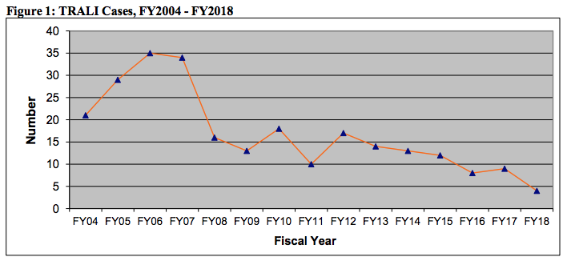
TRALI
Most commonly caused by donor anti-human neutrophil antigen (HNA) antibodies binding to recipient neutrophils
Women who have previously been pregnant have highest incidence and titer of anti-HNA antibodies
Incidence has been decreasing due to restrictive plasma donation policies
From “Fatalities Reported to FDA Following Blood Collection and Transfusion Annual Summary for FY2018”, p. 7,
https://www.fda.gov/media/136907/download

Slide 72
Transfusion-Associated Circulatory Overload (TACO)
Type | Non-infectious, acute
Risk | 1/700 (more common with large volume transfusions)
Timing | During or within 6 hours of a transfusion
Clinical presentation | Respiratory distress Hypoxia Pulmonary edema/infiltrates on CXR Evidence of fluid overload such as hypertension
Pathophysiology/etiology | Volume overload leading to pulmonary edema
Diagnosis | CXR findings of pulmonary edema Response to Lasix
Treatment | Stop transfusion, give diuretics and supportive respiratory care
Prevention | Minimize volume, give Lasix between units, stop other IVF

Slide 73
Acute Hemolytic Transfusion Reaction (AHTR)
Type | Non-infectious, acute
Risk | 1/40,000
Timing | During transfusion (as little as 5-10 mL of donor blood transfused)
Clinical presentation | Fever Anxiety/Panic Low back pain Evidence of hemolysis (hemoglobinuria, hyperbilirubinemia) Hypotension
Pathophysiology/etiology | Isohemagglutinins binding donor red cells and complement fixation causing RBC destruction Mis-identification of crossmatch sample or transfusion recipient
Diagnosis | +DAT, evidence of hemolysis
Treatment | Stop transfusion! Fluid support including diuresis
Prevention | Careful labeling of crossmatch sample, dual check to ensure blood and patient label match

Slide 74
Delayed Hemolytic Transfusion Reaction (DHTR)
Type | Non-infectious, delayed
Risk | 1 in 2,500 hospitalized patients
Timing | 1 – 28 days after transfusion
Clinical presentation | Anemia Jaundice and indirect hyperbilirubinemia Spherocytosis and reticulocytosis Positive direct and indirect antibody tests
Pathophysiology/etiology | Pre-formed antibodies not seen on antibody screen Development of new alloantibodies after transfusion exposure
Diagnosis | +DAT, evidence of hemolysis
Treatment | Often self-limiting, patient may require another transfusion
Prevention | Obtain accurate past transfusion records

Slide 75

Hemolytic Transfusion Reactions (HTR)
Acute HTR –
Intravascular Hemolysis
Complement activation can result in destruction of recipient RBCs
Red urine
(hemoglobinuria)
Red plasma
Donor RBCs
Recipient
antibodies
Complement-
mediated RBC destruction
Empty RBC membrane
Spleen
Yellow urine
Delayed HTR –
Extravascular Hemolysis
The recipient’s RBCs are usually spared destruction
Y
Y
Y
Y
Liver
Y
Yellow plasma
RES
Donor RBCs
Recipient
antibodies
Antibody-coated RBCs
Sequestration and macrophage consumption

Slide 76
Acute Septic Transfusion Reaction
Type | Infectious, acute
Epidemiology/Risk | 0.6 (RBCs) and 9 - 14 (platelets) per 1,000,000 units
Timing | During transfusion or shortly thereafter
Clinical presentation | Fever Hypotension Respiratory distress Post-transfusion positive blood culture
Pathophysiology/etiology | Administration of bacteria directly into bloodstream Administration of endotoxin or other bacterial byproducts
Diagnosis | Positive blood culture of unit and patient Positive blood culture of unit and sick patient Positive blood culture in patient with no other possible source
Treatment | Stop transfusion! Broad-spectrum antibiotics, supportive care
Prevention | Donor screening, proper disinfection at time of collection, pathogen reduction, bacterial surveillance of platelets

Slide 77
Septic Transfusion Reactions
RBCs
0.56:1,000,000
Frequently gram positive bacteria
  Skin flora
  CoNS
Cold-tolerant bacteria
  Serratia
  Yersinia
  Listeria
Include pseudomonal coverage when starting antibiotics
Platelets
1:70,000-110,000 (apheresis)
1:30,000 (whole blood-derived)
Frequently gram positive bacteria
  Skin flora
  CoNS
Less common is gram negative
  Serratia
  Enterobacter
  Salmonella

Slide 78
TA-GVHD
Type | Non-infectious, delayed
Epidemiology/Risk | Very rare, 0 with irradiation or pathogen inactivation, > 90% fatal
Timing | 5-10 days after transfusion, marrow aplasia by 21 days
Clinical presentation | Rash Fever Abdominal pain, vomiting, and diarrhea Identical to SCT-related GVHD
Pathophysiology/etiology | Engraftment of donor T lymphocytes Immunosuppressed recipient Shared HLA haplotype(s) between donor and recipient
Diagnosis | Skin, intestinal, and/or bone marrow biopsy showing GVHD
Treatment | Supportive care. Irreversible and almost universally fatal due to bone marrow aplasia
Prevention | Irradiation or pathogen inactivation

Slide 79
Assorted Transfusion Reactions Boards May or May Not Ask You About
Reaction | Pathophysiology | Epi/Risk | Diagnosis | Management
Cold transfusion reaction | Blood products are < 37°C when transfused | Unknown | Body temperature < 36° May be difficult to distinguish from rigors | Blood warmer Other warming techniques
Citrate toxicity | Citrate chelates calcium. Accumulation when infusion > metabolism. Associated with massive transfusion or apheresis. | Unknown | Signs/symptoms of hypocalcemia Cardiac arrhythmias Low serum calcium | Slow rate of transfusion Administer calcium
Hypotension | Contact activation and bradykinin generation | 0.4-1.3 per 100,000 | > 30 mm Hg drop in systolic or diastolic BP | Supportive measures
Hyperkalemic cardiac arrest | Potassium leakage from stored RBCs. Worse with older and/or irradiated units | Unknown | Cardiac arrest and hyperkalemia | Standard hyper-K Tx Maximum RBC infusion rate: 0.5 mL/kg/min
Post-transfusion purpura | Transfusion causes 2° response against HPA in pre-alloimmunized patients. Mechanism of self- platelet destruction unknown. | Unknown | Thrombocytopenia 5 – 12 days post-transfusion | Plasma exchange IVIg

Slide 80
Summary of Transfusion Reactions
Boards will most likely ask about transfusion reactions/risks
Consider the relationship between component storage and transfusion reactions
  Storage temp and duration can have impact on bacterial contamination
  Amount of plasma can affect allergic transfusions
Consider the relationship between component modification and transfusion reactions
  Irradiation to prevent TA-GVHD
  Volume reduction to decrease risk of TACO
Understand the purpose of pre-transfusion testing (Type & Screen)

Slide 81
Good luck and pay attention to the Roman numerals.

