Slide 1
Thrombotic Disorders
Sarah O’Brien, MD, MSc
Nationwide Children’s Hospital

Slide 2
Topics to be Discussed:
Domain 4: Hemostasis/Thrombosis
C. Acquired disorders of coagulation
  2. Lupus anticoagulants and coagulation inhibitors
D. Thrombotic disorders
  Approach to thrombosis
  Inherited thrombophilia
  Acquired risk factors for thrombosis
  Anticoagulation: unfractionated heparin, low molecular-weight heparin, vitamin K antagonists, direct thrombin inhibitors, and other anticoagulants
  Thrombolysis
  Post-thrombotic syndrome

Slide 3


BASIC SCIENCE & PATHOPHYSIOLOGY

Slide 4
The Pathophysiology of a Blood Clot
Endothelial Injury
Virchow’s Triad
Hypercoagulability
Venous Stasis
© 2018 Dr. Vijaya chandar, MBBS. This file is licensed under the Creative Commons Attribution-Share Alike 4.0 International license; adapted from https://commons.wikimedia.org/wiki/File:Virchow%27s_triad.jpg.
Notes:
Figure is from Wikimedia, designed by my admin b/c the Wikimedia one had a typo

Slide 5
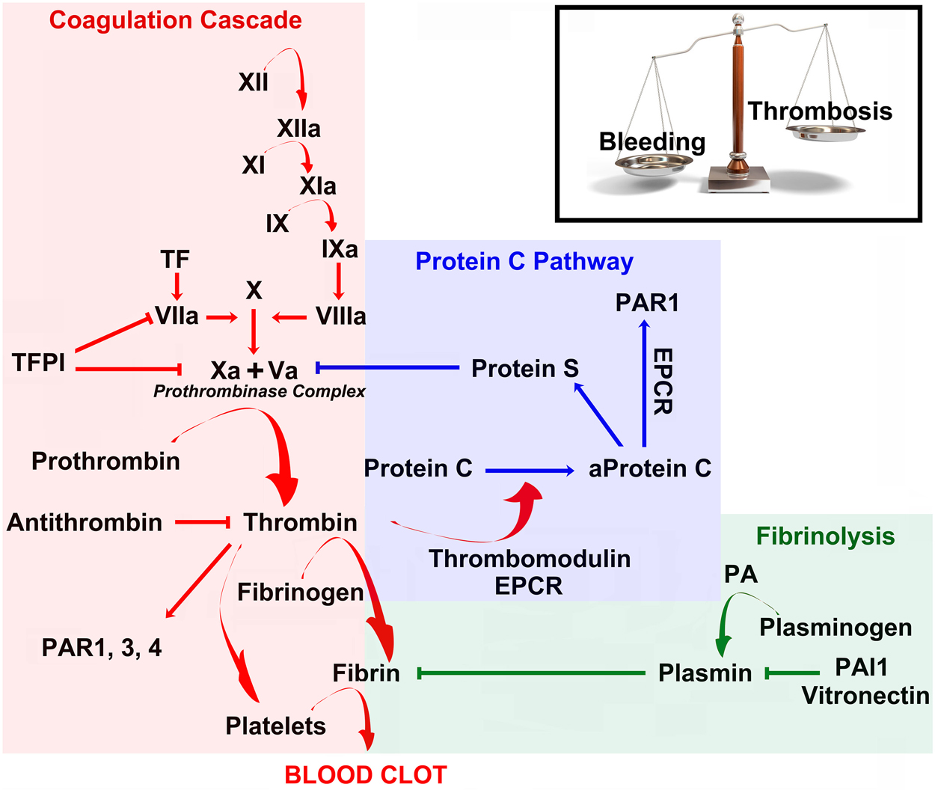
Thrombophilia and the Coagulation Cascade
© 2015 Ben Shimon M, Lenz M, Ikenberg B, Becker D, Shavit Stein E, Chapman J, Tanne D, Pick CG, Blatt I, Neufeld M, Vlachos A and Maggio N (2015) Thrombin regulation of synaptic transmission and plasticity: implications for health and disease. Front Cell Neurosci. 9:151. doi: 10.3389/fncel.2015.00151. This file is licensed under the Creative Commons Attribution-Share Alike 4.0 International license.

Slide 6
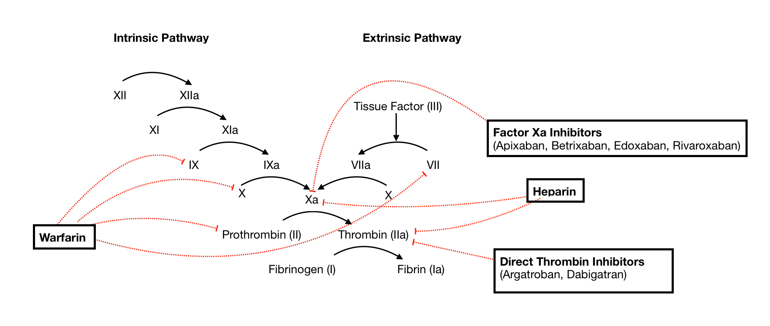

Anticoagulants and the Coagulation Cascade
Fondaparinux
© 2020 SteveKong3. This file is licensed under the Creative Commons Attribution-Share Alike 4.0 International license.; modified from https://commons.wikimedia.org/wiki/File:Coagulation_Cascade_and_Major_Classes_of_Anticoagulants.png.

Slide 7
EPIDEMIOLOGY & RISK ASSESSMENT

Slide 8
Epidemiology of Pediatric VTE
Rare disease (occurs in <1 per 10,000 children)
Notably more common in hospitalized children (~ 1 per 1,000 admits) and rates continue to increase
The majority of VTE in pediatric patients is provoked by at least one, and typically more than one, risk factor
The most common risk factor for DVT in children is the presence of a central line (particularly in neonatal thrombosis)
Mahajerin and Croteau. Front Pediatr 2017.
Jaffray and Young. Pediatr Blood Cancer 2018.
Notes:
In contrast to adults in which 30-50% events are idiopathic/spontaneous
The neonatal group represents a unique population of ill neonates, often premature, in whom DVT is overwhelmingly caused by CVCs

Slide 9
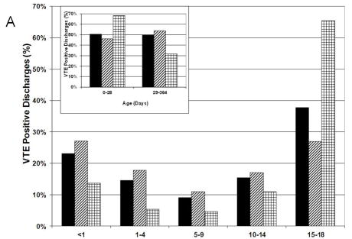
Age Distribution of Pediatric VTE
Setty BA et al. Pediatric VTE in the United States. Pediatr Blood Cancer. 2012.
Notes:
The incidence of thrombosis in children has a bimodal distribution; the highest peak occurs in children <1 month of age (accounts for about 20% of pediatric VTE), with the 2nd peak occurring during adolescence (50% of events occur in children 11-18 years of age).
Many of the adolescent events are cared for in community hospitals – we may not be aware unless they are referred to us for ongoing outpatient management

Slide 10
Acquired Risk Factors for Thrombosis
Top 3
Central venous catheters
Cancer
Cardiac disease
Renal disease
Liver disease
Rheumatologic disease
Inflammatory bowel disease
Diabetes
Infection
Surgery
Trauma
Immobility
Obesity
Estrogen
Dehydration
Antiphospholipid syndrome
Notes:
Malignancy and congenital heart disease are the two chronic diseases with the highest risk for thrombosis
Estrogen containing contraception reduces Protein S activity and increases activated Protein C resistance
APS would considered an acquired thrombophilia

Slide 11

How to Evaluate for an Inherited Thrombophilia
WHAT should I check?
  Antithrombin deficiency
  Protein C deficiency
  Protein S deficiency
  Factor V Leiden mutation
  Prothrombin G20210A mutation
WHEN should I evaluate?
Non-CVL related thrombosis
Recurrent thrombosis
Acquired risk factor in patients with strong family history of VTE (first degree relative <40 years or multiple relatives)
Notes:
cancer, CVC, trauma, major surgery, current OCP use or considering OCP use
We limit inherited thrombophilia (IT) testing to these tests since the pathogenic link to VTE is most clearly established for these five defects. Numerous other inherited defects have been described; however, none have gained widespread acceptance. In particular, testing for polymorphisms in the methylene tetrahydrofolate reductase (MTHFR) gene is not helpful because they are very common and they are not, by themselves, associated with VTE
Functional assays – keep in mind that these levels will drop transiently at time of VTE presentation due to consumption
DNA-based tests

Slide 12
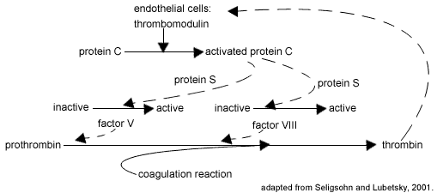
Factor V Leiden Mutation
FVL is a mutant form of Factor V which renders it insensitive to the actions of activated Protein C, a natural anticoagulant
Most common inherited thrombophilia in the US
    Caucasians ~ 5%
    Hispanic ~2%
    Other ethnic groups ~1%
From Seligsohn U, Lubetsky A. Genetic susceptibility to venous thrombosis. N Engl J Med. 2001 Apr 19;344(16):1222-31. doi: 10.1056/NEJM200104193441607. PMID: 11309638. © Massachusetts Medical Society. Reproduced with permission.
Notes:
Modifications in which diluted patient plasma is mixed with factor V-deficient plasma assays have resulted in "second generation" functional assays that correlate extremely well with the presence of the FVL mutation
PCR testing to detect genetic mutation

Slide 13
Prothrombin G20210A Mutation
Second most common inherited thrombophilia
  Predominantly identified in Caucasians (~2%)
Substitution of adenine for guanine in the prothrombin (Factor II) gene
Heterozygotes have ~30% higher plasma prothrombin levels than controls
From Seligsohn U, Lubetsky A. Genetic susceptibility to venous thrombosis. N Engl J Med. 2001 Apr 19;344(16):1222-31. doi: 10.1056/NEJM200104193441607. PMID: 11309638. © Massachusetts Medical Society. Reproduced with permission.
Notes:
at position 20210 in a non-coding region of the prothrombin….
And this is thought to be the mechanism for increased risk of thrombosis

Slide 14
Factor V Leiden
Clinical Manifestations:
  Majority of patients are asymptomatic (95% never have VTE)
  Increased risk of VTE (about 4X greater than general population)
  Arterial thrombosis – data are mixed and FVL likely has a small impact on risk
  Obstetrics -may play a role in some cases of unexplained recurrent late pregnancy loss
For those with VTE:
  Low risk of recurrence in heterozygous state
  Should not alter decision making regarding duration of anticoagulation
  Recent data suggests risk of recurrence also low in homozygous state
Notes:
presumably due to thrombosis of placental vessels

Slide 15
Prothrombin G20210A Mutation
Clinical Manifestations:
  Increased risk of VTE (about 3-4X greater than general population)
  Arterial – does not appear to be a major risk factor, although meta-analyses have documented slightly increased risks in certain settings.
  Obstetrics – if an association exists, it is likely to be small
Low risk of VTE recurrence in heterozygous state
  Should not alter duration of anticoagulation
Notes:
And this is thought to be the mechanism for increased risk of thrombosis

Slide 16
Antithrombin, Protein C, and Protein S Deficiencies
From Ben Shimon M, Lenz M, Ikenberg B, et al. Thrombin regulation of synaptic transmission and plasticity: implications for health and disease. Front Cell Neurosci. 2015;9:151. Published 2015 Apr 21. doi:10.3389/fncel.2015.00151. © 2015 Ben Shimon, Lenz, Ikenberg, Becker, Shavit Stein, Chapman, Tanne, Pick, Blatt, Neufeld, Vlachos and Maggio. This file is licensed under the Creative Commons Attribution-3.0 license (CC-BY).
Notes:
Rare, severe inherited thrombophilias

Slide 17
 | Protein C Def | Protein S Def | Antithrombin Def
Prevalence in VTE patients | 2-5% | 1% | <1%
Event Type | DVT PE Mesenteric CSVT Arterial Linked to fetal loss | DVT PE Mesenteric CSVT Small risk of arterial events | DVT PE Mesenteric CSVT Pregnancy-related VTE
Recurrence | High risk | High risk | Very high risk
Typical Levels | Levels <55% (70-150%) | Levels <35% (60-120%) | Levels <40-60% (110-140%)
Other Notes | Warfarin skin necrosis | Warfarin skin necrosis | Heparin resistance
Notes:
Recognize the association of skin necrosis with warfarin therapy in patients with heterozygous protein C or protein S deficiency

Slide 18



Levels of Natural Anticoagulants Change with Age
  Levels of natural anticoagulants are all low in infancy
  Antithrombin and Protein S activity reach adult levels by 6-12 months of age
  Protein C activity remains lower than adult levels until late teens/early 20s
Top: https://pixabay.com/photos/newborn-baby-infant-cute-little-990691/
Middle: https://www.pexels.com/photo/photo-of-toddler-running-1073088/. Image courtesy of Brett Sayles.
Bottom: https://www.freestock.com/free-photos/happy-graduation-student-full-success-outdoors-21638905. Image used under license from Freestock.com.

Slide 19
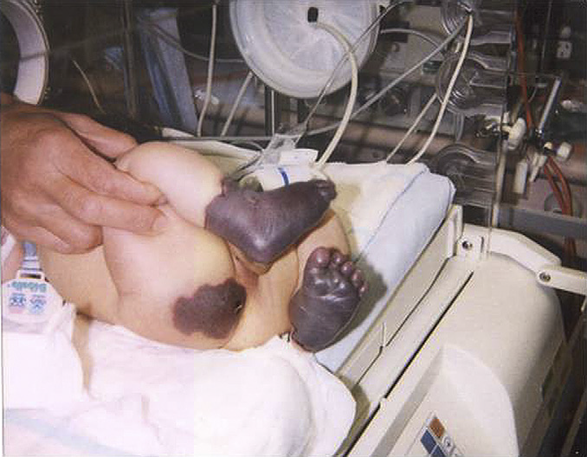
Homozygous Protein C or Protein S Deficiency
Presents in infancy as purpura fulminans
Management:
  Aggressive FFP replacement at time of presentation
  Protein C concentrate if applicable
  Long term management includes LMWH, warfarin, protein C replacement, or a combination of agents
From Price VE, Ledingham DL, Krümpel A, Chan AK. Diagnosis and management of neonatal purpura fulminans. Semin Fetal Neonatal Med. 2011 Dec;16(6):318-22. doi: 10.1016/j.siny.2011.07.009. © 2011 Elsevier Ltd. Reprinted with permission.
Notes:
Homozygous antithrombin deficiency
Usually fatal in utero
Case reports of liver transplant

Slide 20
Antiphospholipid Antibody Syndrome
Consider this diagnosis in the setting of unprovoked VTE or new VTE in a patient with underlying autoimmune disease
Definition - persistent presence of antiphospholipid antibodies or lupus anticoagulant for ≥ 12 weeks in context with an acute thrombotic event
Laboratory Evaluation
  Lupus anticoagulant
  Anticardiolipin antibodies
  Anti-β2 glycoprotein
Management – long-term anticoagulation
Notes:
Venous or arterial thrombosis
Recurrent pregnancy loss < 10 week gestation
Premature delivery or fetal demise >10 week gestation

Slide 21
Lupus Anticoagulants
Antibodies directed against phospholipid-binding proteins
Diagnosed by demonstration of a prolonged phospholipid-dependent screening test of hemostasis
  dilute Russell viper venom time (dRVVT)
  activated partial thromboplastin time (aPTT)
  StaClot – LA
LA are characterized by correction of the prolonged clotting time with added phospholipid but not with control plasma, confirming that the coagulation inhibitor is phospholipid-dependent

Slide 22
DIAGNOSIS

Slide 23
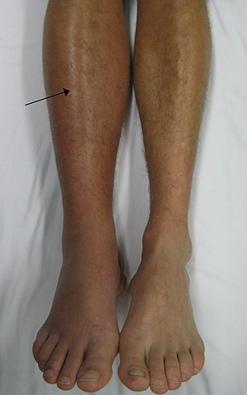
Signs and Symptoms of DVT
  Acute swelling of extremity
  Pain or tenderness
  Discoloration (red, purple)
  Warmth
© James Heilman, MD. This file is licensed under the Creative Commons Attribution-Share Alike 3.0 Unported license; https://commons.wikimedia.org/wiki/File:Deep_vein_thrombosis_of_the_right_leg.jpg

Slide 24
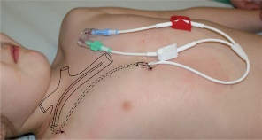
Signs and Symptoms of Catheter-related DVT
Acute
  Extremity swelling
  Extremity pain
  Discoloration
  Line malfunction
Chronic “asymptomatic”
  Catheter occlusion
  Prominent chest wall veins
  Recurrent bacteremia
From Tomaszewski M, Kosiak W, Irga N, Połczyńska K. Ultrasound assessment of thrombotic complications in pediatric patients with tunneled central venous catheters. J Ultrason. 2013;13(55):451-459. doi:10.15557/JoU.2013.0049. This work is licensed under Creative Commons Attribution-NonCommercial-NoDerivatives License (http://creativecommons.org/licenses/by-nc-nd/4.0/) – CC-BY-NC-ND.

Slide 25

Signs and Symptoms of Pulmonary Embolism
Chest pain
Shortness of breath
Hypoxia
Fever
Cough / hemoptysis
Rapid or irregular heartbeat
Only 20% of children have the classic triad at presentation

Slide 26

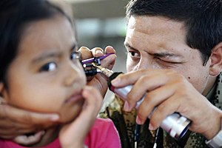
Signs and Symptoms of
Cerebral Sinovenous Thrombosis
Presentation
Risk Factors
  Headache
  Seizures
  Cranial nerve palsies
  Papilledema
  Dehydration
  Lymphadenitis
  Ear infection progressing to mastoiditis
  Jugular vein catheterization
  Neonatal age group
top left: https://pixabay.com/photos/girl-kid-facial-watch-eye-toddler-609639/
bottom right: https://commons.wikimedia.org/wiki/File:Defense.gov_photo_essay_110719-F-ET173-093.jpg

Slide 27
Diagnostic Considerations for Unprovoked VTE
Uncommon clinical scenario
Detailed family history
Laboratory evaluation for inherited thrombophilia and antiphospholipid syndrome
Look for anatomic variants
  May Thurner syndrome
  Thoracic Outlet Syndrome
  IVC atresia/anomalies

Slide 28
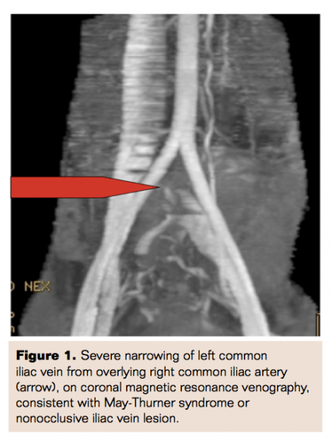
May-Thurner Syndrome
Left-sided iliofemoral thrombosis
Narrowed left iliac vein due to chronic compression from right iliac artery
Most commonly seen in females in the 2nd to 3rd decade of life
From Mahajerin A, Croteau SE. Epidemiology and risk assessment of Pediatric VTE (Figure 1). Front Pediatr. 2017. Reprinted with permission from Vascular Disease Management. https://www.vasculardiseasemanagement.com/content/diagnosis-and-treatment-may-thurner-syndrome. © 2020 HMP Global. All rights reserved.
Notes:
Post-partum, OCPs, multiparous
●Female gender, particularly those who are postpartum, multiparous, or using oral contraceptives
●Scoliosis may predispose to MTS due to compression from the lower lumbar vertebra
●Dehydration
●Hypercoagulable disorders

Slide 29
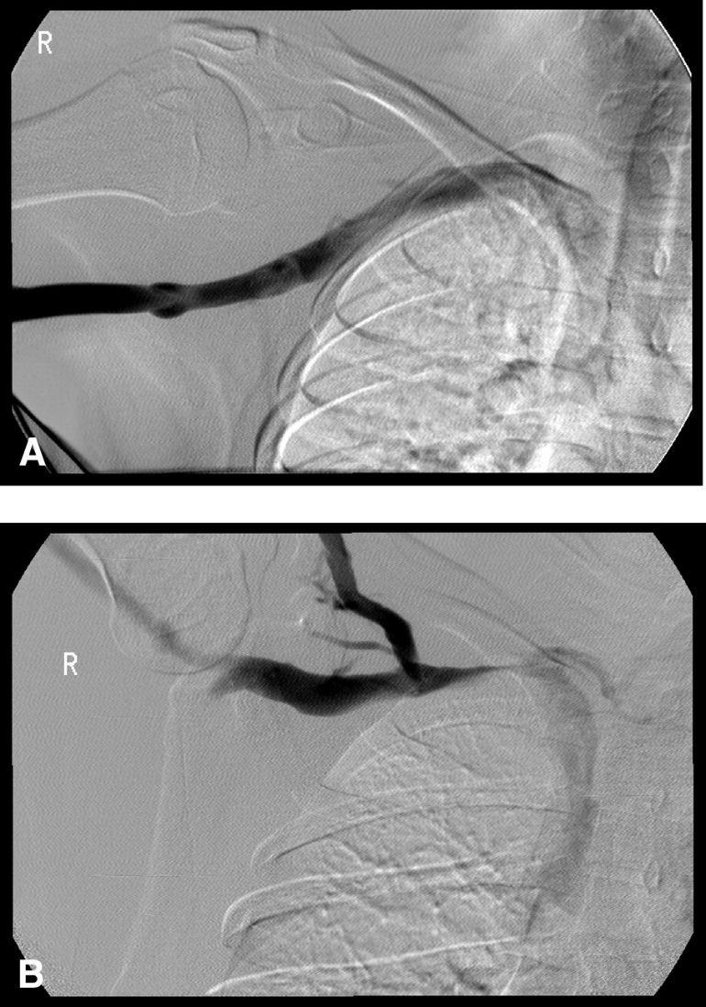
Paget-Schroetter Syndrome /
Thoracic Outlet Syndrome
Axillary/subclavian DVT
Associated with repetitive activity (baseball, softball, swimming, volleyball)
Compression of veins by extra rib, muscle group
Management - first rib resection
Notes:
Effect of arm position on the axillary/subclavian vein at the costoclavicular junction. A, Arm outstretched but less than 90 degrees. Note the absence of obstruction and the absence of collaterals. B, Arm abducted well over 90 degrees. Note the smooth extrinsic compression at the costoclavicular junction and the visualization of the external jugular vein and surrounding collaterals.

Slide 30
MANAGEMENT & TREATMENT

Slide 31
Treatment Options for VTE
Unfractionated heparin
Low molecular weight heparin
Fondaparinux
Parenteral direct thrombin inhibitors
Vitamin K antagonists
Direct oral anticoagulants
Thrombolysis
Notes:
“and other”

Slide 32
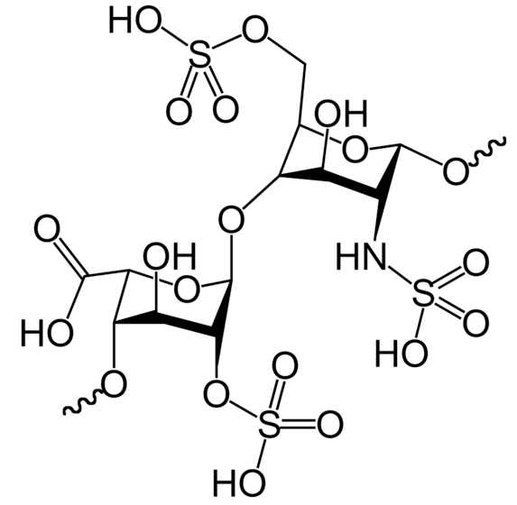
Unfractionated Heparin
  Naturally occurring anticoagulant
  Consists of molecular chains of varying lengths (5,000-40,000 Da)
  Binds reversibly to antithrombin
  After binding, increases antithrombin’s inhibition of thrombin and Factor Xa
  Binds non-specifically to a variety of plasma proteins
Notes:
Know the action of anticoagulant drugs used in thrombotic states or in patients with thrombophilia
Resulting in unpredictable dose-response relationship
Indirect effect on X and thrombin

Slide 33
Low Molecular Weight Heparin and Fondaparinux
Low molecular weight heparin
Consists of only short chains (most <8,000 Da)
Binds to and accelerates the activity of antithrombin, but with a preferential and longer-lasting effect on Xa
Less able to inhibit thrombin and bind to other plasma proteins
Fondaparinux
Binds and enhances activity of antithrombin by 300-fold
Does not bind to other plasma proteins
No direct effect on thrombin
Notes:
Also binds to and accelerates…
Accounts for more predictable a/c response, less inter-patient variability, and longer duration of action than heparin

Slide 34
Comparing UFH, LMWH, and Fondaparinux
 | Mechanism | Other Activity | Monitoring
Unfractionated heparin | Binds to and increases antithrombin (AT) inhibition of Factor Xa AND thrombin | Binds non-specifically to a variety of plasma proteins | PTT, ACT, anti-Xa
Low molecular weight heparin | Binds to and increases AT inhibition of Xa and thrombin, but with a preferential and longer-lasting effect on Xa | Less able to bind to other plasma proteins | Anti-Xa
Fondaparinux | Binds and strongly enhances activity of AT, only inhibits Xa, with no direct effect on thrombin | Does not bind to other plasma proteins | Anti-Xa assay that is calibrated for fondaparinux

Slide 35
Advantages and Disadvantages of UFH vs LMWH
UFH
Continuous IV infusion
Good first choice in unstable patient or one likely to need a procedure
Short half life (30 mins)
Reversible with protamine
LMWH
Subcutaneous injection
Easier to use in stable patient
More predictable pharmacokinetics
Requires good renal function
Longer half life (4-7 hours)
Incomplete reversal with protamine

Slide 36
Monitoring Unfractionated Heparin
Monitor labs at least daily, and 4 hours after any dose changes
PTT (target range 65-80 seconds or 1.5-2.5X baseline)
  Sensitive to numerous factors: improper collection, anemia, thrombocytopenia, factor deficiencies, lupus anticoagulant, patient age
ACT (target range depends on clinical use e.g. ECMO, cardiac catheterization)
  Sensitive to platelet counts and function, factor deficiencies, ambient temperature, hypothermia, lupus anticoagulant
Anti-Xa most consistent result (target 0.3-0.7 units/ml)
  Affected by hemolysis, high bilirubin, high triglycerides
  Not affected by age or coagulopathy

Slide 37
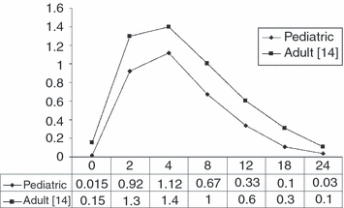
Monitoring Low-molecular-weight Heparin
Obtain anti-Xa level 4-6 hours after dose
Goal 0.5 to 1.0 U/ml for treatment
  Goal 0.1-0.3 for prophylaxis
Infants <3 months need higher doses and more frequent monitoring due to a larger volume of distribution
From O'Brien SH, Lee H, Ritchey AK. Once-daily enoxaparin in pediatric thromboembolism: a dose finding and pharmacodynamics/pharmacokinetics study. J Thromb Haemost. 2007 Sep;5(9):1985-7. doi: 10.1111/j.1538-7836.2007.02624.x. © 2007 International Society on Thrombosis and Haemostasis. Reprinted with permission.

Slide 38
Effect of UFH on Coagulation Assays
Recognize the effect of UFH on coagulation assays (PTT, thrombin time) in specimens from plasma, in particular specimens drawn from central catheters
Know that the presence of heparin can be determined by measuring coagulation assays before and after the addition of a heparin-neutralizer (heparinase)

Slide 39
Heparin-induced Thrombocytopenia (HIT)
Life threatening complication of exposure to heparin (UFH or LMWH)
Rarely seen in pediatrics (~1% rate in PICU, heart surgery, NICU)
Due to formation of auto-antibodies against endogenous platelet factor 4 (PF4)
Development of auto-antibody takes about 5 days
Results in thrombocytopenia and high risk of arterial and venous thrombosis
STOP heparin and initiate alternative anticoagulant (direct thrombin inhibitors)
Test for HIT Ab (ELISA) & confirm with functional assay (serotonin release)
AVOID platelet transfusions unless severe hemorrhage
Notes:
HIT results from an autoantibody directed against endogenous platelet factor 4 (PF4) in complex with heparin. This antibody activates platelets and can cause catastrophic arterial and venous thrombosis
The major mechanism of thrombocytopenia in HIT is removal of IgG-coated platelets by macrophages of the reticuloendothelial system (eg, spleen, liver, bone marrow), similar to other types of drug-induced immune thrombocytopenia. A second cause of thrombocytopenia is consumption of platelets within thrombi.
Unlike most other forms of drug-induced immune thrombocytopenia, HIT is also associated with arterial and venous thrombosis. The mechanism is unknown, although the ability of HIT antibodies to activate platelets is paramount

Slide 40
Parenteral Direct Thrombin Inhibitors
 | Argatroban | Bivalirudin
Thrombin Binding | Reversible | Partially reversible
Half-life in Healthy Subjects | 45 minutes | 25 minutes
Elimination | Hepatic | Renal
Lab Monitoring | aPTT, ACT | aPTT, ACT
Antidote | None | None

Slide 41
Vitamin K Antagonists (Warfarin)
Mechanism - inhibits the synthesis of vitamin K-dependent clotting factors, which include: Factors II, VII, IX, and X
Don’t forget VKA also inhibits Proteins C and Protein S
Must be given with another anticoagulant for ≥5 days and until a therapeutic INR is achieved
Once daily oral dosing, typically around 0.1 mg/kg/day
Laboratory monitoring by INR - a calculation made to standardize prothrombin time (PT)
  INR is the ratio of the patient's PT and the normal mean PT

Slide 42
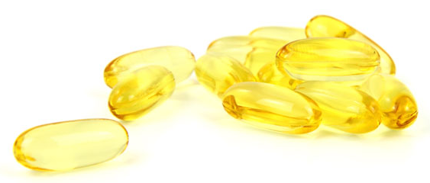
Recognize that many dietary items and drugs can interact with vitamin K antagonists
Initiation and discontinuation of medications
  Antibiotics
  Anti-convulsants
  Anti-fungals
  Antacids
Febrile illnesses
Gastroenteritis
Liver disease
Vitamin K containing foods
Infant / enteral formulas
Mango
Avocado
Fish Oil
Soy milk
Grapefruit

Slide 43
Know the various means to reverse vitamin K antagonists
Vitamin K
  Can be given PO, SQ or IV
Fresh Frozen Plasma
  Stops bleeding but does not completely reverse VKAs
Prothrombin Complex Concentrate
  Contains high concentrations of many Vitamin K dependent proteins

Slide 44
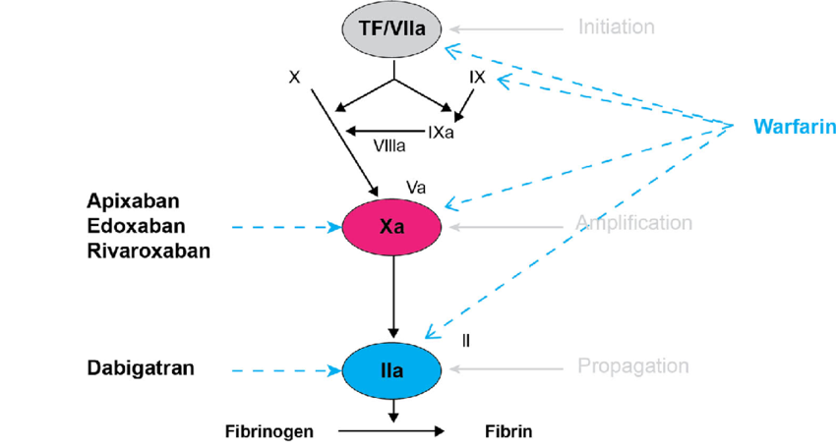
Direct Oral Anticoagulants
Comparable efficacy to VKA in adults, but with significantly lower risk of bleeding
All DOACs have ongoing pediatric investigational plans
Rivaroxaban Phase 3 and dosing studies have been published
Liquids not yet available on market
Reversal agents FDA approved
Content created on this site is licensed under Creative Commons Attribution 4.0 International License; Mechanism of action of the direct oral anticoagulants. Reprinted with permission from: J Thromb Haemost 2005;3:1843–53; https://www.ncbi.nlm.nih.gov/pmc/articles/PMC4715843/
Notes:
2 classes – DTI and Direct Anti-Xa inhibitors
In adults, approved for VTE treatment, prevention, and stroke prevention due atrial fibrillation

Slide 45
Comparing the DOACs
 | Target | Half-life (hours) | Clearance
Dabigatran | Thrombin | 11 – 14 (BID) | RENAL
Rivaroxaban | Factor Xa | 5 – 9 (QD) | Renal
Apixaban | Factor Xa | 9 – 14 (BID) | LIVER/Renal
Notes:
All are, to varying degrees, renally cleared. Dose reduction is recommended for dabigatran, edoxaban, and rivaroxaban in patients with moderate renal impairment, and avoidance altogether is recommended in patients with severe renal impairment and on dialysis. Only apixaban can be used in patients with severely decreased renal function and those on hemodialysis. The FDA-approved prescription information states that full dose apixaban (5 mg [bid]) can be used in such patients, unless at least two of the following characteristics apply: patient age is 80 years or older, body weight is 60 kg or less, and serum creatinine is 1.5 mg/dL or higher, in which case dose reduction to 2.5 mg bid is indicated.¹ However, the prescription information acknowledges that “clinical efficacy and safety studies with Eliquis did not enroll patients with end-stage renal disease (ESRD) on dialysis”.¹
The DOACs have not been studied in patients with hepatic dysfunction. Their effect may be altered by changes in serum proteins, resulting in an altered free fraction compared with patients with normal hepatic function; further, their half-life may be increased as a result of reduced clearance, particularly for those products with higher hepatic clearance. If a DOAC is strongly desired, dabigatran etexilate may be preferred over rivaroxaban and apixaban because of its r

Slide 46
Duration of Anticoagulation
Indication | Duration
Provoked VTE
Reversible risk factor | 3 months (6 weeks in neonates)
Chronic risk factor | 12 months to lifelong
Idiopathic VTE | 6-12 months
Recurrent VTE
Reversible risk factor | 6-12 months
Chronic risk factor | 12 months to lifelong

Slide 47
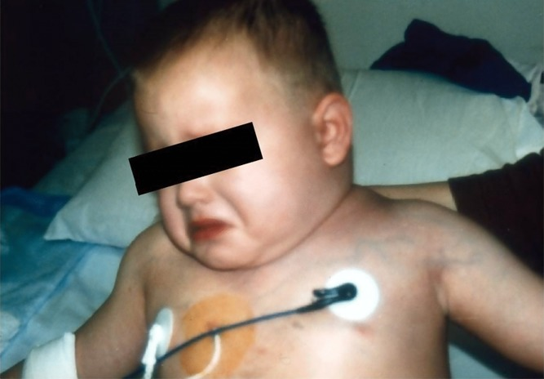
When to Consider Thrombolysis
Limb threatening arterial thrombus
Intracardiac thrombus
Pulmonary embolus with right heart strain or hypotension
Extensive DVT
  Superior vena cava syndrome
  Occlusive IVC thrombosis
  Bilateral renal vein thrombosis with renal compromise
  Large iliofemoral clot
Photo courtesy of Guy Young

Slide 48
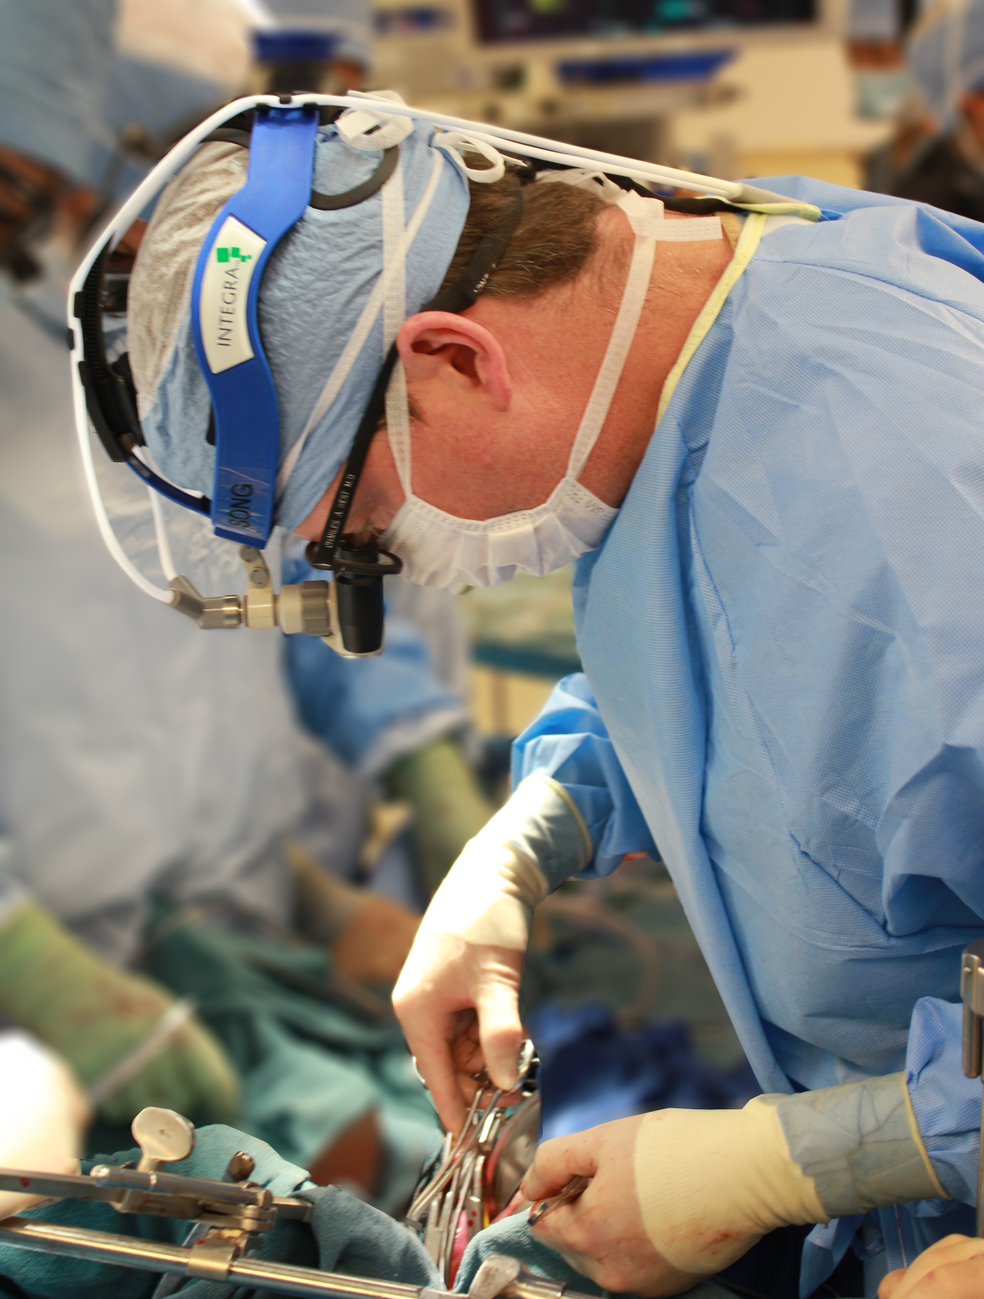

When Not to Consider Thrombolysis
Active major bleeding
Significant potential for uncontrolled local bleeding
Surgery within preceding 10 days (neurosurgery – 60 days)
Neurosurgery
Intracranial neoplasm / cerebral vascular lesion
Seizures within 48 hours
Sepsis
Uncontrolled severe hypertension
Contrast allergy
Notes:
Right arm venogram prior to treatment (a) shows complete occlusion of the subclavian vein. Numerous collaterals are present, which ultimately drain into the superior vena cava. After catheter-directed pharmacomechanical thrombolysis (b), there is complete lysis of the thrombus. There is residual stenosis due to extrinsic compression at the costoclavicular junction, for which partial first ribectomy was subsequently performed.

Slide 49
Thrombolysis – Nuts & Bolts
Tissue plasminogen activator (tPA) most commonly used agent
Routes of Administration
  Catheter-directed
  Low-dose systemic (24-96 hours)
  High-dose systemic (6 hours)
Laboratory Monitoring and Goals
  Fibrinogen 100-200 (should decrease by 20-50%)
  D-dimer Elevated
  PTT 50-70 (low dose UFH often given during thrombolysis)
  Hemoglobin Stable
  Platelets >100K (transfuse to maintain)
Notes:
Placement of large-bore catheter into the vein affected by the DVT to allow slow, direct infusion of thrombolytic agent into the thrombus
PTT/Fibrinogen/D-dimer every 6 hours
CBC every 12 hours, unless sudden drop in blood pressure or extensive active bleeding
Also increasing number of devices used as adjuncts in these procedures

Slide 50
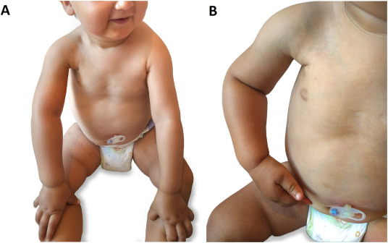
Post-Thrombotic Syndrome
Causes:
residual venous outflow
venous valvular insufficiency
Risk factors include:
  Adolescents
  Obesity
  Extensive DVT (multiple vessels)
  Idiopathic or effort-related upper extremity DVT
  Lack of DVT resolution
Occurs in ~25% of children with upper or lower extremity DVT
Reprinted from Thrombosis Research, 164, Betensky, Goldenberg, Post-thrombotic syndrome in children, 129-135, © 2018, permission from Elsevier.
Notes:
Occurs within 1 year in approximately 25%
Allow reflux of blood into vein
Caused by luminal narrowing or thrombus occlusion which leads to increased venous pressures

Slide 51
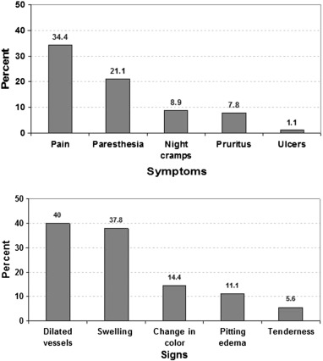
Symptoms and Signs of PTS
Symptoms
%
Validated assessment tools are available in pediatrics
  Modified Villalta Scale
  Manco-Johnson Instrument
Large majority of PTS cases are mild
Children with moderate or severe PTS have significantly lower QOL scores than children with mild or no PTS
Signs
%
Reprinted from Thrombosis Research, 135/2, Kumar, et al, Prevalence and risk factors for post thrombotic syndrome after deep vein thrombosis in children: A cohort study, 347-351, © 2015, permission from Elsevier

Slide 52
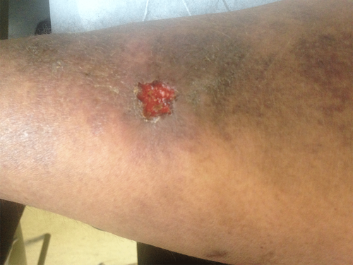
Post-Thrombotic Syndrome Management Considerations
Prevention of PTS
  Optimal management of VTE
  Timely diagnosis and initiation of therapy
  Thrombolysis?
Management of PTS
  Compression stockings
  Physical therapy
  Elevating affected extremity at rest
  Maintaining a healthy weight
Photo courtesy of Guy Young
Jaffray, J. and G. Young, Deep vein thrombosis. Pediatr Blood Cancer, 2018.
Notes:
Management, not treatment

Slide 53
Prevention and Management of PTS
Prevention of VTE
  Validated pediatric risk-assessment tools for consideration of thromboprophylaxis
  Prolonged hospitalization, immobilization, presence of CVL, infection, chronic inflammatory/prothrombotic chronic disease
Optimal Management of VTE
  Timely diagnosis and initiation of therapy
  Thrombolysis?
Once PTS has Occurred
  Elastic compression stockings
  Physical therapy
  Elevating the affected extremity at rest
  Maintaining a healthy weight

Slide 54
QUESTIONS?

