Slide 1
Bone Marrow Failure
Zora R. Rogers, M.D.
Professor of Pediatrics, Emerita
UT Southwestern

Slide 2
Disclosure
I have no significant financial conflicts of interest relevant to this presentation
Consultant relationship with Novartis, manufacturer of products that may be used in the care of patients with these disorders
I do not intend to specifically discuss off-label drug indications

Slide 3
Domain 5: Bone Marrow Failure
5A. Hematopoiesis – normal, abnormal, approaches to pancytopenia
5B. Acquired bone marrow failure
5B1. Idiopathic aplastic anemia
5B2. Secondary marrow suppression
5C. Inherited bone marrow failure
10d. HSCT for bone marrow failure (Dr. Pulsipher)

Slide 4

Bone Marrow Failure
Inherited (IBMFS)
Acquired AA
Fanconi Anemia (FA)
Dyskeratosis Congenita (DC)
Diamond-Blackfan Anemia (DBA)
Shwachman-Diamond Syndrome (SDS)
Congenital Amegakaryocytic
Thrombocytopenia (CAMT)
Thrombocytopenia Absent Radii (TAR))
Severe Congenital Neutropenia (SCN)
Medications
Chemicals
Toxins
Viral Infection
PNH
Idiopathic (immune)

Slide 5
Why worry about these “rare” inherited bone marrow failure syndromes (IBMFS)?
They are not as rare as previously believed:
- Under-recognized de-novo
- May present as aplastic anemia or malignancy
Implications for treatment
- Conventional treatments have excess toxicities
- Require different treatments
- Donor selection for HSCT (siblings may have it too!)
Implications for family planning

Slide 6
Aplastic Anemia
Presentation is often insidious with “inciting event” 6 to 8 weeks previously
Rarely present with infections or weight loss, fever, pain, adenopathy, hepatosplenomegaly that are common in malignancy
Often present with thrombocytopenia, uncommonly with clinical bleeding
MCV is increased with a normal RDW
Fetal hemoglobin and “i” antigen increased

Slide 7
Definition of Severe Aplastic Anemia
2 of 3 peripheral blood criteria:
  - ANC < 500/ml
  - Platelets < 20,000/ml
  - Reticulocytes < 1% corrected (ARC < 40,000/uL)
1 of 2 bone marrow criteria:
  - < 25% cellularity on biopsy
  - cellularity 25 – 50% with < 30% hematopoietic cells
Very severe aplastic anemia
- ANC < 200/ml

Slide 8
“Causes” of Acquired Aplastic Anemia
(usually negative…)
  Radiation
  Drugs/Chemicals/Toxins
  - Cytotoxic agents, benzene, alcohol
  - Idiosyncratic: chloramphenicol, anti-epileptic, anti-inflammatory, and
  psychotropic medications
  Viruses
  - EBV, CMV, sero-negative hepatitis, HHV6, HIV
  - Other severe viral infections

Slide 9
Disorders Associated with Secondary AA
  Autoimmune Disease
  Immune Disease
  - Eosinophilic fasciitis, hypogammaglobulinemia
  Thymoma
  Large granular lymphocytic leukemia (rare)
  Paroxysmal Nocturnal Hemoglobinuria (PNH)
  Myelodysplasia (hypoplastic MDS)

Slide 10
Hepatitis-associated Aplastic Anemia
Seronegative hepatitis (non-A through G)
Onset of cytopenias after hepatitis resolves
Present ~ 30% of patients receiving liver transplantation for hepatitis
High fatality rate if severe and untreated
Treatment (same as idiopathic AA)
- HSCT
- Immunosuppressive therapy (ATG and cyclosporine)

Slide 11
AA Diagnostic Evaluation
Bone marrow aspirate and biopsy
Cytogenetics on marrow; FISH for MDS
Rule out Inherited Bone Marrow Failure Syndromes:
- Chromosome breakage assessment (peripheral blood) with
diepoxybutane (DEB) or mitomycin C (MMC)
- Telomere length
Paroxysmal Nocturnal Hemoglobinuria (PNH) clone size by flow cytometry (peripheral blood)
Viral infection assessment by serology or PCR
- EBV, CMV, Hepatitis A/B/C, HIV, parvovirus
Evaluation of renal, hepatic, (thyroid?) function

Slide 12
Idiopathic Aplastic Anemia:
Aberrant Immune Response
Increased AA prevalence in rheumatologic disorders, pregnancy
Autologous recovery after BMT conditioning
Aberrant immune response to multiple stimuli:
- Oligoclonal T cell expansion
- Cytotoxic T-cells mediate stem cell destruction, suppress normal marrow
- Overproduction of TNF-α and interferon-γ
HSCT is curative if donor available
Anti-T cell therapy should restore hematopoiesis
- Residual stem cell content predicts response to therapy

Slide 13
Immunosuppressive Therapy (IST) for AA
Anti-human T cell serum: anti- CD2, 3, 4, 6, 8, 25 (IL2R), DR
- ATG ~ Horse Anti-human Thymocyte Globulin
- ALG ~ Rabbit Anti-human Lymphocyte Globulin
ATG > 150 mg/kg: 40 mg/kg/day x 4 days
- Steroids 10-28 days to prevent serum sickness
Cyclosporine: for ~12 months, stable counts 3 months before taper
Cytokines
No clear role G/GM-CSF, concern for MDS/AML
Emerging role for eltrombopag (TPO mimetic)
Small series single agent high-dose cytoxan

Slide 14
Immunomodulation
Cyclosporine inhibits proliferation of T cells
- Binds to cytosolic immunophilin receptor
- Inhibits inducible gene transcription in T cells
- Inhibits production of IL2 and interferon-γ
Isolated reports of response after ATG failure
- Reinstitution after relapse may be effective rescue
Tacrolimus
- Block T cell activation by calcineurin inhibition
- May stimulate hematopoietic colony formation
- Small studies in pediatric aplastic anemia

Slide 15
ATG: Side Effects
Allergic: Fever, rigors, urticaria, anaphylaxis
- Pre-treat with steroids, antihistamines, meperidine
- Slower rate of infusion
Serum sickness: Fever, maculopapular rash, myalgia, arthralgia, myocarditis, GI/CNS/renal symptoms
- Usual time frame: 5-10 days after starting ATG
Immune-mediated cytopenias:
  Lymphopenia: pneumocystis jirovecii (PCP) prophylaxis?

Slide 16
Eltrombopag
Oral nonpeptide thrombopoietin receptor agonist
  Triggers transmembrane domain TPO receptor → proliferation and differentiation of megakaryocytes
  Indications in ITP, hepatitis C, and both 1st line and rescue therapy of SAA
Studies are small, benefit unclear in pediatrics where IST response is better
Goal platelet count of 50-200K, but trilineage responses observed
Southeast Asian ancestry – dose reduction
Hepatic decompensation: ALT/bilirubin monitoring
Skin rash, hyperpigmentation, cataracts
Increased early cytogenetic abnormalities (-7), MDS/progression to AML

Slide 17
Acquired Aplastic Anemia: IST
Short-term survival with good to excellent response > 80%:
- ~ 10 - 30% either need ongoing CsA or relapse
Time frame for response typically 3-6 months
  - Complete response: normalization of counts
  - Partial response: transfusion-independence, more usual outcome
Persistent abnormal hematopoiesis
  Evolution of marrow damage
  Pediatric clonal disease ~ 10% at 10 years
  Late relapse; response curve continues to fall

Slide 18
HSCT versus IST with ATG/CsA
Both HSCT and IST: 80-90% transfusion independence
IST higher rates of relapse, clonal evolution
Different shapes of disease free survival curves
  - IST better 6 month short term survival but curve continues to decline as far out as 6 to 10 years
  - HSCT curve plateaus after ~2 years
URD transplant improving outcomes, if MUD readily available …
  - Higher non-engraftment, graft failure
  - Reduced intensity conditioning, no need to remove malignant cells

Slide 19
Acquired Aplastic Anemia Conclusions
Patients with SAA younger than 40 years of age do better with allogeneic sibling matched HSCT
IST with ATG/Cyclosporine is a reasonable first line treatment if there is no sibling donor
Study comparing first line URD HSCT vs IST promising (TRANSIT)
Salvage therapy for response failure in 3-6 months:
  - URD donor HSCT
  - IST retreatment; alternate source ATG? Eltrombopag?
  - High-dose cyclophosphamide

Slide 20
Paroxysmal Nocturnal Hemoglobinuria
PNH: acquired clonal stem cell disorder
- Acquired somatic mutations in PIG-A gene (Xp22.1)
PIG-A functions in glycosylphosphatidylinositol (GPI) anchor biosynthesis
- GPI covalently anchors glycoproteins to cell membrane
- Cells deficient in GPI anchored proteins CD55/59 at risk for complement-mediated lysis
Diagnosis: flow cytometry to quantitate % of GPI deficient anchored protein on granulocytes and other cell lineages
- Replaced the classic sugar water/Hamm test
Leads to hemolysis, hemoglobinuria (classically in AM) and fatal thrombosis (venous, mesenteric)

Slide 21
PNH in Aplastic Anemia
“Classical” presentation of PNH
- Overt hemolysis with increased reticulocyte counts
- Hemolysis may be severe enough to cause iron deficiency
  Hypercellular/normocellular marrow
“Aplastic anemia with PNH clone” before or after therapy
- Typically small % PNH clone – scant overt hemolysis
  - Hypocellular marrow
  Severe cytopenias in PNH positive patients may respond to IST
  After IST, clone size may increase or a measurable clone develop which may progress or be stable

Slide 22
PNH: Treatment
Only curative therapy is HSCT:
- Severe pancytopenia
- Life-threatening thrombosis
Eculizumab:
- Humanized anti-C5 monoclonal antibody
- Inhibits terminal complement activation
- Reduces RBC hemolysis and fatigue, increases QOL
- Appears to reduce thrombosis risk
- Side effects: headache, nasopharyngitis, back pain, URI
- Risk for N. meningitides infection, vaccination needed

Slide 23
5C: Inherited Bone Marrow Failure Syndromes
5C1: Fanconi anemia (FA)
5C2: Dyskeratosis Congenita
5C3: Shwachman-Diamond syndrome
5C4: Congenital neutropenia
5C5: Diamond-Blackfan anemia
5C6: Congenital thrombocytopenia (Dr. Neunert)
5C7: Other inherited bone marrow failure syndromes

Slide 24
Inherited Bone Marrow Failure Syndromes (IBMFS)
Also called constitutional or familial aplastic anemia
Frequently associated with physical abnormalities
- Radial ray, skeletal, short stature, renal
- Anomalies are not always obvious, or present
Hematologic findings not usually present at birth
- May not present until adulthood
Accounts for 10-25% of pediatric aplastic anemia
Increased frequency of cancer
- Squamo-epidermal carcinoma, MDS/AML
- Presenting sign may be the malignancy

Slide 25
5C1: Fanconi Anemia: Clinical Features
Marrow failure: macrocytosis → pancytopenia
Congenital anomalies (see chart)
Not always present, may be subtle
NOT required for diagnosis
Cancer predisposition
MDS/AML
Squamous cell carcinomas (oral, vaginal, vulvar)
Brain tumors, Wilms tumors, other solid tumors
Family History

Slide 26
Congenital Anomalies in FA
Anomaly Frequency
Skin (café a lait, hypopigmented) 40%
Short Stature 40%
Upper limb (thumb) 35%
Male genital 25%
Female genital 2%
Skeletal 25%
Eyes 20%
Renal 20%
Cardiac 6%
GI 5%
CNS 3%
Shimamura A, Alter BP. Pathophysiology and management of inherited bone marrow failure syndromes [published correction appears in Blood Rev. 2010 Jul-Sep;24(4-5):201]. Blood Rev. 2010;24(3):101-122. doi:10.1016/j.blre.2010.03.002

Slide 27
Hands in Fanconi Anemia
Classic congenital anomaly in FA
Primarily radial deformities
- Partial or total absence of pre-axial border
- Bilateral in 50% of cases
- Ulna thickened, bowed toward absent radius
Hypoplastic thumb – subgroup of radial deficiency
Scapula, thenar eminence often reduced in size

Slide 28
Fanconi Anemia: Diagnostic Tests
DNA repair defect = Increased chromosomal breakage
Peripheral blood karyotype with and without exposure of patient cells breakage inducing agent: diepoxybutane (DEB) or mitomycin C (MMC)
- If high clinical suspicion and peripheral blood testing equivocal → repeat breakage testing on cultured skin fibroblasts
  Flow cytometry: clastogen induced G2/M arrest
  Specific mutation analysis

Slide 29
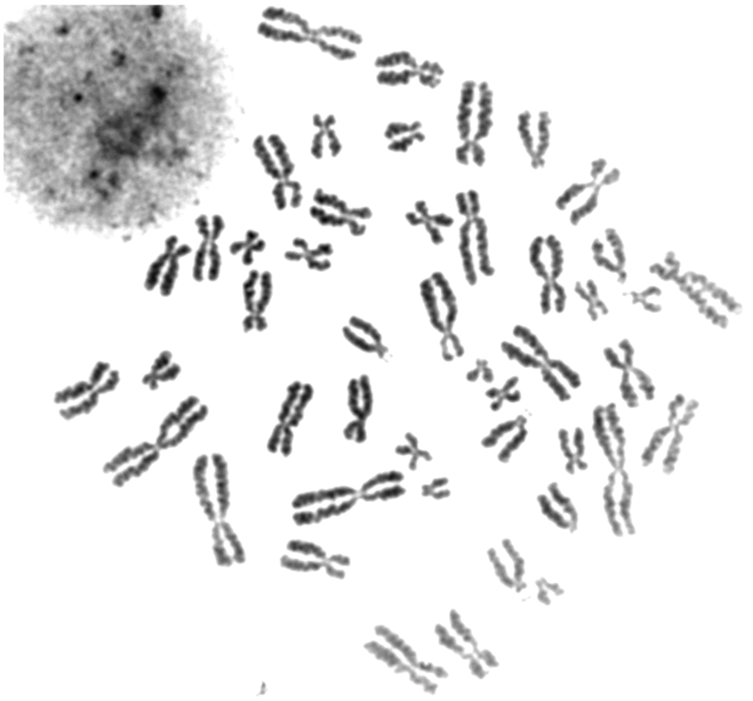
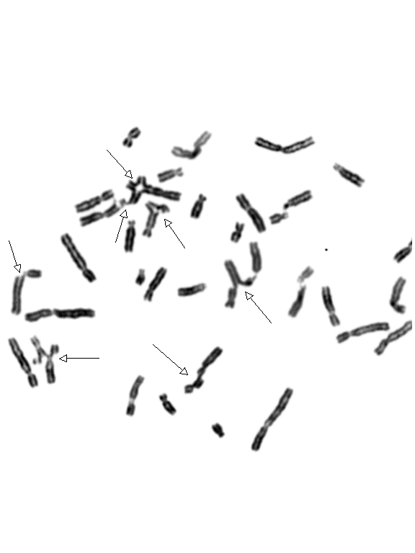
FA Cells Incubated without/with diepoxybutane
without DEB
with DEB
Courtesy of Lisa Moreau, Dana Farber Cancer Institute

Slide 30
Fanconi Anemia Genetics
FA proteins: nuclear protein complex that repairs DNA
Heterozygote frequency 1:300 (1:100 Ashkenazi, Afrikaans)
Complementation studies: 21 groups (A-W, D1-D2)
Mutation analysis establishes a definitive diagnosis
- FANC-A, 16q24.3 (60-70% of FA)
- FANC-C, 9q22.3 (10-15% of FA)
Mutation or complementation group predicts clinical course
- FANC - A has later onset of bone marrow failure
- FANC - C and G have a more severe course
- FANC – B/D1 ~ BRCA 2; very early onset MDS/AML
- FANC D1, N – Wilm’s Tumor, medulloblastoma

Slide 31
Fanconi Anemia Mutations
All are autosomal recessive except FANC B which is X linked recessive
Group | Locus | % FA Patients | Product
FANCA (H/M) | 16q24.3 | 60% | FANCA
FANCB | Xp22.31 | 2% | FANCB
FANCC | 9q22.3 | 14% | FANCC
FANCD1 | 13q12.3 | 3% | BRCA2
FANCD2 | 3p25.3 | 3% | FANCD2
FANCE | 6p21.3 | 3% | FANCE
FANCF | 11p15 | 2% | FANCF
FANCG | 9p13 | 10% | FANCG
FANCI | 15q25-q26 | 1% | FANCI
FANCJ | 17q22 | 2% | BRIP1
FANCL | 2p16.1 | <1% | PHF9
FANCN | 16p12 | <1% | PALB2
FANCO | 17q22 | <1% | RAD51C
FANCP | 16p13 | <1% | SLX4
FANCQ | 16q13 | <1% | XPF/ERCC4
FANCR | 15q15 | <1% | RAD51
FANCS | 17q21 | <1% | BRCA1
FANCT | 1q31 | <1% | UBE2T
FANCU | 7q36 | <1% | XRCC2
FANCV | 1p36 | <1% | MAD2L2
FANCW | 16q23 | <1% | RFWD3

Slide 32
FA: Therapeutic Options
Supportive care as long as possible
Management of congenital anomalies
Transfusion – fewest units, all irradiated
Growth factors?
Monitor for MDS/AML – annual bone marrow (biopsy with FISH)
Oxymethalone (androgen) may slow count decline
- Danazol less virilizing for females?
HSCT – reduced intensity conditioning
- Increased toxicity due to DNA repair defect
- Survival of URD approaching sibling donor

Slide 33
Androgens (oxymetholone): Side Effects
Virilization
Growth spurt followed by premature epiphyseal closure, adult short stature
Hyperactivity/behavioral changes
Cholestatic jaundice or transaminitis**
Hepatic adenoma**, hepatocellular carcinoma
Peliosis hepatis (“blood lakes”)**
Hypertension
** Follow LFTs and hepatic ultrasound on therapy

Slide 34
Malignancy in FA
Risk of malignancy 1,000x greater than normal; 30% by adulthood
Clonal abnormalities in 34-48% of patients
    NOT all with MDS features, presence may wax and wane
10% Leukemia (AML > ALL) especially M4-M5
10% Solid Tumor: squamous cell head/neck
3% Liver tumor: adenoma and hepatoma
6-8% Female genital tract
Risk increased by HSCT:
- Secondary squamous cell carcinoma risk 4x increased
- Age of solid tumors shifted 16 years earlier
- Solid tumor risk associated with inflammation from GVHD

Slide 35
Malignancy in FA - 2
Excessive toxicity with standard chemotherapy
- Standard chemotherapy and radiotherapy regimens lethal for FA patients
FA often diagnosed after treatment started due to increased toxicity
- Suspect underlying IBMFS/FA if toxicity of therapy is early, severe
Surgical approach, especially to solid tumors, preferred
- Early detection is key
Early diagnosis of progression to MDS, AML allows for:
Review of options for therapy
Search for donor for HSCT

Slide 36
5C2: Dyskeratosis Congenita
Ectodermal dysplasia – DNA repair defect
Triad: reticulated skin hyperpigmentation, dystrophic nails, mucous membrane leukoplakia develops with age
- Do not need classical triad or physical stigmata for diagnosis
Aplastic anemia: up to 50% in 2nd to 3rd decade
Solid organ cancers (head, neck, gastrointestinal) and leukemia in 3rd to 4th decades
MDS/AML
Carcinomas of bronchus, tongue, larynx, esophagus, pancreas, skin

Slide 37
DC: Additional Clinical Features
Pulmonary disease**
Dental anomalies
Esophageal stricture
Hair loss, early greying
GI disorders
Ataxia
Epiphora
Hyperhidrosis
Hypogondadism
Microcephaly
Urethral stricture/Phimosis
Osteoporosis
Deafness
Cognitive/developmental delay

Slide 38
DC and Telomere Biology Disorders
Three patterns of inheritance
- Autosomal dominant, recessive and X-linked
- Negative genetic testing does not rule out the diagnosis
Hallmark is VERY short telomeres
- < 1%ile for age in > 3 lymphocyte subsets
All genes are in telomerase complex
Telomere: protein-DNA complexes at end of chromosomes
Prevent premature shortening (aging)
Prevent end-to-end fusions, translocations, breaks

Slide 39
DC and Telomere Biology Disorders: Genetics
Gene | Frequency | Genetics | Product
DKC1 | 17-36% | X-linked | Dyskerin
hTERC | 6-10% | AD | Telomerase RNA
hTERT | 1-7% | AD/AR | Telomerase reverse transcriptase
TINF2 | 11-24% | AD | Shelterin complex
NOP10 | <1% | AR | H/ACA core protein
NHP2 | <1% | AR | H/ACA core protein
WRAP53 | 3% | AR | TCAB1, Shelterin complex
CTC1 | <2% | AR | Telomere maintenance
Many patients with DC lack mutations
Likely additional genes yet to be identified

Slide 40
Dyskeratosis Congenita: Treatment
Supportive Care
- Like FA
Androgens and cytokines
- Caution about viscus rupture with androgen
HSCT
- Reduced intensity regimens
- Pulmonary toxicity (often delayed)
- Increased risk of veno-occlusive disease

Slide 41
5C3: Shwachman-Diamond Syndrome
Hematologic findings:
WBC: fluctuating neutropenia, impaired chemotaxis
Anemia 1/3, thrombocytopenia 20%
Aplasia in 10-25% → MDS/AML
Other findings:
Exocrine pancreatic insufficiency, transaminitis
Low trypsinogen (<3yo), pancreatic isoamylase (>3yo), fecal elastase
Fatty pancreas on imaging
Metaphyseal chondrodysplasia (bell shaped chest)
Short stature, ichthyosis/eczema
Cardiac, endocrine, developmental issues

Slide 42
Shwachman-Diamond Syndrome: Genetics
Autosomal recessive – male predominance (1.7:1)
90% with mutation in SBDS gene (7 centromere: 7p12-q11) or
adjacent pseudogene SBDSP
“SDS-like” disease with mutations in SRP54 (AD), DNAJC21 (AR), ELF1 (AR)
SBDS functions in:
Ribosome biogenesis (associates with 60S subunit, promotes 40S:60S ribosome joining)
Mitotic spindle stabilization
Other, as yet unknown

Slide 43
Shwachman-Diamond Syndrome
Differential Diagnosis:
Cystic Fibrosis
Severe Congenital Neutropenia
- Kostmann Syndrome
- Cyclic Neutropenia
Pearson Syndrome

Slide 44
Shwachman Diamond Syndrome: Treatment
Pancreatic enzyme replacement, ADEK supplements
Management of congenital anomalies
G-CSF – least amount, shortest time
Transfusions
Monitoring for MDS/AML – periodic/annual marrow
  - del 20q, iso 7q very common and may not indicate progression to MDS
Stem Cell Transplantation (few)
- Variable results due to conditioning regimen toxicity

Slide 45
5C4: Congenital Neutropenia
Severe Congenital Neutropenia (Kostmann’s syndrome)
Cyclic Neutropenia
Myelokathexis/WHIM syndrome

Slide 46
Severe Congenital Neutropenia
Heterogeneous disorder of myelopoiesis
- Accompanied by monocytosis, eosinophilia
ANC < 500/uL with most <200/uL from birth
- Early, severe bacterial infections (S. aureus, Pseudomonas)
Mechanism is accelerated apoptosis of myeloid precursors
Maturational arrest at myelocyte/promyelocyte stage
Classically infection, tooth/jaw bone loss, death by age 20
Now GCSF 3-100mcg/kg/day GOAL ANC~1,000/uL
Risk for MDS/AML at least 2%/year; -7, +21 common

Slide 47
Severe Congenital Neutropenia
 | GENE | LOCATION | Inheritance
SCN1 | ELA-2 “Elane” | 19q13 | AD, AR
SCN2 | GF11 | 1p22 | AD
SCN3 | HAX1 | 1q21 | AR
SCN4 | G6PC3 | 17q21 | AR
SCN5 | VPS45 | 1q21 | AR
SCN6 | JAGN1 | 3p25 | AR
SCN7 | CSF3R | 1p34 | AR
SCNX | WAS | Xp11 | X linked
60% European/Middle Eastern pts with ELA-2 mutations
- Most heterozygous
- Same gene as in cyclic neutropenia, but different exons
80% with AML have homozygous SCN7 (CSF3R) mutations

Slide 48
Cyclic Neutopenia
Caused by heterozygous mutations in Elane SCN2
- Autosomal dominant and sporadic mutations
- Mutations near active site (vs other face in SCN)
Cycles of 21+7 days with ANC< 200/uL for 3-5 days
- Marrow arrest at myelocyte level
- Fever, pharyngitis, aphthous ulcers, periodontitis
- Symptoms often improve with age
- Some with cyclic platelets and reticulocytes also
Management aggressive care for infections
- GCSF alternate day, but usually through the month

Slide 49
Myelokathexis/WHIM Syndrome
Neutropenia with Warts, Hypogammaglobulinemia, Infections, Myelokathexis
- Excessive human papillomavirus susceptibility
Noncyclic neutropenia with myeloid hyperplasia of marrow
- Kathexis/retention of myeloid cells in marrow
- Retained cells with condensed nuclei connected by stringy filaments and
with vacuolated cytoplasm
AD mutations in CXCR4 on 2q22.1 cause gain in function defect and limits down regulation after stimulation
GCSF ameliorates neutropenia, apoptosis and hypogammaglobulinemia

Slide 50
5C5: Diamond Blackfan Anemia
Diagnostic Criteria:
  - Age < 1yo
  - Macrocytic anemia
  - Reticulocytopenia
  - Paucity of erythroid precursors in marrow
  Supporting Criteria:
  Major Criteria
  - Pathogenic mutations
  - Positive family history
  Minor Criteria
    - Elevated red cell ADA
    - Congenital anomalies
    - Elevated Hb F
    - No other bone marrow failure syndrome
  Classic DBA: all diagnostic criteria
  Non-classic DBA: various combinations
Notes:
Typically present in first year of life but cases as late as 40s have been reported usually in relation to typical diagnosis in decendent

Slide 51
DBA: Congenital Anomalies
At least 47% of all patients
- 50% cranio-orofacial (tow colored hair, blue sclerae, glaucoma)
- 38% upper extremity (thumbs, may be subtle)
- 39% genitourinary
- 30% cardiac
Over 20% with more than one anomaly
Short stature and bony abnormalities common, and often overlooked!
Neutropenia, and rarely thrombocytopenia also

Slide 52
DBA: Genetics
Autosomal dominant
- May be sporadic or inherited
Mutations/deletions in ribosomal proteins:
RPS19 (DBA 1) 19q13.2 in 25% of patients
RPL5, RPS10, RPL11, RPL35A, RPS26, RPS 24, RPS 17,RPS 7, RPL 19, RPL 26
25-40% of patients with unknown mutations
Assemble proteins from amino acids
Defective erythropoiesis from haploinsufficiency
Special case:
- Acquired haploinsufficiency of RPS14 in 5q- MDS

Slide 53
DBA: Treatment of anemia
Prednisone:
- 2 mg/kg for up to 8-12 weeks before declaring failure
- Taper to minimum dose to maintain Hgb >9 g/dl
- 79% steroid responsive (4% never treated)
For steroid-refractory patients or those requiring high doses of steroids, consider chronic red cell transfusions
Red Cell Transfusions:
Year 1 of life due to pneumocystis jirovecii risk
Extended antigen typing of PRBC, minimum volumes
Iron overload → chelation

Slide 54
DBA Outcomes
Remission of anemia ~ 20% by age 25
No predictive genetic or clinical features
HSCT for transfusion dependent patients, particularly those who are allo-immunized or have OTHER cytopenias (neutropenia)
Does not cure solid tumor risk
Sibling donor needs careful evaluation for DBA

Slide 55
Diamond Blackfan Anemia Malignancy
30 Cases* Reported in the Literature (~5%)
    AML/MDS 15
    ALL 1
    Osteosarcoma 6
    Hodgkin disease/NHL 3
    Breast carcinoma 2
    Hepatocellular carcinoma 2
    GI carcinoma 2
    Melanoma 1
    Malignant fibrous histiocytoma 1
    Soft tissue sarcoma 1
    Non-Hodgkin Lymphoma 1
Shimamura A, Alter BP. Pathophysiology and management of inherited bone marrow failure syndromes [published correction appears in Blood Rev. 2010 Jul-Sep;24(4-5):201]. Blood Rev. 2010;24(3):101-122. doi:10.1016/j.blre.2010.03.002

Slide 56
TEC: Transient Erythroblastopenia of Childhood
Spontaneous cessation of erythropoiesis in an otherwise healthy child
- may also involve neutrophils and platelets
Typically self limited
Serial blood counts, increase in reticulocytes as first sign of marrow recovery
Transfusion if necessary for Hgb<5 with reticulocytopenia
Follow to resolution

Slide 57
Diamond Blackfan Anemia vs TEC
DBA TEC
History: Inherited Acquired
Physical Anomalies: 50% none
Laboratory:
Hgb g/dL 1.2-10.0 2.4-10.6
ANC < 1000/µL 20% 10%
Plts > 400K /µL 20% 50%
< 100K /µL 10% 5%

Slide 58
5C6: Congenital Thrombocytopenia
Congenital Amegakaryocytic Thrombocytopenia (CAMT)
Thrombocytopenia Absent Radius Syndrome (TAR)

Slide 59
Amegakaryocytic Thrombocytopenia
Autosomal recessive
c-MPL gene mutations (thrombopoietin receptor) at 1p34
Decreased bone marrow megakaryocytes
- Thrombocytopenia at birth
Classically red cells macrocytic, increased fetal hemoglobin
- Normal platelet size and morphology
- Hemoglobin normal early
High risk of MDS →AML
Two phenotypes early (80%) vs late thrombocytopenia and aplasia, correlate with specific mutation and c-MPL activity

Slide 60
CAMT: Treatment
Hematopoietic stem cell transplantation, from either an HLA-matched related or alternative donor, is the treatment of choice
HSCT should be performed prior to the development of severe pancytopenia or platelet allo-sensitization

Slide 61
Thrombocytopenia Absent Radius Syndrome
Autosomal Recessive
Due to RBM8A gene mutations (RNA-binding motif protein 8A) at 1q21.1
- One allele deletion of 1q21.1, the other a mutation in the remaining allele
Thrombocytopenia presenting at birth
Two thirds of patients outgrow severe thrombocytopenia by 1 year
- Eventual platelet count may not be normal
Bilateral absence of radii with presence of thumbs (in FA the defect is terminal - thumbs are absent if the radii are absent; in TAR intercalary)

Slide 62
TAR Syndrome - 2
Other cytopenias:
- Leukemoid reaction common >40,000/mm³
- Hypereosinophilia
Other congenital anomalies:
- Micrognathia, brachycephaly, hypertelorism
- Webbed neck, hypogonadism
- Various lower limb abnormalities 40%
- 10% congenital heart disease
Transplantation is curative, but not usually required

Slide 63
5C7: Other - Pearson Syndrome
    Refractory sideroblastic anemia by 6 months of age
    Marrow: vacuolated precursors/ringed sideroblasts
    Associated usually mild neutropenia, thrombocytopenia
    Exocrine pancreatic dysfunction (fat malabsorption)
    Death usually as a consequence of acidosis, sepsis, liver or renal failure related to tubular dysfunction
    - Median survival is age 3 years
    Genetics: Mitochondrial DNA deletion
    - Pathognomonic, maternal inheritance

Slide 64
5C7: Other Disorders
Refractory Cytopenia of Childhood (RCC) – RAS, RUNX1, SETBP1, ASXL1
- <5% marrow blasts with dysplastic changes, and <2% peripheral blasts
MDS due to germline predisposition – really all IBMFS
- Monosomy 7, del7q common
GATA 2 spectrum disorders: monocytopenia, mycobacterial infections, warts
- MonoMAC, DCML deficiency, Emberger Sx (lymphedema)
SAMD9/SAMD9L disorders: immunodeficiency, adrenal insufficiency
- Mirage Sx, Ataxia-Pancytopenia Sx

Slide 65
IBMFS: Diagnostic Suspicion
  Presence of characteristic physical anomalies with hematologic abnormalities
  Unexplained macrocytosis with or without characteristic birth defects
  Children with aplastic anemia or myelodysplasia
  Patients with malignancy who are very sensitive to chemo/radiotherapy
  Cancer in a patient at an atypically early age
    - Head/neck/esophageal cancer <40 years of age
    - Vulvar cancer <30 years of age
    Family members with any of the above

