Slide 1

AYA and XYZ
(aka The End of the Journey)
Karen Effinger, MD, MS
Clinical Director, Survivor Program
Assistant Professor of Pediatrics
Aflac Cancer & Blood Disorders Center
Emory University School of Medicine

Slide 2

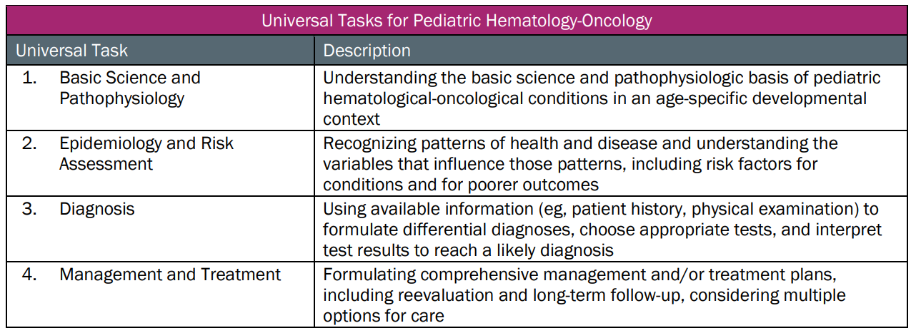
This talk will follow the topical structure suggested by the ABP (Sort of):
Copyright © 2019 by ASPHO

Slide 3
AYA and XYZ (aka the end of the journey):
AYA Oncology, Late Effects, and Palliative Care
AYA Oncology
Late Effects
Fertility Preservation
Pain Management
Palliative Care
Epidemiology and Risk Assessment
Diagnosis
Management and Treatment
Copyright © 2019 by ASPHO

Slide 4
AYA Oncology, Late Effects, and Palliative Care
AYA Oncology
Late Effects
Fertility Preservation
Pain Management
Palliative Care
Copyright © 2019 by ASPHO

Slide 5
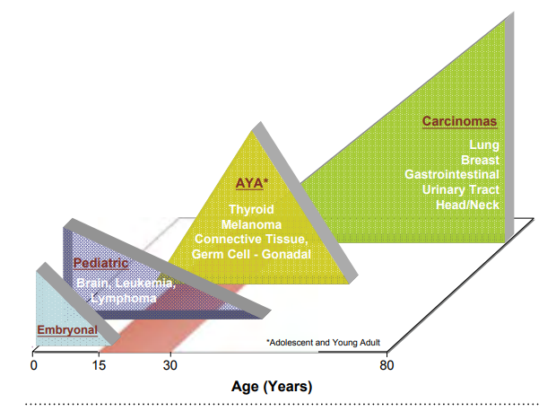
AYA Oncology
NCI definition: Cancer Diagnosis 15-39 years
~68,000 cases/yr vs. 10,450/yr ages 0-14y
4% cancer diagnoses in the United States
Bleyer NCI SEER AYA Monograph 2006; https://seer.cancer.gov/publications/aya/aya_mono_complete.pdf
Copyright © 2019 by ASPHO
Notes:
Most frequent: 90% all invasive cancers are breast cancer, lymphomas, melanoma, female GU tumors (ovary/cervix), thyroid, sarcoma, testicular, colorectal, leukemia, CNS

Slide 6
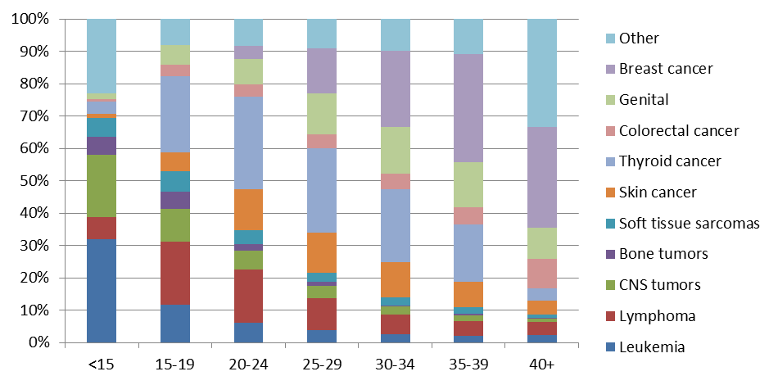
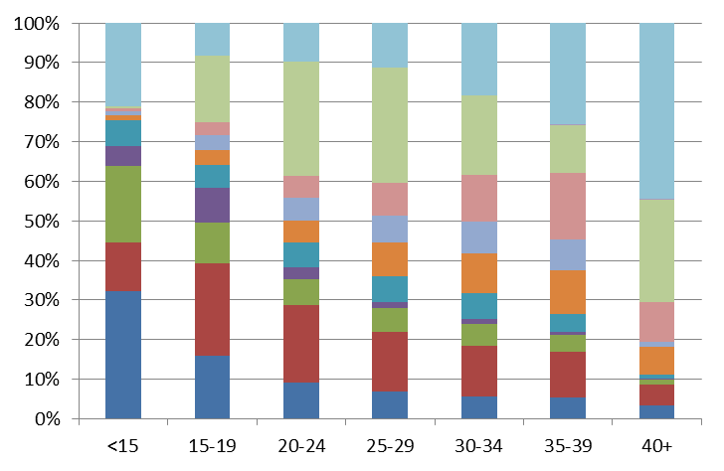

Cancer Site Distribution by Age, SEER 2011-15
FEMALES
MALES
Copyright © 2019 by ASPHO
Notes:
15-19: lymphoma (25%), followed by leukemia, sarcoma, CNS
20-29: Lymphoma (22%), melanoma, thyroid, testicular
HL most common

Slide 7
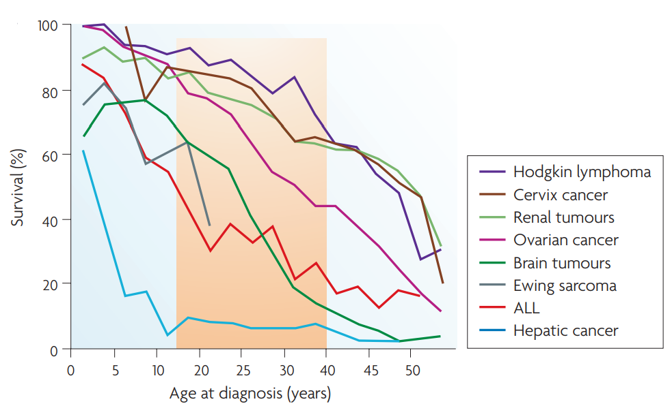
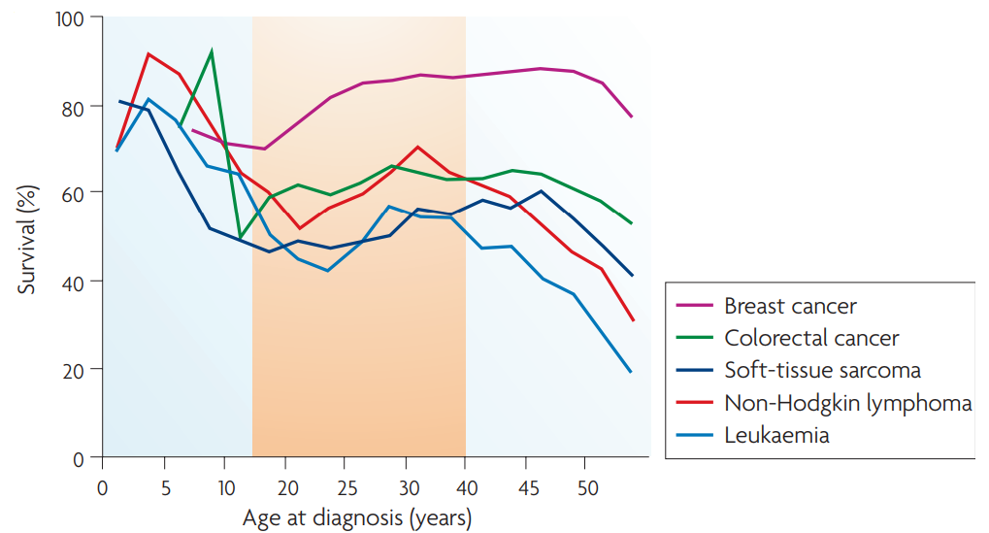
Survival
Relative survival rates are lower in AYAs for some diseases
Compared to younger patients
Compared to younger & older patients
Reprinted by permission from Copyright Clearance Center: Springer Nature. Nature Reviews Cancer. The distinctive biology of cancer in adolescents and young adults, Archie Bleyer, Ronald Barr, Brandon Hayes-Lattin, David Thomas, Chad Ellis et al. Copyright © 2008
Copyright © 2019 by ASPHO
Notes:
Overall gains in survival have been less in AYA patients compared to other age groups
Also NB

Slide 8
Survival
Similar prognosis across age groups for thyroid and testicular cancer
Better prognosis for melanoma
Copyright © 2019 by ASPHO

Slide 9
Causes for Survival Differential
Cancer biology
Familial cancer syndromes or subsequent malignancies
Increased toxicity
Location of care/Clinical trial enrollment
Adherence
Access to healthcare
Psychosocial stressors
Copyright © 2019 by ASPHO

Slide 10
Cancer Biology- Poor Prognostic Findings
B-ALL: More likely to have PH+ t(9;22), PH+-like
B-ALL: Less likely to have ETV6-RUNX1, hyperdiploidy
T-ALL: HOX+
Rhabdomyosarcoma: More likely Alveolar (chromosome 13 translocations)
Neuroblastoma: More likely Stage IV disease
Breast cancer: More likely Estrogen-, progesterone- and HER2 receptor (triple negative) disease
Colorectal cancer: More likely Mucinosis adenocarcinoma
Copyright © 2019 by ASPHO
Notes:
T9;22: <3% children; 3-26% AYAs
½ children have TEL-AML1 compared to 10% AYAs

Slide 11
Cancer Biology- Favorable Prognostic Findings
DLBCL: Less likely to have t(14;18)
Melanoma: More likely to have BRAF mutations
Copyright © 2019 by ASPHO
Notes:
DLBCL- 60% lymphoma in AYA population. More common to have primary mediastinal
BRAF: Lower mitotic rate, thinner tumors

Slide 12
Causes for Survival Differential
Cancer biology
Familial cancer syndromes or subsequent malignancies
Increased toxicity
Location of care/Clinical trial enrollment
Adherence
Access to healthcare
Psychosocial stressors
Copyright © 2019 by ASPHO
Notes:
Breast cancer at early age more likely to have increased familial risk: BRCA1, BRCA2, p53 (though most do not), survivors with chest radiation
Colon cancer: FAP. Herediatry non-polyposis colon cancer
3% thyroid cancer- second malignancy

Slide 13
Familial Cancer Syndromes/Subsequent Malignancies
Breast cancer: Early diagnosis more likely in those with increased familial risk: BRCA1, BRCA2, p53
Breast cancer: Survivors of childhood cancer treated with chest radiation
Colorectal cancer: Highest incidence of heritable CRC: FAP, hereditary non-polyposis colon cancer
Colorectal cancer: Survivors of childhood cancer treated with abdominal radiation
Thyroid cancer: 3% subsequent malignancy
Copyright © 2019 by ASPHO
Notes:
Breast cancer: most young dx do not have family cancer syndrome
Colon cancer: Familial adenomatous polyposis

Slide 14
Causes for Survival Differential
Cancer biology
Familial cancer syndromes or subsequent malignancies
Increased toxicity
Location of care/Clinical trial enrollment
Adherence
Access to healthcare
Psychosocial stressors
Copyright © 2019 by ASPHO

Slide 15
Different Toxicity Profile
Epigenetic factors
Changing volume of distribution
Protein binding
Hepatic/renal function
Obesity
Neuropathy
Osteonecrosis
Glucose intolerance
Pancreatitis
Nausea/emesis
Renal toxicity
Thrombosis
Pain
    Less Myelosuppression
Copyright © 2019 by ASPHO
Notes:
Need higher doses and don’t tolerate
Dose modification

Slide 16
Causes for Survival Differential
Cancer biology
Familial cancer syndromes or subsequent malignancies
Increased toxicity
Location of care/Clinical trial enrollment
Adherence
Access to healthcare
Psychosocial stressors
Copyright © 2019 by ASPHO

Slide 17
Location of Care/Clinical Trial Enrollment
Location of Care
  Comprehensive centers vs. community-based
  Supportive care regimens
  Treatment compliance/intensity
Clinical Trial Enrollment
  Overall survival rate higher when on clinical trials
  Low enrollment (2% of patients aged 20-29 years)
  Improved enrollment with AYA programs (or pediatric center)
Pediatric Treatment Protocols
  Evidence for improved outcomes in ALL, AML, Ewing sarcoma, and Hodgkin lymphoma on pediatric regimens
Copyright © 2019 by ASPHO
Notes:
Location of Care: EWS- # of patients treated
ALL: Asparaginase and increased intensity
AML: 16-21yo: COG performed better but also had younger cohort. COG: Better anti-leukemic efficacy but increased toxicity. Though both age groups had less relapse on COG protocols but higher treatment-related mortality was seen
EWS: Thought to be due to Dose intensity/timing of local control (earlier)- also inferior outcomes based on age
HL: Differing findings. COG AOD0331 vs E2496 E2496 AYAs FFS worse that COG AYAs and older patients; however, trials were different-different criteria

Slide 18
Causes for Survival Differential
Cancer biology
Familial cancer syndromes or subsequent malignancies
Increased toxicity
Location of care/Clinical trial enrollment
Adherence
Access to healthcare
Psychosocial stressors
Copyright © 2019 by ASPHO
Notes:
Studies out there looking specifically at AYA Adherence and incorporating phone apps that improve this.

Slide 19
Causes for Survival Differential
Cancer biology
Familial cancer syndromes or subsequent malignancies
Increased toxicity
Location of care/Clinical trial enrollment
Adherence
Access to healthcare
Psychosocial stressors
Copyright © 2019 by ASPHO
Notes:
Insurance problems, delay in diagnosis, delay in treatment
Lack of PCP

Slide 20
Causes for Survival Differential
Cancer biology
Familial cancer syndromes or subsequent malignancies
Increased toxicity
Location of care/Clinical trial enrollment
Adherence
Access to healthcare
Psychosocial stressors
Copyright © 2019 by ASPHO

Slide 21
Psychosocial stressors
Financial Concerns
Educational/ Employment Concerns
Lack of Medical Home
Health Insurance
Desire for Autonomy
Emotional Challenges
Risky Behaviors
Self-Esteem/ Body Image
Fertility
Sexual Health
Copyright © 2019 by ASPHO
Peer Relations
Family Interactions
Notes:
Uncertainity about future

Slide 22
AYA Oncology, Late Effects, and Palliative Care
AYA Oncology
Late Effects
Fertility Preservation
Pain Management
Palliative Care
Copyright © 2019 by ASPHO

Slide 23
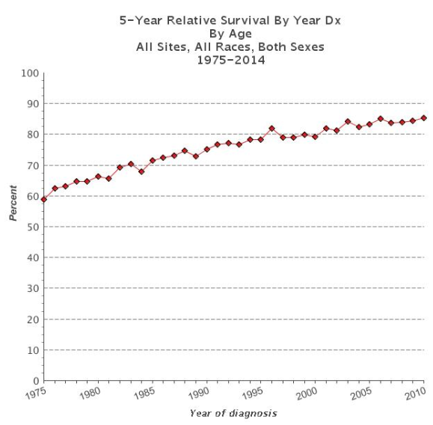
Pediatric Oncology Survivorship
Over 400,000 Americans are childhood cancer survivors
Top 3 cancers among survivors: ALL, brain tumors, Hodgkin lymphoma
Copyright © 2019 by ASPHO
Howlader SEER 2018

Slide 24
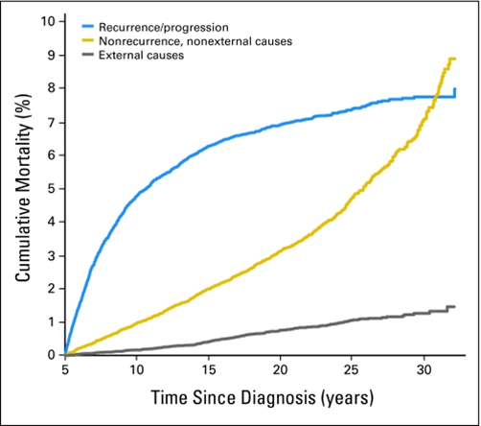
Late Effects
As time from treatment increases, risk of recurrence decreases and risk for late effects increases
At age 45, the estimated cumulative
prevalence of a chronic health condition
was 96% and of a serious/ disabling or
life-threatening condition was 81%
Recipients of HSCT have nearly fourfold
risk compared to those treated with
conventional therapy
Reprinted with permission. © 2009 American Society of Clinical Oncology. All rights reserved. Armstrong G et al: J Clin Oncol 27, no. 14 (May 2009)2328-2338.
Copyright © 2019 by ASPHO
Notes:
Late effects are broadly defined as consequences of cancer and its treatment that manifest either during or after cancer treatment and persist beyond the end of treatment.
Increased risk of late effects and death over time
Lifelong surveillance

Slide 25
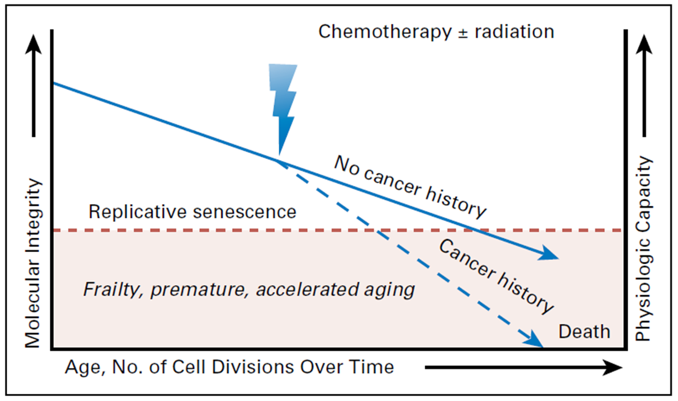
Accelerated Aging
Reprinted with permission. © 2018 American Society of Clinical Oncology. All rights reserved. Ness K et al: J Clin Oncol 36, no. 21 (July 2018)2206-2215.
Copyright © 2019 by ASPHO

Slide 26
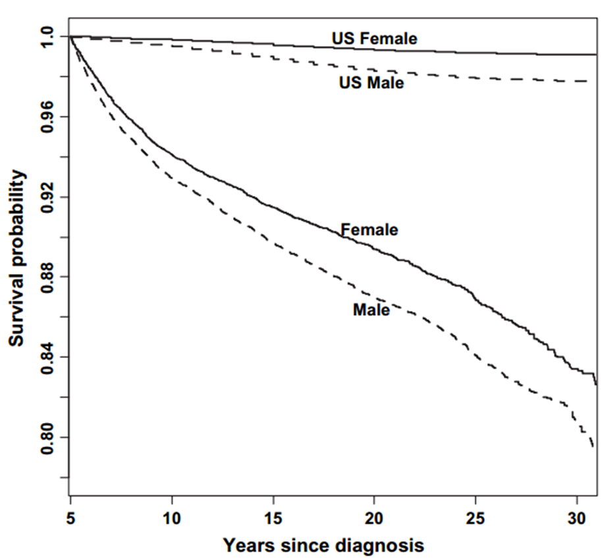
Early Mortality
18% of 5-year survivors had died by 30 years after their diagnosis
Mertens, et al, Cause-Specific Late Mortality Among 5-Year Survivors of Childhood Cancer: The Childhood Cancer Survivor Study, Journal of the National Cancer Institute, © 2008, 100, 19, 1368-1379, by permission of Oxford University Press
Copyright © 2019 by ASPHO

Slide 27
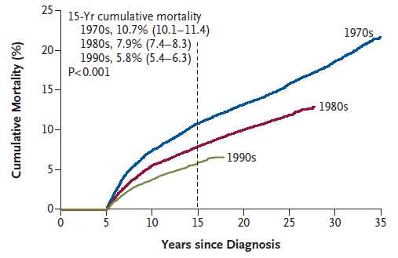
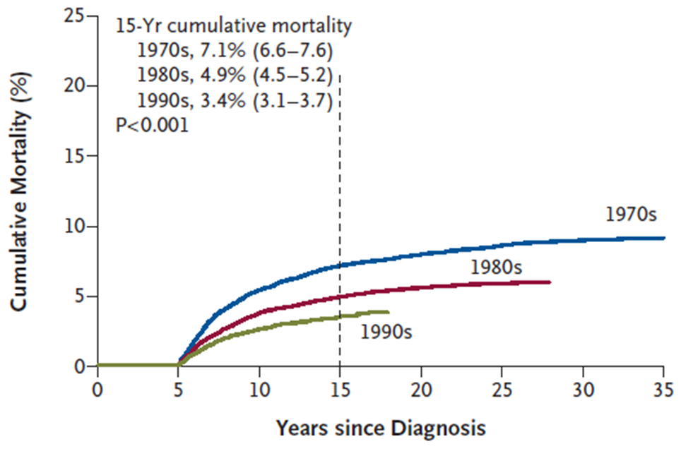
Changes in Mortality
All cause: 3,958 deaths
Primary cancer: 2,002 deaths
From The New England Journal of Medicine, Armstrong, et al, Reduction in Late Mortality among 5-Year Survivors of Childhood Cancer, 374, 833-842. Copyright © 2016 Massachusetts Medical Society. Reprinted with permission from Massachusetts Medical Society.
Copyright © 2019 by ASPHO
Notes:
50% decrease in 15-yr mortality between 1970s and 1990s
Largest cause of death primary cancer- also largest improvement between 1970s/1990s
Other cuases: SMN, cardiac pulmonary

Slide 28
Subsequent Malignant Neoplasms
Develop >2 months from completion of therapy
Leading cause of non-relapse death
Cumulative incidence ~20% at 30 years after diagnosis
Breast cancer most common followed by thyroid cancer
Multiple SMNs are common
  Cumulative incidence of second SMN 47% at 20 years after first SMN
Copyright © 2019 by ASPHO

Slide 29
Subsequent Malignant Neoplasms
t-MDS/AML
  2% at 15 years after therapy
  Topoisomerase II-Inhibitor related: 6mo-3yr, translocation 11q23
  Alkylating-agent related: 3-7yr, 5-/7- mutations
Solid tumors
  80% of SMN
  Associated with radiation
  Risk factors: younger age, increased dose, increased time after radiation
Copyright © 2019 by ASPHO
Notes:
Anthracyclines, epipodophyllotoxins topo-ii inh

Slide 30
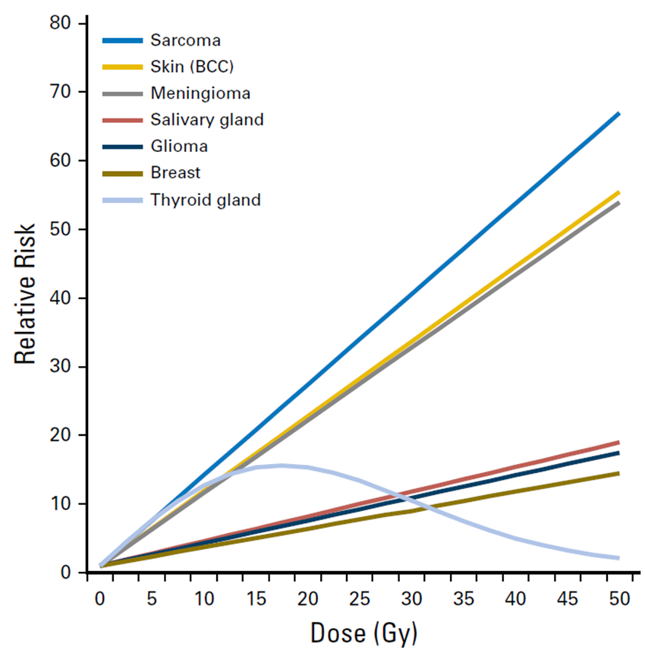
Solid Subsequent Malignant Neoplasms
Reprinted from International Journal of Radiation Oncology, Biology, Physics, 94, Inskip, et al, Radiation-Related New Primary Solid Cancers in the Childhood Cancer Survivor Study: Comparative Radiation Dose Response and Modification of Treatment Effects, 800-807, © 2016, with permission from Elsevier
Copyright © 2019 by ASPHO
Notes:
Dose relative
Thyroid dose-response until about 20 Gy then decrease risk

Slide 31
Subsequent Malignant Neoplasm Screening
Breast cancer: Clinical breast exam annually until 25yr, then q6mo. Mammogram & Breast MRI annually starting at age 25 or 8 yrs post-XRT (whichever is last)
Colorectal cancer: Multitarget stool DNA test q3yr or colonoscopy q5yr starting at age 30 or 5 yrs post-XRT (whichever is last)
Lung cancer: High-risk patients consider spiral CT
Skin cancer: Skin self-exam monthly, dermatology exam annually
Thyroid cancer: Counsel about risk and then decide
  Palpation of thyroid annually vs. US q3-5 yrs
Copyright © 2019 by ASPHO

Slide 32
Cardiovascular Disease
Leading cause of non-oncologic death in survivors
Cardiomyopathy/CHF:
  Anthracycline cardiotoxicity related to myocardial injury due to free radicals
  Risk factors: Increased dose, chest XRT, younger age
  Rare after XRT alone
Coronary Artery Disease:
  Cumulative risk 21% at 20 years after XRT
  Ischemic heart disease most common cause of cardiac death after XRT
  Risk factors: dyslipidemia, hypertension, obesity
Other XRT-related Heart Disease:
  Pericarditis, valvular heart disease, conduction abnormalities
Copyright © 2019 by ASPHO
Notes:
Screening: ECHO, EKG, CAD monitoring, Risk factors

Slide 33
Neurocognitive Sequelae
Attention, executive functioning, memory impairment, processing speed, visual spatial skills, learning difficulties (math/reading)
Radiation-associated (Cranial)
  Evident 1-2yr following XRT, progressive due to failure to slow rate of skill or information acquisition NOT progressive loss
  Risk factors: young age, VP shunt, stroke, hearing/motor impairment
  May have drops in IQ over time
Anti-metabolite therapy (HD-/IT-MTX)
  Risk factors: young age, females
  Global intellectual function relatively preserved
  Persists into adulthood
Copyright © 2019 by ASPHO

Slide 34
AYA Oncology, Late Effects, and Palliative Care
AYA Oncology
Late Effects
Fertility Preservation
Pain Management
Palliative Care
Copyright © 2019 by ASPHO

Slide 35
Reproductive Late Effects
Late Effects | Male | Female
Central Disorders | Precocious Puberty Gonadotropin Insufficiency | Precocious Puberty Gonadotropin Insufficiency
Primary Disorders | Hypoandrogenism Oligo-/Azoospermia | Acute ovarian failure Premature ovarian insufficiency
Sexual Dysfunction | Retrograde ejaculation Anejaculation Erectile dysfunction | Dyspareunia
Structural Disorders |  | Vaginal fibrosis/stenosis Uterine vascular insufficiency Uterine growth impairment
Copyright © 2019 by ASPHO
Notes:
Structural disorders lead to low birth weight, premature birth, malposition of fetus, fetal loss

Slide 36
Risk Factors for Reproductive Late Effects
Organs involved in cancer
Type, dose, combination of cytotoxic therapy
Sex (males more sensitive than females)
Age (in females, younger age protective)
Genetic factors (currently unknown)
Copyright © 2019 by ASPHO
Notes:
Infertility risk hard to determine- not everyone wants a child, in a relationship
Infertility is unsuccessful in becoming pregnant/fathering a child after trying for 1 year

Slide 37
Risk Factors: Reproductive Late Effects-Males
Late Effects | Exposures
Central disorders Precocious Puberty Gonadotropin Insufficiency | Brain surgery Hypothalamic-Pituitary radiation
Primary Disorders Hypoandrogenism Oligo-/Azoospermia | Orchiectomy Pelvic/Testicular radiation Alkylating agent chemotherapy
Sexual Dysfunction Retrograde ejaculation Anejaculation Erectile dysfunction | Pelvic surgery (RPLND, cystectomy, prostatectomy) Spinal surgery Pelvic, bladder, spine radiation
Copyright © 2019 by ASPHO
Notes:
Structural disorders lead to low birth weight, premature birth, malposition of fetus, fetal loss

Slide 38
Risk Factors: Reproductive Late Effects-Females
Late Effects | Exposures
Central disorders Precocious Puberty Gonadotropin Insufficiency | Brain surgery Hypothalamic-Pituitary radiation
Primary Disorders Acute Ovarian Failure Premature Ovarian Insufficiency | Oophorectomy Abdominal/pelvic/spinal radiation Alkylating agent chemotherapy
Sexual Dysfunction Dyspareunia | Spinal and Pelvic surgery (hysterectomy) Uterine or vaginal radiation
Structural Disorders Vaginal stenosis/fibrosis Uterine vascular insufficiency Uterine growth impairment | Vaginal radiation Uterine radiation (abdomen, pelvis, lumbosacral spine)
Copyright © 2019 by ASPHO
Notes:
Structural disorders lead to low birth weight, premature birth, malposition of fetus, fetal loss

Slide 39
Gonadotoxic Chemotherapy
Traditional alkylators converted to Cyclophosphamide Equivalency Doses (CED)
Agents without conversion:
  Temozolomide, Dacarbazine, Heavy Metals (Carboplatin, Cisplatin)
Cyclophosphamide
1mg/m²
BCNU
(Carmustine)
15
Nitrogen mustard
100
Ifosfamide
0.244
Busulfan
8.823
Thiotepa
50
Procarbazine
0.857
Chlorambucil
14.286
CCNU
(Lomustine)
16
Melphalan
40
Copyright © 2019 by ASPHO
Notes:
CED- usually tertile of studies; however, some studies have shown males may not be dose responsive
Highest risk: Males >7500, Females 15,000

Slide 40
Gonadotoxicity Males vs. Females
Males
Females
Compared to controls decreased likelihood of siring pregnancy: HR 0.63 (0.58-0.68)
Leydig cells (secrete testosterone): Fairly resistant
Sertoli cells/germ cells: Sensitive
Pubertal status does not provide protection from gonadal injury
After recovery from therapy, gonadal function is stable with aging
Compared to controls decreased likelihood of having pregnancy: HR 0.87 (0.81-0.94)
Stromal and germ cells equally affected by therapy
Pre-pubertal status protective from gonadal injury
After recovery from therapy, there may be a reproductive window followed by premature menopause
Chow Lancet Oncol 2016
Copyright © 2019 by ASPHO
Notes:
Females: Concurrent endocrine dysfunction and infertilty
Males: Endo ok, fertility not

Slide 41
Fertility Preservation: Males
Post-pubertal (Tanner III)
  SOC: Sperm cryopreservation (masturbation, electroejaculation or testicular sperm extraction)
  Experimental: Testicular tissue cryopreservation, reimplantation/grafting of testicular tissue
Pre-pubertal
  Experimental only: Testicular tissue cryopreservation
Gonadal shielding may reduce exposure to radiation
NO evidence for hormonal gonadoprotection
Copyright © 2019 by ASPHO
Notes:
Electroejaculation (transrectal probe while under anesthesia)
Extraction: Epididymal sperm aspiration, aspiration of sperm from epididymal tubule or testicular sperm extraction: TESE: Low sperm counts or obstructive azoospermia
Reimplantation: not L/L, testiticular tumor- goal reimplantation

Slide 42
Fertility Preservation: Females
Post-pubertal (post-menarchal)
  SOC: Oocyte/Embryo cryopreservation
    Considerations: Delay of cancer treatment, cost
  Experimental: Ovarian tissue cryopreservation
  Hormonal suppression with GnRHa for fertility preservation is controversial
Pre-pubertal
  Experimental Only: Ovarian tissue cryopreservation
Gonadal shielding or ovarian transposition (oophoropexy) may reduce exposure to radiation
Copyright © 2019 by ASPHO
Notes:
Old methods: 2-3 weeks, Newer methods- less delay but still a delay
Ovarian tissue cryopreservation- may become non-experimental in post-pubertal
GnRH analogues gonadotropin-releasing hormone agonists
Oophoropexy: May need ovaries repositioned. May need IVF

Slide 43
Fertility Evaluations in Survivorship
Infertility definition: Unsuccessful in becoming pregnant/siring a child after having tried one year
Males: Semen analysis, FSH for those unable to obtain
Females: Assess menstrual status, Screen with FSH, LH, estradiol, consider AMH
Copyright © 2019 by ASPHO
Notes:
Resumed spermatogenesis 5-10 years post-therapy

Slide 44
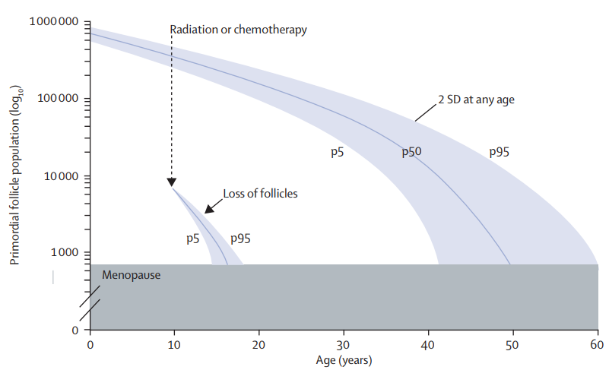
Considerations After Therapy
Reprinted from The Lancet, 376, De Vos, et al, Primary ovarian insufficiency, 911-921, © 2010, with permission from Elsevier
Copyright © 2019 by ASPHO
Notes:
Faddy Gosden

Slide 45

AYA Oncology, Late Effects, and Palliative Care
Many Thanks
Katharine Brock, MD, MS
Director, Supportive Care Clinic
Assistant Professor of Pediatrics
Pediatric Oncology & Palliative Care
Aflac Cancer & Blood Disorders Center
Children’s Healthcare of Atlanta
Emory University School of Medicine
AYA Oncology
Late Effects
Fertility Preservation
Pain Management
Palliative Care
Copyright © 2019 by ASPHO

Slide 46
Pain
The International Association for the Study of Pain (IASP) Definition:
An unpleasant sensory and emotional experience associated with actual or potential tissue damage or described in terms of such damage (e.g., burning/stabbing pain)
Associated neuroelectrical and neurochemical changes
Influenced by emotional and cognitive factors
PAIN IS SUBJECTIVE!
Copyright © 2019 by ASPHO
Notes:
Some kids manifest pain by becoming more quiet and moving around less rather than crying/ moaning/ etc. Parent report and child self-report are key.

Slide 47
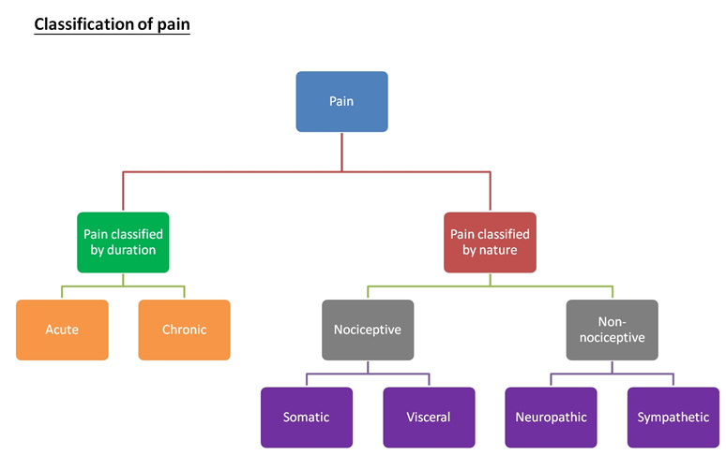
Classification of Pain
Copyright © 2019 by ASPHO
c/o Katharine Brock, MD, MS, Pediatric Oncology/PACT at Emory
Notes:
Not sure if this slide would be helpful visual

Slide 48
Physiology of Pain
Nociceptive
  Neural transmission activated by mechanical, chemical, or thermal damage to the body tissue
  Produces physiologic/endocrine response separate from cognitive/emotional response
    Tachycardia
    Hypertension
    Activation of glucose counter-regulatory hormones (glucagon, epinephrine, cortisone, growth hormone)
    Muscle spasms
    Increase in metabolic demands
  Lack of correlation between tissue injury and intensity of pain
Copyright © 2019 by ASPHO

Slide 49
Physiology of Pain
Neuropathic
  Results from abnormal nerve function due to nerve invasion or inflammation of nerve root
  Etiologies include:
    Nerve damage from drug (e.g., vincristine/cisplatin)
    Neural compression or invasion by tumors
    Physical damage to the nerve
    Infectious etiologies (e.g., herpes zoster reactivation)
Copyright © 2019 by ASPHO

Slide 50
Duration of Pain
Acute
  Usually concordant with degree of tissue damage
  Remits with resolution of injury
Chronic
  Low levels of underlying pathology that do not explain presence/extent of pain
  Perpetuated by factors remote from cause
  Environmental and affective factors exacerbate pain
Copyright © 2019 by ASPHO

Slide 51
Categories of Pain in Pediatric Oncology
Pain associated with medical procedures
Pain associated with bone marrow infiltration
Neuropathic pain and pain due to CNS tumors
Bone/amputation pain
Visceral pain
Pain associated with HSCT complications (e.g., mucositis, GVHD)
Copyright © 2019 by ASPHO

Slide 52
Pain Measurement Tools
Newborns/Infants
  Observational behavioral distress scales focused on facial expressions, crying, body movement
  Vital signs are nonspecific
Children
  Self-report (Faces, Visual Analog Scale)
  Verbal numerical ratings- Gold standard
  FLACC scale (Face, Leg, Activity, Cry, Consolability), CHEOPS (Children’s Hospital of Eastern Ontario Pain Scale)- Scales of posture, movement, facial expression for use in non-verbal children
Copyright © 2019 by ASPHO

Slide 53
Management: Nociceptive Pain
WHO Guidelines on Pharmacological Treatment of Persisting Pain in Children with Medical Illness
  Dosing at regular intervals (ATC not PRN)
  Adapting treatment to child
  Appropriate route of administration (oral when possible)
  2-step strategy
Copyright © 2019 by ASPHO
Notes:
Aim: Round-the-clock analgesia (with additional PRN analgesia for breakthrough pain or titrating to effect)
Alternative routes:
Intravenous (when patient already has access)
Sublingual/buccal
Intranasal
Transdermal (contraindicated in acute pain)

Slide 54
Management: Nociceptive Pain
WHO Step 2
Moderate to
Severe Pain
Not recommended
  Tramadol (if <12y)
  Codeine
  Merperidine
  Nalbuphine
  Hydrocodone
  Combine analgesia (Vicodin, Lortab, Percocet)
WHO Step 1
Mild Pain
Morphine
or
Fentanyl, Hydromorphone, Oxycodone, Methadone
Ibuprofen
and/or
Acetaminophen
Other NSAIDs
Cox-2 Inhibitor
Copyright © 2019 by ASPHO
c/o Katharine Brock, MD, MS, Pediatric Oncology/PACT at Emory
Notes:
Morphine- Gold standard
Morphine/Oxycodone not good for renal failure/insufficiency

Slide 55
Opioid Side Effects
Gut hypomotility (constipation)
  No tolerance
  Needs prophylactic bowel regimen (osmotic laxatives, surfactant laxatives, stimulants)
  Methylnaltrexone
Sedation
  Treat with methylphenidate
Pruritis
  Treat with Nalbuphine, Antihistamine, NSAIDS, Ondansetron, SSRI
  Naloxone 0.2ug/kg/min
Nausea
Urinary retention
Sweating
Opioid Hyperalgesia
  Treat with rotation of medications
  Ketamine
Myoclonus
  Treat with benzodiazepines
Copyright © 2019 by ASPHO
Notes:
Methylnaltrexone- peripheral opioid receptor antagonist- reverses constipation but cannot cross BBB- no change in pain
Stool softeners
1) Osmotic laxatives
Lactulose 15-30ml PO BID
Polyethylene glycol (Miralax) 8.5 – 17g PO qday – BID ++
2) Surfactant laxatives
Docusate 0.5 – 1mg/kg PO qday – QID
Stimulants
Senna (< 6 y/o = ½ tab qday, > 6 y/o = 1 tab qday).
Can be given as suppository
Bisacodyl 5-10mg suppository qday prn
Others:
Octreotide (malignant bowel obstruction)
Low-dose naloxone infusion (0.5-2 mcg/kg/hr for OIC)
Methylnaltrexone (opioid-induced constipation)
(sennosides-only superior to combination with docusate in small RCT)
Myoclonus- can lead to seizures

Slide 56
Why to Rotate Opioids
Renal failure
  Rotate off morphine/oxycodone to fentanyl or methadone (or less ideal, hydromorphone)
Too many side effects with poor pain control
  If excellent pain control, try a 20% dose decrease.
Opioid-induced hyperalgesia
  Allodynia, myoclous, neuroexcitability
Consider a switch across classes
  Morphine/Oxycodone/Hydromorphone (Phenanthrene derivatives)
  Fentanyl (Phenylpiperidine derivatives)
  Methadone (Diphenylheptane derivatives)
Copyright © 2019 by ASPHO
Notes:
Watch for opioid-induced hyperalgesia in patients who you keep going up and up and they pain gets worse and more diffuse, rather than better.

Slide 57
Opioid Terminology
Tolerance: Need to increase dose of opioids over time
Withdrawal: Symptoms if opioid discontinued/tapered too quickly
  Dysphoria, restlessness, anxiety, nausea, diarrhea, abdominal cramps, rhinorrhea, sweating, tachycardia, hypertension, tachypnea
  Addiction: A chronic, relapsing condition characterized by persistent, compulsive dependence on a behavior or substance despite adverse consequences
    Largely genetically determined
  Pseudo-addiction: characteristics similar to addiction that resolve when pain is adequately treated (generally due to inadequate dosing)
Copyright © 2019 by ASPHO

Slide 58
Management: Neuropathic Pain
Gabapentinoids
  Gabapentin
  Pregabalin
Tricyclic antidepressants (TCAs)
  Amitriptyline
  Nortriptyline
Selective serotonin norepinephrine reuptake inhibitors (SSNRIs)
  Venlaxefine
  Duloxetine
Antiepileptic drugs (AEDs)
  Carbamazepine
  Topiramate
Local anesthetics
  Lidocaine (patch or infusion)
  Ketamine
Opioids for pain not effectively treated with other modalities
  Methadone
Copyright © 2019 by ASPHO
Notes:
AED- sedation- slow titration
Other AED: valproate, carbamazepine, topiramate

Slide 59
Other Approaches to Pain
Mechanical approaches
  Physical therapy
  Acupuncture, acupressure
Physical approaches
  Massage
  Positioning
  Heat/cold
Cognitive behavioral techniques
  Guided imagery
  Hyponosis
  Biofeedback
Interventional procedures
  Regional nerve blocks
  Epidural anesthesia
  Nerve ablation for refractory pain
Targeted drug therapies
  NSAIDs, bisphosphonates for bony metastases
  Corticosteroids
  Muscle relaxants
Copyright © 2019 by ASPHO
Notes:
Steroids: visceral distension, bony destruction, cerebral edema

Slide 60
AYA Oncology, Late Effects, and Palliative Care
AYA Oncology
Late Effects
Fertility Preservation
Pain Management
Palliative Care
Copyright © 2019 by ASPHO

Slide 61
What is Palliative Care?
According to the WHO:
  Active total care of the child's body, mind and spirit, and involves giving support to the family
  Begins when illness is diagnosed, and continues regardless of whether or not a child receives treatment directed at the disease
  Requires a broad multidisciplinary approach that includes the family and makes use of available community resources
  Can be provided in tertiary care facilities, community health centers and homes
Copyright © 2019 by ASPHO

Slide 62
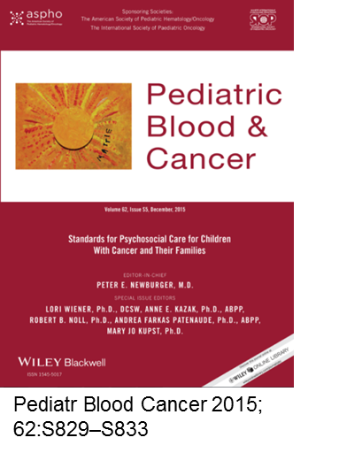

Standard of Care
2015: Palliative Care as Standard of Care in
Pediatric Oncology
2016: Integration of Palliative Care into Standard
Oncology Care: ASCO Clinical Practice Guideline
Update (original in 2012)
Copyright © 2019 by ASPHO

Slide 63
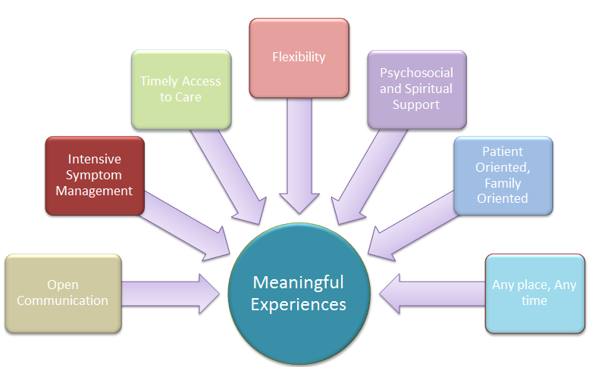
Core Ideals of Palliative Care
Copyright © 2019 by ASPHO
c/o Janet Duncan, CPNP, PACT Boston
Notes:
The Core Ideals of palliative care are all a part of helping patients have a meaningful experience while coping with serious illness.
Our core values include:
Open communication
Intensive symptom management
Timely access to care
Flexibility
Psychosocial and Spiritual Support
Patient oriented and family oriented care
Care that can be delivered at any place and any time

Slide 64
Palliative Care Misconceptions
FALSE: Palliative care is end of life care
TRUE: Palliative care should be a priority from diagnosis of a child with a serious disease
FALSE: Palliative care cannot be concurrent with disease-directed therapy
TRUE: Palliative care is an extra layer of support focused on physical, psychological, social and spiritual needs
FALSE: Palliative care is the same as hospice care
TRUE: Hospice care is a distinct service for children with an expected prognosis of ≤6 months, generally focused on comfort and home-based care
Copyright © 2019 by ASPHO
Notes:
Abrupt transitions to end of life
The Patient Protection and Affordable Care Act that was passed in 2010 included a provision termed “Concurrent Care for Children” Requirement, which requires state Medicaid programs to pay for both curative and hospice care for children <21 years old if the child is within the last 6 months of life based on the expected disease course.

Slide 65
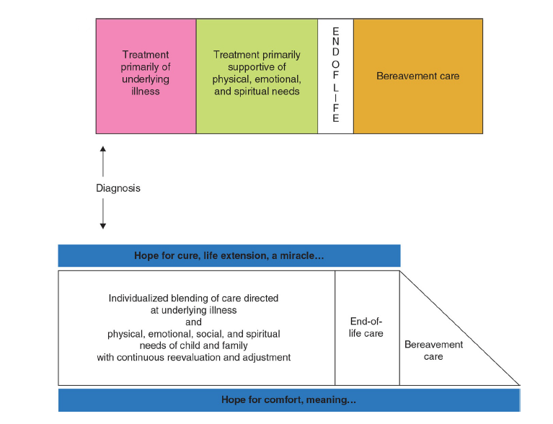
Timing of Palliative Care
Not Ideal:
Abrupt Transition
Copyright © 2019 by ASPHO
Pizzo, Poplack, Principles and Practice of Pediatric Oncology, WK Health Book, Wolters Kluwer Health, © 2015
Notes:
Patients with high-risk or incurable disease who receive cancer-directed care in synergy with PC demonstrate improved outcomes.
Value of palliative oncology well recognized.
Integration of PC principles and services into routine cancer care for children with high-risk disease has been associated with improved symptom management & EOL outcomes for patients and quality of life for both children and families.

Slide 66
Timing of Palliative Care
Not Ideal:
Abrupt Transition
Ideal:
Part of the Paradigm
Copyright © 2019 by ASPHO
Pizzo, Poplack, Principles and Practice of Pediatric Oncology, WK Health Book, Wolters Kluwer Health, © 2015
Notes:
Patients with high-risk or incurable disease who receive cancer-directed care in synergy with PC demonstrate improved outcomes.
Value of palliative oncology well recognized.
Integration of PC principles and services into routine cancer care for children with high-risk disease has been associated with improved symptom management & EOL outcomes for patients and quality of life for both children and families.

Slide 67
Key Components of Palliative Care
Communication
  Understanding of Illness
  Goals of Care
Medical Decision Making
  Advanced Care Planning
  Code status
Care Coordination
  Medical team, support services, home agencies
Symptom Management
Copyright © 2019 by ASPHO
Notes:
Understanding of disease/treatment
Hopes/Worries
Sources of strength
Open-ended questions are crucial
Honest, straightforward language
Acknowledge emotion
LISTEN
Advanced Care Planning
Cancer-directed therapy at the end of life- increase QOL or burdens
Do Not Attempt Resuscitation (DNAR)- Recommend good care not not good care
POLST (Physician Orders for Life-Sustaining Treatment)
Organ donation
Location of Care

Slide 68
Symptoms
System | Symptom
General | Fatigue
Pain | Nociceptive, neuropathic, interventional, radiotherapy
Respiratory | Dyspnea, cough, secretions
FEN/GI | Consideration of IVF, artificial hydration & artificial nutrition N/V, bowel obstruction, constipation, diarrhea, dysmotility, anorexia, dysguesia
Neuro/Psych | Agitation/irritability, anxiety, depression, delirium, sleep challenges, seizures, spinal cord compression
Dermatology | Pruritus
EOL management | Active dying process Pain, dyspnea, secretions, delirium
Copyright © 2019 by ASPHO
c/o Katharine Brock, MD, MS, Pediatric Oncology/PACT at Emory

Slide 69
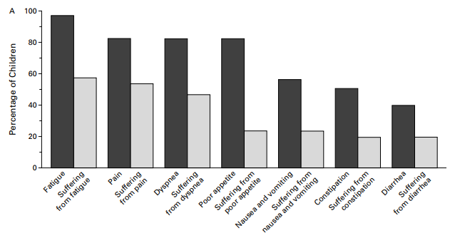
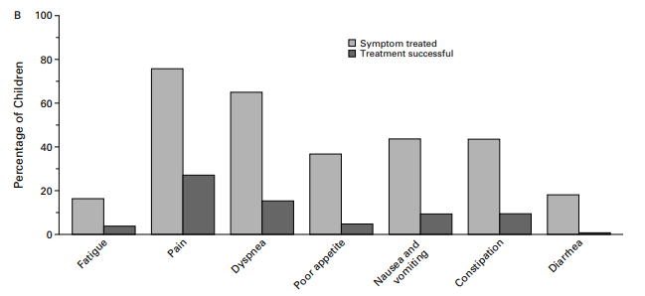
Symptoms at the End of Life
89% suffered from at least 1 symptom
51% suffered from ≥ 3 symptoms
Pain and Dyspnea most commonly treated
Treatment was successful in <30% of children
From The New England Journal of Medicine, Wolfe, et al, Symptoms and Suffering at the End of Life in Children with Cancer, 342, 326-333 Copyright © 2000 Massachusetts Medical Society. Reprinted with permission from Massachusetts Medical Society
Copyright © 2019 by ASPHO
Notes:
Last month of life

Slide 70
Pain Management at End of Life
When switching drugs, decrease dose 25-50% (cross-tolerance)
Fentanyl patches only for stable, chronic pain- NOT acute/EOL titration
Methadone is long-acting, no rapid titration. Increases only every 3 days
Do NOT use combination products (percocet, vicodin)
Increases for moderate pain 30-50% (continuous and PRN)
  Severe pain at EOL often requires dose increases of 50-100%
Rescue dose should be 10% of daily requirement
  50-100% of continuous dose if using PCA
NO data that pain medication hastens death- may prolong life
NO ceiling dose at EOL
Copyright © 2019 by ASPHO
Notes:
Acetaminophen combination products (e.g. Tylenol #3, Vicodin [hydrocodone], Percocet [oxycodone]) are not recommended as dosing cannot be increased with increasing pain without risking associated liver toxicity of high doses of acetaminophen.

Slide 71
Dyspnea
Subjective!
  Do not use oxygen saturations, RR, retractions
  Ask or look at face (scared/ startled look), expressions, breathing pattern
Management:
  Opioids!!
    Generally 1/3-1/2 the pain dose is sufficient (if isolated problem)
    When already on opioids, use same dose as pain dose
  Fan to the face
  Increase head of bed/reposition
  Oxygen by nasal cannula if hypoxic
  Benzodiazepines helpful if significant anxiety component
  Discussing stopping IVF, as likely making this worse
Copyright © 2019 by ASPHO
Notes:
Ask the patient if they’re short of breath.
If the look startled/ scared/ eyes wide open → that’s a sign of dyspnea.
Dyspnea algorithm: (1) opioids, (2) fan, (3) o2 if hypoxic, (4) opioids, (5) benzos,

Slide 72
“Terminal” delirium
More common problem than is commonly recognized
Treat underlying cause if possible and in line with goals of care
May be hyperactive or hypoactive or mixed
  Agitated/confused/decreased attention, altered cognition, a change from baseline, fluctuating/intermittent, +/- hallucinations
If you’re going way up on opioids and the patient won’t settle, consider this as an etiology
Management:
  Monitor, or consider using anti-psychotics (haloperidol)
  Avoid treating with benzos and anti-cholinergics
Copyright © 2019 by ASPHO
Notes:
This is standard of care for now. This may change over time as new studies come out. All data extrapolated from adult care.
- Other anti-psychotics such as risperidone (risperdal), olanzapine (zyprexa), quietapine (seroquel), and chlorpromazine (thorazine) would all be second to third line agents.

Slide 73
Secretions
Gurgling sound (aka, death rattle) caused by pooling of saliva in back of throat due to the body relaxing
Not distressing to patient
Management:
  Provide anticipatory guidance and reassurance
  Atropine 1% eye drops given SL
  Hyoscyamine (0.125mg/1ml soln)
  Glycopyrrolate 0.004 -0.005 mg/kg IV q4 hours prn
Copyright © 2019 by ASPHO
Notes:
Hospice will often use hyoscyamine (levsin) or atropine drops depending on the company.
- Hyoscyamine comes in two concentrations (0.125mg/1ml soln) and a 0.125mg/5ml elixir. The latter is much more volume. i.e. for a 50kg patient, would have to give 5ml which is often too difficult to tolerate unless there is a g-tube in place.

Slide 74
Changes at the End of Life
In the days/weeks prior to death:
  Increased somnolence
  Less interactivity (walking/speaking)
  Decreased appetite
  Weight loss/gain
  Skin changes (pallor, cool)
  Respiratory changes
In hours/days prior to death:
  Somnolence → sleeping up to 22 hours per day → comatose
  Decreased solids → Decreased liquids → no intake
  Decreasing urination → anuria
  Waxy appearance, jaw falls back
  Labored breathing
  Secretions that cause a gurgling sound
Copyright © 2019 by ASPHO
Notes:
Most families have NEVER done this! They don’t know what to expect. And most think it will be a quiet, peaceful process with everyone holding hands and singing and they will have warning, etc. It doesn’t always go like this. So don’t promise things you can’t guarantee will occur. You can promise that you will do your best to keep the child as comfortable as possible, and that you will be honest with the family.
** families often want to know when this will occur – while it is hard to prognosticate, you still know more than they do, so give your best hours-days, days-weeks, weeks-months, months-years estimate if the family wants a time. Also, you get more accurate as the time gets closer, so you can let them know that you’ll be able to provide better guidance as time gets close. If at home, hospice can also be the eyes/ears for this. We watch a lot of people die, so they’ll know when things are close.
-- For example, when the breathing is the apneic/ slow breathing – death is likely to occur in the next ~ 24 hrs.

