Slide 1


Slide 2

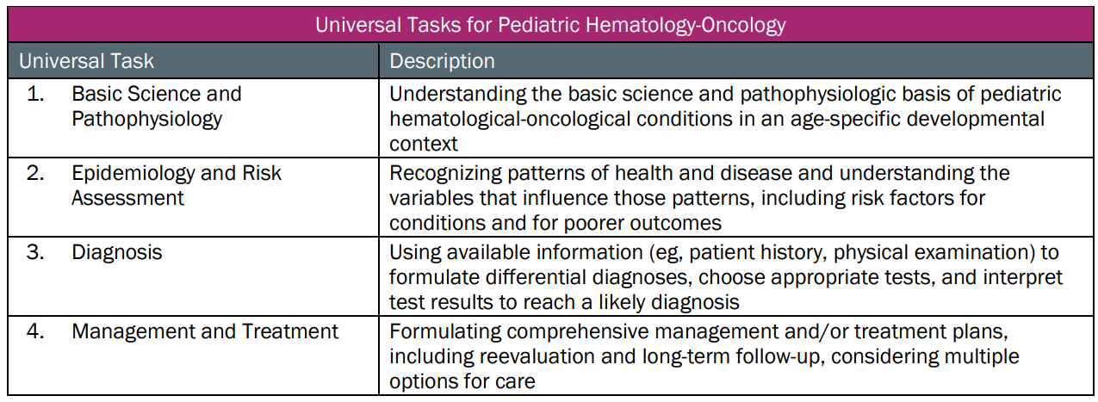
This talk will follow the topical structure suggested by the ABP:
Copyright © 2019 by ASPHO

Slide 3
Sarcomas (domain 9, subdomain B): Objectives
To review the universal tasks for rhabdomyosarcoma (RMS) (subdomain B3), osteosarcoma (OS) (subdomain B1) and Ewing sarcoma (EWS) (subdomain B2)
To review general principles for the universal tasks for tumors classified as non-rhabdomyosarcoma soft tissue sarcomas (NRSTS) (subdomain B4)
To contrast the universal tasks for different types of sarcomas
Copyright © 2019 by ASPHO

Slide 4
Sarcomas: Rhabdomyosarcoma (subdomain B3)
Basic Science and Pathophysiology
Epidemiology and Risk Assessment
Diagnosis
Management and Treatment
Copyright © 2019 by ASPHO

Slide 5
Sarcomas: Rhabdomyosarcoma (subdomain B3)
Basic Science and Pathophysiology
Epidemiology and Risk Assessment
Diagnosis
Management and Treatment
Copyright © 2019 by ASPHO

Slide 6
  Somatic mutations in RMS
• PAX-FOXO1 fusions in ARMS
PB
HD
PAX3 (2q35)
PAX3-FOXO1
t(2;13)
60%
PB
HD
FD
FOXO1 Activation
FOXO1 (13q14)
PAX7-FOXO1
t(1;13)
20%
PB
HD
PB
HD
PAX7 (1p36)
Breakpoint
Copyright © 2019 by ASPHO
(Barr et al., J Mol Diagn 2006; 8:202) (Courtesy of William Meyer)
Notes:
In ARMS, recurrent translocations result in production of tumor specific fusions of PAX and FKHR genes.
(⇓) Pax 3, on chromosome 2 OR
(⇓) Pax 7, on chromosome 1 AND
(⇓) FKHR on chromosome 13 are involved in this gene translocation (⇓)
Creating either
(⇓) a tumor specific PAX3/FKHR fusion product, OR
(⇓) the PAX7/FKHR fusion product

Slide 7
    Fewer mutations in PAX-FOXO1 fusion positive RMS
      •Average of 6 in fusion positive vs. 18 in fusion negative tumors
    Abnormalities in ERMS (fusion negative RMS)
      •Aneuploidy
      •Activating mutations of the RAS pathway (FGF4, NRAS, KRAS, HRAS, NF1, PIK3CA, and others)
      •Loss of heterozygosity (LOH) or loss of imprinting (LOI) at 11p15.5 associated with enhanced IGF2 expression
      •p53 mutations associated with anaplasia
(Shern et al., Cancer Disc 2014; 4:216. Chen et al., Cancer Cell 2013; 24:710)
Copyright © 2019 by ASPHO

Slide 8
1. Germline Mutations Associated with RMS
Syndrome | Features | Gene | Mechanism
Li-Fraumeni | Cancer predisp. | p53 | AD mutations
BWS | Overgrowth | IGF2 | 11p15 LOH/LOI
Costello | Facial, cutaneous, skeletal, cardiac | HRAS | AD mutations
Noonan | CHD, pectus, facial features | RAS-MAPK pathway | AD mutations
NF1 | Café-au-lait spots, phakomatosis | NF1 | AD mutations
Gorlin | BCC | PTCH1 | AD mutations
PBB | Cancer predisp. | Dicer1 | AD mutations
Copyright © 2019 by ASPHO

Slide 9
Sarcomas: Rhabdomyosarcoma (subdomain B3)
Basic Science and Pathophysiology
Epidemiology and Risk Assessment
Diagnosis
Management and Treatment
Copyright © 2019 by ASPHO

Slide 10
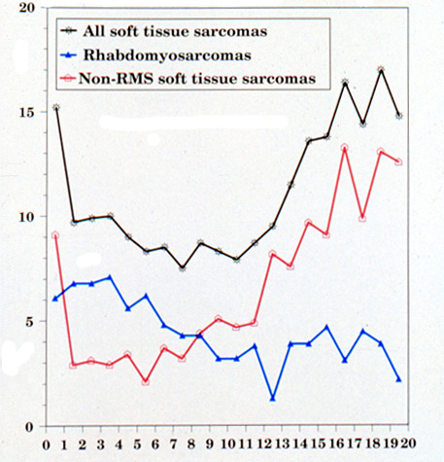
2. STS/RMS Annual Rate per Million by Age
300 new cases annually
Years
(SEER Pediatric Monograph, NIH Pub. No.99-4649, 1999)
Copyright © 2019 by ASPHO

Slide 11
2. RMS Clinical Presentation
Mass, +/- pain, +/- disturbance in function, may occur in any location in the body
Primary site distribution (IRS-II)
Site Frequency
Head/Neck 34%
Orbit (8%)
Non-Parameningeal (8%)
Parameningeal (18%)
GU 23%
Paratestis/Vag/Uterus (12%)
Bladder/Prostate (11%)
Extremity 17%
Other 25%
(Maurer et al., Cancer 1993; 71:1904)
Patterns of spread
Lymphatic: 40% of paratesticular and 20% of extremity tumors
CNS extension: 50% of parameningeal (cranial nerve palsies, erosion of cranial bone, direct intracranial growth)
Hematogenous: 10-20% at diagnosis (lung, bone, bone marrow, liver)
Copyright © 2019 by ASPHO

Slide 12
2. RMS Staging
Staging workup
    MRI or CT of primary site and regional nodal basin
    CT of chest
    PET scan or bone scan
    Bilateral bone marrow aspirate/biopsy
    Special situations
      CSF cytology for parameningeal/paraspinal tumors
      Lymph node assessment for paratesticular ≥10 yrs or extremity
      Patients with ERMS, T1, N0 disease have a low rate of bone, BM, and lung metastases, making bone scan, BM aspirate/biopsy and possibly chest CT unnecessary
(Weiss et al. J Clin Oncol 2013; 31:3226)
Copyright © 2019 by ASPHO

Slide 13
  IRS staging system (clinical system)
Stage Sites T Size N
1 Orbit, non-para- T₁ or T₂ a or b N_{o}, N₁, or N_{x}
meningeal head
and neck, non-
bladder/prostate
GU, biliary tract
2 Parameningeal, T₁ or T₂ a N₀ or N_{x}
bladder/prostate,
extremity, other
3 Parameningeal, T₁ or T₂ a N₁
bladder/prostate, b N₀, N₁, or Nx
extremity, other
4 All with distant T₁ or T₂ a or b N₀ or N₁
metastases
Definitions: T=tumor invasiveness; T₁=confined to anatomic site of origin; T₂=extension and/or fixation to surrounding tissue; a =≤ 5 cm; b= > 5 cm; N=regional nodes; N₀=regional nodes not clinically involved; N₁=regional nodes clinically involved; N_{x}=clinical status of regional nodes unknown
Reprinted with permission © (2001) American Society of Clinical Oncology. All rights reserved. Crist, W et al: J Clin Oncol Vol. (12) 2001.
Copyright © 2019 by ASPHO

Slide 14
  IRS grouping system (surgical pathologic system)
    Group I: Localized disease, completely resected
    Group II: Gross total resection with evidence of regional spread
      Grossly resected tumor with microscopic residual
      disease
      Complete resection of primary tumor, regional
      nodes involved and completely resected
      Regional disease with involved nodes, grossly
      resected but microscopic residual disease and histologic
      involvement of resected regional nodes
    Group III: Incomplete resection with gross residual disease
    Group IV: Distant metastatic disease
    (Maurer et al., Cancer 1988; 61:209)
Copyright © 2019 by ASPHO

Slide 15
2. RMS Prognostic Factors at Diagnosis
RMS prognosis by stage (IRS-IV)
  Stage 3-yr FFS
  1 86%
  2 80%
  3 68% (p<0.001)
  4 25%
  (Crist et al., J Clin Oncol 2001; 19:3091. Breneman et al., J Clin Oncol 2003; 21:78)
Copyright © 2019 by ASPHO

Slide 16
  RMS prognosis by group (IRS-IV)
Group 3-yr FFS
I 83%
II 86%
III 73%
IV 25% (p<0.001)
(Crist et al., J Clin Oncol 2001; 19:3091. Breneman et al., J Clin Oncol 2003; 21:78)
Copyright © 2019 by ASPHO

Slide 17
  RMS prognosis by histology/fusion status
2013 WHO Classification of RMS (Fusion negative RMS)
Subtype 5-yr EFS (IRSG/COG)
Spindle Cell 83%
Botryoid 80% p<0.001
Embryonal 73% After adjusting for risk group p=0.66
(Rudzinski et al., Arch Pathol Lab Med 2016; 139:1281)
Histology and Fusion Status (D9803 Intermediate Risk; n=434)
Subtype 5-yr FFS
ERMS 77%
ARMS with t(2;13) 54% p<0.001 p=0.15
ARMS with t(1;13) 65%
ARMS (without fusion) 90%
(Skapek et al., Pediatr Blood Cancer 2013; 60:1411)
Copyright © 2019 by ASPHO

Slide 18
  RMS prognosis by COG risk group (Stage, Group, Histology/Fusion Status, Age)
Low (5-yr FFS ≥ 85%):
Stage 1, 2; Group I, II; ERMS
Stage 1; Group III (orbit); ERMS
Intermediate (5-yr FFS = 50-75%):
Stage 1; Group III (non-orbit); ERMS
Stage 2; Group III; ERMS
Stage 3; Group I, II, III; ERMS
Stage 4; Group IV; < 10 years old; ERMS
All localized ARMS (fusion positive)
High (5-yr FFS ≤ 20%):
Stage 4; Group IV; ≥ 10 years old; ERMS
Stage 4; Group IV; ARMS (fusion positive)
  (Meza et al., J Clin Oncol 2006; 24:3844. Breneman et al., J Clin Oncol 2003; 21:78)
Copyright © 2019 by ASPHO

Slide 19
  RMS prognosis by primary site (Groups I-III) (IRS-IV)
Most favorable
Orbit/Head and Neck
GU, non-Bladder/prostate
GU, Bladder/Prostate
Parameningeal
Other
Extremity
Least favorable
(Crist et al., J Clin Oncol 2001; 19:3091)
Copyright © 2019 by ASPHO

Slide 20
  RMS prognosis by metastatic site
Metastatic site 3-yr FFS
Lung 42%
Bone or bone marrow 15-17%
Number of metastatic sites
< 2 sites 30%
> 3 sites 14% (p<0.0001)
(Oberlin et al., J Clin Oncol 2008; 14:2384)
Copyright © 2019 by ASPHO

Slide 21
2. RMS Prognosis at Recurrence
Following recurrence on IRS-III, -IVP, -IV or if treated on COG ARST0121
    Median survival following 1st recurrence = 0.8 yrs
    3-5-yr survival = 17-28%
Favorable factors: 5-yr survival = 50%
    Botryoid histology (any initial stage or group)
    ERMS (stage 1 or group 1 at initial diagnosis) with local or regional recurrence and not previously treated with cyclophosphamide
Unfavorable factors: 5-yr survival = 10%
    All others
      (Pappo et al., J Clin Oncol 1999; 17:3487. Mascarenhas et al., J Clin Oncol 2010; 28:4658)
Copyright © 2019 by ASPHO

Slide 22
Sarcomas: Rhabdomyosarcoma (subdomain B3)
Basic Science and Pathophysiology
Epidemiology and Risk Assessment
Diagnosis
Management and Treatment
Copyright © 2019 by ASPHO

Slide 23
3. RMS Pathology
Morphology, Immunostains and Differential Diagnosis
Spindle cell tumor Immunohistochemistry
ERMS/Spindle cell RMS MyoD, Myogenin, Desmin,
Muscle Specific Actin
Synovial Sarcoma Cytokeratin, EMA, Bcl2
Small round blue cell tumor Immunohistochemistry
ARMS MyoD, Myogenin, Desmin,
Muscle Specific Actin
Lymphoma LCA, CD3, CD20, TdT
Neuroblastoma NSE, Synaptophysin, TH, PHOX2B
EWS/PNET CD99, Vimentin, +/- NSE, Synaptophysin
Copyright © 2019 by ASPHO

Slide 24
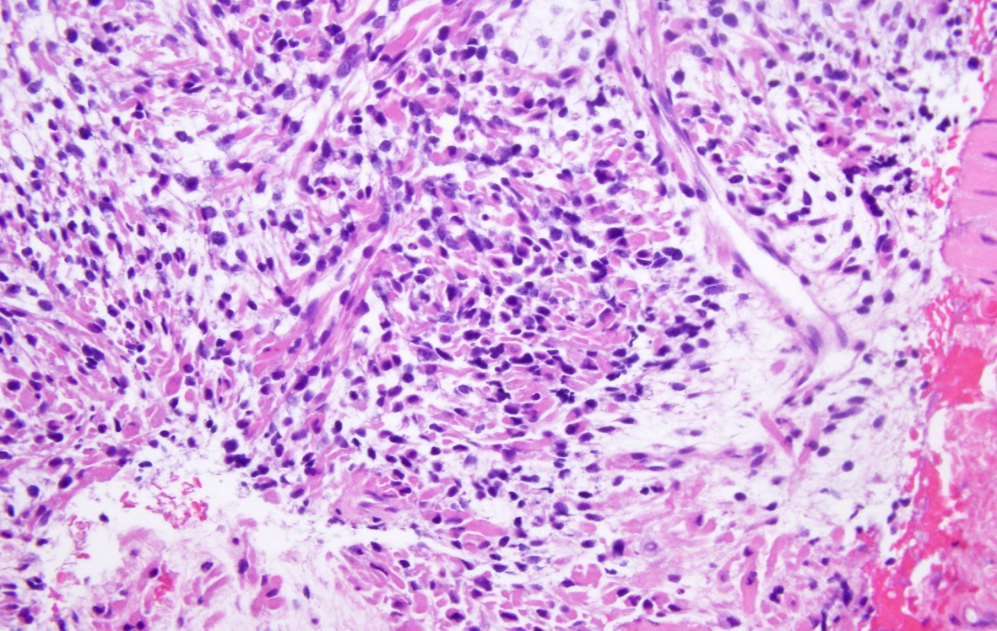
3. RMS Pathologic Subtypes
  •ERMS
    60-70% of cases
    Resembles immature muscle
    Includes the botryoid pattern
    Associated with younger age,
    favorable site, localized disease,
    favorable prognosis
  Spindle cell/Sclerosing RMS
    5-10% of cases
    Spindled cells with fascicular
    growth pattern +/- sclerosis
    Associated with favorable
    prognosis in pediatrics
⇧
⇧
(WHO Classification: Fletcher et al., IARC Press, Lyon 2013.
Rudzinski et al., Arch Pathol Lab Med 2015, 139:128)
Image courtesy of Pauline Chou
Copyright © 2019 by ASPHO

Slide 25
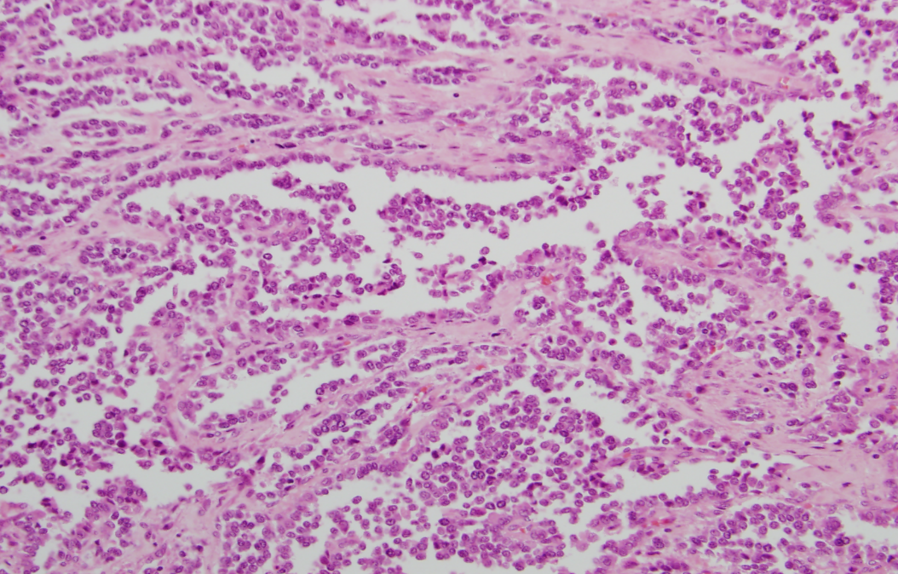
  ARMS
    20% of cases
    Growth pattern reminiscent
    of pulmonary alveoli
    > 50% of the tumor must
    show the alveolar pattern
    Usually associated with either a
    t(2;13)(q35;p14) or t(1;13)(p36;q14), 20% fusion negative
    Associated with extremity primary, lymph node involvement, bone/bone marrow involvement, and an unfavorable prognosis
(WHO Classification: Fletcher et al., IARC Press, Lyon 2013. Rudzinski et al., Arch Pathol Lab Med 2015, 139:128)
Image courtesy of Pauline Chou
Copyright © 2019 by ASPHO

Slide 26
Sarcomas: Rhabdomyosarcoma (subdomain B3)
Basic Science and Pathophysiology
Epidemiology and Risk Assessment
Diagnosis
Management and Treatment
Copyright © 2019 by ASPHO

Slide 27
4. RMS Treatment Planning
  Treatment philosophy
    Optimal treatment requires a coordinated multidisciplinary management plan to provide local and systemic therapy:
    SURGERY, RADIOTHERAPY, CHEMOTHERAPY
  Treatment based on risk group
    Defined by stage, group, histology/fusion status, and sometimes age
Copyright © 2019 by ASPHO

Slide 28
4. RMS Treatment
Surgery
  Form of local therapy
  Excision of the primary tumor upfront whenever possible without causing major functional or cosmetic deficits
  Sites requiring surgical assessment of lymph nodes
    Paratesticular (ipsilateral RLNA if ≥10 years)
    Extremity (node sampling)
  Delayed primary resection sometimes done during treatment for residual tumor
Copyright © 2019 by ASPHO

Slide 29
Radiation Therapy
  Form of local therapy
    Local/regional relapse: 61-67% of recurrences (Crist et al., J Clin Oncol 2001; 12:3091. Wolden et al., Int J Radiat Oncol Biol Phys 2015; 93:1071. Hawkins et al., J Clin Oncol 2018; 36:2770)
  Patients with group I ERMS/Spindle cell RMS do not receive RT
  RT usually begins during weeks 3-15 of therapy
  Treatment volume determined by pretreatment (pre-surgical) tumor
  size
  Doses of 36.0 - 50.4 Gy used; dose depends on group, site, nodal involvement, histology, and whether delayed primary resection performed
  Higher RT doses under investigation
Copyright © 2019 by ASPHO

Slide 30
Chemotherapy
  Local and systemic tumor control
  Standard (intermediate-risk)
    Vincristine, Dactinomycin, and Cyclophosphamide (VAC) x 45 weeks
    Alternatively, VAC alternating with Vincristine/Irinotecan
  Low-risk (low stage, low group, ERMS)
    VA
    Alternatively, shorter duration therapy with VA + lower CPM dose
  High-risk (metastatic)
    Standard therapy has not been defined
    Strategies have included use of additional active agents (Doxorubicin, Etoposide, Ifosfamide, Irinotecan) and interval compression
  Maintenance therapy
    Role under investigation: Vinorelbine, Cyclophosphamide
(Hawkins et al, J Clin Oncol 2018 36;2770. Walterhouse et al, J Clin Oncol 2014 32;3547)
Copyright © 2019 by ASPHO

Slide 31
4. RMS Management
Evaluation
  PE every 1-3 months, imaging every 3 months
  For group III RMS on D9803 (n=338)
    Response rate (CR + PR) at week 12 = 85%
    Response at week 12 not predictive of FFS
    Response 5-yr FFS
    CR 74%
    PR 75%
    NR 64% (p=0.49)
    (Rodeberg et al., Eur J Cancer 2014; 50:816)
  Residual masses may be followed without intervention
Copyright © 2019 by ASPHO

Slide 32
4. RMS Complications/Late Effects
Acute toxicity
    Hematologic toxicity: > 85% of patients per VAC course
    Infectious complications: 20% of patients per VAC course
    Sinusoidal obstruction syndrome (VOD): associated with dactinomycin and cyclophosphamide; rate 4-5% on VA or VAC (Arndt et al., J Clin Oncol 2004; 22:1894)
Long-term effects
    Infertility: associated with higher cumulative doses of alkylating agents (Kenney et al., Cancer 2001; 91:613. Green et al., Lancet Oncol 2014; 15:1215)
    SMNs: 2.3% at 30 years: greater risk if ERMS or <2 years of age (Archer et al., Pediatr Blood Cancer 2016; 63:196)
    Bone growth arrest/muscular atrophy
Copyright © 2019 by ASPHO

Slide 33
Sarcomas: NRSTS (subdomain B4)
Basic Science and Pathophysiology
Epidemiology and Risk Assessment
Diagnosis
Management and Treatment
Copyright © 2019 by ASPHO

Slide 34
Sarcomas: NRSTS (subdomain B4)
Basic Science and Pathophysiology
Epidemiology and Risk Assessment
Diagnosis
Management and Treatment
Copyright © 2019 by ASPHO

Slide 35
1-3. NRSTS Epidemiology/Staging/Prognosis
  Epidemiology (>50 tumor types)
    40% of soft tissue sarcomas < 5 yrs of age, but 77% of soft tissue sarcomas among 15 – 19 yr olds
  Clinical presentation/Staging
    May arise in any part of the body, most commonly the extremities and trunk
    Metastatic spread to lungs, bone, lymph nodes
    MR/CT of primary site, CT chest, PET scan, nodal evaluation for select tumors
  Prognosis:
    Depends on stage (localized vs. metastatic), group (extent of resection), tumor size (≤ 5 cm vs. > 5 cm), grade (mitotic rate, necrosis, nuclear atypia), tumor type, and age
    Low-risk (resected localized) 5-yr OS 89%; intermediate-risk (unresected localized) 5-yr OS 56%; high-risk (metastatic): 5-yr OS 15%
  (Spunt et al., J Clin Onco 1999; 17:3697. Spunt et al., J Clin Oncol 2002; 20:3225. Spunt et al. Proc Annu Meet Am Soc Clin Oncol 2014; 32:10008)
Copyright © 2019 by ASPHO

Slide 36
1-3. Chemotherapy Responsive NRSTS
Synovial sarcoma: Most common NRSTS; associated with t(X;18)(p11;q11) = SYT-SSX fusion; 56% response rate to chemo (Pappo et al., J Clin Oncol 2005; 23:4031)
Undifferentiated sarcoma: One of the more common NRSTS; No identifiable line of differentiation when analyzed by available technology; gene copy number changes and oncogenic fusions sometimes found, CIC-DUX4, BCOR-CCNB3 (Laetsch et al., Clin Cancer Res 2018; 24:3888).
Infantile fibrosarcoma: Infantile form (< 2 yrs) associated with t(12;15)(p13;q25) = ETV6-NTRK3 fusion; most common STS in children < 1 yr; VA, VAC or larotrectinib if not resected (Laetsch et al., Lancet Oncol 2018; 19:705)
Copyright © 2019 by ASPHO

Slide 37
1-3. NRSTS that are poorly responsive to chemotherapy
MPNST: One of the more common NRSTS; 20-50% associated with NF1; 5-16% of NF1 patients develop (Ferrari et al., Paediatr Drugs 2007; 9:239)
Leiomyosarcoma: Associated with immunosuppression and HIV (Beral and Newton, J Natl Cancer Inst Monogr 1998; 23:1)
Alveolar soft part sarcoma: Non-reciprocal t(X;17)(p11.2;q25) = ASPSCR1-TFE3 fusion (Brennan et al., Pediatr Blood Cancer 2018; 65)
Epithelioid sarcoma: Associated with nodal metastases (Casanova et al., Cancer 2006; 106:708)
Copyright © 2019 by ASPHO

Slide 38
Sarcomas: NRSTS (subdomain B4)
Basic Science and Pathophysiology
Epidemiology and Risk Assessment
Diagnosis
Management and Treatment
Copyright © 2019 by ASPHO

Slide 39
4. NRSTS Treatment Planning
  Treatment philosophy
    A multimodality approach, including surgery, radiotherapy for residual disease/risk factors,
    +/- chemotherapy
  Treatment based on risk group
    Defined by stage, group, grade, size and chemotherapy sensitivity
Copyright © 2019 by ASPHO

Slide 40
4. NRSTS Treatment
  Treatment Guidelines by Extent of Resection (Group):
    Group I; observe unless grade 3 and > 5 cm, then consider RT and/or chemotherapy (Doxorubicin + Ifosfamide)
    Group II; RT alone unless grade 3 and/or > 5 cm, then consider chemotherapy (Doxorubicin + Ifosfamide)
    Group III-IV or grade 3 and > 5 cm any group; RT, delayed surgery, consider chemotherapy (Doxorubicin + Ifosfamide)
    Role of tyrosine kinase inhibitors (Pazopanib) under investigation
  (Spunt et al., J Clin Oncol 2002; 20:3225. Spunt et al. Proc Annu Meet Am Soc Clin Oncol 2014; 32:10008)
Copyright © 2019 by ASPHO

Slide 41
Sarcomas: Osteosarcoma (subdomain B1)
Basic Science and Pathophysiology
Epidemiology and Risk Assessment
Diagnosis
Management and Treatment
Copyright © 2019 by ASPHO

Slide 42

1. OS Genetic Abnormalities
  Cytogenetic abnormalities
    Majority have karyotypic abnormalities
    Genetic heterogeneity
    Chromosomal instability, including chromothripsis (shattering of small groups of chromosomes and random re-assembly)
    Supernumerary ring chromosome (12q13-15) characteristic of parosteal OS
  Molecular genetic abnormalities
    Tumor suppressor gene mutations
      Rb: germline (Hereditary Rb) or somatic
      p53: germline (Li-Fraumeni Syndrome) or somatic
    RECQL4 helicase mutations (germline)
      Rothmund-Thomson Syndrome (aut. rec.); rash, sparse hair, cataracts, small stature, and skeletal abnormalities, 32% develop OS (Colombo et al. Int J Mol Sci, 2018)
(WHO Classification of Tumors of Soft Tissues and Bone: Fletcher et al., IARC Press, Lyon 2013)
Image courtesy of Katrin Carlson Leuer
Copyright © 2019 by ASPHO

Slide 43
Sarcomas: Osteosarcoma (subdomain B1)
Basic Science and Pathophysiology
Epidemiology and Risk Assessment
Diagnosis
Management and Treatment
Copyright © 2019 by ASPHO

Slide 44
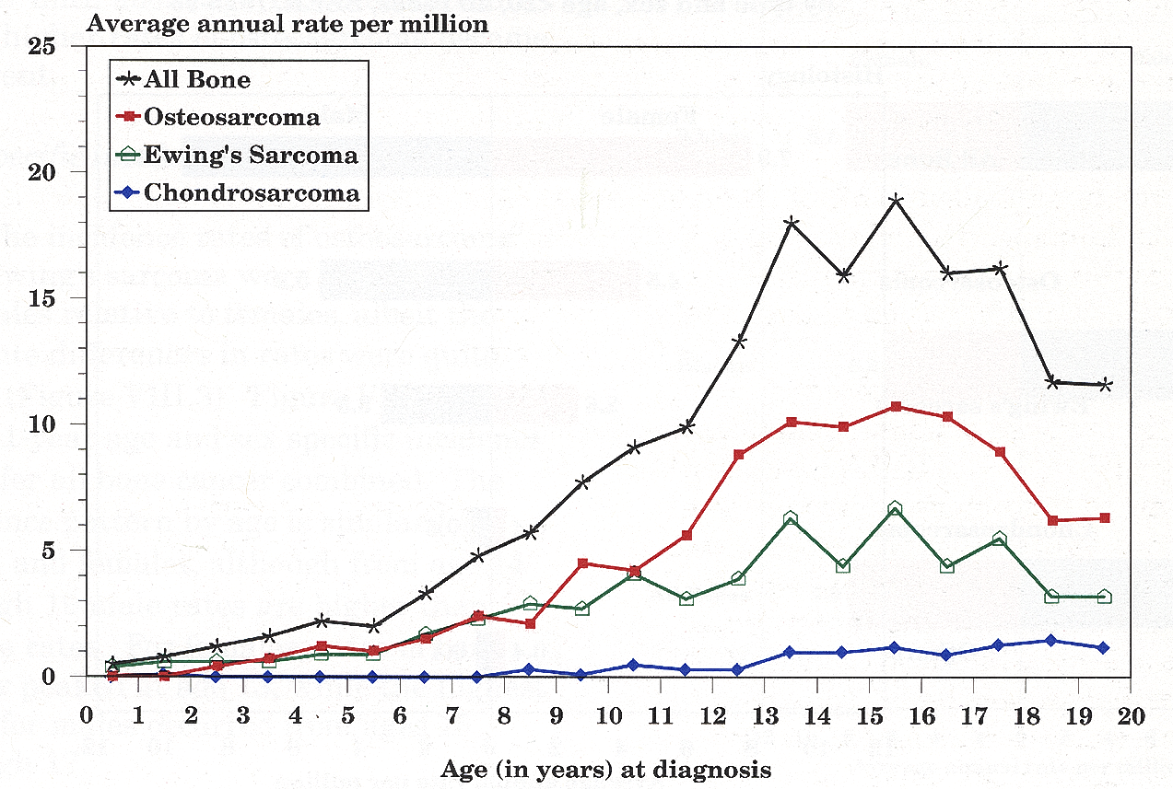
2. Bone Tumor/OS Annual Rate per Million by Age
Annually,
150 cases <15 yrs
400 cases <20 yrs
Years
Copyright © 2019 by ASPHO
(SEER Pediatric Monograph, NIH Pub. No.99-4649, 1999)

Slide 45
2. OS Predisposing Factors
  Ionizing radiation
    Cause of 3% of OS
    Median time of 9 – 11 yrs following exposure
    Dose response (RT dose usually 45-60 Gy)
        (Newton et al., Cancer 2001; 67:193)
  Hereditary Rb (germline Rb mutations)
    Cumulative incidence of bone sarcoma 7-8% at 20 yrs and 9-10% at 30 yrs
    OS develops within and outside of radiation fields
        (Kleinerman et al., J Clin Oncol 2012; 30:950)
Copyright © 2019 by ASPHO

Slide 46
2. OS Clinical Presentation
  •Pain, +/- mass, typically involves metaphyses of long bones
Patterns of spread
Skip lesions: Occur in up to 20% of cases several cm from primary in the same bone
Hematogenous: 15-20% at diagnosis (lung > bone)
(Goorin et al., J Clin Oncol 2002; 20:426. Meyers et al., J Clin Oncol 1993; 11:449)
Most common primary sites:
distal femur (55%) > proximal tibia (27%) > proximal humerus (11%) > other sites
(Meyers et al., J Clin Oncol 2005; 23:2004)
Copyright © 2019 by ASPHO

Slide 47
2. OS Staging
  Staging workup
    Plain films of involved bone
    MRI of involved bone
    CT of chest
    PET scan or bone scan
  Stage assignment
    Localized vs. Metastatic
    Resectable vs. Unresectable
Copyright © 2019 by ASPHO

Slide 48
2. OS Prognostic Factors at Diagnosis
  OS prognosis by stage
                3-yr EFS
  Localized 65-70%
  (Meyers et al., J Clin Oncol 2008; 26:633)
  5-yr EFS
  Metastatic (overall) <30%
  Unilateral pulm mets 20-40%
  Bone or bilat pulm mets <15%
  (Bacci et al., J Surg Oncol 2008; 98:415. Meyers et al., J Clin Oncol 1993; 11:449)
  OS prognosis by histology
    Parosteal favorable
    Fibroblastic (82% 8-yr DFS) or telangiectatic (76% 8-yr DFS) favorable
  (Ferrari et al., Ann Oncol 2001; 12:1145)
Copyright © 2019 by ASPHO

Slide 49
OS prognosis by histopathologic response (% necrosis) to preoperative chemotherapy
  Following 10 weeks of pre-operative chemo,
  Necrosis 3-yr EFS (localized disease)
  ≥90% (good responder) 77-80%
  <90% (poor responder) 57-60%
      (Bielack et al., J Clin Oncol 2015; 33:2279. Marina et al., Lancet Oncol 2016; 17:1396)
Copyright © 2019 by ASPHO

Slide 50
OS prognosis by tumor location and size at diagnosis
Location/Size | 10-yr survival | RR of adverse event
Axial | 27% | 2.4
Extremity | 62% (p<0.0001) | 1.0 (p=0.0095)
Ext (≥1/3 length) | 52%
Ext (<1/3 length) | 67% (p<0.0001)
9+ cm |  | 1.5
≤8 cm |  | 1.0 (p=0.0044)
(Bielack et al., J Clin Oncol 2002; 20:776. Meyers et al., J Clin Oncol 2005; 23:2004)
Copyright © 2019 by ASPHO

Slide 51
2. OS Prognosis at Recurrence
Patients with recurrent OS on phase II trials 1997-2007
  4-month EFS for patients with measurable disease = 12%
  12-month EFS for patients with fully resected disease = 20%
Risk factors for shorter survival after relapse
  Age >10 years
  Metastatic disease at diagnosis
  Lung + bone recurrence
  Time to relapse <2 years
(Lagmay et al., J Clin Oncol 34; 2016; Spaker-Perlman et al., Pediatr Blood Cancer 25, 2018)
Copyright © 2019 by ASPHO

Slide 52
Sarcomas: Osteosarcoma (subdomain B1)
Basic Science and Pathophysiology
Epidemiology and Risk Assessment
Diagnosis
Management and Treatment
Copyright © 2019 by ASPHO

Slide 53
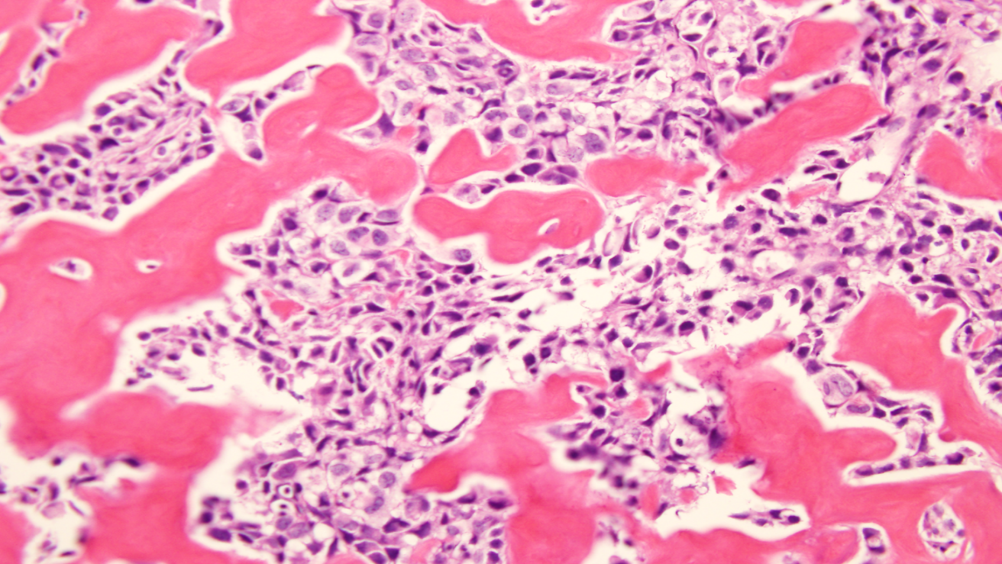
3. OS Pathology
Diagnosis requires finding osteoid-producing malignant cells
Histopathologic subtypes: WHO 2013
    Central (medullary) tumors
      Conventional OS (90%)
        Osteoblastic OS
        Chondroblastic OS
        Fibroblastic OS
      Telangiectatic OS
      Small round cell OS
      Low grade central OS
    Surface tumors
      Parosteal OS (low grade)
      Periosteal OS (intermediate grade)
      High-grade surface OS
Osteoid = unmineralized bone matrix
(WHO Classification of Tumors of Soft Tissues and Bone: Fletcher et al., IARC Press, Lyon 2013)
Copyright © 2019 by ASPHO
Image courtesy of Pauline Chou

Slide 54
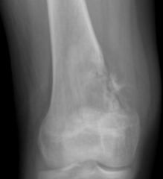
3. Radiologic appearance of OS of long bones
  Plain films
    Mixed (osteoblastic + osteolytic) > Osteoblastic > Osteolytic
    Cortical destruction and expansion into soft tissue
    Periosteal reaction: Codman triangle, sunburst pattern
  MRI
    Intramedullary extent of disease
    Associated soft tissue mass
    Skip lesions
Image courtesy of Jonathon Samet
Copyright © 2019 by ASPHO

Slide 55
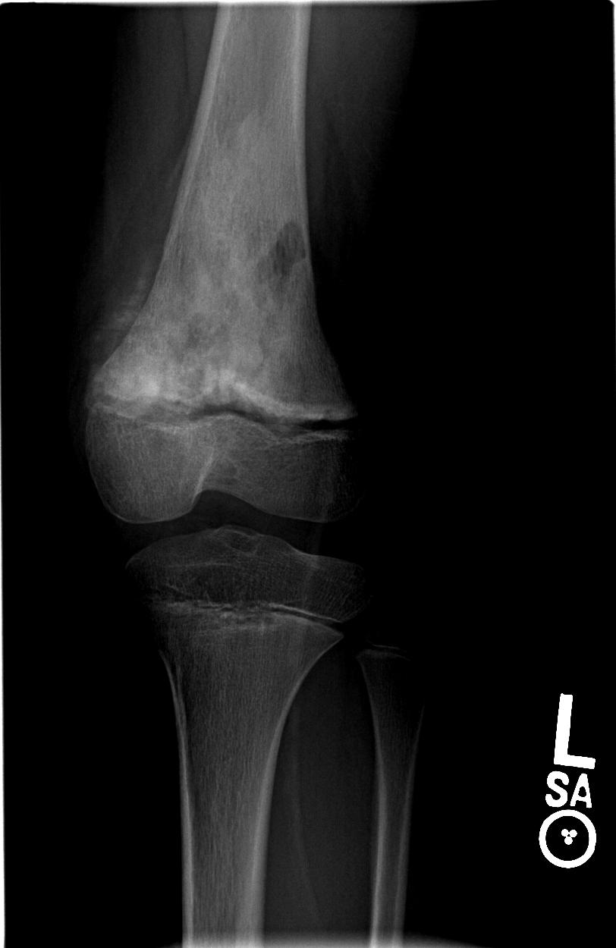
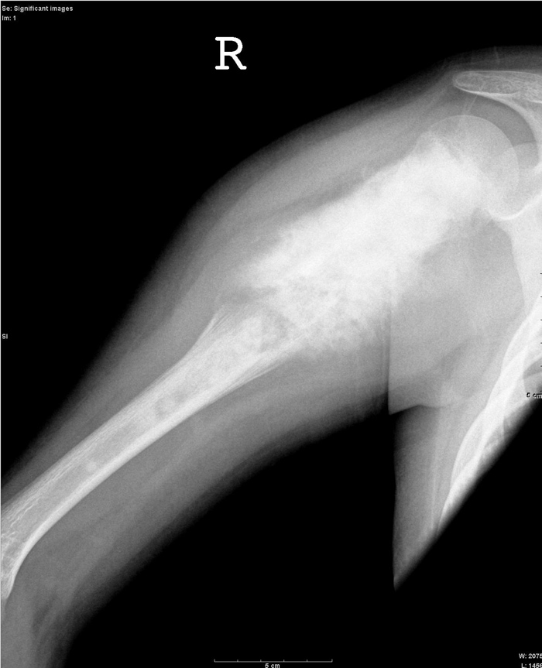
3. OS periosteal reactions
Codman Triangle:
elevation of periosteum
Sunburst Pattern: extension of
tumor through the periosteum
Copyright © 2019 by ASPHO
Image courtesy of Jonathon Samet

Slide 56
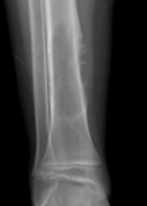
3. Differential diagnosis of suspected OS
  Malignancy
    Osteosarcoma
    Ewing sarcoma (osteolytic; but telangiectatic OS may be osteolytic)
    Metastasis OS EWS
    LCH
  Infection
    Osteomyelitis
  Benign (less likely)
    Osteoblastoma
    Aneurysmal bone cyst
    Fibrous dysplasia
Image courtesy of Jonathon Samet
Copyright © 2019 by ASPHO

Slide 57
Sarcomas: Osteosarcoma (subdomain B1)
Basic Science and Pathophysiology
Epidemiology and Risk Assessment
Diagnosis
Management and Treatment
Copyright © 2019 by ASPHO

Slide 58
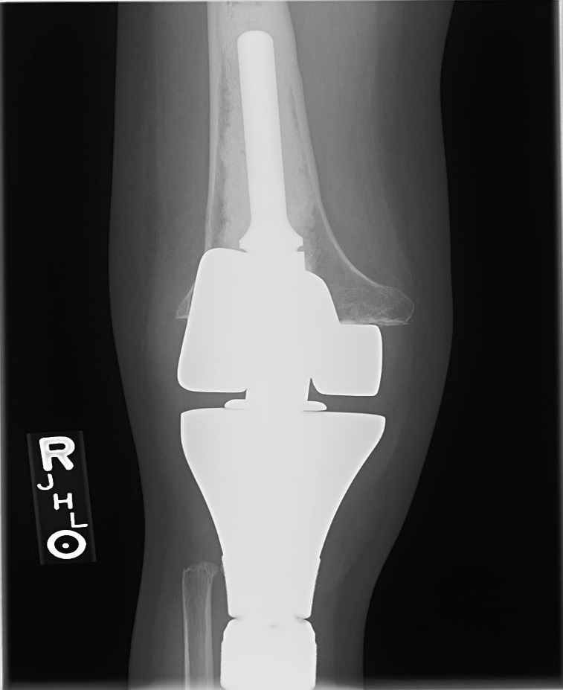
4. OS Treatment
Treatment Philosophy
  Curative therapy requires surgical resection of all sites of disease as local control and systemic chemotherapy
Surgery
  Role of surgery
    Removal of all gross tumor with margins en bloc and biopsy site through normal tissue planes is required
    Metastatic sites must be resected
  Surgical options
    Amputation or limb salvage procedure (metallic
    endoprosthesis, allograft, vascularized or
    non-vascularized autograft)
    Type of procedure depends on tumor location, size,
    extra-medullary extent, presence of metastases, age,
    skeletal development, and life-style preference
  Timing
    Following neoadjuvant chemotherapy (week 10)
Image courtesy of Jonathon Samet
Copyright © 2019 by ASPHO

Slide 59
Chemotherapy
  Treatment schedule
    Chemo administered pre-operatively and post-operatively
    Pre-operative therapy allows starting therapy more rapidly, may facilitate limb salvage, and provides histologic response
  Agents
    Primarily systemic tumor control
    Standard therapy: HD-MTX, Doxorubicin, Cisplatin (MAP)
    Other active agents: Ifosfamide, Etoposide
(Bielack et al. J Clin Oncol 2015; 33:2279. Marina et al. Lancet Oncol 2016; 17:1396)
Copyright © 2019 by ASPHO

Slide 60
4. Treatment of rare OS variants
Variant | Typical Location | Grade | Treatment
Parosteal | Distal femur | Low | Resection
Periosteal | Proximal tibia | Intermed. | Resection +/- chemo
Copyright © 2019 by ASPHO

Slide 61
4. OS Management
Follow-up Evaluation
  PE every 1-3 months, imaging every 3 months
  Pre-operative clinical response
    Decrease pain/mass
  Pre-operative radiographic response
    Increased ossification
    Sclerosis or calcification of border
    Reduction in soft tissue mass
  Pathologic response
    Assessment of necrosis
Copyright © 2019 by ASPHO

Slide 62
4. OS Complications/Late Effects
  Surgical
    Studies continue to look at functional outcomes for patients undergoing limb salvage vs. amputation (Nagarajan et al., J Cancer Surviv 2009; 3:59)
  Chemotherapy
    Anthracycline-induced cardiomyopathy; cumulative incidence of 7.5-10% in sarcoma patients following approximately 300 mg/m² (Paulides et al., Pediatr Blood Cancer 2006; 46:489. van Dalen et al., Eur J Cancer 2006; 42:3191)
    Cisplatin-induced ototoxicity; 11% of patients (Meyers et al., J Clin Oncol 2005; 23:2004)
Copyright © 2019 by ASPHO

Slide 63
Sarcomas: Ewing Sarcoma (subdomain B2)
Basic Science and Pathophysiology
Epidemiology and Risk Assessment
Diagnosis
Management and Treatment
Copyright © 2019 by ASPHO

Slide 64
1. Ewing Family Tumors
Ewing Sarcoma of Bone
Extraosseous Ewing Sarcoma
Primitive Neuroectodermal Tumor
Askin Tumor (PNET of the chest wall)
Copyright © 2019 by ASPHO

Slide 65
1. Cytogenetic abnormalities associated with EWS
• EWSR1-FLI1 fusion
(Delattre et al., Nature 1992; 359:162)
EWS Regulatory Domain
RNA Binding Domain
EWSR1 (22q12)
NH₂
COOH
EWSR1/FLI1 t(11:22)(q24:q12)
NH₂
COOH
FLI1 (11q24)
Ets DNA Binding Domain
NH₂
COOH
TET
ETS
Breakpoint
Copyright © 2019 by ASPHO

Slide 66
1. EWS fusions and assays
  Many different fusions in EWS (TET-ETS), including
    t(11;22) = EWSR1-FLI1 85%
    t(21;22) = EWSR1-ERG 5-10%
    t(2;22) = EWSR1-FEV rare
    t(7;22) = EWSR1-ETV1 rare
    t(17;22) = EWSR1-E1AF rare
    t(16;21) = FUS-ERG rare
    t(2;16) = FUS-FEV rare
  RT PCR
    Primers detect specific translocation
  FISH
    EWSR1 break-apart probes detect translocations involving EWSR1
Copyright © 2019 by ASPHO

Slide 67
Sarcomas: Ewing Sarcoma (subdomain B2)
Basic Science and Pathophysiology
Epidemiology and Risk Assessment
Diagnosis
Management and Treatment
Copyright © 2019 by ASPHO

Slide 68
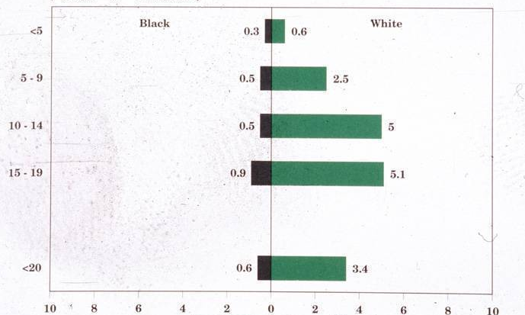
2. EWS Incidence Rates by Age and Race
Black White
200 cases < 20 yrs annually
Age (years)
Average annual rate per million
(SEER Pediatric Monograph, NIH Pub. No.99-4649, 1999)
Copyright © 2019 by ASPHO

Slide 69
2. EWS Clinical Presentation
Pain, +/- palpable mass, may involve bone or soft tissues
Systemic involvement
Symptoms:
Fever, weight loss
Pattern of spread:
20% metastatic
lung > bone > BM
(Bernstein et al., J Clin Oncol 2006; 24:152)
Primary site
Diaphyses and central axis (47 -74%) involved more frequently than with osteosarcoma
Most commonly: pelvis (23%), femur (18%), rib (13%)
(Grier et al., N Eng J Med 2003; 348:694)
Copyright © 2019 by ASPHO

Slide 70
2. EWS Staging
  Staging workup
    Plain films of primary site
    MRI or CT of primary site
    CT of chest
    PET scan or bone scan
    Bilateral bone marrow aspirate/biopsy
  Stage assignment
    Localized vs. Metastatic
Copyright © 2019 by ASPHO

Slide 71
2. EWS Prognostic Factors at Diagnosis
  EWS prognosis by stage
                5-yr EFS
        localized 73% (AEWS0031)
        metastatic 22% (IESS-3)
  EWS prognosis by site
              5-yr EFS (IESS-3)
        distal extremity 68%
        proximal extremity 61%
        pelvis 50% p=0.003
(Womer et al., J Clin Oncol 2012 30;4148. Grier et al., N Engl J Med 2003; 348:694)
Copyright © 2019 by ASPHO

Slide 72
  EWS prognosis by age
        5-yr EFS (IESS-3)
        <10 yrs 70%
        10-17 yrs 60%
        >18 yrs 44%
  EWS prognosis by tumor size
        5-yr EFS (IESS-3)
        <8 cm 75%
        ≥8 cm 55%
    (Grier et al., N Engl J Med 2003; 348:694)
Copyright © 2019 by ASPHO

Slide 73
Sarcomas: Ewing Sarcoma (subdomain B2)
Basic Science and Pathophysiology
Epidemiology and Risk Assessment
Diagnosis
Management and Treatment
Copyright © 2019 by ASPHO

Slide 74
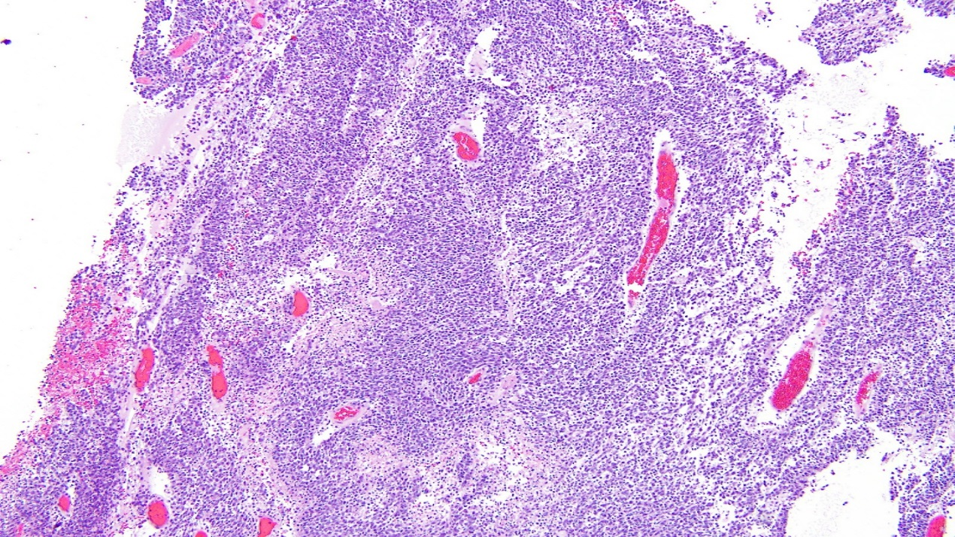
3. EWS Pathology
  EWS/PNET are small round blue cell tumors
    CD99 +, Vimentin +
    Exclude lymphoma, NBL, RMS
  EWS
    Without differentiation
  PNET
    Neural differentiation; rosettes
    and/or + for NSE, synaptophysin
Image courtesy of Pauline Chou
Copyright © 2019 by ASPHO

Slide 75
3. Radiologic appearance of EWS
Plain films
    Permeative lytic lesion with a wide zone of transition and periosteal reaction
    Sclerotic lesions are rare and may be
    mistaken for OS
    Aggressive periosteal reaction:
    Codman triangle, sunburst pattern, or
    onion-skin pattern
    Differential includes OS, metastasis,
    LCH, or osteomyelitis
Image courtesy of Jonathon Samet
Copyright © 2019 by ASPHO

Slide 76
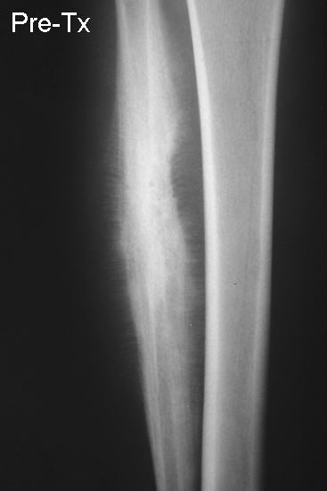
3. EWS Periosteal Reaction
Sunburst Pattern:
extension of
tumor through the periosteum
Image courtesy of Jonathon Samet
Copyright © 2019 by ASPHO

Slide 77
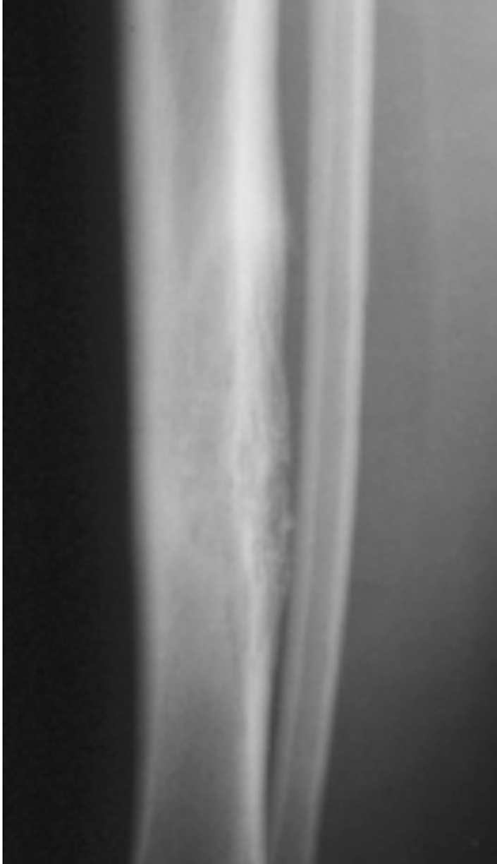
3. EWS Periosteal Reaction
Onion-skin Pattern:
laminated periosteal reaction
Image courtesy of Jonathon Samet
Copyright © 2019 by ASPHO

Slide 78
Sarcomas: Ewing Sarcoma (subdomain B2)
Basic Science and Pathophysiology
Epidemiology and Risk Assessment
Diagnosis
Management and Treatment
Copyright © 2019 by ASPHO

Slide 79
4. EWS Treatment Planning
Treatment philosophy of EWS
    A multidisciplinary approach must provide local control and systemic therapy: SURGERY, RADIOTHERAPY, CHEMO, (SCT)
    Treatment based on stage, site
    Local control measures should not compromise systemic therapy because when treatment fails it is usually due to the development of metastatic disease
Copyright © 2019 by ASPHO

Slide 80
4. EWS Treatment – Local Control
  Local control for EWS: surgery and/or radiation therapy
    No randomized studies comparing surgery and RT
    Current trend favors surgery when possible
      IESS-1: 21% underwent surgery (Nesbit et al., J Clin Oncol 1990; 8:1664)
      IESS-2: 42% underwent surgery (Burgert et al., J Clin Oncol 1990; 8:1514)
      IESS-3: 61% underwent surgery (Grier et al., N Engl J Med 2003; 348:692)
      AEWS0031: 79% underwent surgery (Womer et al, J Clin Oncol 2012; 30:4148)
    Combined surgery/RT approach sometimes used
    Definitive local control usually done after several weeks of chemo (week 12 – 14)
    RT doses usually 36.0 – 50.4 Gy; depending on site, whether delayed primary resection done, nodal involvement
Copyright © 2019 by ASPHO

Slide 81
4. EWS Treatment – Systemic Therapy
  Systemic therapy: chemotherapy, SCT
    All patients require chemotherapy
    Pre-operative and post-operative chemotherapy
    Standard therapy: Vincristine, Doxorubicin, Cyclophosphamide, Ifosfamide, Etoposide (VDC + IE)
    Improved outcomes using interval compression
    Other active agents: Topotecan, Irinotecan, Temozolomide
    SCT: possible role for high-risk localized EWS, but efficacy may depend on chemotherapy that is used
(Womer et al., J Clin Oncol 2012 30;4148. Whelan et al., J Clin Oncol 2018)
Copyright © 2019 by ASPHO

Slide 82
4. EWS Management
Monitoring the response to treatment of EWS
  PE every 1-3 months, imaging every 3 months
  Pre-operative clinical response
    Decrease pain/mass
  Pre-operative radiographic response
    Increased ossification
    Sclerosis or calcification of border
    Reduction in soft tissue mass
(Heinemann et al., Pediatr Blood Cancer 2018; 65)
Copyright © 2019 by ASPHO

Slide 83
4. EWS Complications/Late Effects
Complications of radiation therapy
    SMNs: 5-10% at 10-20 yrs; latent period of 10 yrs for carcinomas/sarcomas and ≤ 5 yrs for leukemias (Schiffman and Wright, Sarcoma 2011; 2011:736841)
    Pathologic fractures/limb length discrepancy/femoral head necrosis (Fuchs et al., Cancer 2003; 98:2687)
Complications of chemotherapy
    Anthracycline-induced cardiomyopathy (Paulides et al., Pediatr Blood Cancer 2006; 46:489. van Dalen et al., Eur J Cancer 2006; 42:3191)
    Ifosfamide-induced nephrotoxicity; proximal tubular damage, dose-dependent (Oberlin et al., J Clin Oncol 2009; 32:5350)
Copyright © 2019 by ASPHO

Slide 84
Sarcoma | Biology | Epidemiology/Risk | Diagnosis | Treatment
RMS | ERMS: Aneuploidy, point mutations ARMS: PAX-FOXO1 fusions | Head, GU tract most common Risk group based on stage, group, fusion status/histology | ERMS: Spindle cell tumor ARMS: SRBCT Myogenin, desmin positive | Local control: Upfront surgery +/- delayed RT/surgery Systemic: VAC +/- VI
NRSTS | Many tumor types | Extremities, trunk most common Risk based on stage, group, tumor size, grade, histology | Synovial sarcoma most common Select NRSTS chemo sensitive | Local control: Surgery (may be delayed) +/- RT (may be pre-op) Systemic: +/- Dox, Ifos, depending on chemo sensitivity
OS | Chromosomal instability | Metaphyseal, distal femur and proximal tibia most common Risk based on stage, resectability | Osteoid-producing malignant cells | Local control: Delayed surgery Systemic: MAP
EWS | TET-ETS fusion: EWSR1-FLI1 | Diaphyseal or soft tissue, pelvis and central axis common Risk based on stage, site | SRBCT, CD99+, PNET with neural differentiation | Local control: Delayed surgery and/or RT Systemic: VDC/IE
Copyright © 2019 by ASPHO

