Slide 1
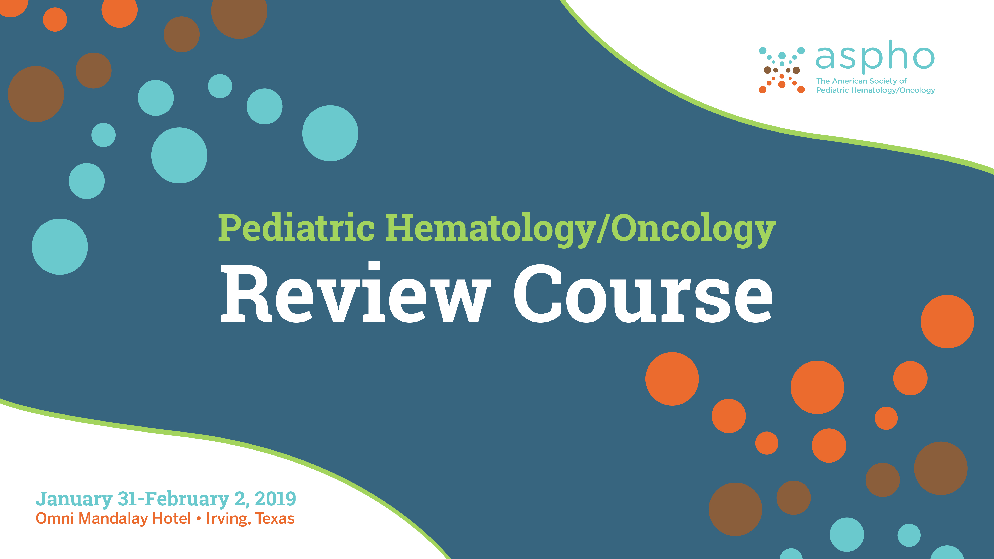
Thrombotic Disorders
Sarah O’Brien, MD, MSc

Slide 2


APPROACH TO THROMBOSIS

Slide 3
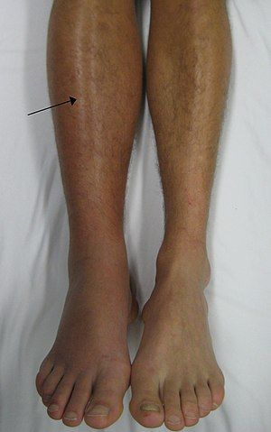
Signs and symptoms of venous thrombosis
Deep Vein Thrombosis (DVT)
  Acute swelling of extremity
  Pain or tenderness
  Discoloration (red, purple)
  Warmth
Copyright © 2019 by ASPHO

Slide 4
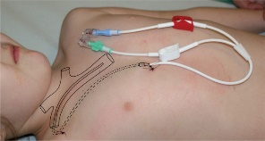
Signs and symptoms of catheter-related DVT
Acute
  Extremity Swelling
  Extremity Pain
  Discoloration
  Line malfunction
Chronic “asymptomatic”
  Catheter occlusion
  Prominent chest wall veins
  Recurrent bacteremia
Copyright © 2019 by ASPHO

Slide 5
Signs and symptoms of pulmonary embolism
Chest pain
Shortness of breath
Hypoxia
Fever
Cough / Hemoptysis
Rapid or irregular heart beat
History or presence of extremity swelling/pain OR known DVT
Only 20% of children have the classic triad at presentation
Copyright © 2019 by ASPHO

Slide 6
Signs and symptoms of cerebral sinovenous thrombosis
Risk Factors
  Ear infection progressing
  to mastoiditis
  Lymphadenitis
  Dehydration
  Jugular vein catheterization
  Neonate
Presentation
  Headache
  Seizures
  Cranial nerve palsies
  Papilledema
  Focal neurologic signs (cortical vein thrombosis)
  Eyelid swelling, proptosis (cavernous thrombosis)
Copyright © 2019 by ASPHO

Slide 7
Sign and Symptoms: Portal & Renal Vein Thrombosis
Portal Vein Thrombosis
  Acute abdomen
  More commonly asymptomatic until symptoms of chronic portal hypertension occur (splenomegaly, esophageal varices)
Renal Vein Thrombosis
  Hematuria, anuria, vomiting, proteinuria, thrombocytopenia
  More commonly insidious onset with no symptoms referable to the kidney
  Lower extremity swelling if extends into the IVC
Copyright © 2019 by ASPHO
Notes:
Renal vein thrombosis — In children, renal vein thrombosis (RVT) most commonly occurs secondary to nephrotic syndrome and renal transplantation [53-55]. The author of this topic review has also seen RVT as the presenting manifestation of systemic lupus erythematosus; however, this is uncommon [56]. (See "Complications of nephrotic syndrome in children", section on 'Thromboembolism' and "Complications of renal transplantation in children", section on 'Vascular thrombosis' and "Overview of the clinical manifestations of systemic lupus erythematosus in adults", section on 'Thromboembolic disease'.)
RVT may manifest with hematuria, anuria, vomiting, hypovolemia, proteinuria, and thrombocytopenia. However, RVT most often has an insidious onset and produces no symptoms referable to the kidney. In this case, the RVT may first be diagnosed when the patient presents with a thromboembolic event (eg, PE). When the thrombus extends from the renal vein into the inferior vena cava, both lower extremities may become cyanotic and edematous. (See "Renal vein thrombosis and hypercoagulable state in nephrotic syndrome", section on 'Renal vein thrombosis'.)
RVT is the most prevalent non-catheter-related VTE during the neonatal period and accounts for up to 20 percent of all thromboembolic events in newborns [57]. RVT in neonates is discussed separately. (See "Pathogenesis, clinical features, and diagnosis of thrombosis in the newborn", section on 'Renal vein thrombosis'.)
Portal vein thrombosis — Children may develop portal vein thrombosis (PVT) secondary to liver transplantation, infections, splenectomy, sickle cell disease, chemotherapy, or the presence of antiphospholipid antibodies [58-63]. PVT may manifest acutely with symptoms of an acute abdomen, particularly in adolescents [64], or may be asymptomatic for long periods of time until symptoms reflecting chronic portal hypertension occur (eg, splenomegaly or gastrointestinal bleeding secondary to esophageal varices) [46].

Slide 8
Laboratory measures AT diagnosis (not FOR diagnosis) in pediatric VTE
CBC (thrombocytopenia)
Coagulation Studies - PT/PTT, fibrinogen, D-Dimer and FVIII
    Baseline prior to initiating anticoagulation
    D-Dimer not FOR diagnosis (non-specific)
    Elevated D-Dimer and FVIII prognostic for poorer outcomes
Creatinine (prior to initiating low molecular weight heparin)
Pregnancy test (prior to starting warfarin)
Thrombophilia evaluation
    Not necessary or urgent
    False results in very acute phase
Copyright © 2019 by ASPHO
Notes:
Not specific
Can be positive in patients with cancer, infection, trauma
Can be normal with subacute thrombus (CVL thrombosis)

Slide 9
Evaluation of a child with established DVT of unknown cause
Uncommon clinical scenario
Detailed family history
Work-up for inherited thrombophilia
Test for antiphospholipid antibodies
Look for anatomic variants
  May Thurner syndrome
  Thoracic Outlet Syndrome
  IVC atresia/anomalies
Copyright © 2019 by ASPHO

Slide 10
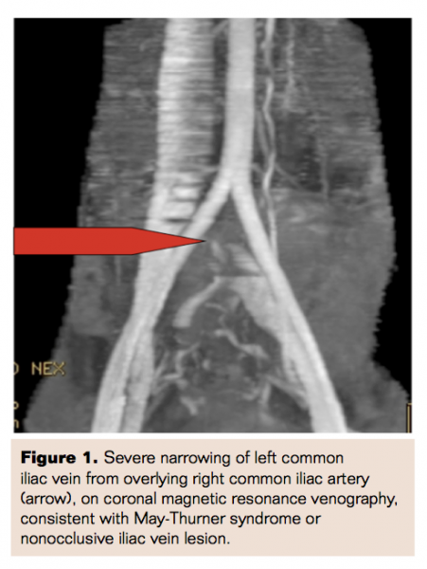
Evaluation of a child with established DVT of unknown cause
May Thurner
  Left-sided ileofemoral thrombosis
    Narrowed left iliac vein due to chronic compression from right iliac artery
    Most commonly seen in females in the 2nd to 3rd decade of life
Copyright © 2019 by ASPHO
Notes:
Post-partum, OCPs, multiparous
●Female gender, particularly those who are postpartum, multiparous, or using oral contraceptives
●Scoliosis may predispose to MTS due to compression from the lower lumbar vertebra
●Dehydration
●Hypercoagulable disorders

Slide 11
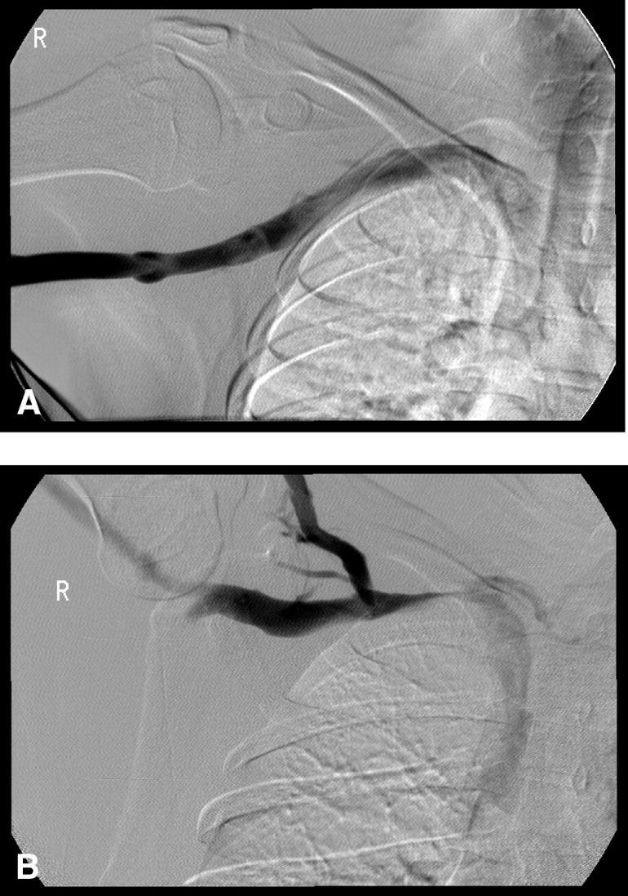
Evaluation of a child with established DVT of unknown cause
Paget-Schroetter
  Axillary/Subclavian vein thrombosis
    Also called Thoracic Outlet Syndrome, or Exertional Thrombosis
    More likely in adolescents
    Associated with repetitive activity (baseball, softball, swimming, volleyball)
    Compression of veins by extra rib, muscle group
    First rib resection
Copyright © 2019 by ASPHO
Notes:
Effect of arm position on the axillary/subclavian vein at the costoclavicular junction. A, Arm outstretched but less than 90 degrees. Note the absence of obstruction and the absence of collaterals. B, Arm abducted well over 90 degrees. Note the smooth extrinsic compression at the costoclavicular junction and the visualization of the external jugular vein and surrounding collaterals.

Slide 12
INHERITED THROMBOPHILIA

Slide 13
Know how to evaluate a hypercoagulable state
Inherited
  Antithrombin deficiency
  Protein C deficiency
  Protein S deficiency
  Factor V Leiden mutation
  Prothrombin G20210A mutation
  Dysfibrinogenemia
  Hyperhomocysteinemia
    MTHFR
    homocysteinuria
  Elevated FVIII
  Elevated Lipoprotein a
  PAI-1 polymorphisms/ Elevated PAI-1
WHEN do I evaluate?
Non-CVL related thrombosis
Recurrent thrombosis
Contraception counseling in adolescent female with strong family history (first degree relative <40 years or multiple relatives)
Copyright © 2019 by ASPHO

Slide 14
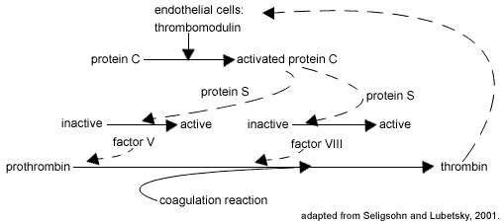
Factor V Leiden
FVL is a mutant form of coagulation factor V which renders factor V insensitive to the actions of activated protein C, a natural anticoagulant
Most common inherited thrombophilia in the States
Most common inherited thrombophilia in the United States
    Caucasians ~ 5%, Hispanic Americans ~2%, other ethnic groups ~1%
Laboratory testing
  Functional aPC resistance assays
  PCR testing
Copyright © 2019 by ASPHO
Notes:
Modifications in which diluted patient plasma is mixed with factor V-deficient plasma assays have resulted in "second generation" functional assays that correlate extremely well with the presence of the FVL mutation
PCR testing to detect genetic mutation

Slide 15
Heterozygous Factor V Leiden
Clinical Manifestations:
  Increased risk of VTE (about 4X greater than general population)
  Arterial thrombosis – data are mixed and FVL likely has a small impact on risk
  Obstetrics -may play a role in some cases of unexplained recurrent late pregnancy loss
  Majority of patients are asymptomatic (95% never have VTE)
For those with VTE:
  Low risk of recurrence in heterozygous state
  Should not alter decision making regarding duration of anticoagulation
  Recent data suggests risk of recurrence also low in homozygous state
Copyright © 2019 by ASPHO
Notes:
presumably due to thrombosis of placental vessels

Slide 16
Prothrombin G20210A Mutation
2nd most common inherited thrombophilia
  Predominantly identified in Caucasians (~2% of general population)
Substitution of adenine for guanine at position 20210 in a non-coding region of the prothrombin (Factor II) gene
Heterozygotes for the G20210A mutation have ~30% higher plasma prothrombin levels than controls
Copyright © 2019 by ASPHO
Notes:
And this is thought to be the mechanism for increased risk of thrombosis

Slide 17
Prothrombin G20210A Mutation
Clinical Manifestations:
  Increased risk of VTE (about 3-4X greater than general population)
  Arterial – does not appear to be a major risk factor, although meta-analyses have documented slightly increased risks in certain settings.
  Obstetrics – if an association exists, it is likely to be small
Low risk of VTE recurrence in heterozygous state
  Should not alter duration of anticoagulation
Copyright © 2019 by ASPHO
Notes:
And this is thought to be the mechanism for increased risk of thrombosis

Slide 18
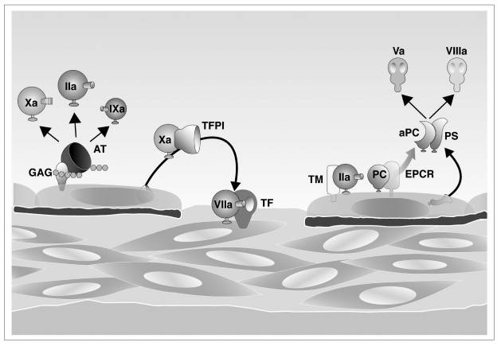
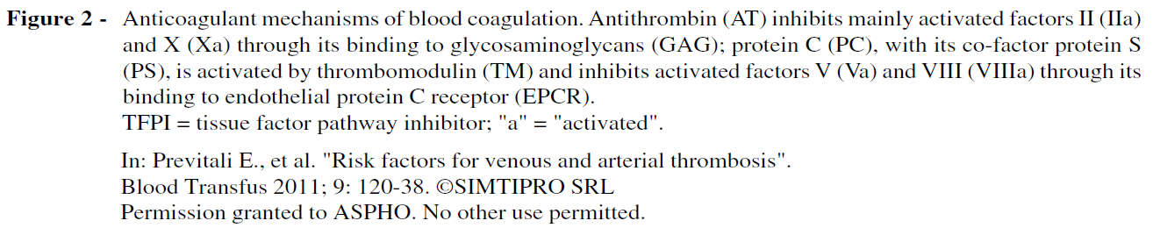
Antithrombin, Protein C, and Protein S deficiencies
Copyright © 2019 by ASPHO
Notes:
Rare, severe inherited thrombophilias

Slide 19
 | Protein C | Protein S | Antithrombin
Frequency in VTE patients | 2-5% | 1% | <1%
Event Type | DVT PE Mesenteric CSVT Arterial Linked to fetal loss | DVT PE Mesenteric CSVT Small risk of arterial events | DVT PE Mesenteric CSVT Pregnancy-related VTE
Spontaneous |  | 50% | 40%
Recurrence | High risk | High risk | Very high risk
Other | Levels <55% (wide range) | Levels <35% (60-120) | Levels 40-60% (110-140) Heparin resistance
Copyright © 2019 by ASPHO
Notes:
ALLI CAN YOU MAKE THE COLORS RED INSTEAD OF BLUE SO IT MATCHES THIS SLIDE TEMPLATE BETTER?

Slide 20
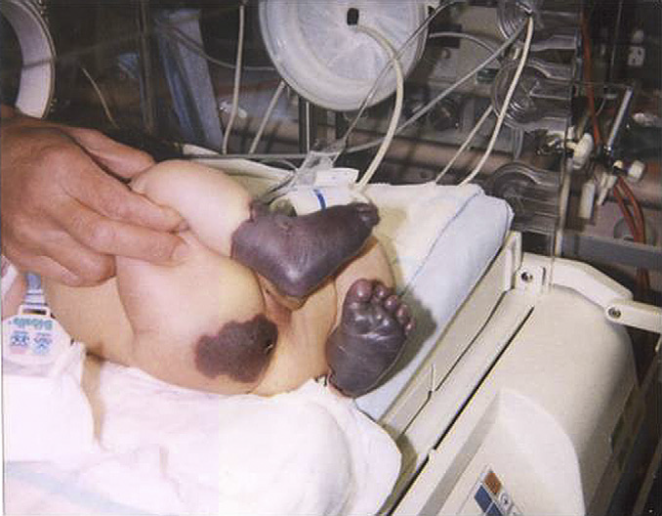
Homozygous Antithrombin, Protein C, and Protein S deficiencies
Homozygous antithrombin deficiency
  Usually fatal in utero
Homozygous Protein C or S deficiency
  Presents in infancy with purpura fulminans
Management of Purpura Fulminans
  Aggressive FFP replacement at time of time of presentation
  Protein C concentrate if applicable
  Life long anticoagulation with warfarin
  Case reports of liver transplant
Copyright © 2019 by ASPHO

Slide 21
Levels of natural anticoagulants change with age
  Levels of natural anticoagulants are all low in infancy
  Antithrombin and Protein S activity reach adult levels by 6-12 months of age
  Protein C activity remains lower than adult levels until late teens/early 20s
Copyright © 2019 by ASPHO
Notes:
ALLI – CAN YOU PLEASE PUT A WHITE BOX OVER “GROWING UP” TO COVER THAT UP?

Slide 22
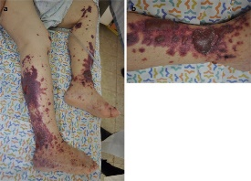
Diagnosing hypercoagulable states in patients receiving warfarin
Warfarin inhibits synthesis of all Vitamin K dependent proteins, including Protein C and S
Warfarin initially decreases protein C levels faster than the other coagulation factors
  Paradoxically increases blood's tendency to coagulate when treatment is
  first begun warfarin necrosis
  Why we start heparin first
  Warfarin necrosis more frequent in patients with Protein C and S deficiency
Copyright © 2019 by ASPHO
Notes:
Recognize the association of skin necrosis with warfarin therapy in patients with heterozygous protein C or protein S deficiency
Warfarin-Induced Skin Necrosis
Natalia Kozac, Ami Schattner
J Gen Intern Med. 2014 Jan; 29(1): 248–249

Slide 23
ACQUIRED RISK FACTORS FOR THROMBOSIS

Slide 24
Acquired Risk Factors for Venous Thrombosis
Cancer
Cardiac Disease
Renal disease
Liver disease
Rheumatologic disease
Inflammatory Bowel disease
Infection
  Sepsis/DIC
Diabetes
Surgery
Trauma/Immobility
  Venous stasis
Obesity
Use of estrogens
Dehydration
APS (antiphospholipid Ab)
Any condition that requires central venous catheter
Copyright © 2019 by ASPHO

Slide 25
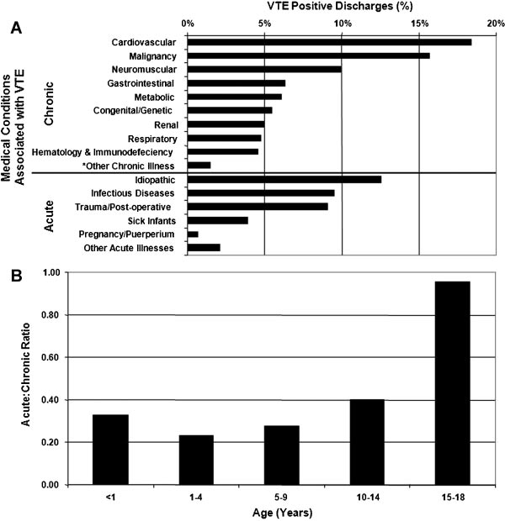
Copyright © 2019 by ASPHO
Notes:
PMID:

Slide 26
Acquired Risk Factors for Arterial Thrombosis
Arterial ischemic stroke
  Cardiogenic and large-vessel dissection-related embolism
  Cerebral vasculopathy
    Moyamoya, Sickle Cell Disease
  In situ thrombosis
    Systemic infection and dehydration
    Iron deficiency anemia
    Hyperhomocysteinemia, elevated lipoprotein (a)
Other arterial thrombosis
  Umbilical artery catheters
  Femoral artery (cardiac catheterizations)
  Perinatal stroke
Copyright © 2019 by ASPHO
Notes:
The conditions
underlying these three mechanisms for stroke
differ markedly in children compared with adults and
notably exclude atherosclerosis.

Slide 27
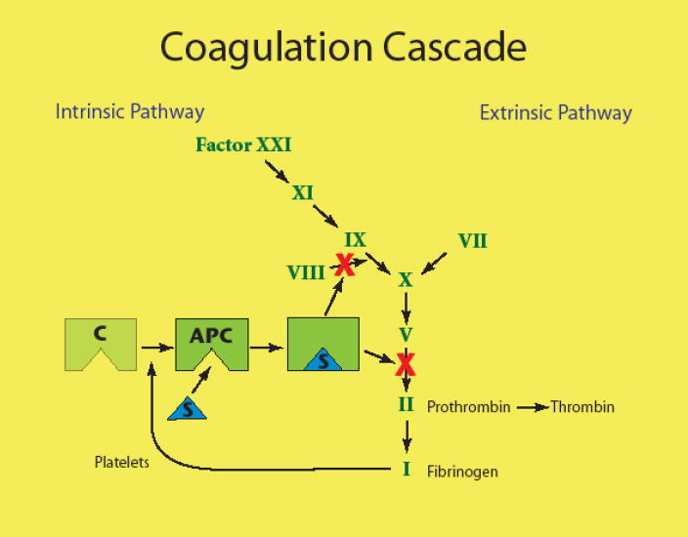
Estrogen-containing Contraceptives and Thrombosis
Estrogen containing contraception reduces Protein S activity and increases activated Protein C resistance
VTE rates in 15-19 year old women:
  Non-users: 0.7 VTE in 10,000 women-years
  OCP users: 4.2 VTE in 10,000 women-years
Most teens who develop OCP-related thrombosis have additional risk factors (obesity, family history of thrombosis, thrombophilia)
Patch, vaginal ring
Copyright © 2019 by ASPHO
Notes:
DVT, PE, stroke, and in adults - MI

Slide 28
Antiphospholipid Antibody Syndrome
Persistent presence of antiphospholipid antibodies or lupus anticoagulant for ≥ 12 weeks in context with an acute thrombotic event
  Venous or arterial thrombosis
  Recurrent pregnancy loss < 10 week gestation
  Premature delivery or fetal demise >10 week gestation
Laboratory Evaluation
  Lupus anticoagulant
  Anticardiolipin antibodies
  Anti-β2 glycoprotein
Management - indefinite anticoagulation for patients with definitive APS and thrombosis
Copyright © 2019 by ASPHO

Slide 29
Lupus Anticoagulants
Antibodies directed against phospholipid-binding proteins
Diagnosed by demonstration of a prolonged phospholipid-dependent screening test of hemostasis, such as the dilute Russell viper venom time (dRVVT) and an activated partial thromboplastin time (aPTT)
Mixing patient plasma with normal plasma fails to correct the prolonged screening test(s)
Addition of excess phospholipid shortens or corrects the prolonged coagulation test (demonstration of phospholipid-dependence)
Copyright © 2019 by ASPHO
Notes:
LA are characterized by correction of the prolonged clotting time with added phospholipid but not with control plasma, confirming that the coagulation inhibitor is phospholipid-dependent

Slide 30
ANTICOAGULATION

Slide 31
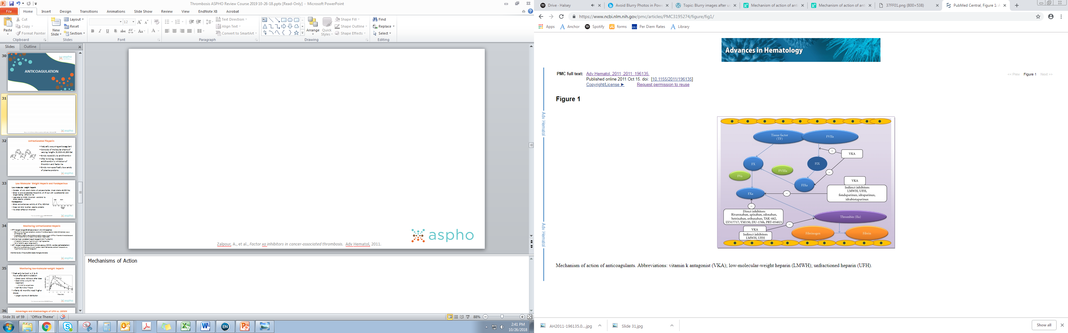
Copyright © 2019 by ASPHO
Notes:
Mechanisms of Action

Slide 32
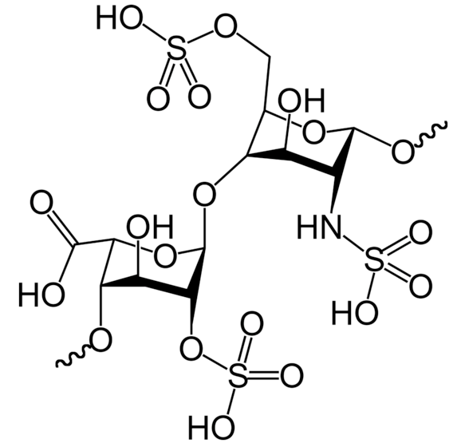
Unfractionated Heparin
  Naturally occurring anticoagulant
  Consists of molecular chains of varying lengths (5,000-40,000 Da)
  Binds reversibly to antithrombin
  After binding, increases antithrombin’s inhibition of thrombin and Factor Xa
  Binds non-specifically to a variety of plasma proteins
Copyright © 2019 by ASPHO
Notes:
Know the action of anticoagulant drugs used in thrombotic states or in patients with thrombophilia
Resulting in unpredictable dose-response relationship
Indirect effect on X and thrombin

Slide 33
Low Molecular Weight Heparin and Fondaparinux
Low molecular weight heparin
Consists of only short chains of polysaccharide (most chains <8,000 Da)
Binds to and accelerates the activity of AT, but with a preferential and longer-lasting effect on Xa
Less able to inhibit thrombin and bind to other plasma proteins
Fondaparinux
Binds and enhances activity of AT by 300-fold
Does not bind to other plasma proteins
No direct effect on thrombin
Copyright © 2019 by ASPHO
Notes:
Also binds to and accelerates…
Accounts for more predictable a/c response, less inter-patient variability, and longer duration of action than heparin

Slide 34
Monitoring Unfractionated Heparin
PTT (target range 65-80 seconds or 1.5-2.5X baseline)
  Sensitive to improper collection, anemia, thrombocytopenia, factor deficiencies, lupus anticoagulant, age
  Presence of heparin can be determined by measuring an APTT or thrombin time before and after the addition of a heparin-neutralizer (heparinase)
Anti-Xa most consistent result (target 0.3-0.7 units/ml)
  Affected by hemolysis, high bilirubin, high triglycerides
  Not affected by age or coagulopathy
ACT (target range depends on clinical use e.g. ECMO, cardiac catheterization)
  Sensitive to platelet counts and function, factor deficiencies, ambient temperature, hypothermia, lupus anticoagulant
Monitor every 4 hours after dose change and daily
Copyright © 2019 by ASPHO

Slide 35
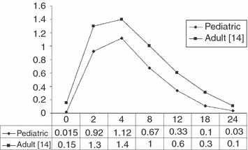
Monitoring low-molecular-weight heparin
Peak anti-Xa level is 2 to 6 hours after administration
  Obtain level 4-6 hours after dose
  Goal 0.5 to 1.0 U/ml for treatment
    0.1-0.3 for prophylaxis
  Half life 4.5 to 7 hours
Infants <3 months need higher doses
  Larger volume of distribution
Once‐daily enoxaparin in pediatric thromboembolism: a dose finding and pharmacodynamics/pharmacokinetics study1, Volume: 5, Issue: 9, Pages: 1985-1987, First published: 21 May 2007, DOI: (10.1111/j.1538-7836.2007.02624.x) ; with permission through Copyright Clearance Center
Copyright © 2019 by ASPHO

Slide 36
Advantages and disadvantages of UFH vs. LMWH
LMWH
Subcutaneous injection
Easier to use in stable patient
  More predictable pharmacokinetics
Requires good renal function
Incomplete reversal with protamine
UFH
Continuous IV infusion
Good first choice in unstable patient or one likely to need a procedure
  Reversible with protamine and short half-life
Copyright © 2019 by ASPHO

Slide 37
Heparin-induced Thrombocytopenia (HIT)
Life threatening complication of exposure to heparin (UFH or LMWH)
Due to formation of auto-antibodies against endogenous platelet factor 4 (PF4) in complex with heparin
Results in thrombocytopenia and is associated with arterial and venous thrombosis
  Thrombocytopenia - Removal of IgG-coated platelets by the reticuloendothelial system
  Thrombosis – mechanism unclear but presumably due to platelet activation
Occurs in 1 to 3% of adult cardiac surgeries
In pediatrics incidence of 0.5-2.3% reported (PICU, heart surgery, NICU)
More common in infants and teens
Development of auto-antibody takes about 5 days
Copyright © 2019 by ASPHO
Notes:
HIT results from an autoantibody directed against endogenous platelet factor 4 (PF4) in complex with heparin. This antibody activates platelets and can cause catastrophic arterial and venous thrombosis
The major mechanism of thrombocytopenia in HIT is removal of IgG-coated platelets by macrophages of the reticuloendothelial system (eg, spleen, liver, bone marrow), similar to other types of drug-induced immune thrombocytopenia. A second cause of thrombocytopenia is consumption of platelets within thrombi.
Unlike most other forms of drug-induced immune thrombocytopenia, HIT is also associated with arterial and venous thrombosis. The mechanism is unknown, although the ability of HIT antibodies to activate platelets is paramount

Slide 38
Diagnosis - pretest probability: the 4 T’s
 | 2 | 1 | 0
Thrombocytopenia | > 50% platelet count fall to nadir ≥ 20 | 30-50% platelet count fall to nadir 10-19 | <30% platelet count fall to nadir ≤ 10
Timing of fall in platelet count or other sequelae | Onset d 5-10 or < 1 d (if heparin exposure within 30 d) | > d 10, or timing unclear, or < d 1 with recent heparin 31-100 d | Platelet count fall < d 4 (without recent heparin exposure)
Thrombosis or other sequelae | New thrombosis; skin necrosis; post-heparin bolus acute systemic reaction | Progressive or recurrent thrombosis; erythematous skin lesions; suspected thrombosis – not confirmed | None
OTher cause for thrombocytopenia | No other cause for platelet count fall is evident | Possible other cause is evident | Definite other cause is present
Copyright © 2019 by ASPHO
Notes:
HIT is a complex disorder where frequently the diagnosis must be made a against a background of equally complex and distracting medical conditions.
It is useful to have a systematic approach to either rule in rule out the diagnosis (1). Assignment of pre-test probability is particularly useful in clinical decision making in the case of a reduction in platelet count in the absence of other sequelae of HIT such as thromboembolic disease (2).
Warkentin, T.E. & Heddle, N.M. Laboratory diagnosis of immune heparin-induced thrombocytopenia. Current Hematology Reports, 2003; 2: 148–157.
Warkentin TE. Heparin-Induced Thrombocytopenia: Pathogenesis & Management. Brit J Haematol. 2003; 121: 535-555.

Slide 39
Management of HIT – treatment
When HIT is strongly-suspected (score ≥ 4):
Stop heparin (UFH/LMWH), even in patients without thrombosis because thrombosis risk is VERY high
Initiate alternative non-heparin anticoagulant (direct thrombin inhibitor)
Test for HIT antibodies/Confirm with functional assay
  ELISA test detects all circulating Ab that bind heparin PF4 complexes
  Serotonin release assay
Duplex ultrasonography for lower-limb DVT screening
Do not give platelet transfusions unless needed to manage serious hemorrhage
Copyright © 2019 by ASPHO
Notes:
SRA serotonin is marker of platelet activiation, if release is high the dx of HIT is confirmed
If HIT is suspected the use of heparin, including flushing of arterial and

Slide 40
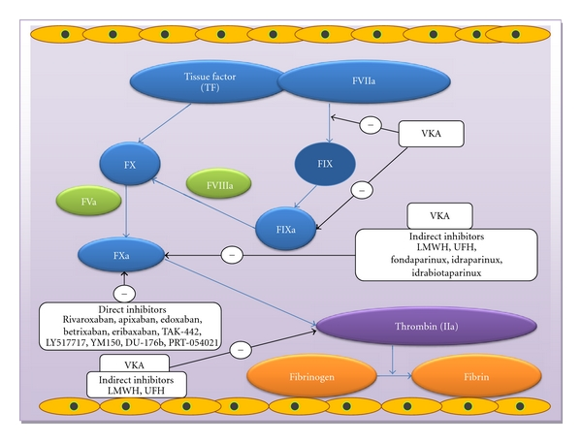
Warfarin and other Vitamin K Antagonists
Inhibit the synthesis of vitamin K-dependent clotting factors, which include:
  Factors II, VII, IX, and X
  Anticoagulant proteins C and S
Copyright © 2019 by ASPHO

Slide 41
Warfarin and the International Normalized Ratio (INR)
Once daily oral dosing, typically around 0.1 mg/kg/day
Must be given with another anticoagulant for ≥5 days and until a therapeutic INR is achieved
INR is a calculation made to standardize prothrombin time (PT). The INR is the ratio of the patient's PT and the normal mean PT
Target range INR 2-3 for most patients with DVT/PE
2.5-3.5 for mechanical valves and some patients with Antiphospholipid Syndrome (APS)
Copyright © 2019 by ASPHO

Slide 42
Recognize that many dietary items and drugs can interact with vitamin K antagonists
Initiation and discontinuation of medications
  Antibiotics
  Anti-convulsants
  Anti-fungals
  Antacids
Febrile illnesses
Gastroenteritis
Liver disease
Vitamin K containing foods
Enteral feeds
Mango
Avocado
Fish Oil
Soy milk
Grapefruit
Copyright © 2019 by ASPHO

Slide 43
Know the various means to reverse vitamin K antagonists
Vitamin K 2-5 mg PO, SQ or IV
  IV slow infusion due to anaphylaxis
Fresh Frozen Plasma
  Stops bleeding but does not completely reverse VKAs
Prothrombin Complex Concentrates
  Contain many Vitamin K dependent proteins at high concentration
Copyright © 2019 by ASPHO

Slide 44
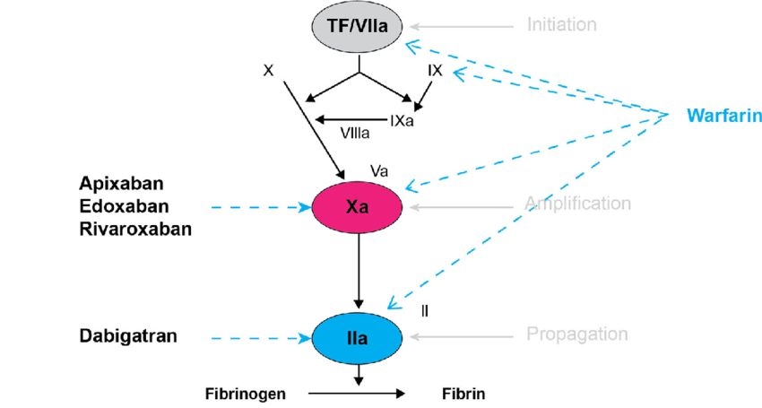
Direct Thrombin Inhibitors
Bind avidly and reversibly to thrombin, blocking both circulating and clot-bound thrombin
Content created on this site is licensed under Creative Commons Attribution 4.0 International License; Mechanism of action of the direct oral anticoagulants. Reprinted with permission from: J Thromb Haemost 2005;3:1843–53; https://www.ncbi.nlm.nih.gov/pmc/articles/PMC4715843/
Copyright © 2019 by ASPHO

Slide 45
Direct Thrombin Inhibitors
 | Argatroban IV | Bivalirudin IV | Dabigatran PO
Half-life in healthy subjects | 39-51 min | 25 minutes | 12-14 hours
Elimination | Hepatic | 80% Enzymatic 20% Renal | Renal
Monitoring needed | aPTT, ACT | aPTT, ACT | None
Thrombin binding | Reversible | Partially reversible | Reversible
Antidote | None | None | Yes
Copyright © 2019 by ASPHO
Notes:
idarucizumab

Slide 46
Direct Oral Anticoagulants
Comparable efficacy to VKA in adults, but with significantly lower risk of bleeding
All DOACs have ongoing pediatric investigational plans
Reversal agents FDA approved
May allow children to receive anticoagulation without injections or laboratory monitoring
Content created on this site is licensed under Creative Commons Attribution 4.0 International License; Mechanism of action of the direct oral anticoagulants. Reprinted with permission from: J Thromb Haemost 2005;3:1843–53; https://www.ncbi.nlm.nih.gov/pmc/articles/PMC4715843/
Copyright © 2019 by ASPHO
Notes:
2 classes – DTI and Direct Anti-Xa inhibitors
In adults, approved for VTE treatment, prevention, and stroke prevention due atrial fibrillation

Slide 47
Direct Oral Anticoagulants
 | Target | Half-life (h) | Excretion renal (%) | Excretion extrarenal (%)
Dabigatran | Thrombin | 11 – 14 (BID) | 80 | 20
Rivaroxaban | Factor Xa | 5 – 9 (QD) | 66 | 34
Apixaban | Factor Xa | 9 – 14 (BID) | 25 | 75
Edoxaban | Factor Xa | 10 – 14 (QD) | 50 | 50
Betrixaban | Factor Xa | 19 – 27 (QD) | 15 | 85
Copyright © 2019 by ASPHO
Notes:
All are, to varying degrees, renally cleared. Dose reduction is recommended for dabigatran, edoxaban, and rivaroxaban in patients with moderate renal impairment, and avoidance altogether is recommended in patients with severe renal impairment and on dialysis. Only apixaban can be used in patients with severely decreased renal function and those on hemodialysis. The FDA-approved prescription information states that full dose apixaban (5 mg [bid]) can be used in such patients, unless at least two of the following characteristics apply: patient age is 80 years or older, body weight is 60 kg or less, and serum creatinine is 1.5 mg/dL or higher, in which case dose reduction to 2.5 mg bid is indicated.¹ However, the prescription information acknowledges that “clinical efficacy and safety studies with Eliquis did not enroll patients with end-stage renal disease (ESRD) on dialysis”.¹
The DOACs have not been studied in patients with hepatic dysfunction. Their effect may be altered by changes in serum proteins, resulting in an altered free fraction compared with patients with normal hepatic function; further, their half-life may be increased as a result of reduced clearance, particularly for those products with higher hepatic clearance. If a DOAC is strongly desired, dabigatran etexilate may be preferred over rivaroxaban and apixaban because of its r

Slide 48
Duration of Anticoagulation
Indication | Duration
Provoked VTE
Reversible risk factor | 3 months (6 weeks in neonates)
Chronic risk factor | 12 months to lifelong
Idiopathic VTE | 6-12 months
Recurrent VTE
Reversible risk factor | 6-12 months
Chronic risk factor | 12 months to lifelong
Copyright © 2019 by ASPHO

Slide 49
THROMBOLYSIS

Slide 50
Types of Thrombolysis
Tissue plasminogen activator (tPA) is the most commonly used thrombolytic agent
Catheter-Directed Thrombolysis
  Placement of large-bore catheter into the vein affected by the DVT to allow slow, direct infusion of thrombolytic agent into the thrombus
Systemic Thrombolysis
  Low-dose regimens (0.03-0.1 mg/kg/h, maximum of 2 mg/h) over 24-96 hrs
  High-dose regimens (0.5-0.6 mg/kg/h) over 6 hours
  Concurrent anticoagulation (5-15 units/kg/hr of UFH)
  Close monitoring for bleeding
Copyright © 2019 by ASPHO
Notes:
Also increasing number of devices used as adjuncts in these procedures

Slide 51
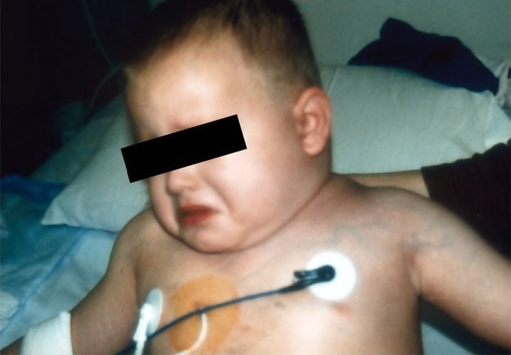
Possible Indications for Thrombolysis
Arterial thrombosis- limb threatening
Intracardiac thrombus
Pulmonary embolus with right heart strain or hypotension
Extensive DVT
  SVC syndrome
  Occlusive IVC thrombosis
  Bilateral renal vein thrombosis with renal compromise
  Large iliofemoral clot
Photo courtesy of Guy Young
Copyright © 2019 by ASPHO

Slide 52
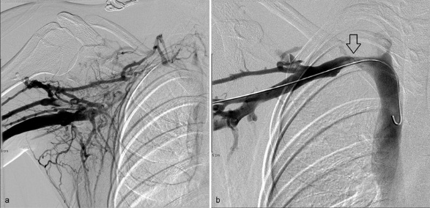
Contraindications to Thrombolysis
Active major bleeding
Significant potential for uncontrolled local bleeding
Surgery within preceding 10 days
Neurosurgery, including spinal surgery, within preceding 60 days
Seizures within 48 hours
Sepsis
Elevated serum creatinine
Uncontrolled hypertension
Contrast allergy
Copyright © 2019 by ASPHO
Notes:
Right arm venogram prior to treatment (a) shows complete occlusion of the subclavian vein. Numerous collaterals are present, which ultimately drain into the superior vena cava. After catheter-directed pharmacomechanical thrombolysis (b), there is complete lysis of the thrombus. There is residual stenosis due to extrinsic compression at the costoclavicular junction, for which partial first ribectomy was subsequently performed.

Slide 53
Monitoring Systemic Thrombolytic Therapy
  PTT/Fibrinogen/D-dimer every 6 hours
  CBC every 12 hours, unless sudden drop in blood pressure or extensive active bleeding
  Goals
    Fibrinogen 100-200 (should decrease by 20-50%)
    D-dimer elevated
    PTT 50-70 (prophylactic heparin)
    Hb stable (major bleeding if >2 g/dl drop)
    Plt >100K (transfuse to maintain)
Copyright © 2019 by ASPHO
Notes:
By 20-50% with adequate therapy

Slide 54
POST-THROMBOTIC SYNDROME

Slide 55
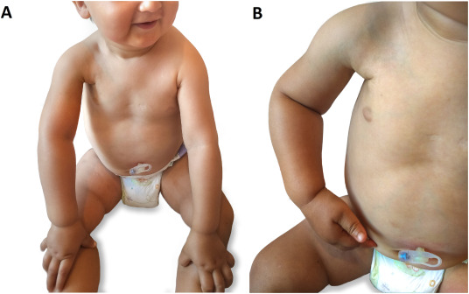
Post-Thrombotic Syndrome
Development of venous insufficiency
Will occur within 1 year in approximately 25% of children who develop an extremity DVT
Thought to be the result of venous valvular insufficiency and residual venous outflow obstruction
Copyright © 2019 by ASPHO
Notes:
Allow reflux of blood into vein
Caused by luminal narrowing or thrombus occlusion which leads to increased venous pressures

Slide 56
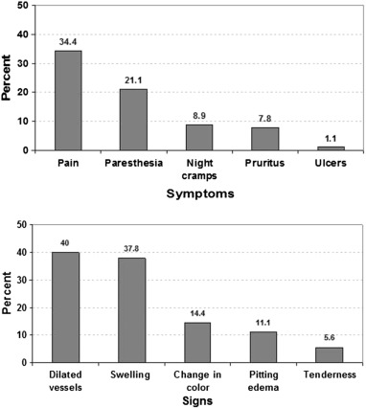
Symptoms and Signs of PTS
Validated assessment tools are available in pediatrics
  Modified Villalta Scale
  Manco-Johnson Instrument
Large majority of PTS cases are mild
Children with moderate or severe PTS have significantly lower QOL scores than children with mild or no PTS
Copyright © 2019 by ASPHO

Slide 57
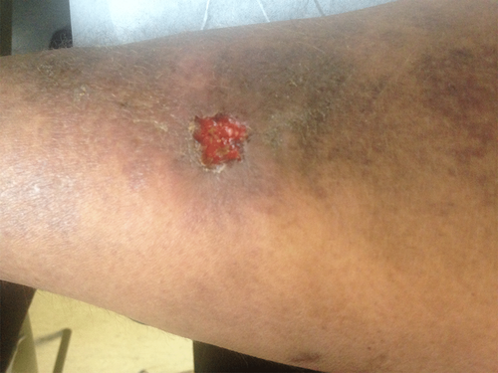
Risk Factors for Post-Thrombotic Syndrome
Adolescents
Obesity
Extensive DVT (multiple vessels)
Lack of thrombus resolution
Idiopathic or effort-related upper extremity DVT
Photo courtesy of Guy Young
Jaffray, J. and G. Young, Deep vein thrombosis. Pediatr Blood Cancer, 2018.
Copyright © 2019 by ASPHO

Slide 58
Prevention and Management of PTS
Prevention of VTE
  Validated pediatric risk-assessment tools for consideration of thromboprophylaxis
  Prolonged hospitalization, immobilization, presence of CVL, infection, chronic inflammatory/prothrombotic chronic disease
Optimal management of VTE
  Timely diagnosis and initiation of therapy
  Thrombolysis?
Once PTS has occurred
  Elastic compression stockings
  Physical therapy
  Elevating the affected extremity at rest
  Maintaining a healthy weight
Copyright © 2019 by ASPHO

Slide 59
QUESTIONS?

