Slide 1


Slide 2
Disclosures
I have no relevant conflicts of interest to disclose
Acknowledgements
  Dr. Chris Wong
  Dr. Leo Mascarenhas
  Dr. Steve Joffe
Copyright © 2019 by ASPHO

Slide 3
This will be a talk in two parts
Domain 11: Core Knowledge in Scholarly Activities
  Part 1= Ethics in research
    Principles of research involving human subjects
    Principles of consent and assent
    Professionalism and misconduct in research
  Part 2= Quality improvement
    Project design
    Data and measurement
Copyright © 2019 by ASPHO

Slide 4
How do we know if human subjects research is ethically sound?
Copyright © 2019 by ASPHO

Slide 5
Research
A systematic investigation, including research development, testing and evaluation, designed to develop or contribute to generalizable knowledge
  Federal regulations 45 CFR 164.501, 164.508, 164.512(i)
Copyright © 2019 by ASPHO

Slide 6
Seven Requirements for Ethical Human Subjects Research
Social or
scientific value
Copyright © 2019 by ASPHO
JAMA 283:2701, 2000

Slide 7
Seven Requirements for Ethical Human Subjects Research
Social or
scientific value
Scientific validity
Copyright © 2019 by ASPHO
JAMA 283:2701, 2000

Slide 8
Seven Requirements for Ethical Human Subjects Research
Social or
scientific value
Scientific validity
Fair subject selection
Copyright © 2019 by ASPHO
JAMA 283:2701, 2000

Slide 9
Seven Requirements for Ethical Human Subjects Research
Social or
scientific value
Scientific validity
Fair subject selection
Favorable risk-benefit ratio
Copyright © 2019 by ASPHO
JAMA 283:2701, 2000

Slide 10
Seven Requirements for Ethical Human Subjects Research
Social or
scientific value
Scientific validity
Fair subject selection
Favorable risk-benefit ratio
Independent review
Copyright © 2019 by ASPHO
JAMA 283:2701, 2000

Slide 11
Seven Requirements for Ethical Human Subjects Research
Social or
scientific value
Scientific validity
Fair subject selection
Favorable risk-benefit ratio
Independent review
Informed consent
Copyright © 2019 by ASPHO
JAMA 283:2701, 2000

Slide 12
Seven Requirements for Ethical Human Subjects Research
Social or
scientific value
Scientific validity
Fair subject selection
Favorable risk-benefit ratio
Independent review
Informed consent
Respect for potential and enrolled subjects
Copyright © 2019 by ASPHO
JAMA 283:2701, 2000

Slide 13
#1 Social or Scientific Value
Study must ask an important question
  Valuable for improving health and/or for basic scientific knowledge
  Research is unethical if question is trivial, has already been answered, etc.
Copyright © 2019 by ASPHO

Slide 14
#2 Scientific Validity
Even if question is important, study is unethical if methods aren’t likely to answer it
  not feasible
  poor outcomes measures
  inadequate sample size
  poor statistical analysis
Data produced must be valid and reliable
Copyright © 2019 by ASPHO

Slide 15
#3 Fair Subject Selection
Historically, risky or non-beneficial research has disproportionately enrolled vulnerable populations
  economically disadvantaged
  ethnic minorities
  mentally incapacitated, institutionalized
Conversely, exclusion of certain groups from research disenfranchises them from benefits of the knowledge gained
Vulnerable groups must not be over-burdened and the privileged must not receive preferential benefits
Copyright © 2019 by ASPHO

Slide 16
#3: Fair Subject Selection
Three categories of vulnerable subjects are considered in the regulations:
  Pregnant Women, Human Fetuses and Neonates involved in human subjects research
  Prisoners
  Children
Copyright © 2019 by ASPHO

Slide 17
#4 Risk/Benefit Balance
Risks must be minimized
Benefits of a clinical trial must justify the risks
  sometimes, risks clearly outweigh benefits for the participant
    e.g., most healthy-volunteer research
Benefits
to self
Risks
Copyright © 2019 by ASPHO

Slide 18
#4 Risk/Benefit Balance
Risks must be minimized
Benefits of a clinical trial must justify the risks
  sometimes, risks clearly outweigh benefits for the participant
    e.g., most healthy-volunteer research
Risks
Benefits
to self
Benefits to society
Copyright © 2019 by ASPHO

Slide 19
#4 Risk/Benefit Balance
Magnitude of risk of harm must be categorized
  Influences role of IRB and consent
Minimal Risk Definition:
  The probability and magnitude of harm and discomfort anticipated in research are not greater in and of themselves than those ordinarily encountered in daily life or during the performance of routine physical and psychological examination or tests such as:
    Noninvasive imaging – MRI and ultrasound but not X-ray or CT scan
    Venipuncture
    Behavioral, neuropsychological or social surveys
  Expedited IRB review may be possible
Copyright © 2019 by ASPHO

Slide 20
#4 Risk/Benefit Balance
Research involving more than minimal risk but preserving the prospect of direct benefit to the individual subjects
Examples:
  Clinical trials involving drugs and devices
  Risk is justified by benefit- anticipated benefit is as favorable as the alternative
  Arrangements for assent and consent
Copyright © 2019 by ASPHO

Slide 21
#4 Risk/Benefit Balance
Research involving greater than minimal risk and no prospect of benefit to individual subjects but likely to yield generalization about the subjects disorder or condition
  Must represent only a minor increase over minimal risk
  Procedures must be inherent in the treatment of the condition
Examples involve drawing extra tissue samples –blood sampling in children at a greater frequency than is allowed normally.
Copyright © 2019 by ASPHO

Slide 22
#5 Informed Consent
Ensure respect for individuals’ values & preferences in decisions about their medical care & research participation
View as ongoing process, not one-time event
Valid informed consent includes numerous components
Copyright © 2019 by ASPHO

Slide 23
#5 Informed Consent
Voluntariness
  Freedom from coercion
Decision-making capacity
Disclosure of material information
  Distinction between research and standard practice
Understanding
Ability to make a decision
Copyright © 2019 by ASPHO

Slide 24
#5 ½: Assent for minors
In human subjects research involving children, we must consider assent.
Assent of child subjects (< 18 years of age) must be elicited, when they are capable of providing such assent.
After learning what will happen to the child and why, assent is the child’s process of making an affirmative decision to participate in research.
Permission of one or two parents is also required, depending on the research category.
45 CFR 46.408
Copyright © 2019 by ASPHO

Slide 25
#5 ½: Assent for Minors
Assent should include the following elements.
  Information that helps the child to understand why he or she is being asked to participate in the research.
  A description of what the child will experience from the perspective of the child.
  A statement that the child has a choice to participate and may withdraw at any time for any reason.
45 CFR 46.408
Copyright © 2019 by ASPHO

Slide 26
5 ½: Assent May Not be Needed if….
Child not capable of giving assent
  In determining whether a child is capable of assenting, consider age, maturity, and psychological state of the child.
  Medical circumstances
Treatment is not available outside the research protocol, and it is best available therapy.
Assent waived by IRB
45 CFR 46.408
Copyright © 2019 by ASPHO

Slide 27
#6 Respect for Potential and Enrolled Subjects
Permitting withdrawal from research
Protection of privacy, confidentiality
Informing subjects of newly identified risks or benefits
Informing subjects of results
Maintaining welfare of subjects
Copyright © 2019 by ASPHO

Slide 28
#7 Independent Review
Institutional Review Boards (IRBs)
  Independent review is mandated by federal law for most research with human subjects
  IRBs review studies at inception
    science, risk/benefit ratio, informed consent
  IRBs also monitor studies as they proceed
    continuing reviews at least annually
    reporting of adverse events, unexpected problems
Copyright © 2019 by ASPHO
Notes:
I want to note that independent review is a procedural requirement, not a substantive requirement. Its purposes are to provide a mechanism for holding both investigators & institutions accountable, and to ensure that the other (substantive) requirements are met.

Slide 29
#7 Independent Review
Oversees potential conflicts of interest
  Investigators balancing many important priorities that may come into conflict
    Research
    Research subjects
    Academic career
    Clinical work
Serve to protect members of society
Copyright © 2019 by ASPHO

Slide 30
Studies Exempt from IRB Review
Activities not meeting definition of research
Use of existing data or specimens if available to the public or data without personal identifiers.
Taste or food quality and consumer acceptance studies.
Research conducted in educational settings, involving normal educational practices.
Observation of public behavior, without intervention, and if subjects can not be identified.
Copyright © 2019 by ASPHO

Slide 31
Studies Exempt from IRB Review
Systematic investigations which are not Research:
  Public health interventions.
  Quality assessment of health care efforts.
  Resource utilization review.
  Evaluation of medication adverse events.
The decision whether or not a study is exempt is determined by the IRB, not by the investigator.
IRB judgment that a study is exempt is good for 2-years.
If the study continues longer than 2-years, investigators must reapply for exemption.
Copyright © 2019 by ASPHO

Slide 32
Belmont Report (1978)
Ethical Principles and Guidelines for the Protection of Human Subjects
  Respect
    individuals should be treated as autonomous agents and persons with diminished autonomy are entitled to protection
  Beneficence
    respecting the individual’s decisions and protecting them from harm but also securing their well-being
  Justice
    Receipt of benefits of research and who bears its burdens
Copyright © 2019 by ASPHO

Slide 33
Application of the Belmont Report
RESPECT | BENEFICENCE | JUSTICE
Acknowledge autonomy and protect those with diminished autonomy | Protect from harm and secure well-being | Fairness in distribution
Consent or assent | Risk/Benefit Analysis | Subject selection
2017 Review Course, Research Ethics, Leo Mascarenhas, MD MS
Copyright © 2019 by ASPHO

Slide 34
What constitutes misconduct in scientific research?
Copyright © 2019 by ASPHO

Slide 35
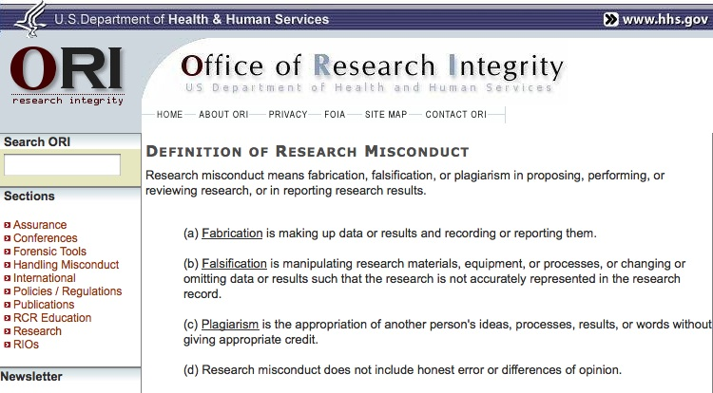
Research Misconduct
N. Steneck, Introduction to the Responsible Conduct of Research, ORI 2007
http://ori.dhhs.gov/misconduct/definition_misconduct.shtml
Copyright © 2019 by ASPHO

Slide 36
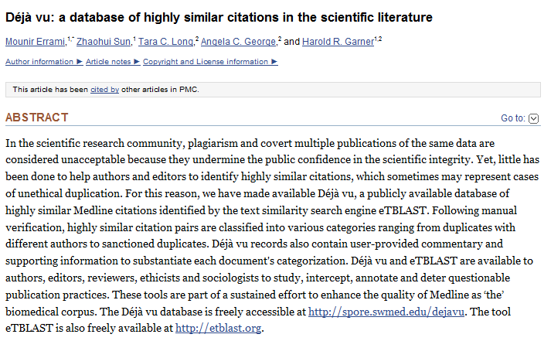
Plagiarism
Copyright © 2019 by ASPHO

Slide 37
Plagiarism: An Egregious Example
Copyright © 2019 by ASPHO

Slide 38
Plagiarism: An Egregious Example
Copyright © 2019 by ASPHO

Slide 39
Broader Context of
Research Misconduct
Research Misconduct
(FFP)
Questionable
Research Practices
(QRPs)
Copyright © 2019 by ASPHO

Slide 40
Examples of QRPs
Ignoring human subects requirements
Not disclosing financial ties
Unauthorized use of confidential information
Failing to present data that contradict one’s prior research
Overlooking others’ use of flawed data or questionable interpretations
Changing study design, conduct or results in response to pressure from a funding source
Nature 435:737, 2005
Copyright © 2019 by ASPHO

Slide 41
Examples of QRPs
Duplicate publication
Inappropriate assignment of authorship credit
  Ghost or honorary authorship
Withholding details of methods or results
Using inadequate or inappropriate research designs
Dropping observations or data points from analyses based on feeling they are inaccurate
Inadequate research record keeping
Nature 435:737, 2005
Copyright © 2019 by ASPHO

Slide 42
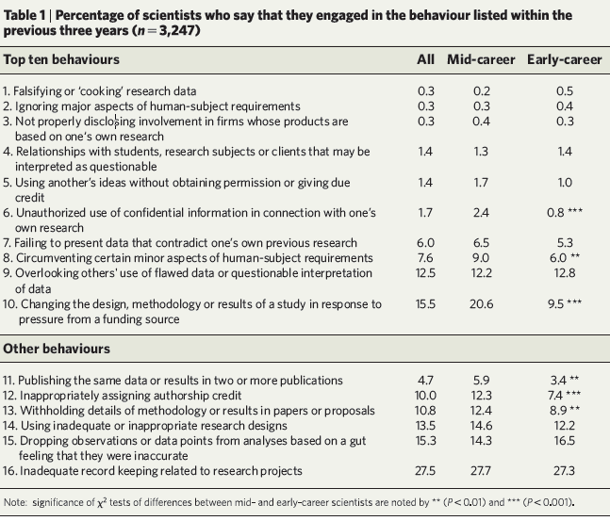
Reprinted by permission from Copyright Clearance Center: Nature, Springer Nature, Scientists behaving badly, Brian C. Martinson, Melissa S. Anderson, Raymond de Vries, © 2005
Copyright © 2019 by ASPHO

Slide 43
Considering Authorship
The International Committee of Medical Journal Editors recommends that authorship be based on the following 4 criteria:
  Substantial contributions to the conception or design of the work; or the acquisition, analysis, or interpretation of data for the work; AND
  Drafting the work or revising it critically for important intellectual content; AND
  Final approval of the version to be published; AND
  Agreement to be accountable for all aspects of the work in ensuring that questions related to the accuracy or integrity of any part of the work are appropriately investigated and resolved.
http://www.icmje.org/recommendations/browse/roles-and-responsibilities/defining-the-role-of-authors-and-contributors.html
Copyright © 2019 by ASPHO

Slide 44
Where does conflict of interest fit in as a questionable research practice?
Copyright © 2019 by ASPHO

Slide 45
Conflicts of Interest
Interest
  “Commitment, goal, or value held by an individual or an institution”
  Examples of interests include
    Getting a project completed
    Earning an important grant
    Being promoted
    Receiving salary support or honoraria
  Inevitably, two or more interests will come into conflict for at individual or institutional level
  Whether the conflict is actual or just potential or perceived may not matter
https://ori.hhs.gov
Copyright © 2019 by ASPHO

Slide 46
Conflicts of Interest
A conflict of interest may not be inherently bad
Must be disclosed to scientific product can be critically appraised with the conflict in mind
Conflicts must be mitigated in order to protect research subjects from undue risk of harm
https://ori.hhs.gov
Copyright © 2019 by ASPHO

Slide 47
Conflicts of Interest
NIH and others have adopted rules to “limit the impact of investigator conflicts of interest”
  Investigators must disclose financial interests and those of his/her spouse and dependent children that could be affected by the research
    >$10,000
  Institutions must vet these disclosures and respond appropriately to mitigate bias and minimize harm before allowing grants expenditures
https://ori.hhs.gov
Copyright © 2019 by ASPHO

Slide 48
Take-home point
“The decision about disclosure of a COI should never be left to the possessors of the COI because they are susceptible to self-deception or worse about the influence of the COI on their research behavior. ”
https://ori.hhs.gov
Copyright © 2019 by ASPHO

Slide 49
How do we know if an endeavor qualifies as research or quality improvement?
Copyright © 2019 by ASPHO

Slide 50
How do we know if an endeavor qualifies as research or quality improvement?
In order to answer, we must know a bit more about quality improvement itself!
Copyright © 2019 by ASPHO

Slide 51
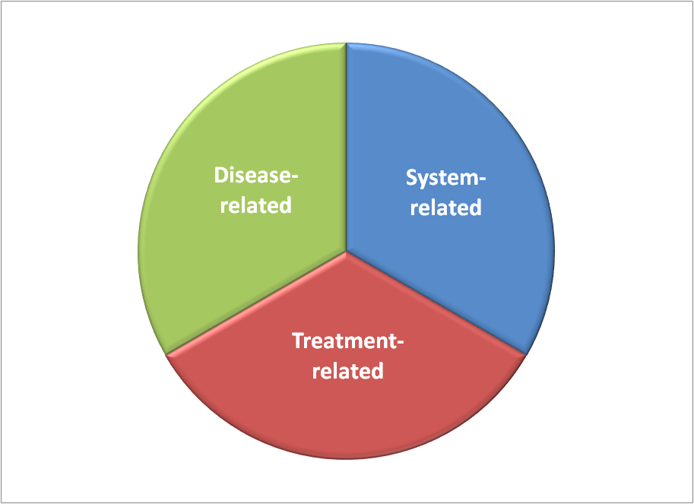
Suffering from the Patient’s Perspective
Copyright © 2019 by ASPHO
51

Slide 52
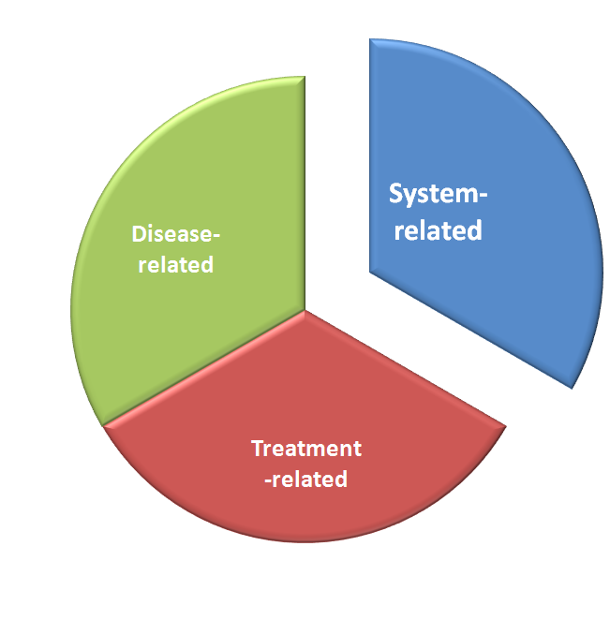
Aims to reduce avoidable suffering due to dysfunction of the care delivery system
Quality Improvement
Avoidable
Suffering
=
Copyright © 2019 by ASPHO

Slide 53
Domains of Quality in Health Care:
Institute of Medicine (IOM). Crossing the Quality Chasm: A New Health System for the 21st Century. Washington, D.C: National Academy Press; 2001.
Safe: patients are not harmed by care intended to help them
Effective: based on evidence and produces better outcomes than alternatives
Patient-Centered: focuses on patient experience, needs, and preferences
Timely: provides seamless access to care without delays
Efficient: avoids waste including unnecessary procedures and rework
Equitable: assures fair distribution of resources based on patients’ needs
Copyright © 2019 by ASPHO
Notes:
In 1999, the Institute of Medicine (IOM) in Washington, DC, USA, released To Err Is Human: Building a Safer Health System, an alarming report that brought tremendous public attention to the crisis of patient safety in the United States. In 2001, IOM followed up with Crossing the Quality Chasm: A New Health System for the 21st Century, a more detailed examination of the immense divide between what we know to be good health care and the health care that people actually receive.
The report calls the divide not just a gap but a chasm, and the difference between those two metaphors is quantitative as well as qualitative. Not only is the current health care system lagging behind the ideal in large and numerous ways, but the system is fundamentally and incurably unable to reach the ideal. In order to begin achieving real improvement in health care, the whole system has to change.
Remember the six dimensions of health care systems from the Institute of Medicine’s (IOM’s) Crossing the Quality Chasm report that we mentioned in Lesson 3 of QI 101? (By the way, a handy mnemonic device for remembering the six IOM dimensions is STEEEP—Safe, Timely, Effective, Efficient, Equitable, and Patient-centered.)
They are a good guide for teams to use in developing organizational and project-based aims.
First, health care must be safe. This means much more than the ancient maxim "First, do no harm," which makes it the individual caregiver’s responsibility to somehow try extra hard to be more careful (a requirement modern human factors theory has shown to be unproductive). Instead, the aim means that safety must be a property of the system. No one should ever be harmed by health care again.
Second, health care must be effective. It should match science, with neither underuse nor overuse of the best available techniques—every elderly heart patient who would benefit from beta-blockers should get them, and no child with a simple ear infection should get advanced antibiotics.
Third, health care should be patient-centered. The individual patient’s culture, social context, and specific needs deserve respect, and the patient should play an active role in making decisions about his or her own care. That concept is especially vital today, as more people require chronic rather than acute care.
Fourth, care should be timely. Unintended waiting that doesn’t provide information or time to heal is a system defect. Prompt attention benefits both the patient and the caregiver.
Fifth, the health care system should be efficient, constantly seeking to reduce the waste—and hence the cost—of supplies, equipment, space, capital, ideas, time, and opportunities.
Sixth, health care should be equitable. Race, ethnicity, gender, and income should not prevent anyone in the world from receiving high-quality care. We need advances in health care delivery to match the advances in medical science so the benefits of that science may reach everyone equally.

Slide 54
Quality in Healthcare
Copyright © 2019 by ASPHO

Slide 55
Quality in Healthcare
Structure
Process
Culture
Outcome
+
+
=
Copyright © 2019 by ASPHO

Slide 56
Quality in Healthcare
Structure
Process
Culture
Outcome
+
+
=
Copyright © 2019 by ASPHO

Slide 57
Process Improvement Increases Quality of Care
“A data-driven, system-level discipline designed to achieve appropriate, consistent and efficient delivery of established clinical measures by changing human performance.”
Davidoff F: Systems of service: reflections on the moral foundations of improvement. BMJ Quality and Safety 2011
Copyright © 2019 by ASPHO

Slide 58
Process Improvement is Essential
To reduce costs associated with health care delivery
Increase revenue based on high quality experiences and referrals
Enhance the satisfaction for staff
“If you can’t describe what you are doing as a process, you don’t know what you’re doing”
W.Edwards Deming
Copyright © 2019 by ASPHO

Slide 59
Process Improvement Methods
Have a systematic approach
Aim to improve
Rely on customer to define the value and priorities
Use data
Multiple different methods can be used, alone or in combination
Copyright © 2019 by ASPHO

Slide 60
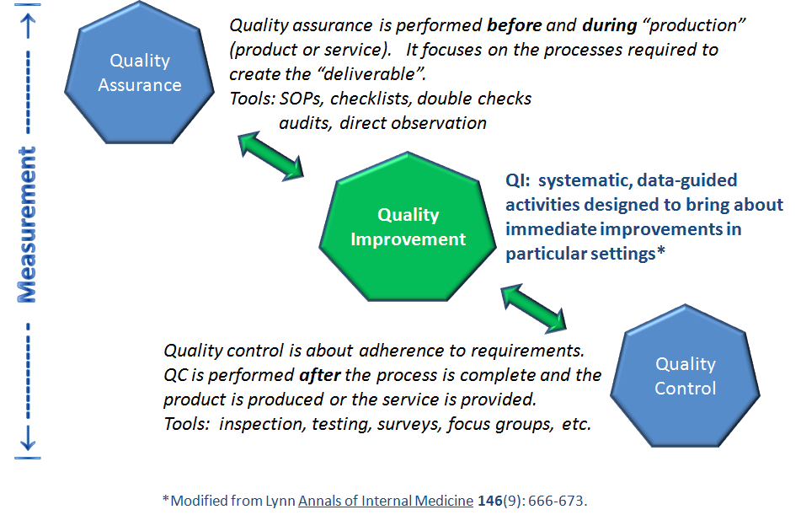
Quality Improvement
With permission from Chris I. Wong, MD MPH CPPS
Copyright © 2019 by ASPHO

Slide 61
Quality Improvement: where do we start?
Analyzing the current state
  Current State Analysis
Areas needing improvement
  Root Cause Analysis
Benchmarking
  Comparing own process to “best practice”
Copyright © 2019 by ASPHO
Notes:
Benchmarking
Comparing own process to “best practice” can help identify where your own system falls short
Benchmarking in its simplest form is merely looking around at how others are doing things and trying to learn new approaches and possibilities. A formal benchmarking process provides a method with some structure for making these observations, and then using this information for improvement.¹
If you’re trying to reduce medication errors in your clinic, you might consider bar-coding medicines, or computerized physician order entry (CPOE). These are just two examples of how technology — such as automation, new equipment, or new information systems — can lead to improvement. But be careful! Technology that isn’t reliable, or that simply makes a bad system more accessible via the Internet, is not necessarily the fix you’re looking for.
4. Creative thinking
Where do new ideas come from? You can spark creative thinking in various ways, including simply taking the time to do this sort of thinking; identifying the boundaries that limit the changes you can make and then finding ways to dismantle those boundaries; temporarily considering unrealistic goals that can prompt you to break out of your old way of thinking; and exposing yourself to situations that can spark new ideas, such as taking the role of a patient to view health care in a different light.
Using change concepts
A change concept is a general notion or approach to change that has been found to be useful in developing specific ideas for changes that lead to improvement. Here are some examples.
Move Steps Closer Together. Can you think of a way to reduce the distance between steps in a process to reduce delays and communication problems?
Reduce Reliance on Memory. Can you make it easier to remember to do the right thing?
Reduce Handoffs. Can you cut down on the number of times a process element is transferred from one person to another?
Combining these change concepts with knowledge about specific subjects can help generate ideas for tests of change.
See The Improvement Guide² for a list of 72 change concepts, as well as examples of how they were applied in process improvement, both inside and outside health care.

Slide 62
Planning a QI Project
Specific
Measurable
Attainable
Relevant
Time-based
SMART
Define the problem and set goals to fix it!
Copyright © 2019 by ASPHO

Slide 63


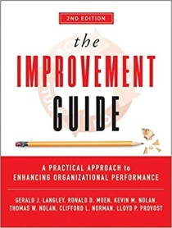
Improvement Science Methodologies
  Lean Methodology
    Eliminate steps in a process that have no added value (Toyota)
  Six Sigma
    Decrease long term defect levels by decreasing variation and employing standard processes
  PDSA
Copyright © 2019 by ASPHO
Notes:
Multiple models can be used successfully
All based on similar foundations
Vary on the approach and terminology

Slide 64
Lean Six Sigma Methodology
Talent
Motion
Inventory
Waiting
Transportation
Defects
Over-production
Over processing
Eliminate waste of 8 types:
Goleansixsigma.com
Copyright © 2019 by ASPHO

Slide 65
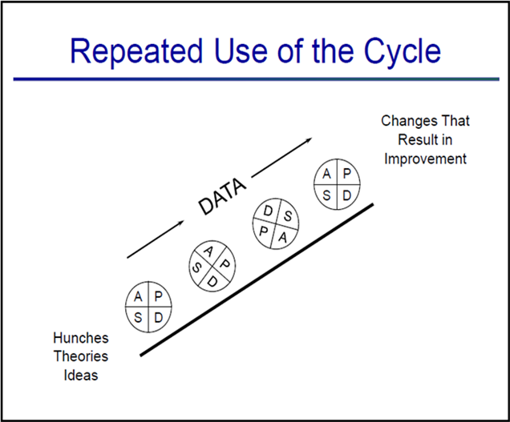
PDSA: A Model for Testing Change and Improvement
Plan
  What you want to happen or to achieve
Do
  Implement or work the plan
Study
  Look at what happened and why
Act
  Act on what you learned from the first three steps
Repeat PDSAs cycle with changes from the previous cycle
Copyright © 2019 by ASPHO

Slide 66
Transition from testing to implementation
Testing: learning what works in your system
  Not permanent change
  High failure rate expected
  Relative small number of people affected
Implementation: Making this change a permanent part of the system’s routine operation
  Needs long-term supporting processes
  High success rate if testing has been well done
  Increased resistance likely
Copyright © 2019 by ASPHO

Slide 67
Research vs Quality Improvement
Research
Quality Improvement
Systematic investigation designed to develop or contribute to generalizable knowledge
  Tests hypotheses
  Designed to develop new knowledge, not to implement knowledge
Systematic, data-guided activities designed to bring about immediate improvements in particular settings
  Focuses on implementation and sustainability
  Findings are context specific
The Ethics of Using QI Methods to Improve Health Care Quality & Safety
www.thehastingscenter.org
Copyright © 2019 by ASPHO

Slide 68
Research vs. Quality Improvement
 | Measurement for research | Measurement for learning and process improvement
Purpose | To discover new knowledge | Bring new knowledge into daily practice
Tests | One large blind test | Many sequential, observable tests
Biases | Control for as many biases as possible | Stabilize biases from test to test
Data | Gather as much data as possible, just in case | Gather just enough data to learn and complete another cycle
Duration | Results come over long period of time | Small tests yield change more quickly to accelerate improvement
Copyright © 2019 by ASPHO

Slide 69
Examples of QI Projects that may not Require IRB Review
Evaluation of characteristics of patients with catheter-associated UTI on a specific service to minimize this complication
Implementation of a daily checklist to continually assess extubation readiness in the ICU
Tracking door-or-procedure or door-to-drug times to develop ways to better meet accepted standards or goals
Reviewing pharmacy records to determine whether a particular medication can be changed from IV to oral to minimize risks and reduce costs
Copyright © 2019 by ASPHO

Slide 70
When to Involve the IRB
When in doubt, ask!
Intent to publish is not relevant
  Some quality improvement projects will be published
  Some research will not be published
Intent to create generalizable knowledge is what defines research and creates the requirement for IRB review
Copyright © 2019 by ASPHO

Slide 71
Thanks and Good Luck!!
Jennifer Kesselheim, MD, MEd, MBE
  Jennifer_kesselheim@dfci.Harvard.edu
Copyright © 2019 by ASPHO

